Slide 1
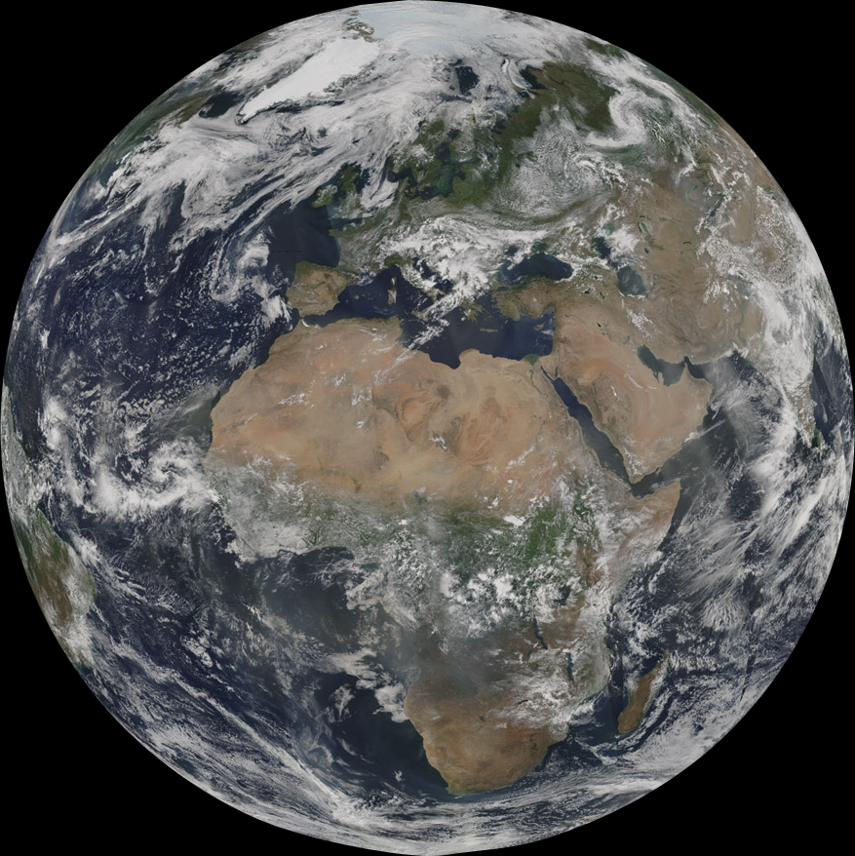
Spatial and Temporal Distribution of Cloud Properties Observed by MODIS: Level-3 Results from Collection 6
Michael D. King,¹ Steven Platnick,² Kerry G. Meyer,^{2,3} and Paul A Hubanks⁴
¹University of Colorado Boulder
²NASA Goddard Space Flight Center
³Universities Space Research Association
⁴ADNET Systems, Inc.
MODIS operational cloud products
Cloud fraction
Contents and changes in Collection 6
Examples from Aqua (Collection 6)
Cloud fraction by phase
Cloud optical & microphysical properties
Zonal cross sections
Probability density functions
Joint probability density functions

Slide 2
MODIS Operational Cloud Products
Pixel level products (Level-2)
Cloud mask – S. A. Ackerman, R. A. Frey
1 km, 48-bit mask, clear sky confidence in bits 1,2
Cloud top properties – W. P. Menzel, R. A. Frey
Cloud top pressure, temperature, effective emissivity
CO₂ slicing for high clouds, 11 µm for low clouds
Cloud optical & microphysical properties –S. Platnick, K. G Meyer, M. D. King
Optical thickness, τ_{c}, effective particle size, r_{e}, water path, thermodynamic phase
Cirrus reflectance (via 1.38 µm band) – B. C. Gao
SDS name Cirrus_Reflectance
Gridded & time-averaged products (Level-3)
Scalar statistics, 1-D and 2-D histograms
Contains all atmosphere products (clouds, aerosol, atmospheric profiles)
MOD35,
MYD35
MOD06,
MYD06
MOD08,
MYD08

Slide 3
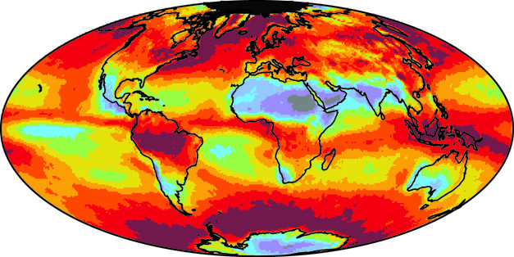
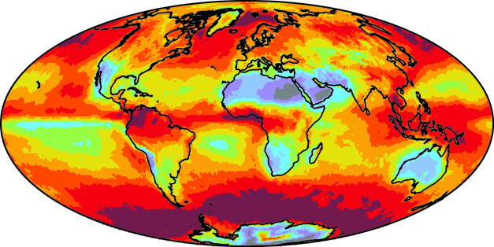
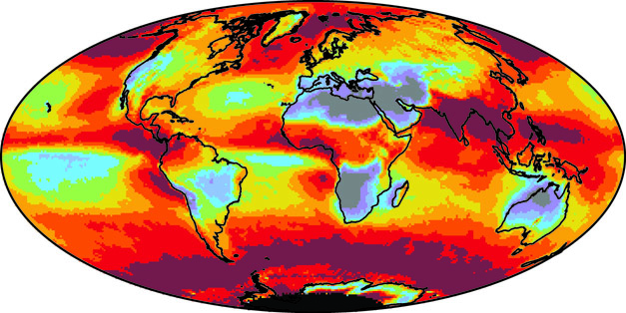
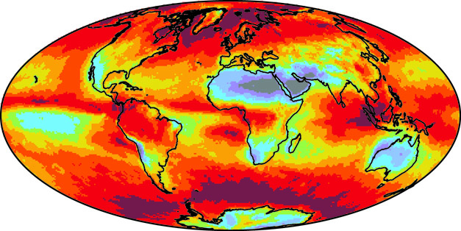
Seasonal Mean Daytime Cloud Fraction Aqua MODIS (2002-2011)
a) December-February
b) March-May
c) June-August
d) September-November
Cloud Fraction
0.0
0.2
0.4
0.6
0.8
1.0
King et al. (2013)
Notes:
King, M. D., S. Platnick, W. P. Menzel, S. A. Ackerman, and P. A. Hubanks, 2013: Spatial and temporal distribution of clouds observed by MODIS onboard the Terra and Aqua satellites. IEEE Trans. Geosci. Remote Sens., 51, 3826–3852

Slide 4
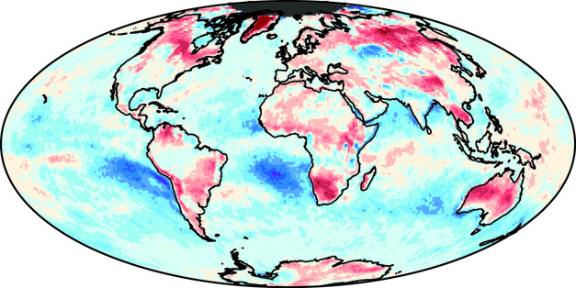
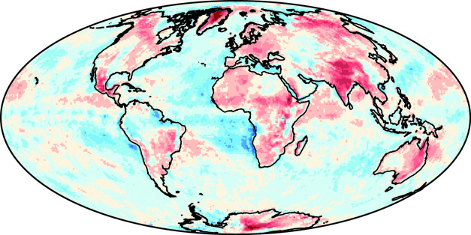
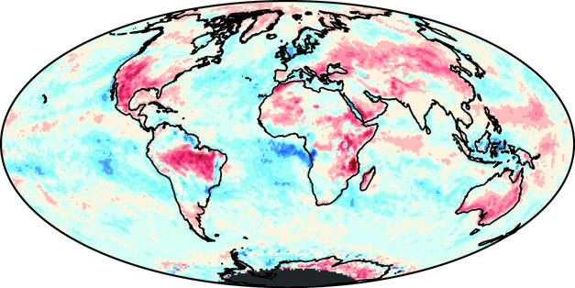
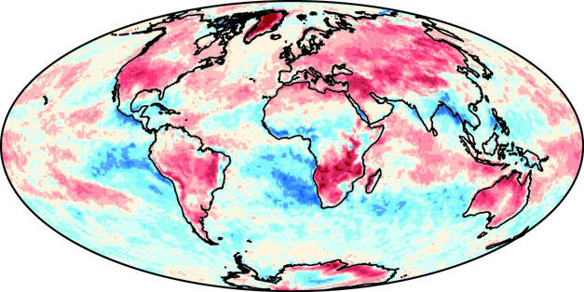
Aqua-Terra Daytime Cloud Fraction (September 2002-August 2011)
a) December-February
b) March-May
c) June-August
d) September-November
Cloud Fraction (Aqua-Terra)
-0.2
-0.1
0.0
0.1
0.2
King et al. (2013)
Notes:
King, M. D., S. Platnick, W. P. Menzel, S. A. Ackerman, and P. A. Hubanks, 2013: Spatial and temporal distribution of clouds observed by MODIS onboard the Terra and Aqua satellites. IEEE Trans. Geosci. Remote Sens., 51, 3826–3852.

Slide 5
Time Series of Daytime Cloud Fraction (March 2000-December 2011)
Collection 5
King et al. (2013)
Notes:
It is evident from the MODIS cloud fraction analysis over 12 years of Terra and 10 years of Aqua that:
• there is very little detectable trend in global cloudiness
• it is cloudier over the ocean (~72%) than over the land (~55%)
• it is cloudier over ocean in the morning (Terra) and over land in the afternoon (Aqua)
• the global cloud fraction is nearly identical for Terra and Aqua (~67%) with no detectable trend
King, M. D., S. Platnick, W. P. Menzel, S. A. Ackerman, and P. A. Hubanks, 2013: Spatial and temporal distribution of clouds observed by MODIS onboard the Terra and Aqua satellites. IEEE Trans. Geosci. Remote Sens., 51, 3826–3852.

Slide 6
Time Series of Daytime Cloud Fraction (March 2000-December 2011)
Collection 6
Notes:
It is evident from the MODIS cloud fraction analysis over 12 years of Terra and 10 years of Aqua that:
• there is very little detectable trend in global cloudiness
• it is cloudier over the ocean (~72%) than over the land (~55%)
• it is cloudier over ocean in the morning (Terra) and over land in the afternoon (Aqua)
• the global cloud fraction is nearly identical for Terra and Aqua (~67%) with no detectable trend
King, M. D., S. Platnick, W. P. Menzel, S. A. Ackerman, and P. A. Hubanks, 2013: Spatial and temporal distribution of clouds observed by MODIS onboard the Terra and Aqua satellites. IEEE Trans. Geosci. Remote Sens., 51, 3826–3852.

Slide 7
Changes for Collection 6
Category | Collection 5 | Collection 6 | Notes
Radiative Transfer
Cloud Model: all phases | Combined discrete ordinates LUT (small COT) + asymptotic theory parameters (large COT) | Full reflectance, flux, and emissivity LUTs across retrieval space/geometry LUT entries provided for multiple scattering only; phase function provided in file for direct calculation of single scattering | Single approach (LUT) ⇒ easier retrieval code maintenance LUT grid designed to limit median linear interpolation error to ≪1% Separation of single scattering component ⇒ fewer LUT grid points and interpolations during processing Required DISORT code mod to improve efficiency for BRF-specified surfaces
Ice Cloud Model | Variable habit (smooth) vs. size/empirical distributions Relatively large asymmetry parameter (g) and highly dependent on CER | Single habit (severely roughened aggregated columns) w/analytic gamma distribution (v_{e} = 0.10) | Smaller g reduces COT & provides closure with non-opaque IR COT retrievals Constant g vs. CER SWIR/MWIR particle absorption decreases ⇒ larger retrieved CER
Surface Ancillary Datasets | Team-designed nominal annual gap-filled spectral albedo dataset using Terra C5 product MOD43 | New dynamic gap-filled spectral albedo dataset derived from Aqua + Terra C5 MCD43B3 Emissivity dataset from MOD06 CT product for spectral consistency | C6 albedo dataset provided higher temporal resolution than C5 (8 day interval, 16 day average) Sea-ice spectral albedo dataset same as for C5
Ocean Surface BRDF | Lambertian (5%) | Cox-Munk BRDF for 3 wind speeds (3, 7, and 15 ms⁻¹) | Independent ocean LUTs with Cox-Munk explicitly modeled

Slide 8
Ice Crystal Models
Severely roughed aggregate columns
Smaller asymmetry factor
Leads to smaller cloud optical thickness
Particle absorption decreases
Leads to larger effective radius
Platnick et al. (2016)
Notes:
Platnick, S., K. Meyer, M. D. King, G. Wind, N. Amarasinghe, B. Marchant, G. T. Arnold, Z. Zhang, P. A. Hubanks, R. E. Holz, P. Yang, W. L. Ridgway, and J. Riedi, 2016: The MODIS cloud optical and microphysical products: Collection 6 updates and examples from Terra and Aqua. Submitted to IEEE Trans. Geosci. Remote Sens

Slide 9
Changes for Collection 6 (Continued)
Category | Collection 5 | Collection 6 | Notes
Level-1 Analysis/Corrections
Band 1,2 trend detection/correction | N/A | COT monthly anomaly trend analysis | Used to justify MCST work with desert site response vs scan angle corrections
Aqua Band 1,2 250m-1km aggregation | N/A | Used to improve known Aqua VNIR focal plane misregistration with SWIR, MWIR, and IR focal planes | Impacts Aqua COT and CER statistics in heterogeneous low cloud regimes
Algorithm – Retrieval Science
Retrieval channel pairs | CER differences for VNIR-SWIR/MWIR channel pairs (relative to standard VNIR-2.1 µm) | Full retrievals reported separately for as many as 4 spectral channel pairs | Doesn’t filter alternate channel pair retrievals by success of standard retrieval Allows for separate evaluation/aggregation of all channel pairs
Cloud-top pressure/temperature | Used 5 km MOD06 CT product | Uses new 1 km MOD06 CT product; incorporates non-unity cloud emissivity from optical retrievals
Thermodynamic Phase | Used SWIR/VNIR ratio tests as a proxy for particle size that was then used to indicate phase | SWIR/VNIR ratio tests replaced with separate ice and liquid water retrievals Used new trispectral IR phase product Eliminates use of individual cloud mask | Algorithm tests/weights validated against CALIOP, POLDER products Significant skill improvement seen for most regions (e.g., land, ocean, snow/ice) though still limited by available spectral bands

Slide 10
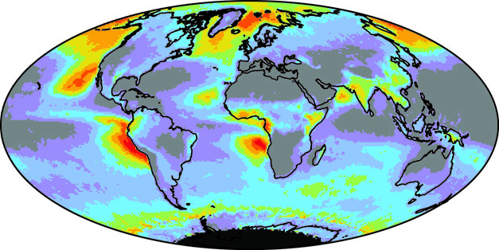
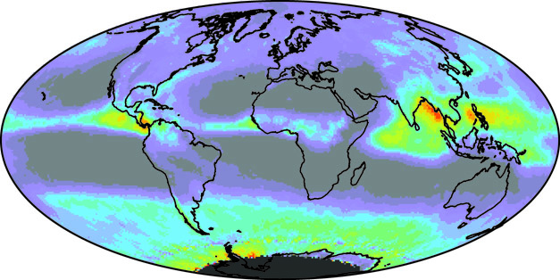
Seasonal Cloud Fraction for Liquid and Ice Clouds Aqua (June-August, 2002-2011)
a) Liquid Water (Collection 5)
b) Ice (Collection 5)
c) Liquid Water (Collection 6)
d) Ice (Collection 6)
Cloud Fraction
0.0
0.2
0.4
0.6
0.8
1.0

Slide 11
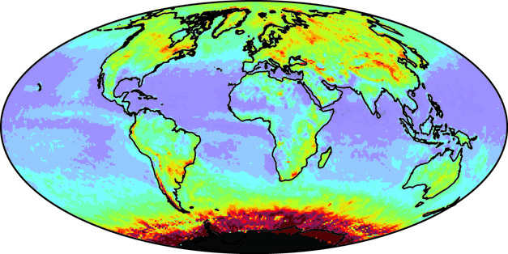
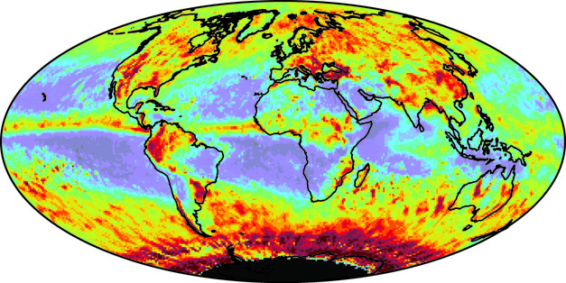
Seasonal Cloud Optical Thickness Aqua (June-August, 2002-2011)
Liquid Water Clouds
Ice Clouds
a) Collection 5
b) Collection 6
Cloud Optical Thickness
0
4
8
12
16
20
24
28
32

Slide 12
Zonal Mean Cloud Optical Thickness Aqua (June-August, 2002-2011)
Collection 5

Slide 13
Zonal Mean Cloud Optical Thickness Aqua (June-August, 2002-2011)
Collection 6

Slide 14
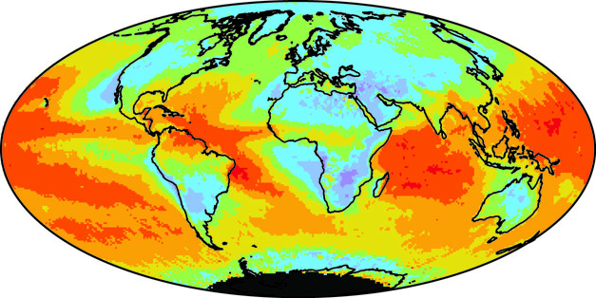
Seasonal Cloud Effective Radius for Liquid Water Clouds Aqua (June-August, 2002-2011)
a) 2.1 µm (Collection 5)
b) 2.1 µm (Collection 6)
c) 1.6 µm (Collection 6)
d) 3.7 µm (Collection 6)
Cloud Effective Radius (µm)
5
9
13
17
21
25

Slide 15
Seasonal Cloud Effective Radius for Ice Clouds Aqua (June-August, 2002-2011)
a) 2.1 µm (Collection 5)
b) 2.1 µm (Collection 6)
c) 1.6 µm (Collection 6)
d) 3.7 µm (Collection 6)
Cloud Effective Radius (µm)
16
22
28
34
40

Slide 16
Zonal Mean Cloud Effective Radius Aqua (June-August, 2002-2011)
Collection 5

Slide 17
Zonal Mean Cloud Effective Radius Aqua (June-August, 2002-2011)
Collection 6

Slide 18
Probability Distribution of MODIS Cloud Optical Thickness
July 2006
Notes:
King, M. D., S. Platnick, W. P. Menzel, S. A. Ackerman, and P. A. Hubanks, 2013: Spatial and temporal distribution of clouds observed by MODIS onboard the Terra and Aqua satellites. IEEE Trans. Geosci. Remote Sens., 51, 3826–3852.

Slide 19
Probability Distribution of MODIS Cloud Effective Radius
July 2006
Notes:
King, M. D., S. Platnick, W. P. Menzel, S. A. Ackerman, and P. A. Hubanks, 2013: Spatial and temporal distribution of clouds observed by MODIS onboard the Terra and Aqua satellites. IEEE Trans. Geosci. Remote Sens., 51, 3826–3852.

Slide 20
MODIS τ_{c} vs r_{e} Joint Histograms Liquid Water Clouds over Ocean
32°-40°N, 117°-125°W
July 2006
Collection 6

Slide 21
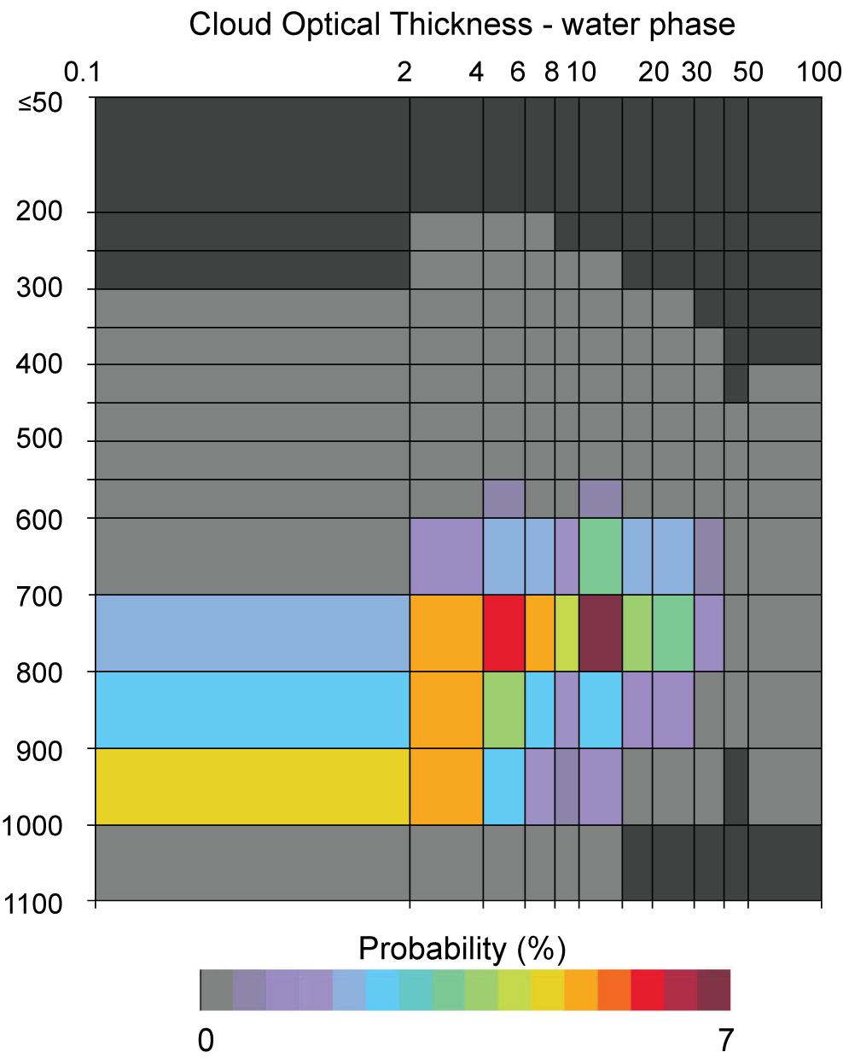
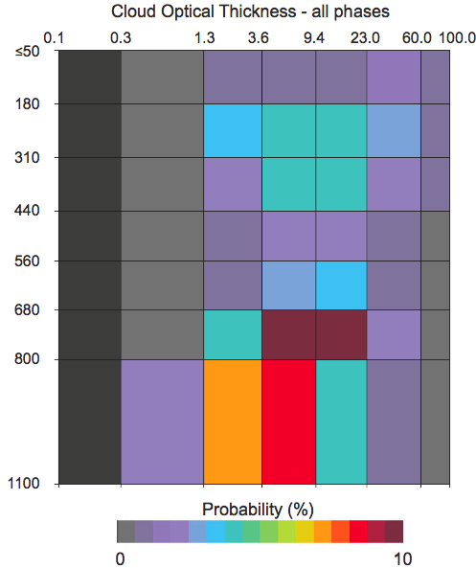
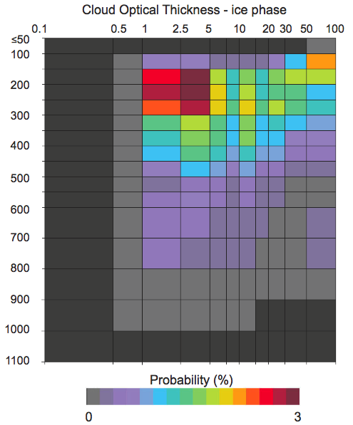
MODIS and ISCCP-like τ_{c} vs p_{c} Joint Histograms
50°N-50°S
Terra
August 2001

Slide 22
Summary and Resources
Terra and Aqua
MODIS atmosphere products (descriptions, Level-1b and Level-3 browse imagery, documentation, contact information, tools for working with and ordering data…)
modis-atmos.gsfc.nasa.gov
Collection 6 enhancements and reprocessing
Atmosphere forward and reprocessing of Aqua began on December 13, 2013
Terra forward and reprocessing began on October 15, 2014
Data available for browse (Level-1b and atmosphere Level-2 and Level-3) and ordering at Level 1 and Atmosphere Archive and Distribution System (LAADS)
ladsweb.nascom.nasa.gov
User’s guide for cloud optical properties
modis-atmos.gsfc.nasa.gov/_docs/C6MOD06OPUserGuide.pdf
Article submitted for publication
Platnick, S., K. Meyer, M. D. King, G. Wind, N. Amarasinghe, B. Marchant, G. T. Arnold, Z. Zhang, P. A. Hubanks, R. E. Holz, P. Yang, W. L. Ridgway, and J. Riedi, 2016: The MODIS cloud optical and microphysical products: Collection 6 updates and examples from Terra and Aqua. Submitted to IEEE Trans. Geosci. Remote Sens.

