Slide 1
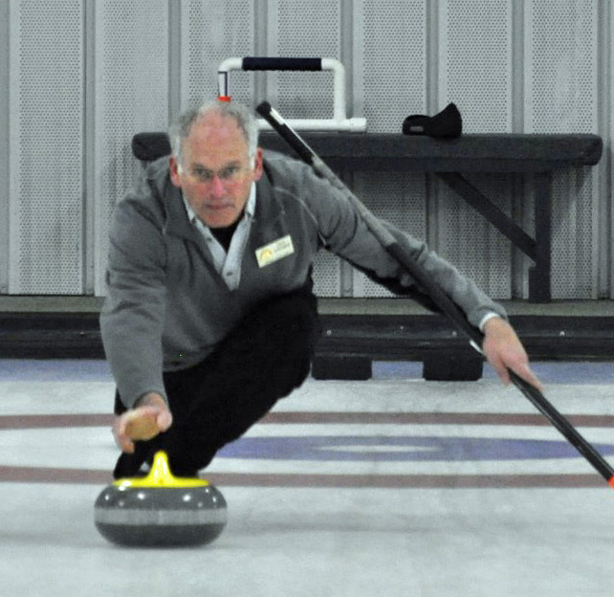
MODIS Cloud MASK MOD35
Steve Ackerman
P. Menzel, R. Frey, K. Strabala,
R Holz, B Maddux
Director, Cooperative Institute for Meteorological Satellite Studies
University of Wisconsin-Madison

Slide 2
Outline
Introduction
Description of the Cloud Mask
Assessment and Validation
Some Applications
Summary
Some Useful References

Slide 3
What is a cloud?
Depends on detection objective….
What are three ways that we detect objects using our visual sensors (eyes and brain)?

Slide 4
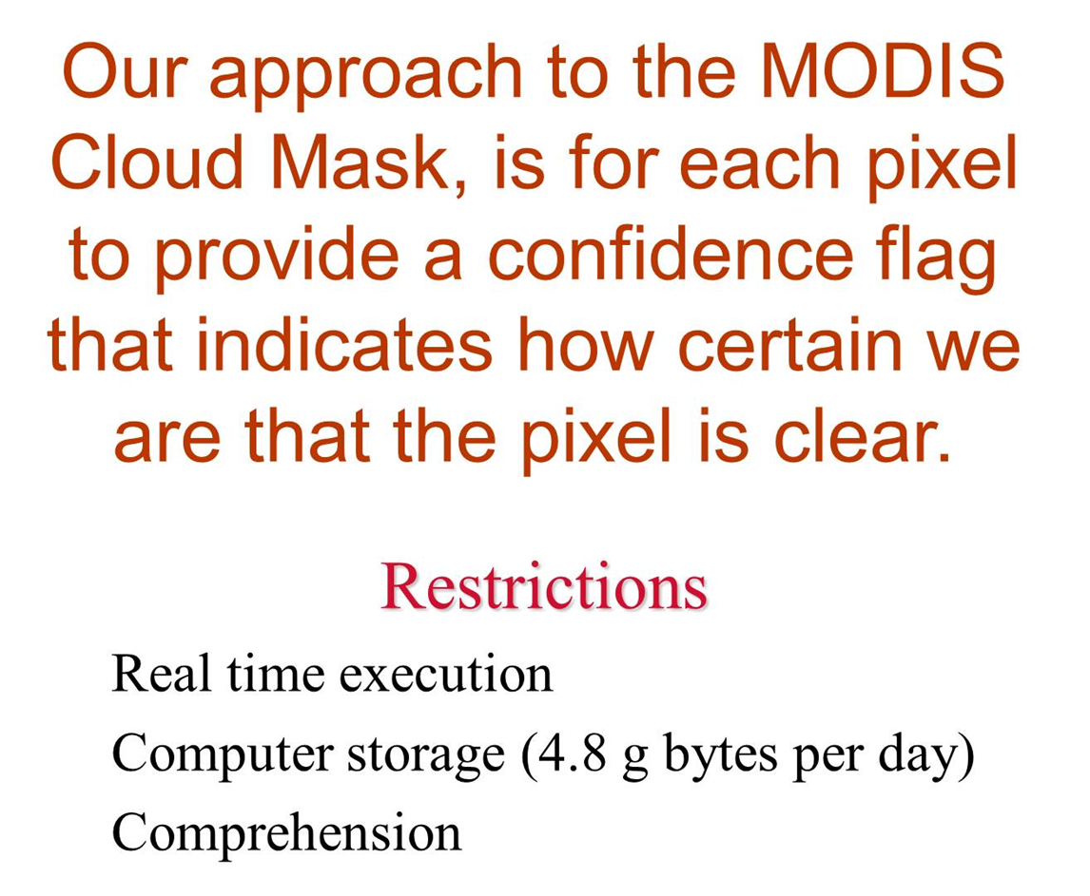
Our philosophy
Restrictions in the 1990s

Slide 5
MODIS
The MODIS (Moderate Resolution Imaging Spectroradiometer) measures radiances at 36 wavelengths including infrared and visible bands with spatial resolution 250 m to 1 km.
MODIS “cloud mask” algorithm uses conceptual domains according to surface type and solar illumination including land, water, snow/ice, desert, and coast for both day and night.
A series of threshold tests attempts to detect instrument field-of-view scenes with un0bstructed views of surface.
Notes:
Quick overview – don’t spend much time.

Slide 6
Table 2 in MODIS Cloud Mask ATBD

Slide 7
Table 4 in MODIS Cloud Mask ATBD

Slide 8
Cloud Mask output
Bits 1&2 most popular
48 bits
Table 3 in MODIS Cloud Mask ATBD

Slide 9
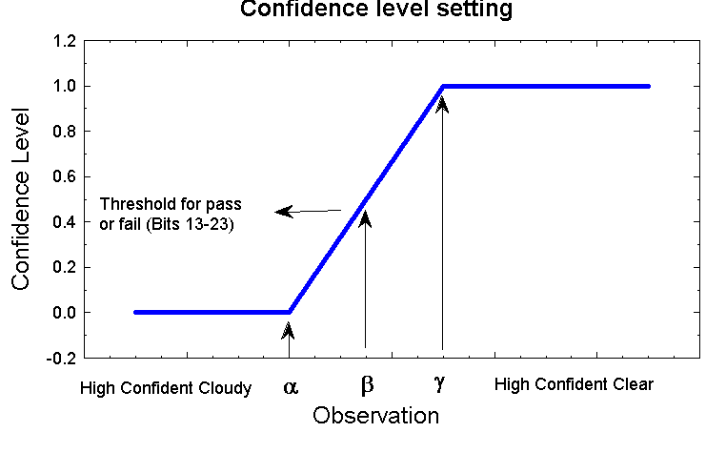
Thresholds range from 0 to 1
Notes:
A value of 1 is high confident clear, 0 is confident cloudy. We are clear sky biased in the sense that if we are unsure of the result, we tend to call it cloudy – thus some regions are flagged as cloudy.

Slide 10
Cloud detection Threshold approach
Each test returns a confidence (F ) ranging from 0 to 1.
Similar tests are grouped and minimum confidence selected [min (F_{i} ) ]
Quality Flag is
Four values; , >.66, >.95 and >.99
Notes:
Quick overview

Slide 11
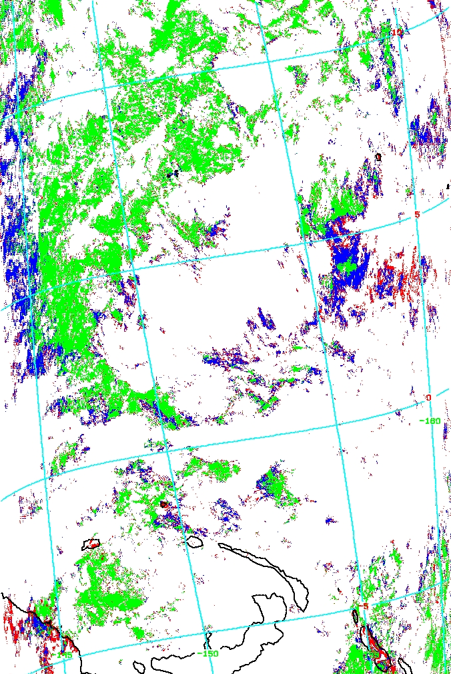
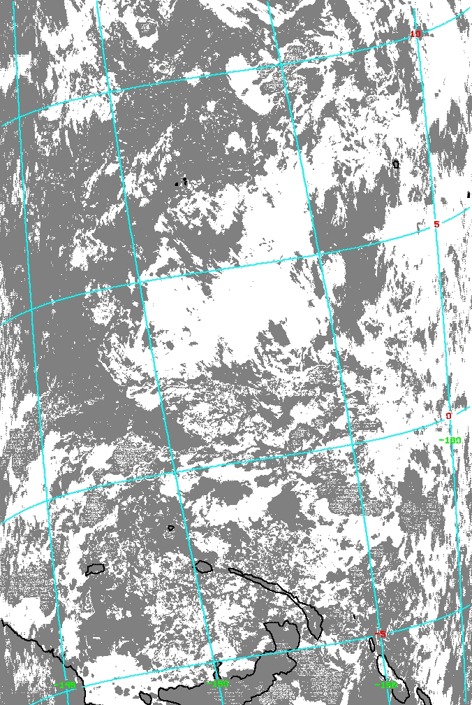
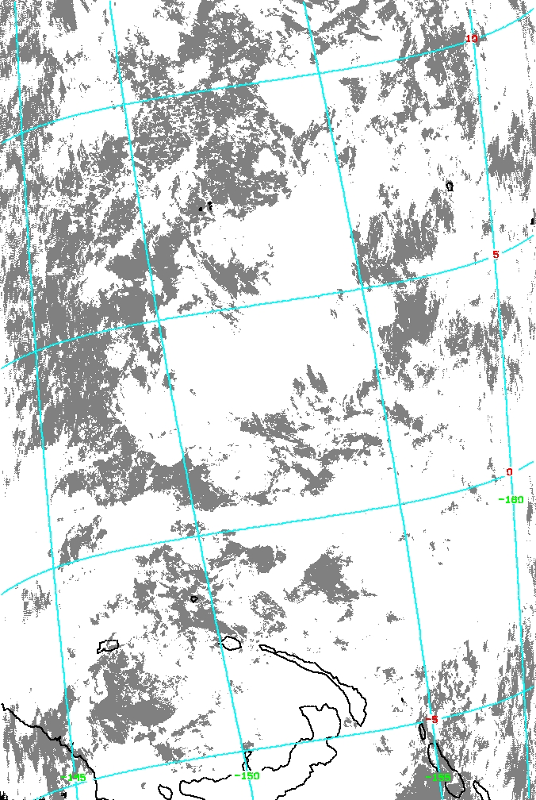
Example: Collection 6 MOD35 Cloud Test Results
Final Confidence of Clear Sky
Green confident clear
Blue probably clear
Red probably cloudy
White confident cloudy
11-3.9 μm Cloud Test
IR “SST” Cloud Test

Slide 12
Validation…. Assume a truth
How do we validate our cloud detection algorithm?
Compare with visual observations, lidar ground based observations, CALIOP, other satellites.

Slide 13
Comparison with Ground and Satellite -based Lidars/Radars
Systems are non-scanning, small fov

Slide 14
ARM site in central region of the USA
ARCL clear
ARCL cloudy
MODIS clear
Terra: 146
Aqua: 117
Terra: 45
Aqua: 58
MODIS cloudy
Terra: 38
Aqua: 12
Terra: 298
Aqua: 185
Ackerman et al 2008
MODIS and radar/lidar detection agree 85% of the time.

Slide 15
What is the optical depth threshold for detection by MODIS algorithm?
AHSRL measures optical depth directly.

Slide 16
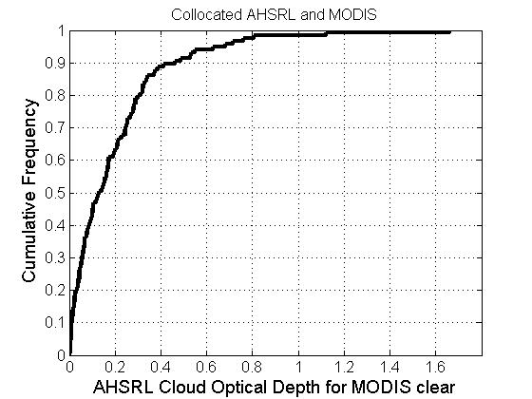
MODIS optical depth threshold: over Wisconsin
MODIS clear, AHSRL cloudy
Ackerman et al 2008
MODIS optical depth threshold ~ 0.4

Slide 17
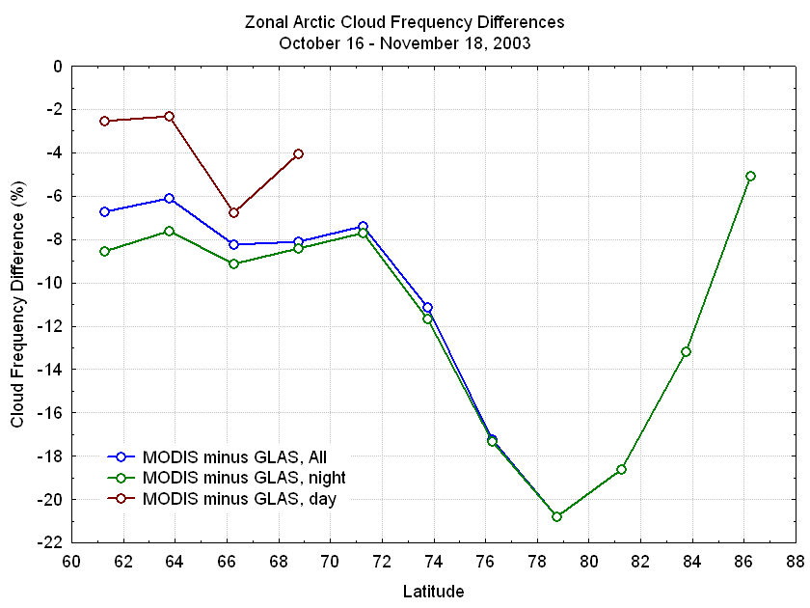
Comparison with GLAS
Daytime better than night…
Difference, MODIS minus GLAS cloud amount
Frey et al 2008
Notes:
Daytime ok – nighttime some problems.

Slide 18
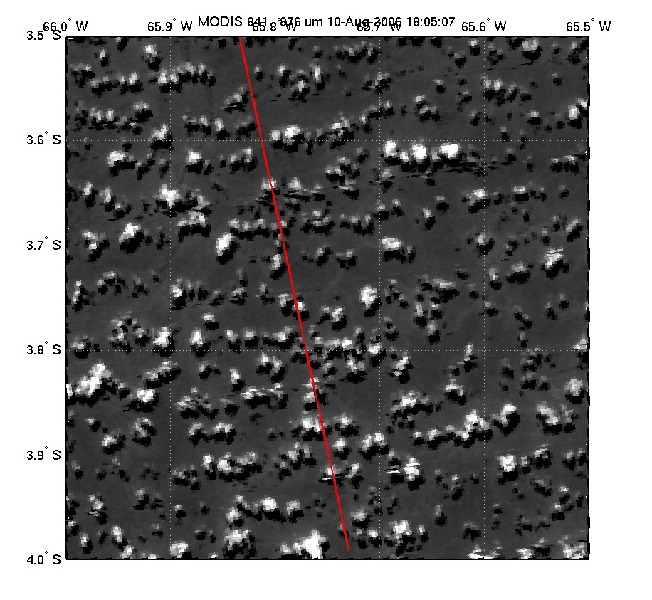
CALIOP and MODIS make very different measurements with different sampling characteristics. To correctly compare, collocation must be done carefully!
MODIS 250 m resolution image with the CALIOP sampling represented by the red line. The finer resolution of CALIOP makes careful collocation important in an analysis of combined data streams.
Notes:
Ack: two instruments give different views of a cloud field. So, we have to be careful of interpreting results.

Slide 19
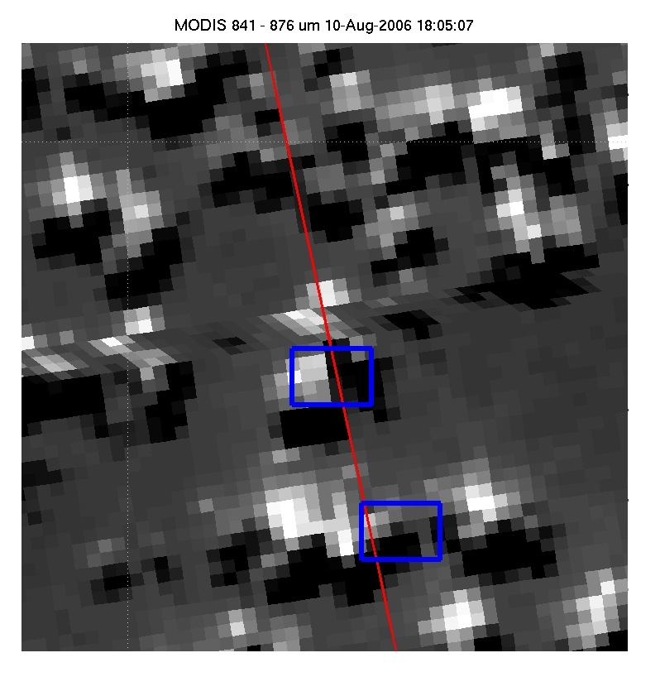
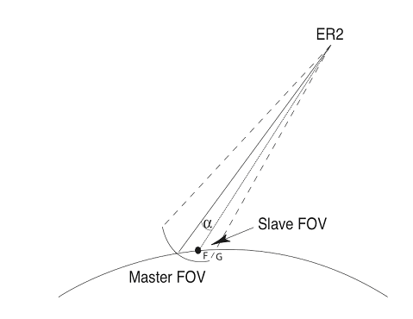
Careful Collocation
Notes:
Bob: The first thing to do is careful collocations.

Slide 20
Global Comparison
CALIPSO clear
CALIPSO cloudy
MODIS clear
27.5%
6.2%
MODIS cloudy
6.3%
60.0%
Comparison of MODIS cloud detection with collocated observations from CALIPSO for the entire month of August 2006. Over 5 million observations went into the analysis. The results are expressed as a percentage.
Notes:
Ack: Global comparison are ‘pretty good’.
Bob: Global means don’t mean much – really need regional comparisons

Slide 21
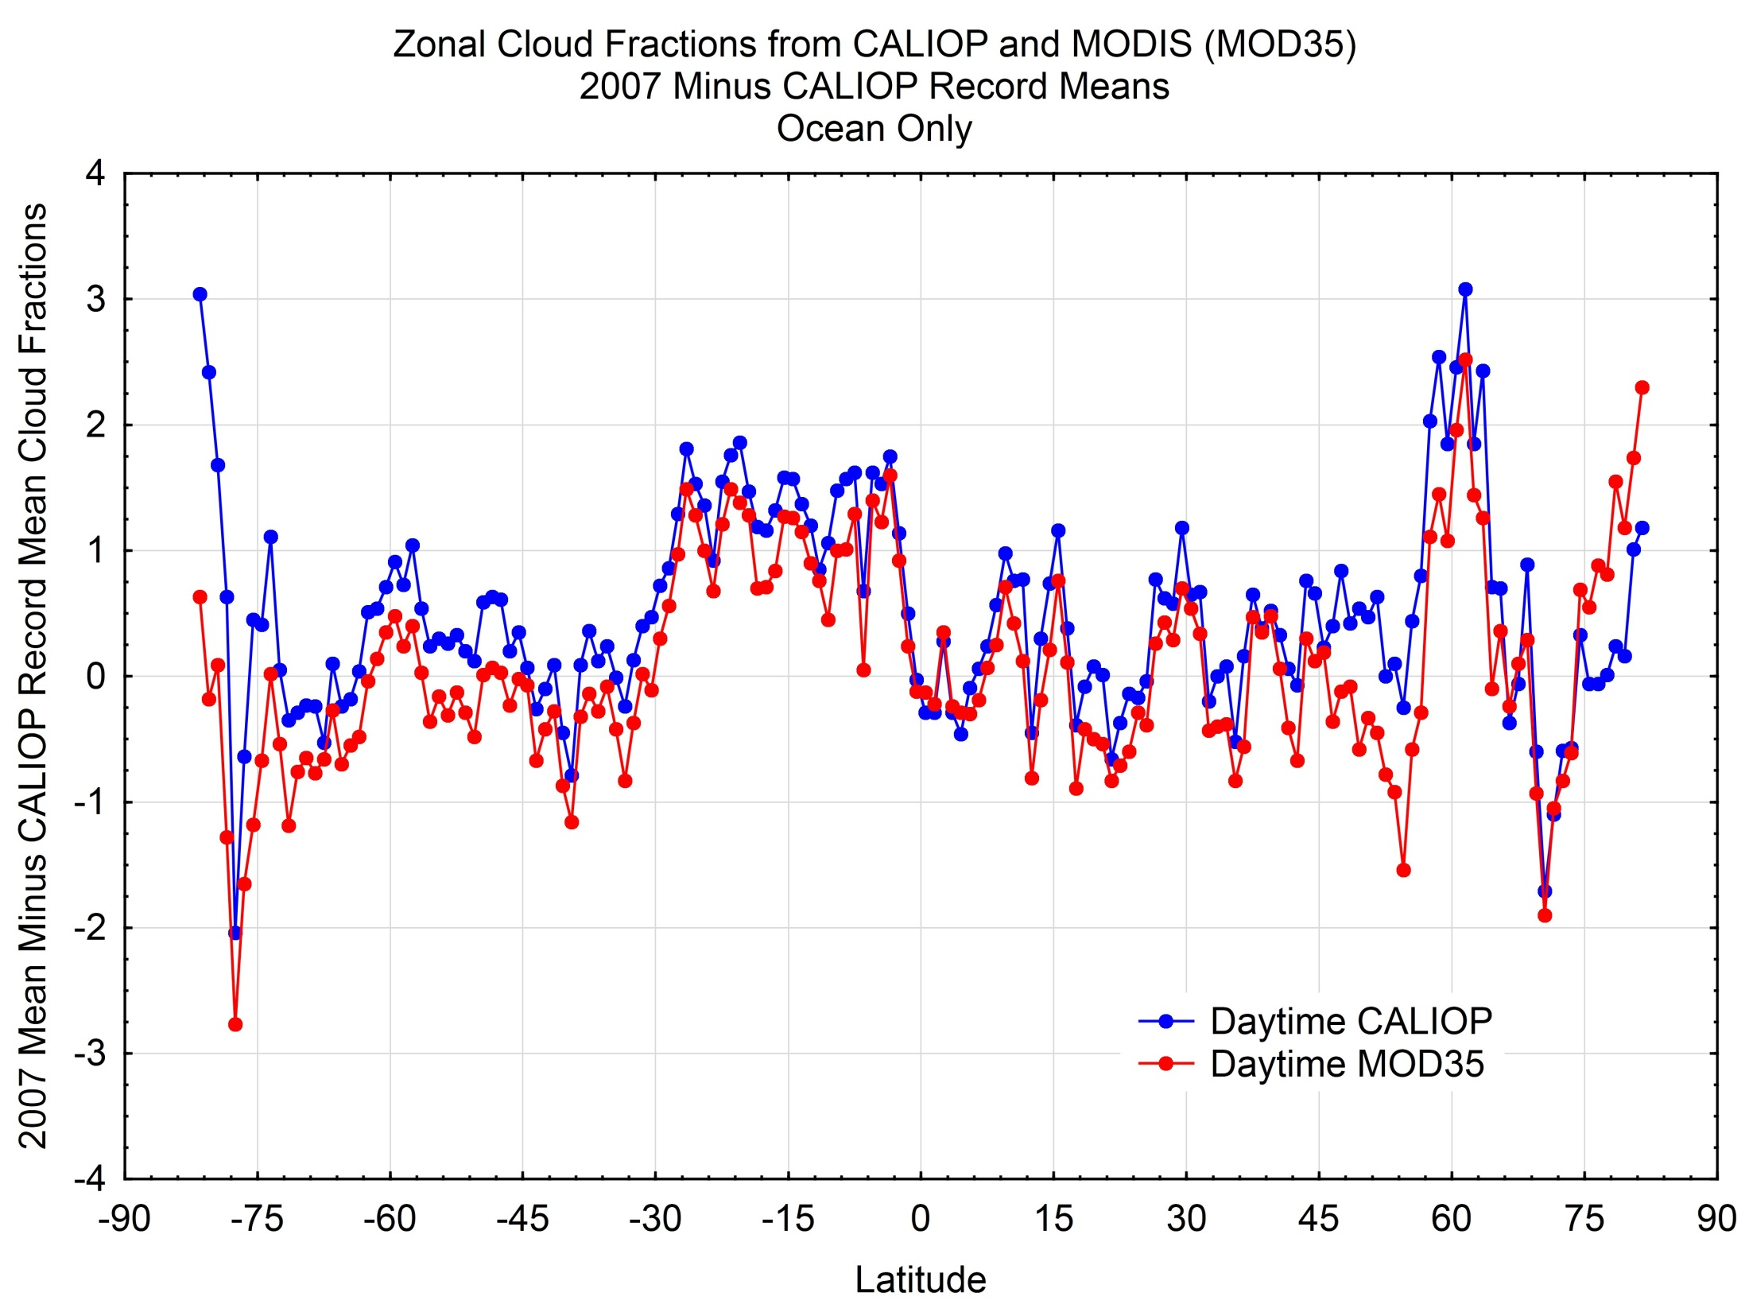
Overall cloud detection by MODIS (1st byte) has been shown to be excellent (e.g. 90% agreement with lidar)

Slide 22
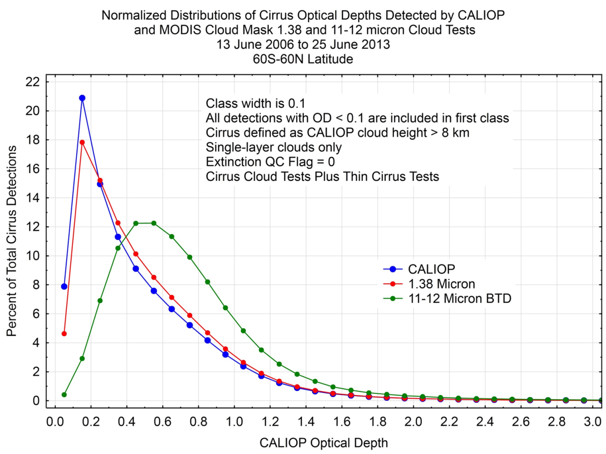
Validation of MODIS Cloud Mask Bits
Bit structure demonstrates increased sensitivity to optically thin cirrus clouds
Ackerman, Frey, MODIS team
Notes:
Upper Left: Collocated MODIS and CALIOP cloud masks during 2007 over ocean during day. The 2007 cloud amount departures of zonal means relative to a 6 year CALIOP record for CALIOP (blue) and MODIS (MOD35, red). This demonstrates how well MODIS does at capturing variability in cloud amount. The comparison is based on the 1st Byte of the MODIS cloud mask and thus the final result of all tests.
Lower Right: Again a collocated data set of CALIOP and MODIS, so we are viewing the same scenes. This is the histogram of the percent of cirrus as detected by CALIOP (truth) and two of the MODIS cloud mask individual cloud tests output as single bits: the 1.38 micron reflectance test and the split window test. For these cases, the 1.38 micron test is sensitive to clouds with optical depths of less than .02.

Slide 23
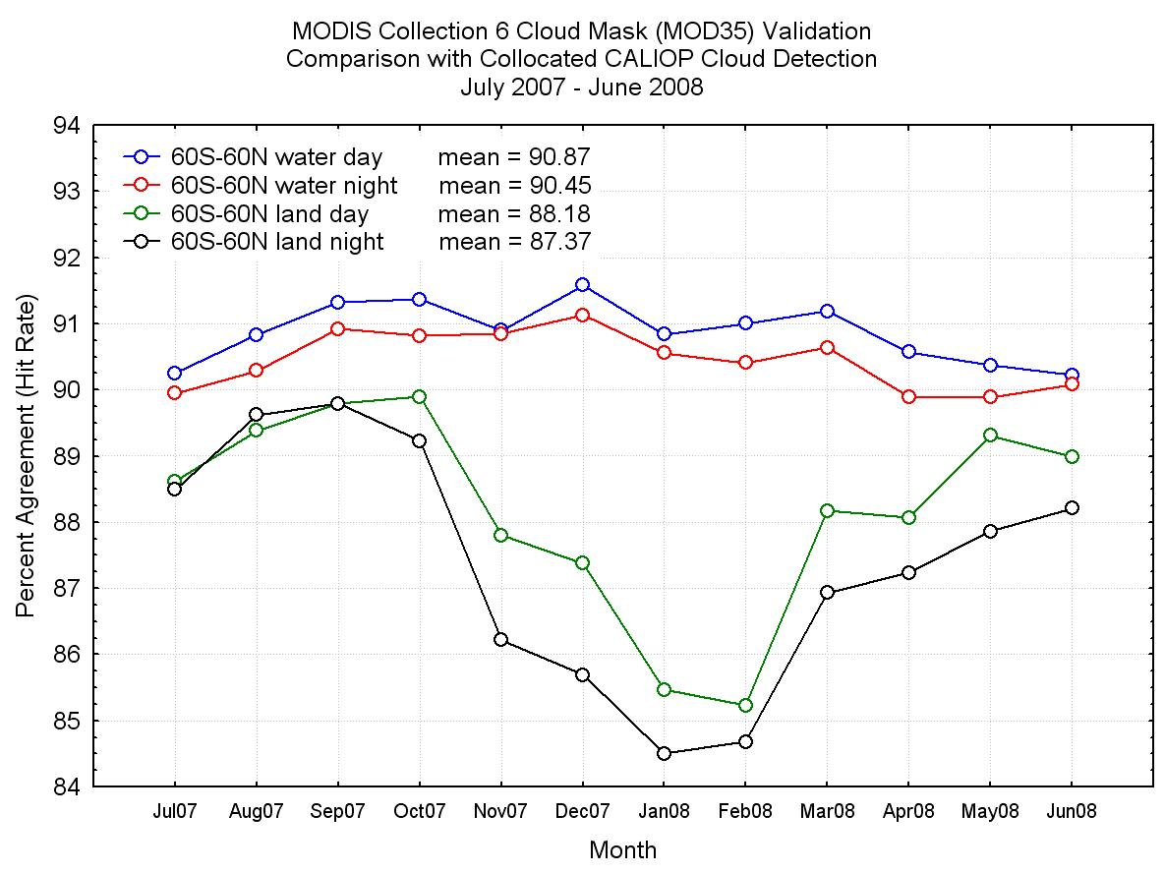

Cooperative Institute for Meteorological Satellite Studies
University of Wisconsin - Madison
Notes:
C6 only: shows differences between non-polar ocean and land, NH summer, and NH winter.

Slide 24
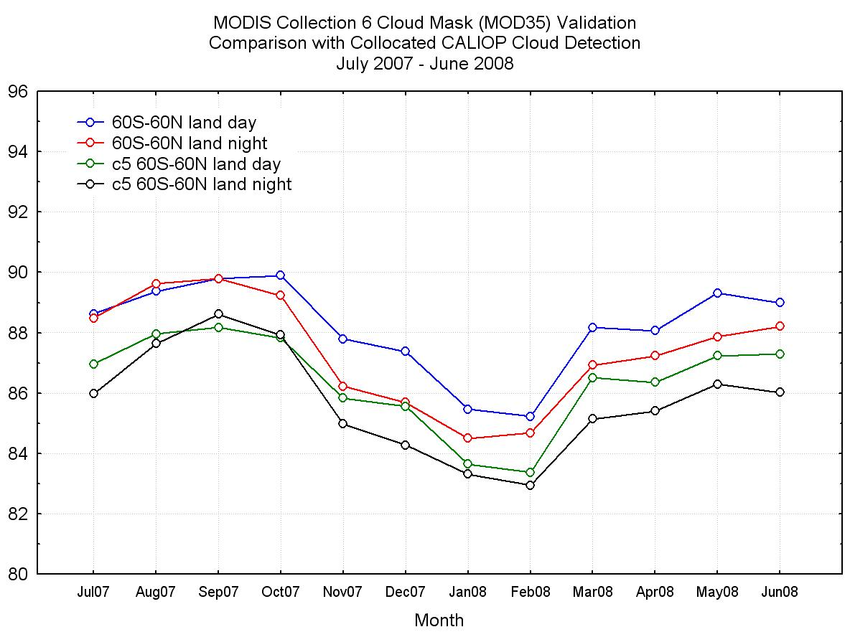
C5 versus C6
Hit Rate (%)
Cooperative Institute for Meteorological Satellite Studies
University of Wisconsin - Madison
Notes:
Yearly validation results for non-polar land surfaces. Hit rates between MOD35 and CALIOP for C6 nighttime land are higher than C5 daytime land.
Each point is hit rate over an entire month.

Slide 25
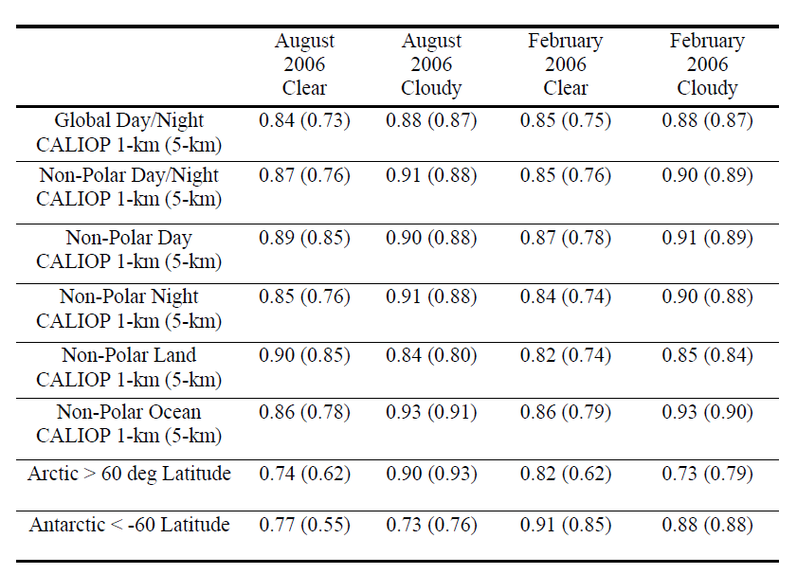
The global fractional agreement of cloud detection between MODIS and CALIOP for August 2006 and February 2007. The results are separated by CALIOP averaging amount, with the 5 km averaging results in parenthesis, as well as day, night and surface type. From Holz et al 2008.

Slide 26
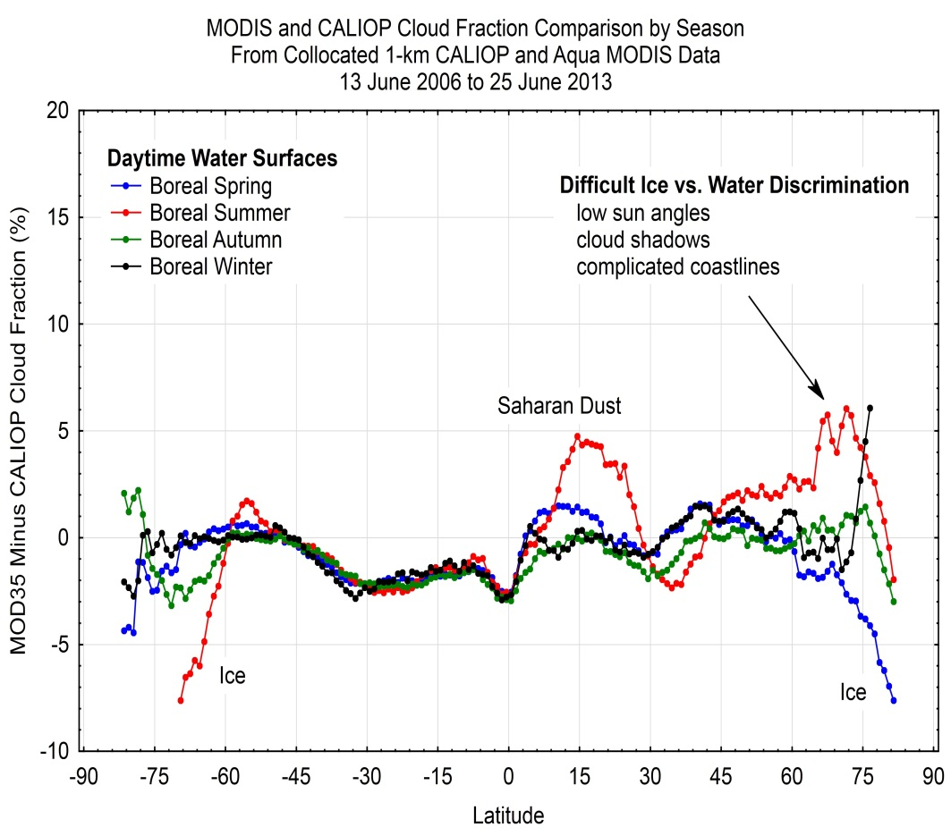
CALIOP lidar vs. MODIS Imager Cloud Mask Comparisons
2006 – 2013 (Daytime Water)
Notes:
CALIPSO 1-km collocated CALIOP (lidar) vs. MODIS cloud mask (MOD35) seasonal comparisons.
**Main Point: cloud detection quality may now be quantified with reasonable certainty as sampling frequency extends over multiple years.
Top figure is daytime water, bottom is nighttime water; both include water ice surfaces.
Top plot shows the difficulty distinguishing low clouds from thick aerosols and clouds from ice surfaces.
Bottom plot shows lesser agreement/more variability over unfrozen water due to lack of solar input and problems in polar night cloud detection due to little thermal contrast; increasing errors with decreasing contrast.

Slide 27
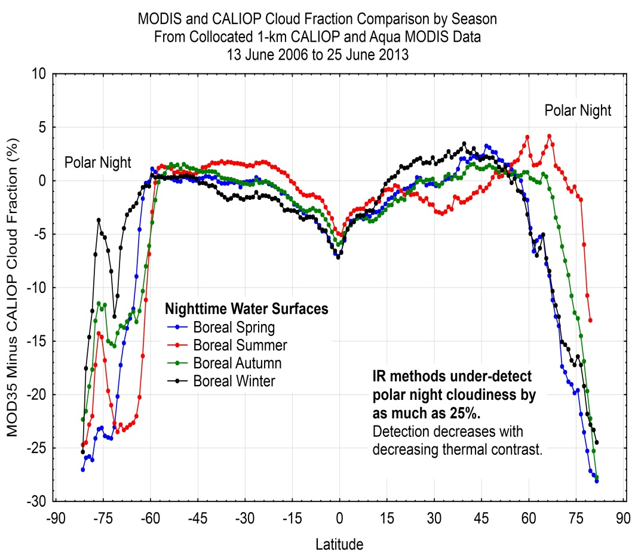
CALIOP lidar vs. MODIS Imager Cloud Mask Comparisons
2006 – 2013 (Nighttime Water)
Notes:
CALIPSO 1-km collocated CALIOP (lidar) vs. MODIS cloud mask (MOD35) seasonal comparisons.
**Main Point: cloud detection quality may now be quantified with reasonable certainty as sampling frequency extends over multiple years.
Top figure is daytime water, bottom is nighttime water; both include water ice surfaces.
Top plot shows the difficulty distinguishing low clouds from thick aerosols and clouds from ice surfaces.
Bottom plot shows lesser agreement/more variability over unfrozen water due to lack of solar input and problems in polar night cloud detection due to little thermal contrast; increasing errors with decreasing contrast.

Slide 28
Comparison with active systems…
Generally good agreement.
Optical depth threshold of ~0.3-0.4 over land (not including thin cirrus alone bit)
Detection a function of scene
Polar regions at night still a problem for passive systems.
Understanding strengths and weakness makes for a good data set!

Slide 29
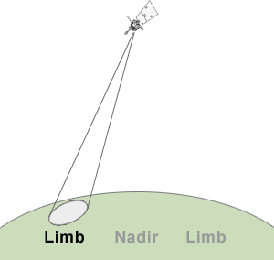
MODIS view angle dependence…
View angle dependence is a issue will all sensors.
  FOV size
  Optical depth
In some cases, as large as 25%.
One option is to restrict viewing geometry.
How does viewing on the limb impact cloud detection?

Slide 30
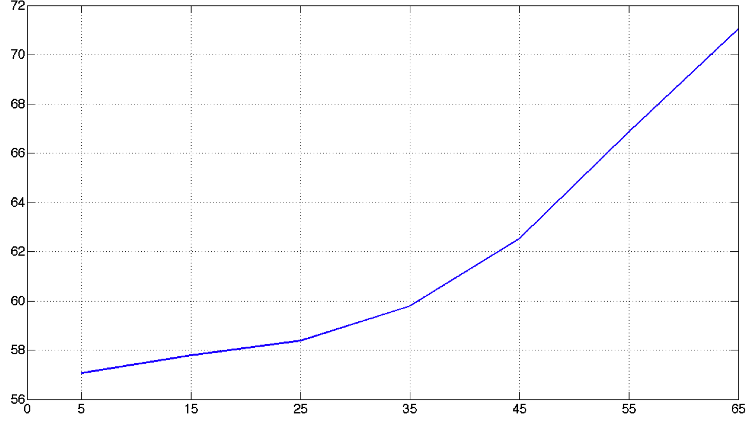
Cloud Fraction vs Viewing Angle
7 years of Aqua and Terra
16% increase from near nadir to edge of scan
View angle effect not constant for all cloud types
Cloud Fraction vs Sensor Zenith Angle
Cloud Fraction (%)
Sensor Zenith Angle
Maddux et al

Slide 31
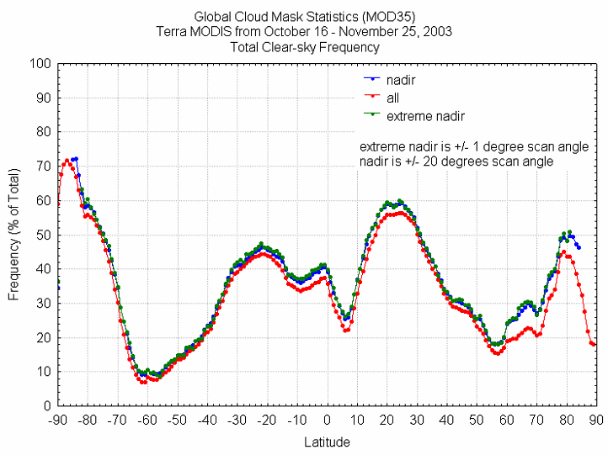
Notes:
We’ll need this later when we compare against GLAS, which is nadir only.

Slide 32
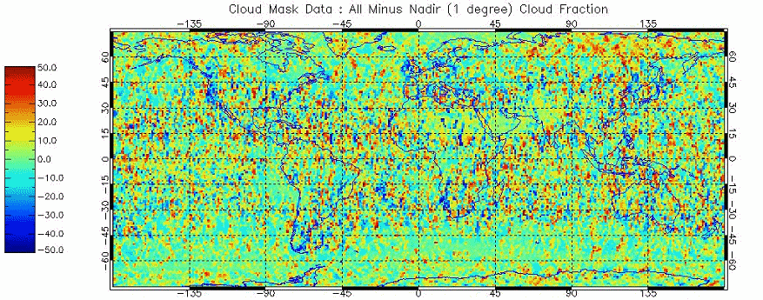
Cloud Fraction in %: Difference between All angles – Nadir (1 degree) for one month
Notes:
We’ll need this later when we compare against GLAS, which is nadir only.

Slide 33
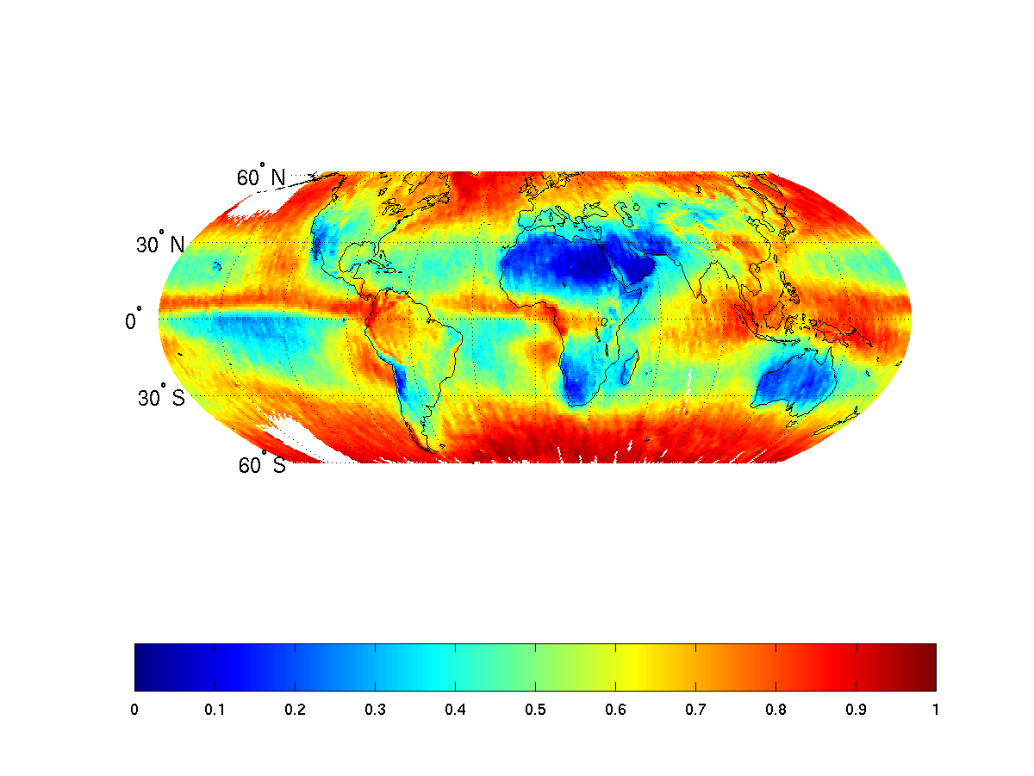
Mean Cloud Fraction for view < 10 degree
Notes:
Demo view angle dependences.

Slide 34
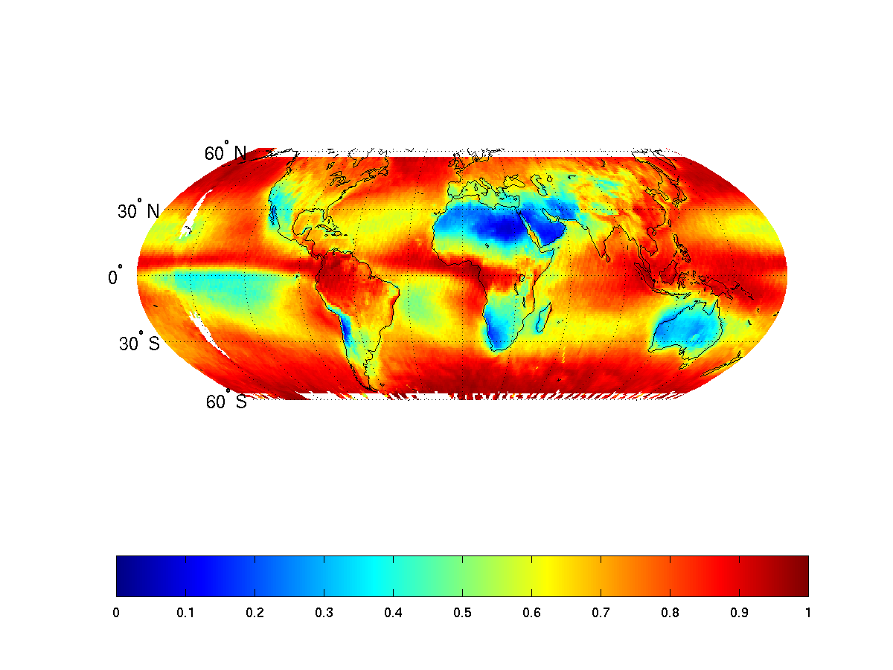
Mean Cloud Fraction for view > 70 degree
Notes:
Demo view angle dependences.

Slide 35
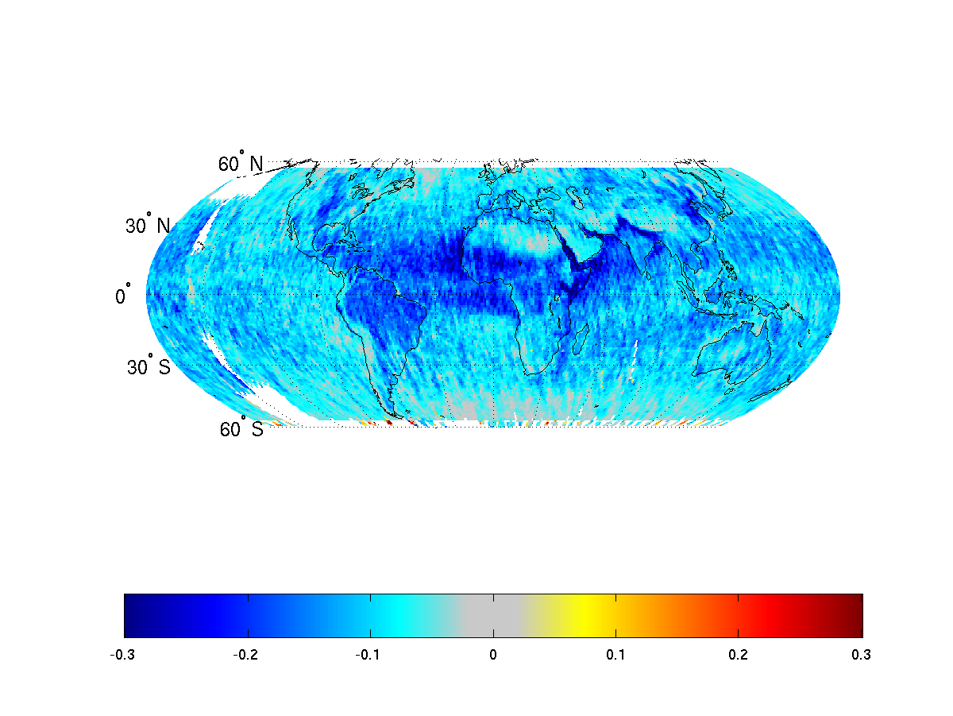
Mean Cloud Fraction difference
Impact is just perspective, projected a 3-D field on a 2-D plane, and increased detection of thin cloud or aerosol.
Notes:
Demo view angle dependences – somewhat of an extreme case. What does this look like if we compare 10 with 35-45 degrees?

Slide 36
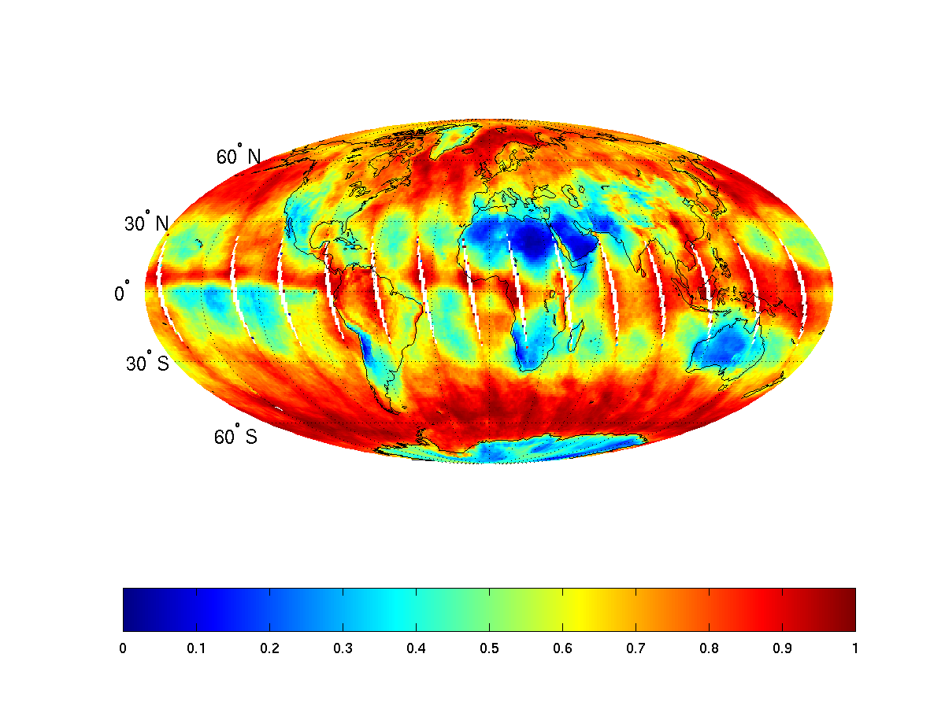
Day 1 cloud amount – one year and 1x1 degree
Notes:
Here’s another way to look at it – might not show this one.

Slide 37
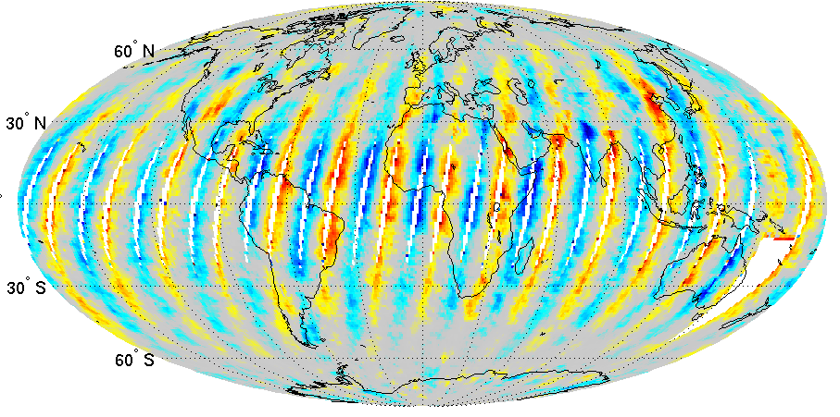
Orbit Day 1 – Orbit Day 2
-0.4 -0.2 0 0.2 0.4
Cloud Fraction
Notes:
Here’s another way to look at it – might not show this one, given time.

Slide 38
MODIS view angle dependence…
View angle dependence is a issue will all sensors.
In some cases, as large as 25%.
One option is to restrict viewing geometry in compositing.

Slide 39
Spectral tests
MODIS – number and thresholds vary with scene type.
Eliasson,

Slide 40
Sensitivity to Input Reflectance Biases and Reflectance Thresholds; Daytime Terra MODIS Data
April 1, 2003 60N to 60S
 |  | Cloud Amount
Collection 5 Cloud Mask |  | Water 72.7% Land 54.1%
Increase All B1, B2 Reflectances by 5% of Original |  | Water 73.3% (+0.6%) Land 54.6% (+0.5%)
Decrease All B1, B2 Reflectances by 5% of Original |  | Water 72.2% (-0.5%) Land 53.6% (-0.5%)
Increase VIS/NIR Reflectance Test Thresholds by 1% |  | Water 70.7% (-2.0%) Land 53.6% (-0.5%)
Decrease VIS/NIR Reflectance Test Thresholds by 1% |  | Water 75.5% (+2.8%) Land 54.7% (+0.6%)
Notes:
No one test dominates, but hard to get a global mean to less than 1%.

Slide 41
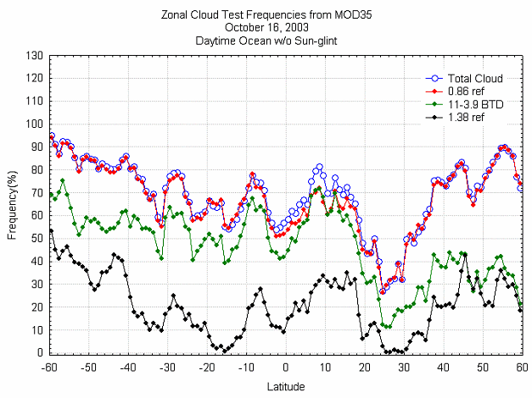
Single test does well over ocean, sun glint free
Zonal mean – total and for particular tests
Notes:
Daytime, dark ocean the R_0.86 a good test. Most instruments have it, so we should do a comparison against one another using only this channel.

Slide 42
MODIS spectral tests…
No one test dominates…
Global means can differ by 2%…
Random shifting is less 10ths of a percent
Reflectance at 0.86 micron over oceans and out of sun-glint holds potential for comparison with other satellite cloud records…

Slide 43
Applications…

Slide 44
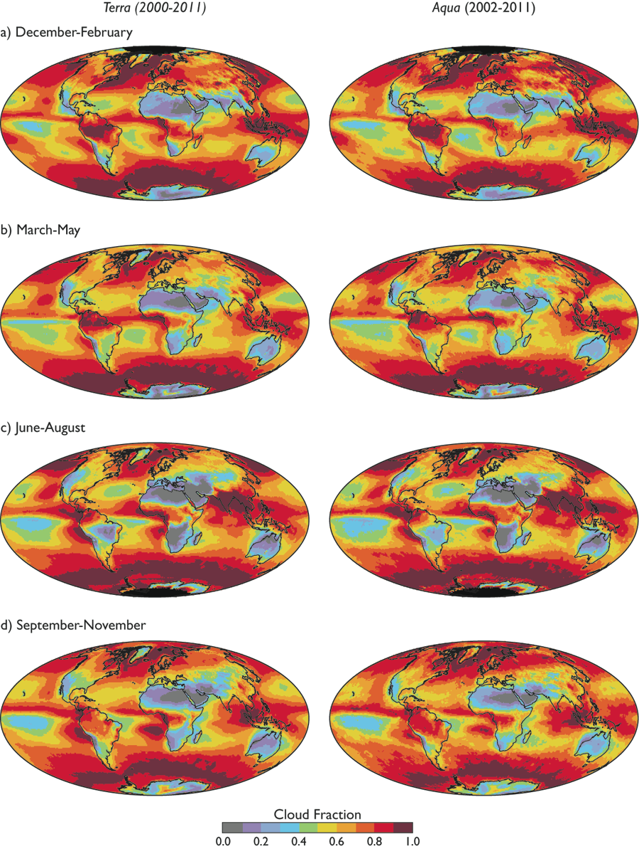
Global Cloud Cover
Global Cloud cover from the two MODIS instruments.
King et al 2013

Slide 45
Aqua – Terra cloud fraction…

Slide 46
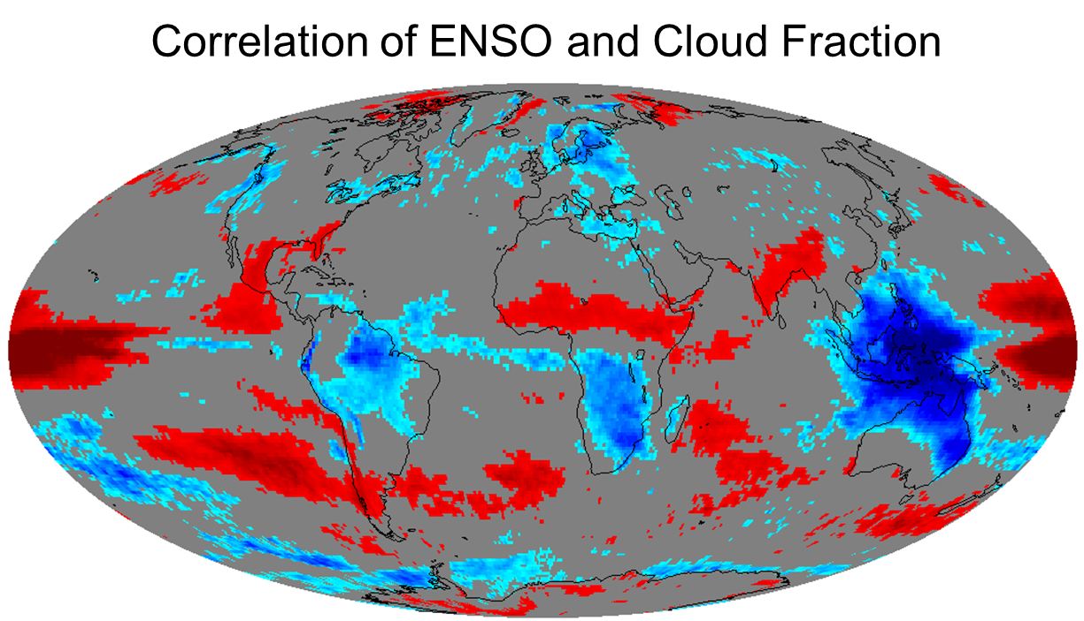
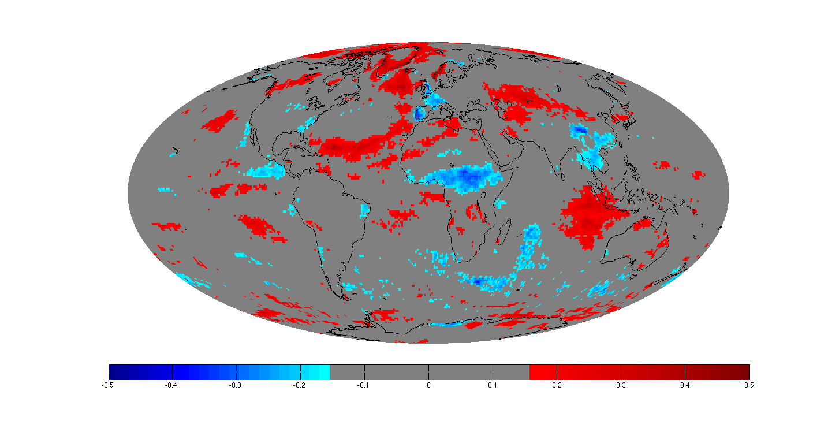
Correlations with indices (ENSO)
-0.5 -0.4 -0.3 -0.2 0 0.2 0.3 0.4 0.5
Correlation is significant >± .15 for a p-value of .05

Slide 47
BAMS – State of Climate 2013

Slide 48
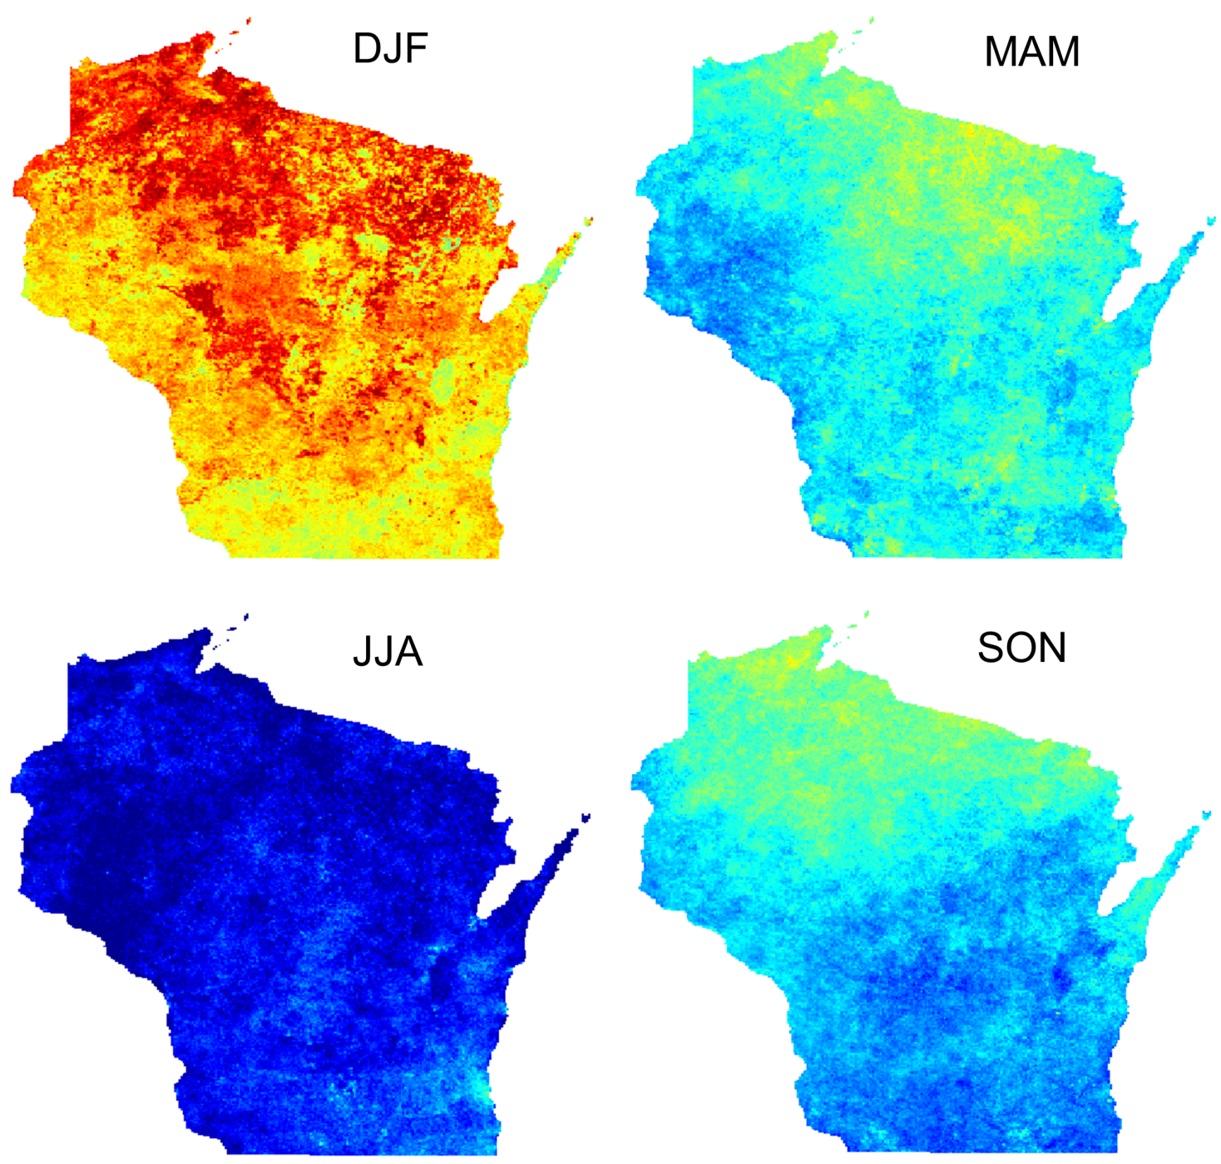
Regional Scale Analysis
The seasonal mean cloud amount at high spatial resolution enable regional studies.

Slide 49
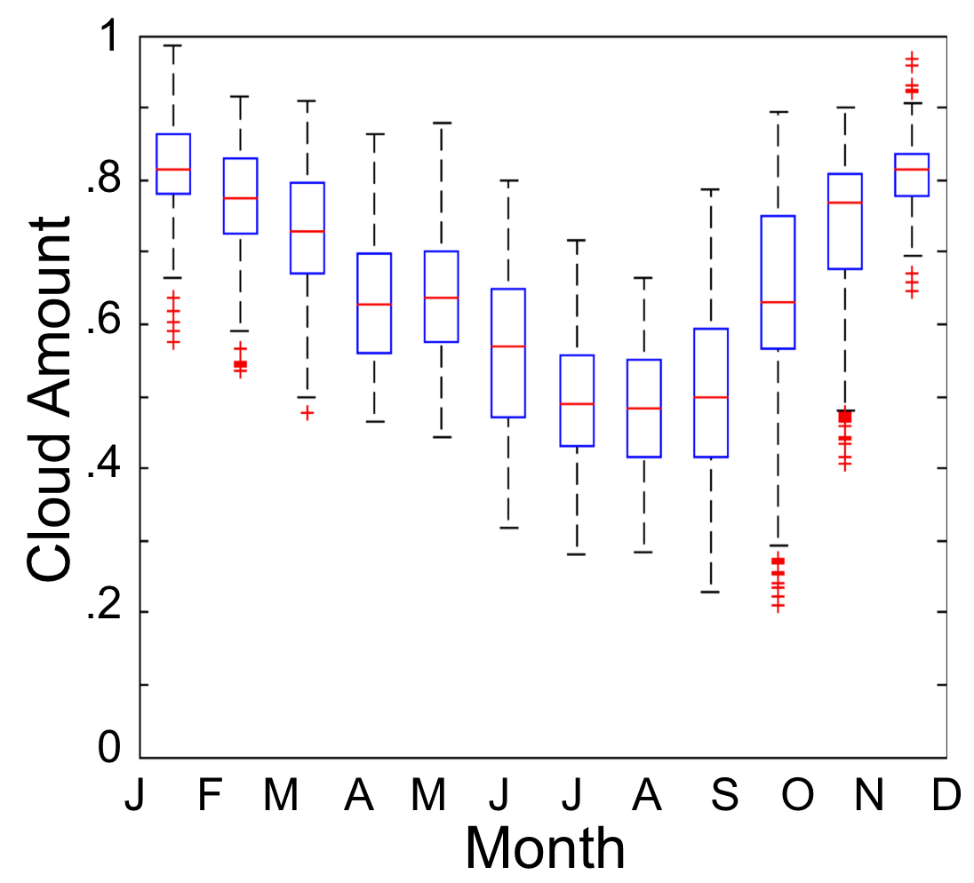
Regional Scale Analysis
Seasonal variation of cloud amount over Wisconsin (Box Plot.)

Slide 50
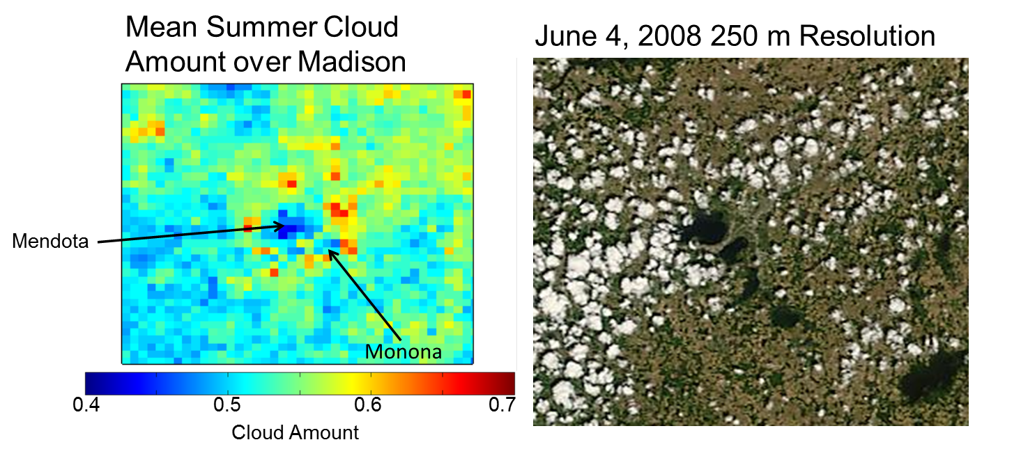
Regional Satellite Climate Studies
Extremely high resolution data shows the suppression of clouds over the lakes during the summer in Madison. The increase in summer cloud cover over other developed areas is also evident in the MODIS data record

Slide 51
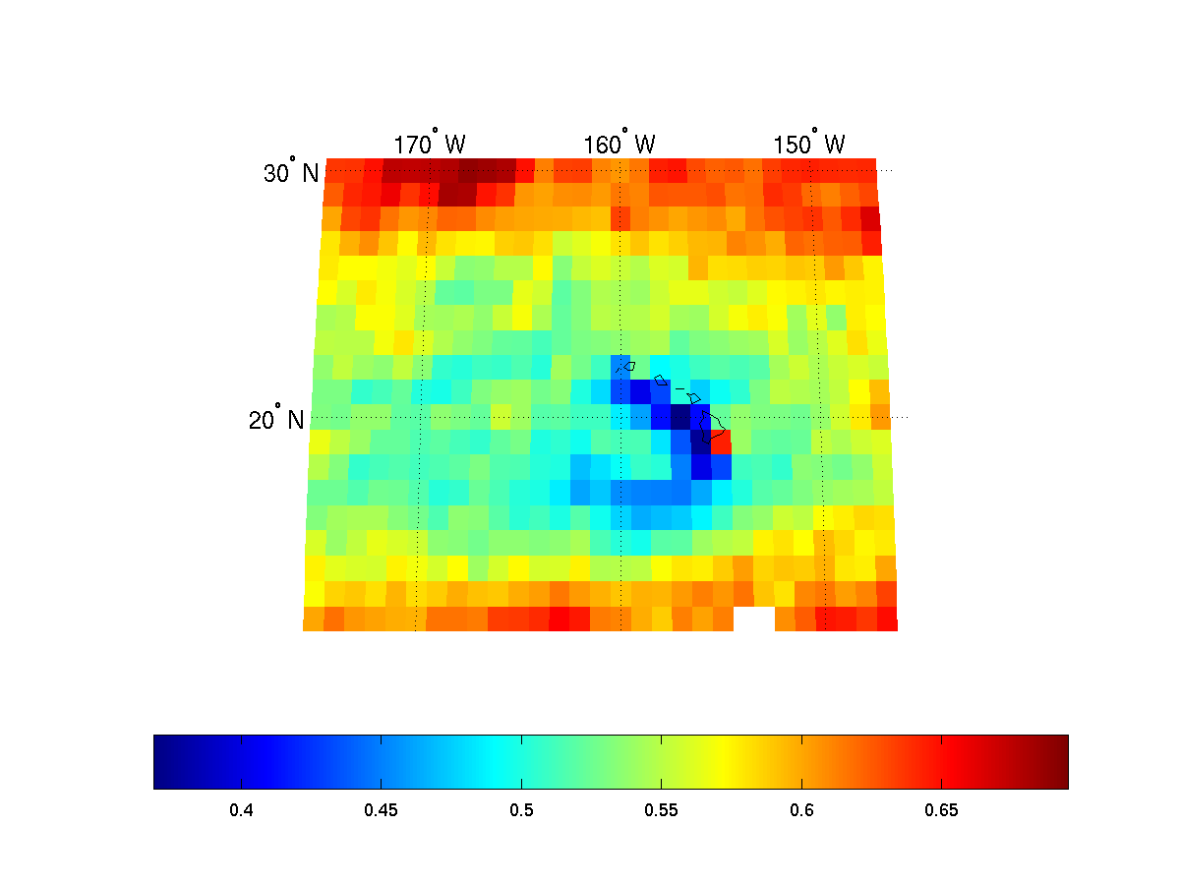
Annual Cloud amount around Hawaiian Islands
Lee side of Hawaiian Islands has reduced cloud cover
Upslope
Cloud fraction in 1 degree grids
Alliss

Slide 52
Summary
Cloud coverage varies with:
  the spatial resolution of the instrument
  spectral resolution of the instrument
  viewing geometry and scene illumination.
MODIS, AVHRR dependencies have be quantified
The dependence of cloud detection on calibration and improvements requires a need to monitor changing instruments and satellites. Needed for long-term monitoring of cloud amount.
MODIS cloud detection optical depth threshold ~ 0.4
Level-3 properties are accurately capturing small spatiotemporal scale variability. Be careful in your averaging choices!

Slide 53
Thank you – Questions?

Slide 54
Useful References
Ackerman, S. A., A. Heidinger, M. J. Foster, and B. Maddux, 2013: Satellite Regional Cloud Climatology over the Great Lakes. Remote Sens. 5(12), 6223-6240; doi:10.3390/rs5126223 http://www.mdpi.com/2072-4292/5/12/6223
King, M. D., S. Platnick, W. P. Menzel, S. A. Ackerman, and P. A. Hubanks, 2013: Spatial and Temporal Distribution of Clouds Observed by MODIS Onboard the Terra and Aqua Satellites. IEEE Transactions on Geoscience and Remote Sensing, 51, 7, 3826-3852.
Stubenrauch, C. J., W. B. Rossow, S. Kinne, S. Ackerman, G. Cesana, H. Chepfer, B. Getzewich, L. Di Girolamo, A. Guignard, A. Heidinger, B. Maddux, P. Menzel, P. Minnis, C. Pearl, S. Platnick, C. Poulsen, J. Riedi, S. Sun-Mack, A. Walther, D. Winker, S. Zeng, and G. Zhao, 2013: Assessment of global cloud datasets from satellites: Project and database initiated by the GEWEX Radiation Panel. Bull. Am. Meteor. Soc. 94, 1031–1049.
Foster, M. J.; Ackerman, S. A.; Heidinger, A. K. and Maddux, B. C. State of the climate in 2011: Cloudiness. Bulletin of the American Meteorological Society, 93, Issue 7, 2012, S27-S28.
Baum, B. A., W. P. Menzel, R. A. Frey, D. C. Tobin, R. E. Holz, S. A. Ackerman, A. K. Heidinger and P. Yang, 2012. MODIS Cloud Top Property Refinements for Collection 6. Jour. App. Meteor. and Clim. 51:6, 1145-1163
Pincus, R., S. Platnick, S. A. Ackerman, R. S. Hemler, R. J. Hofmann, 2012: Reconciling simulated and observed views of clouds: MODIS, ISCCP, and the limits of instrument simulators. J. Climate , 25, 4699-4720. doi:10.1175/JCLI-D-11-00267.1.
Foster, M.J., S.A. Ackerman, A.K. Heidinger, and B.C. Maddux, 2011: Global Cloudiness [in "State of the Climate in 2010"]. Bull. Amer. Meteor. Soc., 92.

Slide 55
Useful References
Maddux, B. C., S. A. Ackerman, and S. Platnick, 2010: Viewing Geometry Dependencies in MODIS Cloud Products. J. Atmos. Oceanic Tech. 27, no.9, pp1519-1528
Liu, Y., S. A. Ackerman, B. C. Maddux, J. R. Key, and R. A. Frey, 2010: Errors in Cloud Detection Over the Arctic and Implications for Observing Feedback Mechanisms, J. Climate, 23, Issue 6, 1894-1907
Holz, R.E., S. A. Ackerman, F.W. Nagle, R. Frey, R.E. Kuehn, S. Dutcher, M. A. Vaughan and B. Baum., 2008: Global MODIS Cloud Detection and Height Evaluation Using CALIOP. J. Geophys. Res., 113, doi:10.1029/2008JD009837.
Ackerman, S. A., A. J. Schreiner, T. J. Schmit, H. M. Woolf, J. Li, and M. Pavolonis, 2008 Using the GOES Sounder to Monitor Upper-level SO2 from Volcanic Eruptions. J. Geophys. Res., 113, doi:10.1029/2007JD009622.
Frey, R. A., S. A. Ackerman, Y. Liu, K. I. Strabala, H. Zhang, J. Key and X. Wang, 2008: Cloud Detection with MODIS, Part I: Recent Improvements in the MODIS Cloud Mask, J. Atmos. Oceanic Tech., 25, 1057-1072.
Ackerman, S. A., R. E. Holz, R. Frey, E. W. Eloranta, B. Maddux, and M. McGill, 2008: Cloud Detection with MODIS: Part II Validation, J. Atmos. Oceanic Tech., 25, 1073-1086.
Platnick, S., M. D. King, S. A. Ackerman, W. P. Menzel, B. A. Baum, J. C. Riédi, and R. A. Frey, 2003: The MODIS cloud products: Algorithms and examples from Terra. IEEE Trans. Geosci. Remote Sens., 41, 459-473.
Ackerman, S. A., K. I. Strabala, W. P. Menzel, R. A. Frey, C. C. Moeller, and L. E. Gumley Discriminating Clear-sky from Clouds with MODIS, 1998: J. Geophys. Res., 103, D24, 32,141

