Slide 1
MODIS CTP (MOD06) Webinar #7
Cloud top pressure, effective emissivity, and phase
Studying Clouds
The CTP Problem
The CO2 Slicing Solution
Resolving some early Issues
C6 Results
20 August 2014
Richard Frey, Bryan Baum, Andy Heidinger,
Steve Ackerman, Brent Maddux, Paul Menzel

Slide 2
Studying Clouds

Slide 3
The difficulty in studying clouds
Aerosols <0.1 micron, cloud systems >1000 km.
Cloud particles grow in seconds: climate is centuries.
Cloud growth can be explosive (e.g. thunderstorms) and carry a lot of energy.
Cloud properties can vary by a factor of 1000 in hours.
Few percent change in cloud cover can drive climate sensitivity
Current climate models have resolutions of more than 100 km
Cloud updrafts are a 100 m to a few km.

Slide 4
Clouds are important for understanding the global energy balance
Trenberth et al, BAMS 2009

Slide 5
Studying Clouds
clouds are a strong modulator of shortwave and longwave; their effect on global radiative processes is large
(1% change in global cloud cover equivalent to about 4% change in CO2 concentration)
accurate determination of global cloud cover has been elusive
(semi transparent clouds often underestimated by 10%)
global climate change models need accurate estimation of cloud cover, height, emissivity, thermodynamic state, particle size
(high/low clouds give positive/negative feedback to greenhouse effect, and
higher albedo from anthropogenic aerosols may be negative feedback)
there is a need for consistent long term observation records to enable better characterization of weather and climate variability
(ISSCP is a good start)

Slide 6
A global cloud climatology using imagers on
geo & leo op weather satellites (GOES-E & –W,
Meteosats, GMS, and am and pm AVHRRs).
5 countries collect and feed data to NASA/GISS.
VIS & IRW radiances are used.
Data are calibrated wrt NOAA-9.
Global cloud analysis is produced every 3 hours
for tracking diurnal periods to decadal changes.
Data record of 1983 to 2006 is being expanded.

Slide 7
The CTP Problem

Slide 8
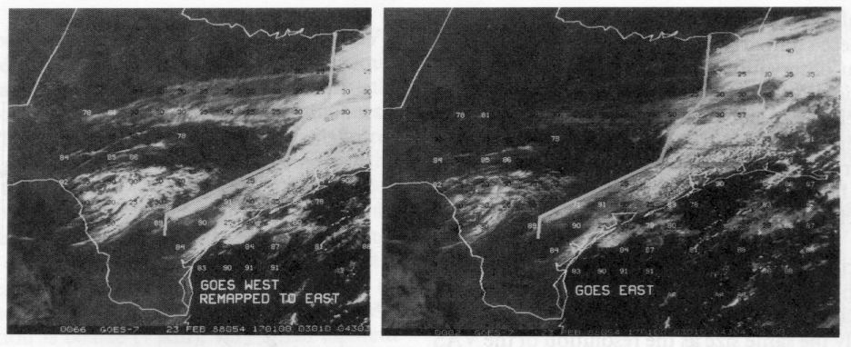
Cirrus detection has been elusive in the visible bands
yes
no
Depending on view angle cirrus is seen in visible image

Slide 9
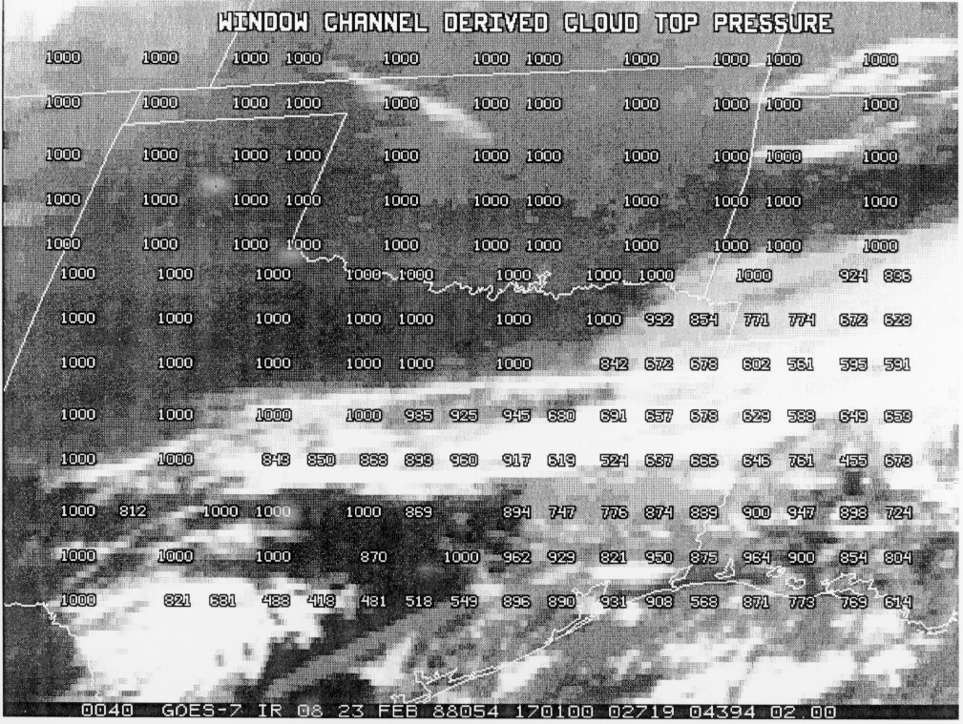
IR window sees cirrus but places cloud height too low

Slide 10
Need correction for cloud semi-transparency
Radiance from a
partly cloudy FOV
R=[1- Nε]R_{clear air} + Nε R_{opq cld} (P_{c})
Two unknowns, Nε and P_{c} ,
require two measurements

Slide 11
The CO2 Slicing Solution

Slide 12
Cloud Top Properties Algorithm Overview
Cloud-top properties (temperature, pressure, and effective emissivity) are derived using the IR window and longwave CO₂ absorption bands (both day and night). Pressure is derived from ratios of differences in radiances between cloudy and clear-sky regions at two spectrally close channels. Adjustments are made for radiance biases so that clear (calculated) and cloudy (observed) radiances are both referenced to the NCEP/EMC Global Forecast System forward calculated radiances. Effective cloud amount (cloud fraction times cloud emissivity at 11 μm) is derived using the inferred cloud top pressure and the radiative transfer equation for the 11 μm band. For low clouds (> 700 hPa), the CO₂ channel SNR decreases, so the IR window 11 μm brightness temperature is assumed to be the opaque cloud-top temperature and a cloud-top pressure is assigned using the NCEP/EMC GFS temperature profile. Cloud phase is primarily determined from the beta ratio of the 8.5 and 11 μm clear minus cloudy radiances with some IR adjustments for high versus low and thin versus thick clouds.

Slide 13
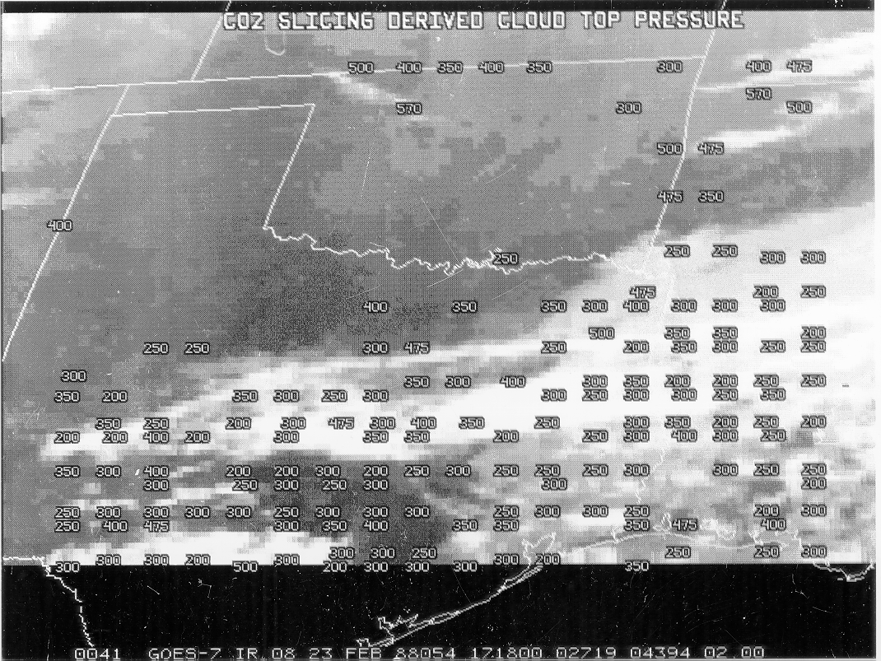
CO2 slicing corrects for semi-transparency of cirrus

Slide 14
RTE in Cloudy Conditions
I_{λ} = η I^{cd} + (1 - η) I^{clr} where cd = cloud, clr = clear, η = cloud fraction
^{λ λ}
o
I^{clr} = B_{λ}(T_{s}) τ_{λ}(p_{s}) + ∫ B_{λ}(T(p)) dτ_{λ} .
^{λ} p_{s}
p_{c}
I^{cd} = (1-ε_{λ}) B_{λ}(T_{s}) τ_{λ}(p_{s}) + (1-ε_{λ}) ∫ B_{λ}(T(p)) dτ_{λ}
^{λ} p_{s}
o
+ ε_{λ} B_{λ}(T(p_{c})) τ_{λ}(p_{c}) + ∫ B_{λ}(T(p)) dτ_{λ}
p_{c}
ε_{λ} is emittance of cloud. First two terms are from below cloud, third term is cloud contribution, and fourth term is from above cloud. After rearranging
p_{c} dB_{λ}
I_{λ} - I_{λ}^{clr} = ηε_{λ} ∫ τ(p) dp .
p_{s} dp

Slide 15
Cloud Properties from CO2 Slicing
RTE for cloudy conditions indicates dependence of cloud forcing (observed minus clear sky radiance) on cloud amount (ηε_{λ}) and cloud top pressure (p_{c})
p_{c}
(I_{λ} - I_{λ}^{clr}) = ηε_{λ} ∫ τ_{λ} dB_{λ} .
p_{s}
Higher colder cloud or greater cloud amount produces greater cloud forcing; dense low cloud can be confused for high thin cloud. Two unknowns require two equations.
p_{c} can be inferred from radiance measurements in two spectral bands where cloud emissivity is the same. ηε_{λ} is derived from the infrared window, once p_{c} is known.

Slide 16
CO2 channels see to different levels in the atmosphere
14.2 um 13.9 um 13.6 um 13.3 um

Slide 17
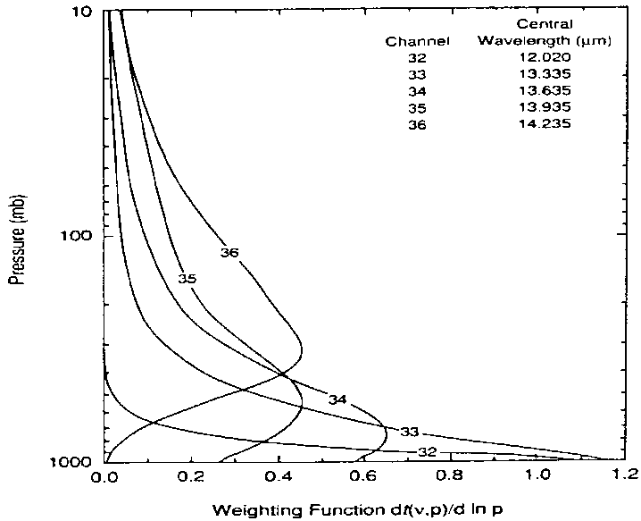
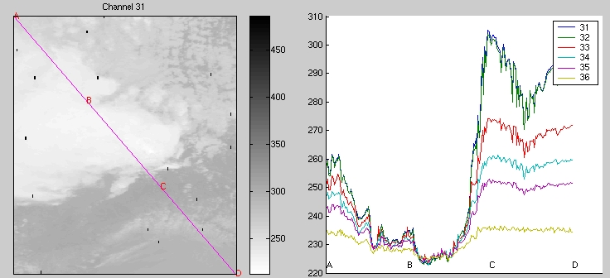
BTs in and out of clouds for MODIS CO₂ bands
demonstrate weighting functions and cloud top algorithm

Slide 18
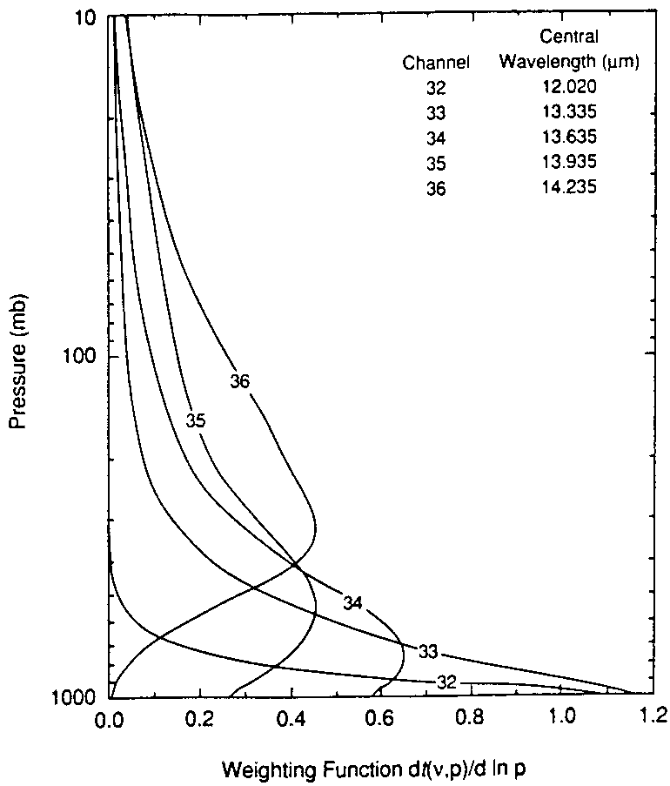
_{CTPs using CO2 Slicing}
Different ratios reveal cloud properties
at different levels
hi - 14.2/13.9
mid - 13.9/13.6
low - 13.6/13.3
Meas Calc
p_{c}
(I_{λ1}-I_{λ1}^{clr}) ηε_{λ1} ∫ τ_{λ1} dB_{λ1}
p_{s}
----------- = -----------------
p_{c}
(I_{λ2}-I_{λ2}^{clr}) ηε_{λ2} ∫ τ_{λ2} dB_{λ2}
p_{s}
if (I_{λ}^{clr} - I_{λ}) < Δ
then IRW is used
Notes:
Clear sky radiances calculated from NCEP ReAnalysis – need correction for observed minus calculated radiance bias

Slide 19
Different ratios reveal cloud properties
at different levels
hi - 14.2/13.9
mid - 13.9/13.6
low - 13.6/13.3
Meas Calc
p_{c}
(I_{λ1}-I_{λ1}^{clr}) ηε_{λ1} ∫ τ_{λ1} dB_{λ1}
p_{s}
----------- = ------------------
p_{c}
(I_{λ2}-I_{λ2}^{clr}) ηε_{λ2} ∫ τ_{λ2} dB_{λ2}
p_{s}
if (I_{λ}^{clr} - I_{λ}) < Δ
then IRW is used
_{CTPs using CO2 Slicing}
For spectrally close bands cloud emissivities are the same, Ɛ_{λ1} = Ɛ_{λ2}
Clear sky radiances I_{λ} are calculated
from GDAS (Global Data
Assimilation System)
Corrections up to several tenths of a radiance unit (W/m2/ster/µm) for observed minus calculated radiance differences are applied for eight day composites of clear sky observations (in 1 degree latitude bins accumulated separately for
ocean-day&night, land-day, and land-night)
_{k}
Notes:
Clear sky radiances calculated from GDAS – need correction for observed minus calculated radiance bias

Slide 21
Resolving some early issues

Slide 22
August 2006
MODIS C5 and CALIOP Cloud Properties Comparison
marine strat
too high
high thin clouds placed low by IRW
Notes:
22
Add process slide with computer picture and processing times

Slide 23
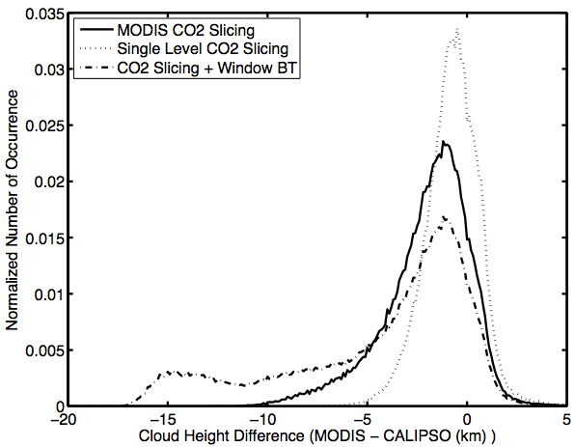
Collect 5 Single Level CO2 Slicing CTHs
Notes:
23

Slide 24
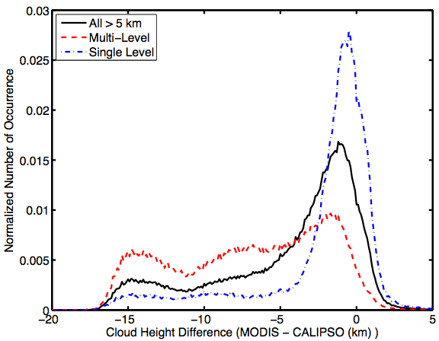
Collect 5 Impact of Multilevel Clouds
Notes:
24
Make title more of a thought process

Slide 25
Summary of Changes for Collect 6 (MOD06CT & MYD06CT)
Lower "noise" thresholds (clear minus cloudy radiances required to indicate cloud presence in CO₂ bands) enabling more CO₂ slicing solutions for high thin clouds.
Implement CO₂ spectral band shifts suggested by Tobin et al. (JGR 2006) for Terra and Aqua MODIS.
Adjust ozone profile between 10 and 100 hPa to GDAS values instead of using climatology (so that CO₂ radiances influenced by O₃ profiles are calculated correctly).
Incorporate sinusoidal CO2 increase.
Prohibit CO₂ slicing solutions for water clouds; use only IRW solution. Avoid IRW solutions for ice clouds; use CO₂ slicing whenever possible.
Restrict CO₂ solution to the appropriate part of troposphere (determined by CO₂ band weighting functions so 36/35 < 450 hPa, 35/34 < 550 hPa, and 34/33 < 650 hPa).
Implement marine stratus improvement where a constant lapse rate is assumed in low level inversions according to latitude region.
Add Upper Troposphere / Lower Stratosphere Flag
Use Beta-ratios to determine cloud phase.

Slide 26
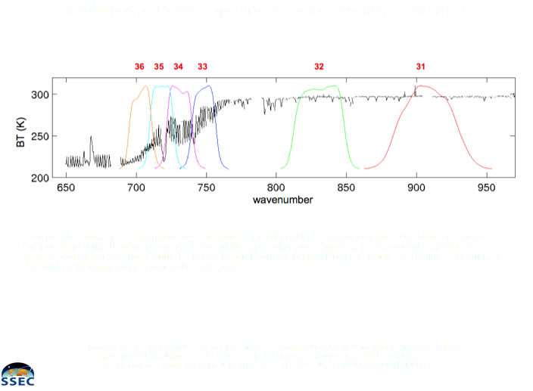

Slide 27
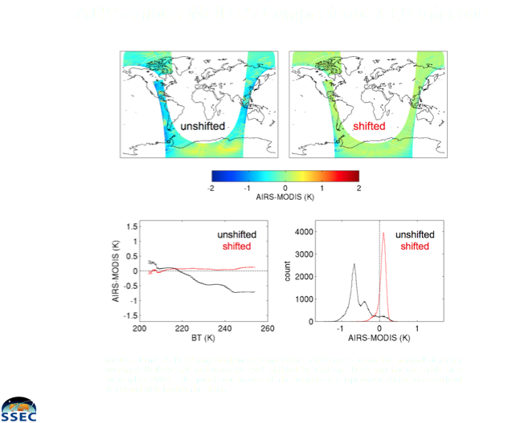
Exploring
MODIS SRF
Shifts

Slide 28
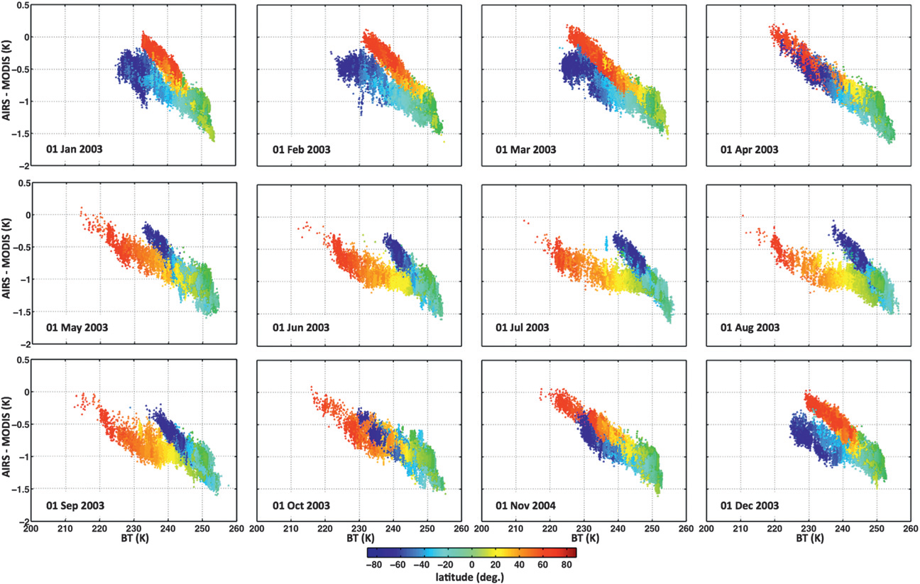
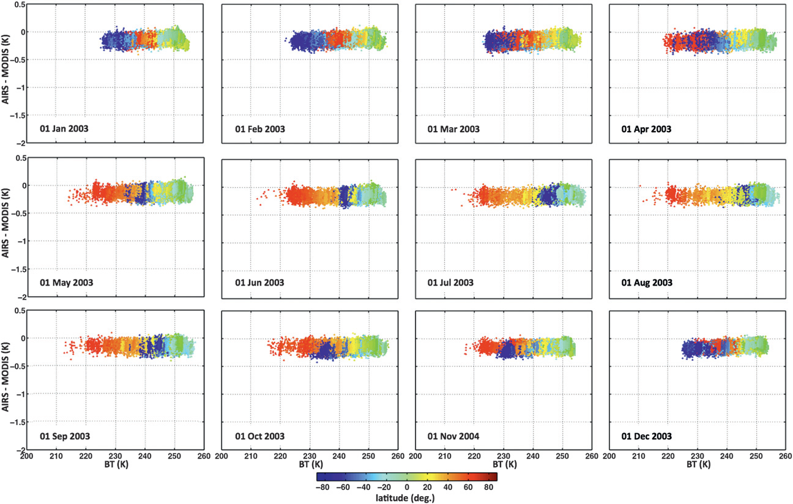
Band 35
(AIRS–MODIS band35) BTDs as a function of 11-µm BTs, calculated with AIRS convolved using unshifted (left) and shifted (right) Aqua MODIS SRFs. BTDs are color coded with red (blue) points coming from high NH (SH) latitudes (Baum et al JAMC 2012)

Slide 29
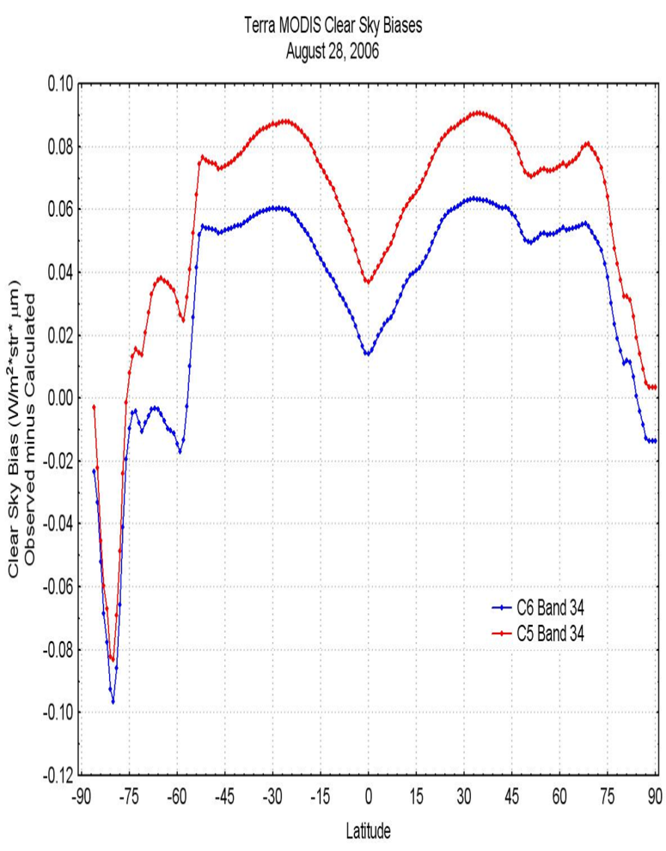
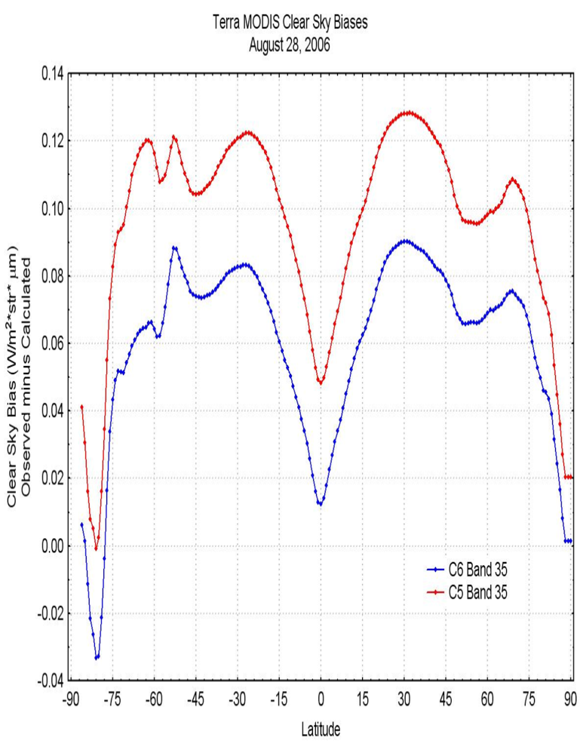
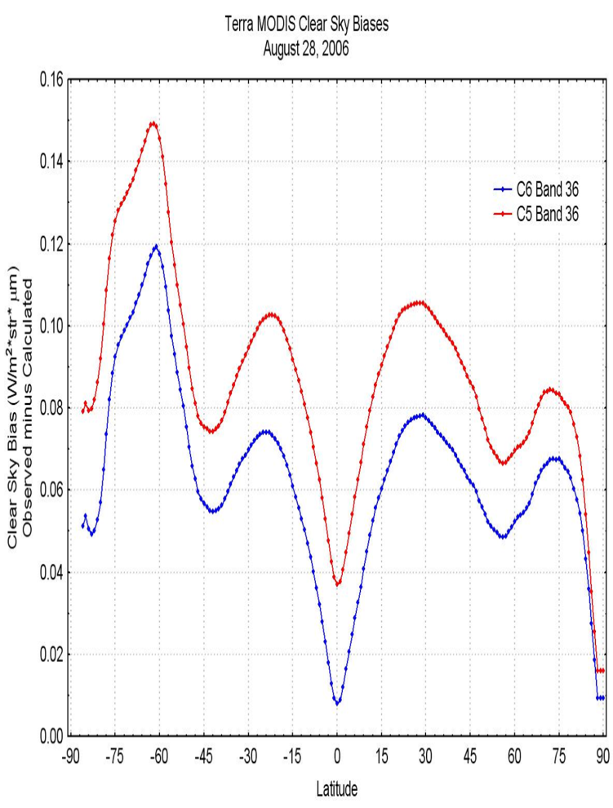
Spectral Shifts Reduce Calculated vs Observed Radiance Biases
8-day 1-degree latitude zone means of observed minus calculated clear-sky radiances for Terra MODIS bands 33-36 (in 5-zone moving averages) are created from 8-day 25-km biases for daytime land, nighttime land, and ocean data. Day and night land data are combined south of 60˚S due to poor clear-sky sampling and the difficulty of discriminating between clear and cloudy conditions in this region. Figures show C5 versus C6 band 34-36 biases from 26 August 2006 over ocean. Land values (not shown) are used for ocean ice cases in polar regions.

Slide 30
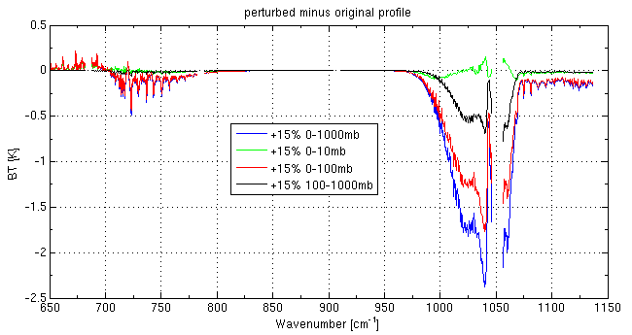
O3 affects CO2 bands
Adjust ozone profile between 10 and 100 hPa to GDAS values instead of using climatology (so that CO₂ radiances influenced by O₃ profiles are calculated correctly).

Slide 31
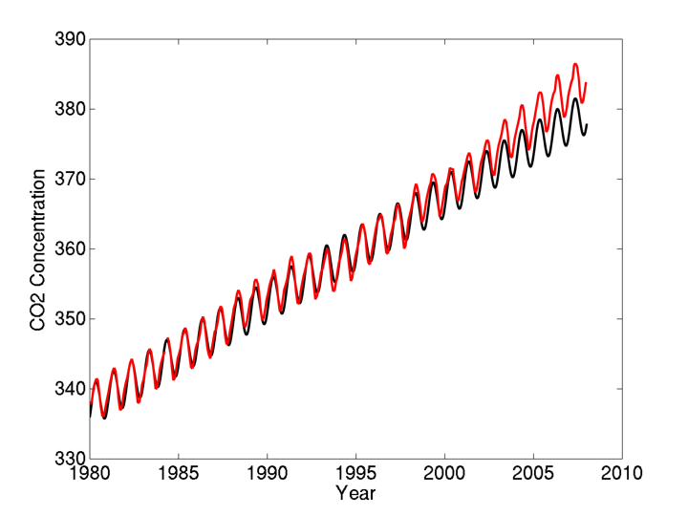
MODIS-C6: Tracking CO2 changes over time
From the Carbon Dioxide Information Analysis Center
Mauna Loa
Parameterization

Slide 32
Avoid IRW solutions for ice clouds
Number for
Aug 2006
1
km
CTH MODIS - CALIOP
IRW CTHs are too low for ice clouds
Notes:
Get rid of bottom image and say:
IR window for ice suscpect
Add X label “error”
32

Slide 33
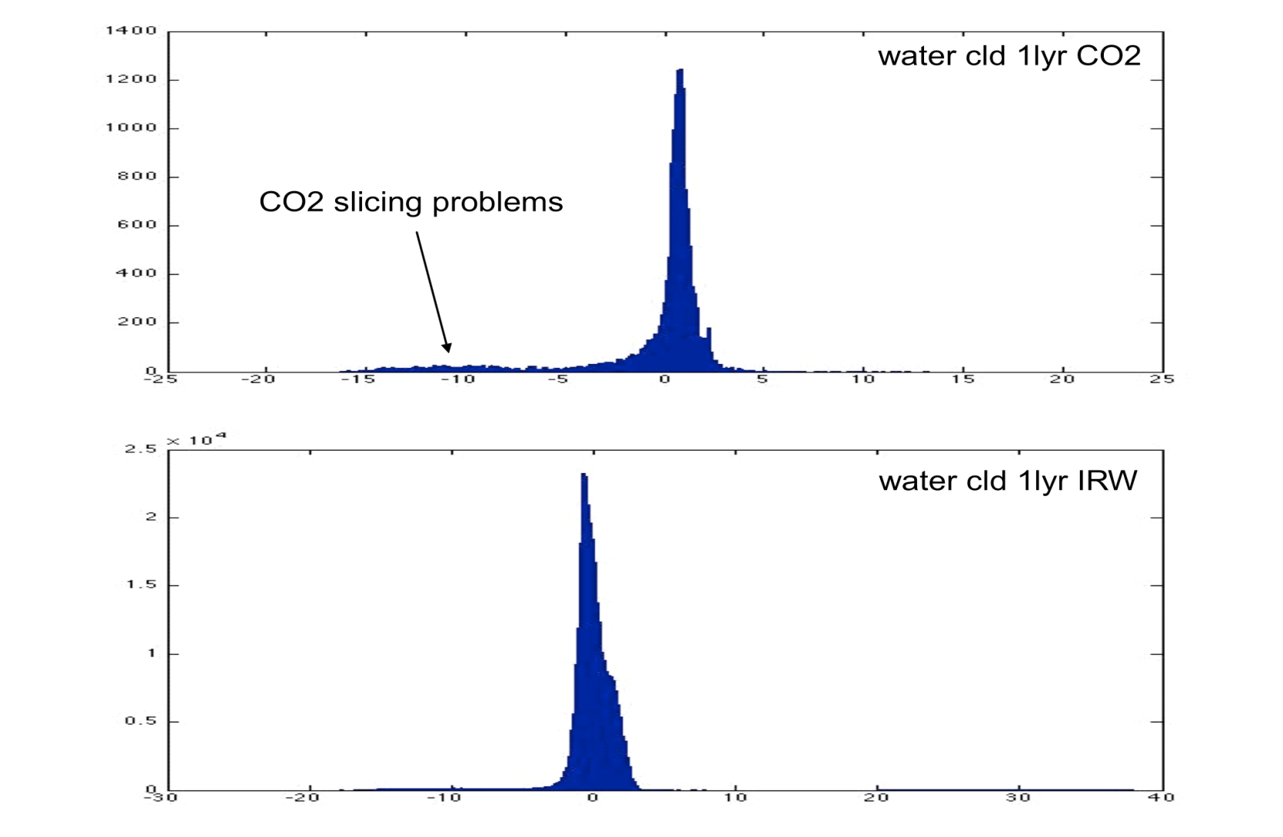
Avoid CO2 slicing solutions for water clouds
Number for
Aug 2006
CTH MODIS - CALIOP
km
Number for
Aug 2006
CTH MODIS - CALIOP
km

Slide 34
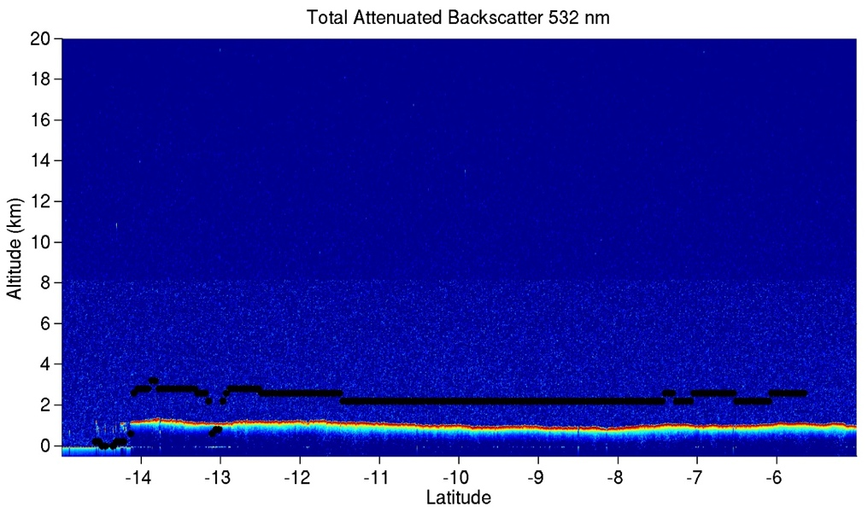
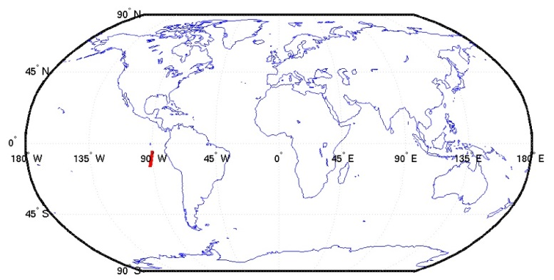
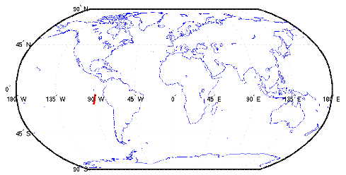
Marine Stratus CTH Over-Estimated
_{MODIS CTH}
_{CALIOP CTH}
Notes:
34

Slide 35
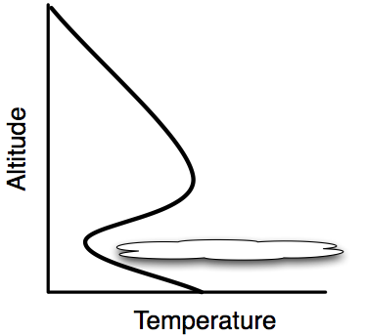
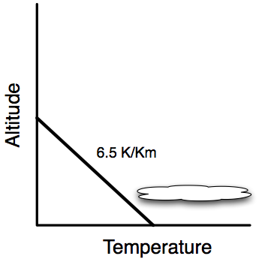
Marine Stratus Correction for Low Level Inversion
Current
Modified (Minnis 1992)
35
Notes:
35

Slide 36
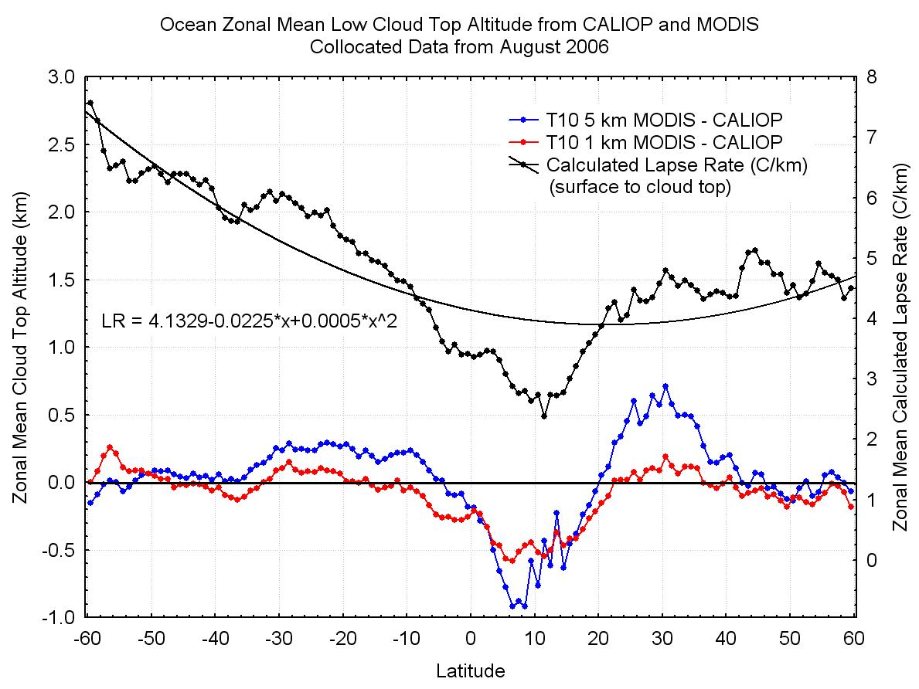

Slide 37
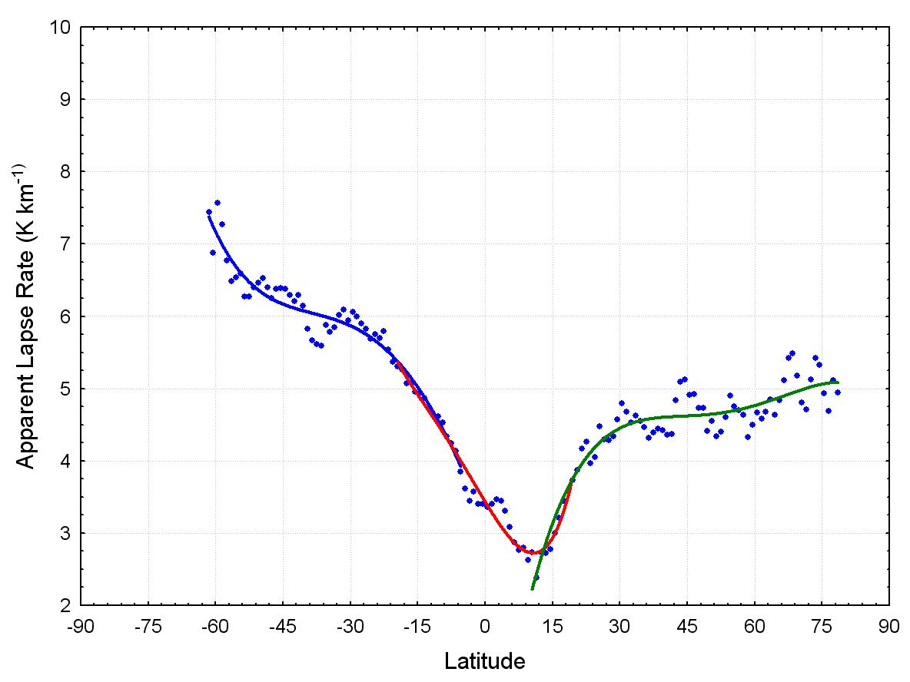
The apparent lapse rates are based on 11-micron differences between clear-sky and measured cloud radiances. Regression coefficients are based on latitude, using curve fitting for three different segments as shown above. Coefficients are provided for each month.

Slide 38
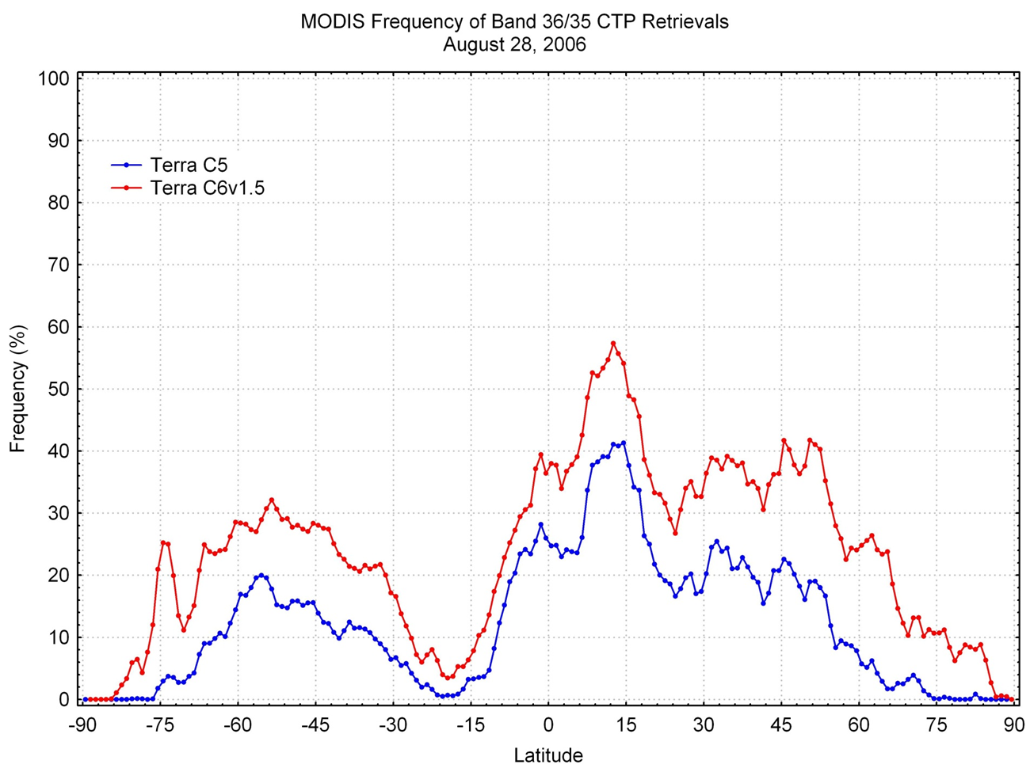
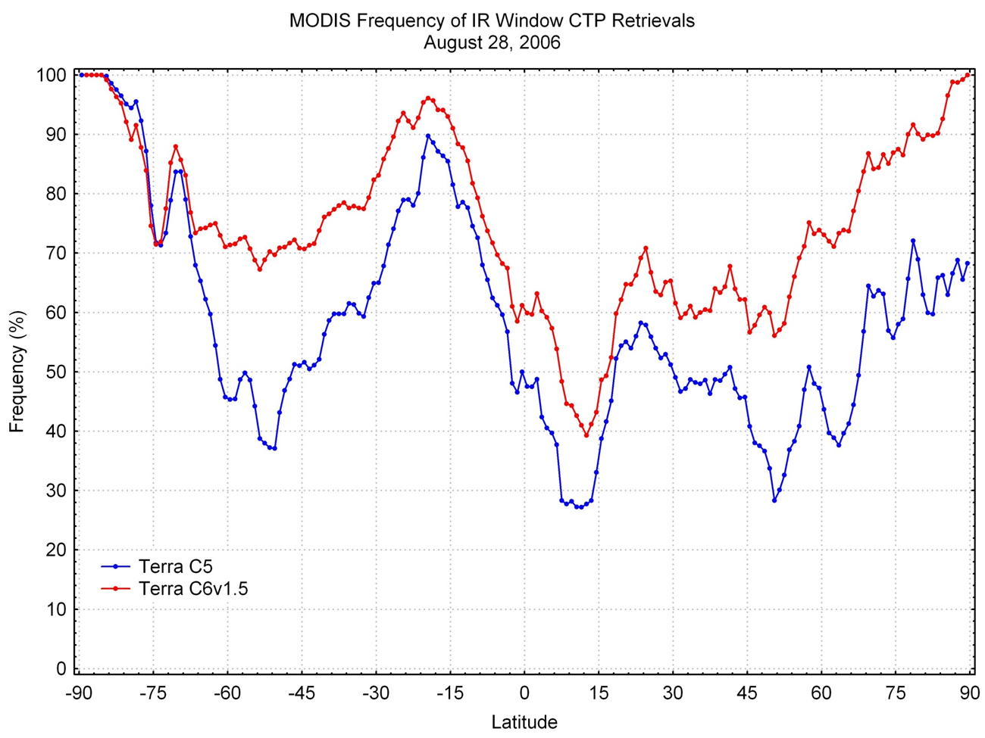
C6 Produces More High CO₂ Slicing and Low IRW Solutions caused by spectral shift and cloud phase discriminator
Collect 5 versus 6 latitudinal distribution of high cloud CO₂ slicing solutions (from 36/35) and low water cloud IRW solutions for Terra MODIS on 28 August 2006 (in % of all cloudy observations)

Slide 39
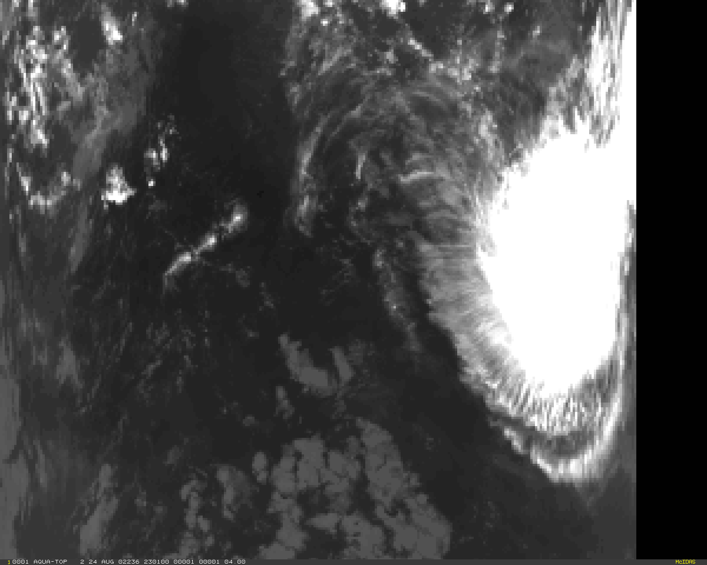
Example of High Clouds in the Equatorial Pacific
IRW
Notes:
Aqua MODIS Band 31. Equatorial Pacific.

Slide 40
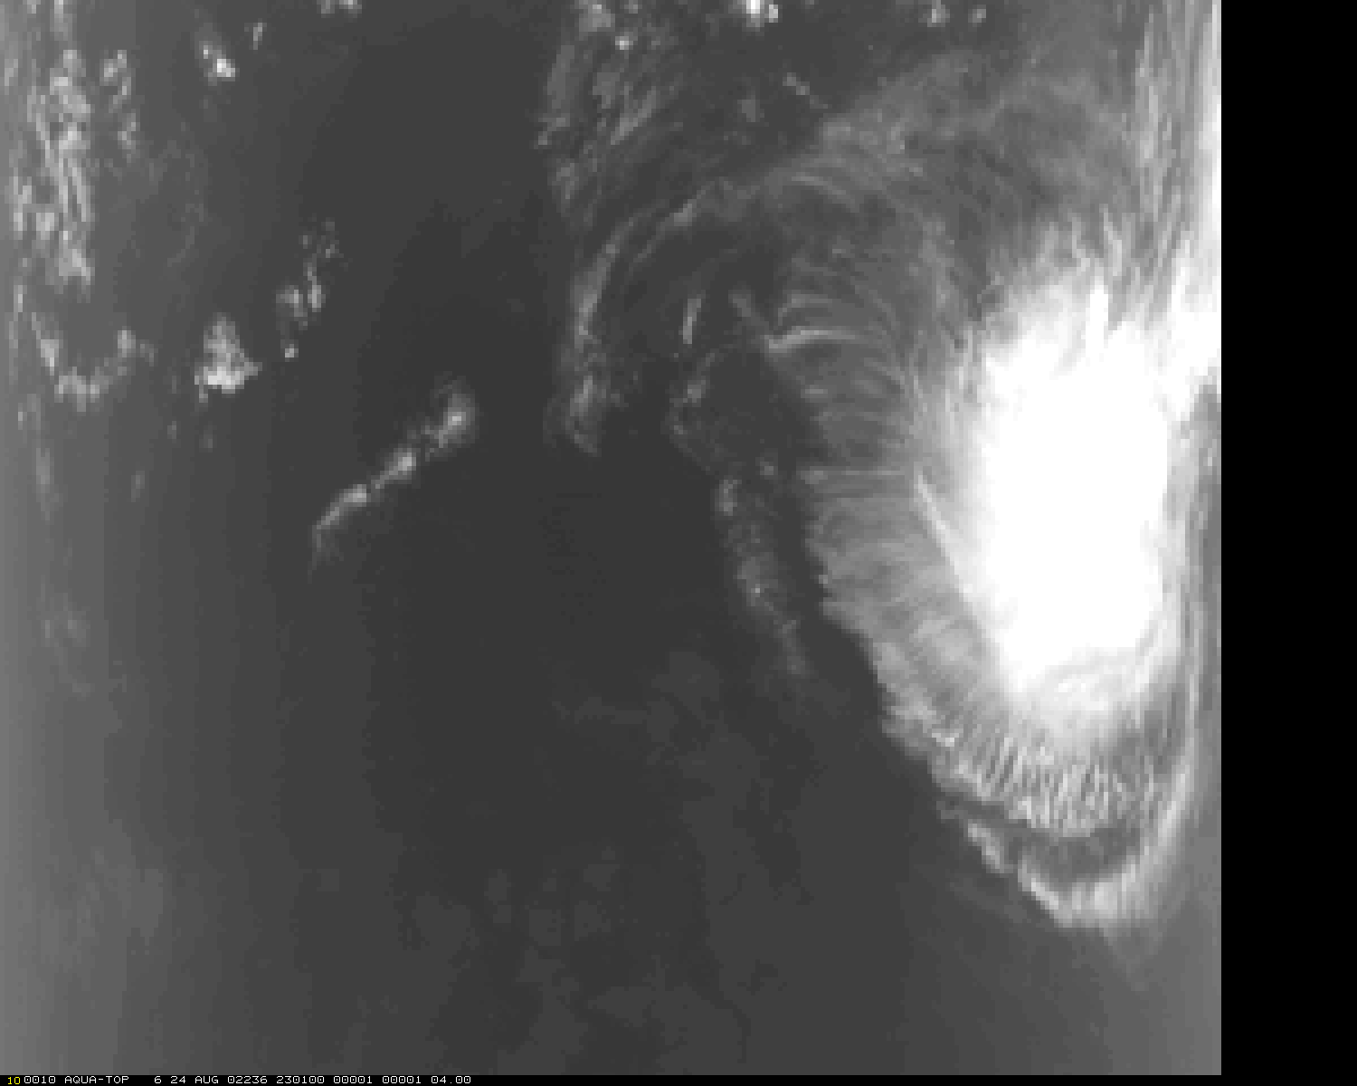
CO2 at 13.9 µm
Notes:
Aqua MODIS Band 35.

Slide 41
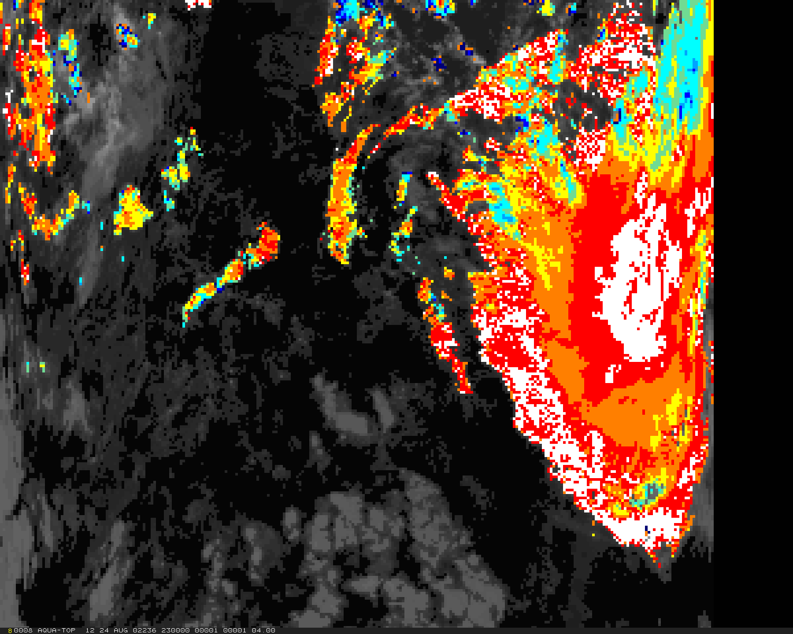
C5 CTP
(hPa) - White 95-125; Red 125-160; Orange 160-190; Yellow 190-225; Aqua 225-260; Cyan 260-300; Sky 300-330; Blue 330-360; Navy 360-390; Light Orange 390-440
Notes:
Collection 5 CTP.

Slide 42
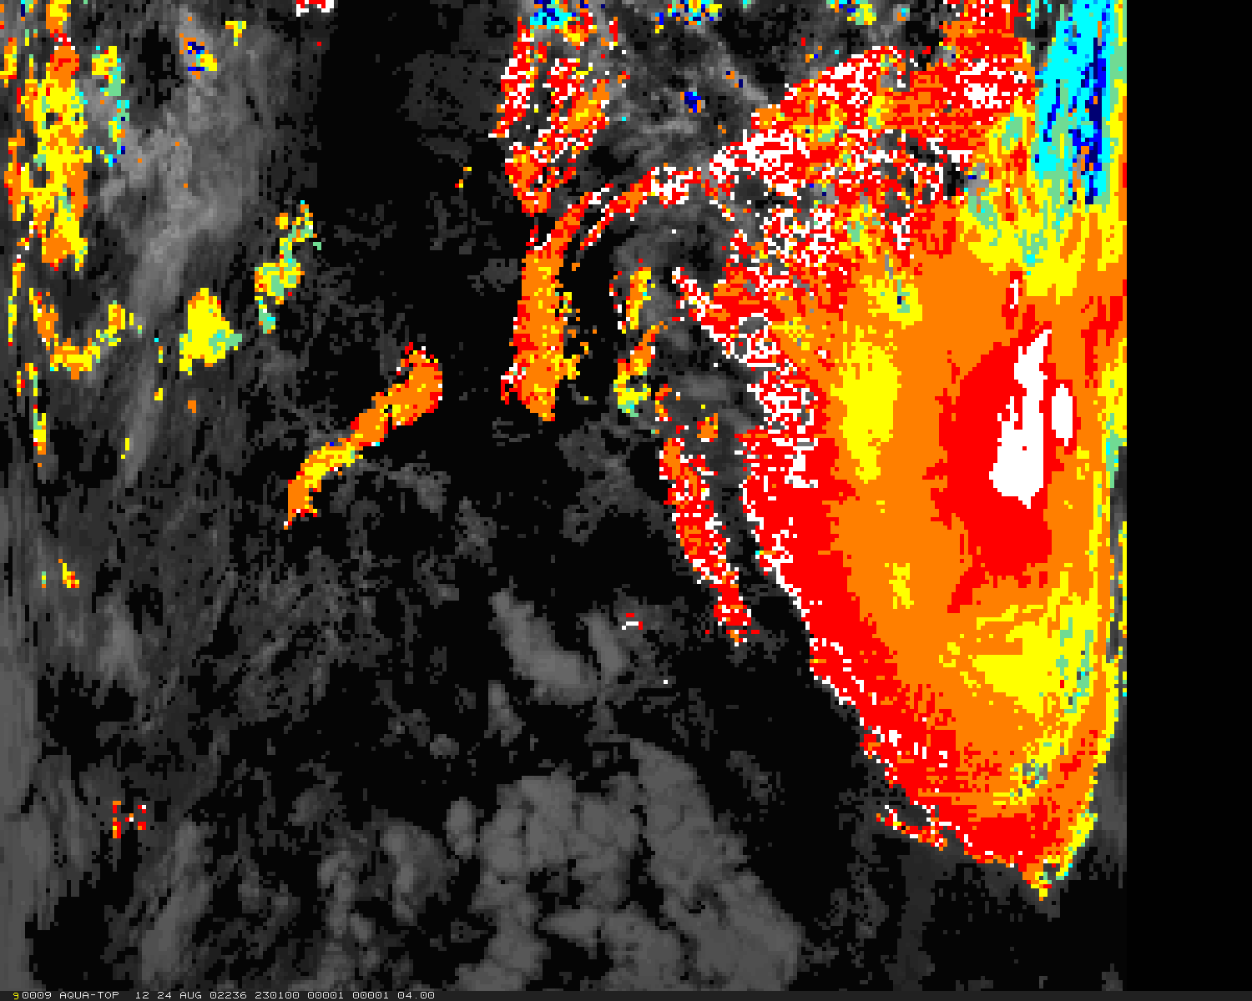
C6 CTP
(hPa) - White 95-125; Red 125-160; Orange 160-190; Yellow 190-225; Aqua 225-260; Cyan 260-300; Sky 300-330; Blue 330-360; Navy 360-390; Light Orange 390-440
Notes:
C6 CTP.

Slide 43
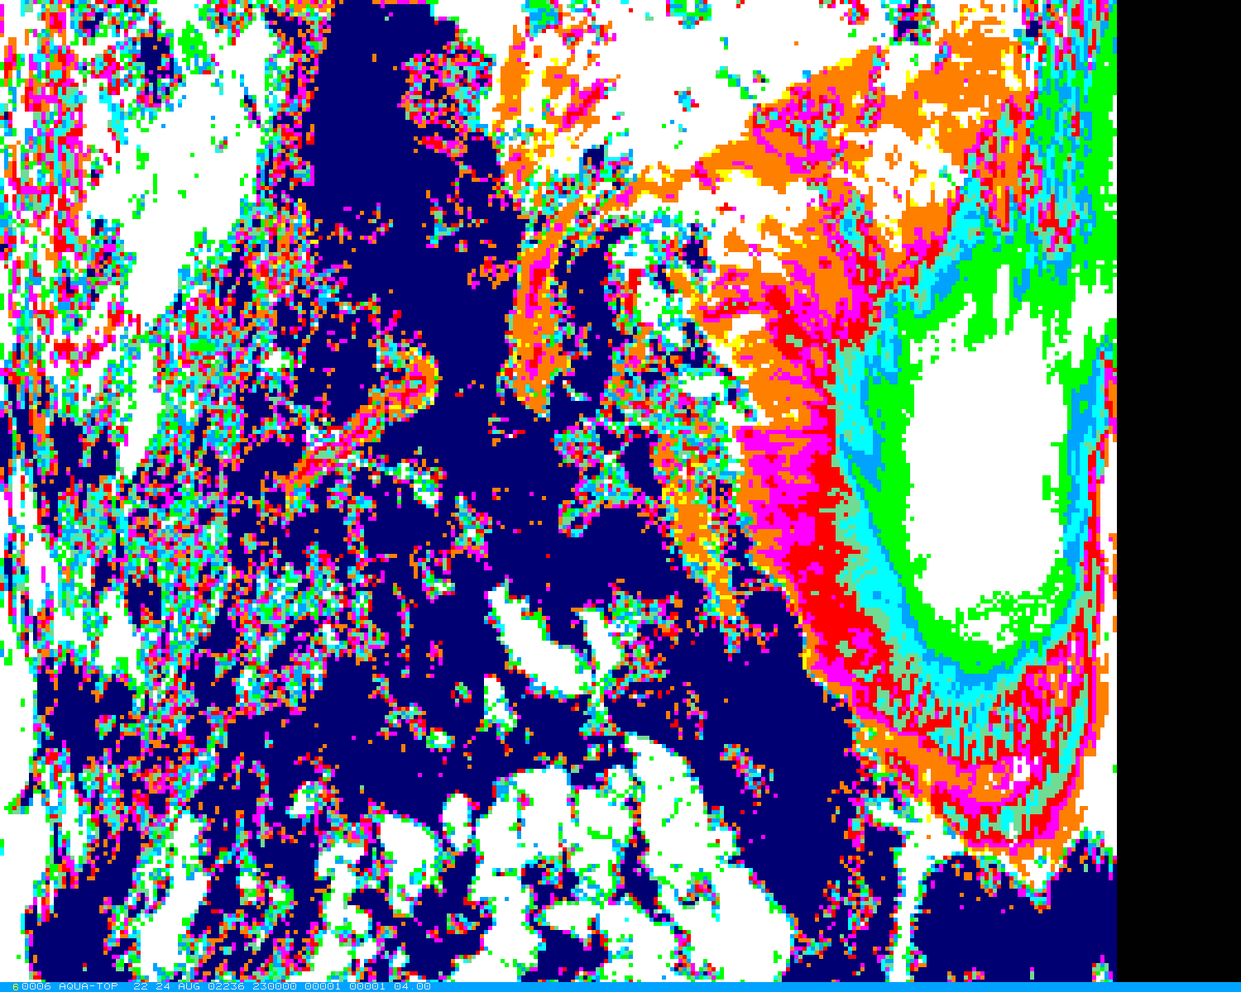
C5 ECA
White 0.9-1.0; Green 0.8-0.9; Sky 0.7-0.8; Cyan 0.6-0.7; Aqua 0.5-0.6;
Red 0.3-0.5; Magenta 0.2-0.3; Orange 0.1-0.2, Yellow 0.0-0.1; Navy Clear
Notes:
C5 ECA.

Slide 44
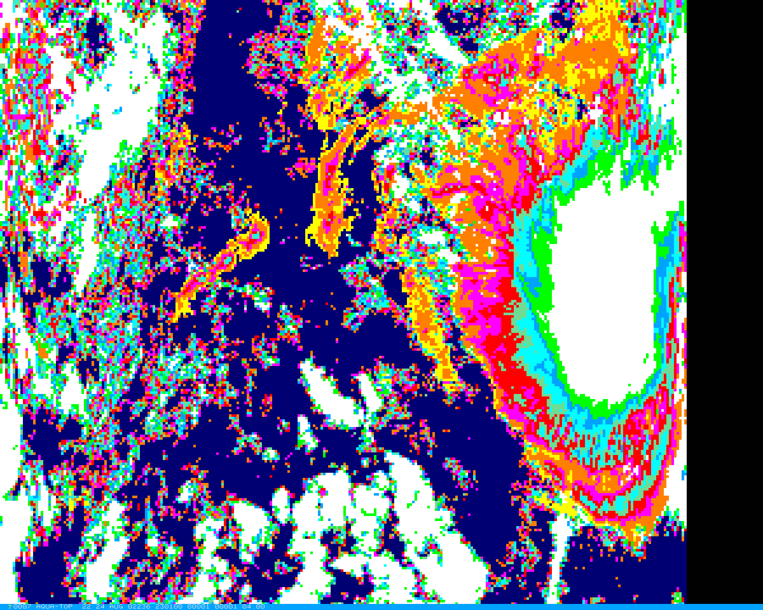
C6 ECA
White 0.9-1.0; Green 0.8-0.9; Sky 0.7-0.8; Cyan 0.6-0.7; Aqua 0.5-0.6;
Red 0.3-0.5; Magenta 0.2-0.3; Orange 0.1-0.2, Yellow 0.0-0.1; Navy Clear
Notes:
C6 ECA.

Slide 45
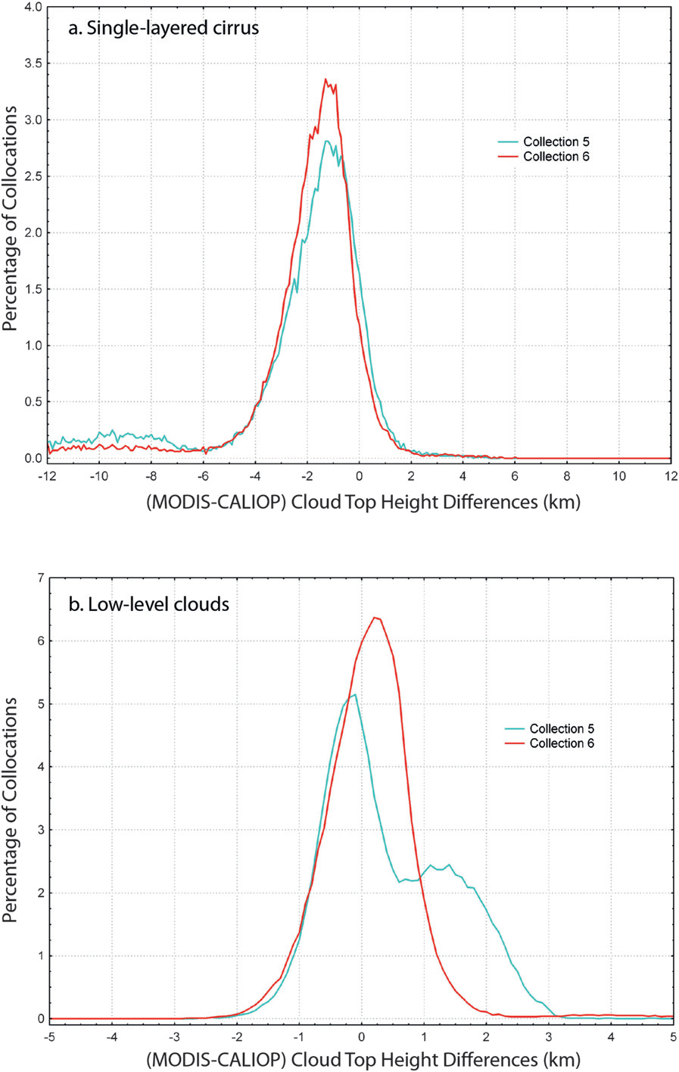
Comparisons with CALIOP Confirm C6 Improvements
Aqua
August 2006

Slide 46
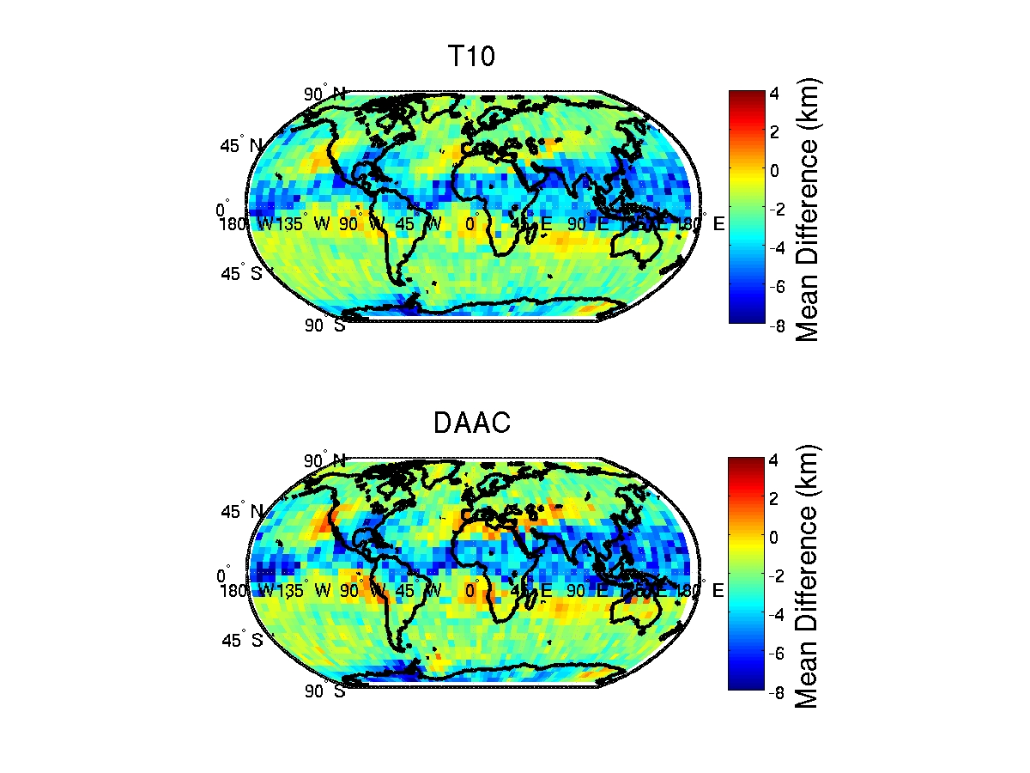
Collect 6
Collect 6
Collect 5

Slide 47
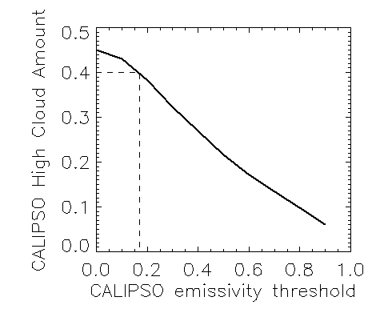
CALIOP Estimates MODIS Thin Cloud Sensitivity
By matching the Aqua MODIS high cloud amount values to CALIPSO’s curve of high cloud amount versus cloud emissivity, we can determine the sensitivity of MODIS to cloud emissivity.
MODIS value
Required CALIPSO emissivity threshold
For the Tropics in August 2006, the MODIS high cloud amounts are about 0.32. This gives a cloud emissivity limit of about 0.3.
Notes:
This is just another way to look at it. To get the same tropical high cloud amount from MODIS and CALIPSO, we have to throw away cells with ec from CALIPSO < 0.3.

Slide 48
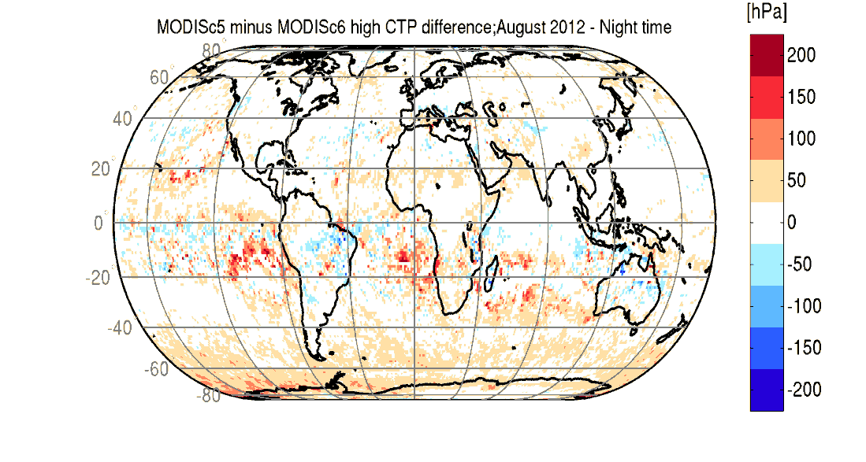
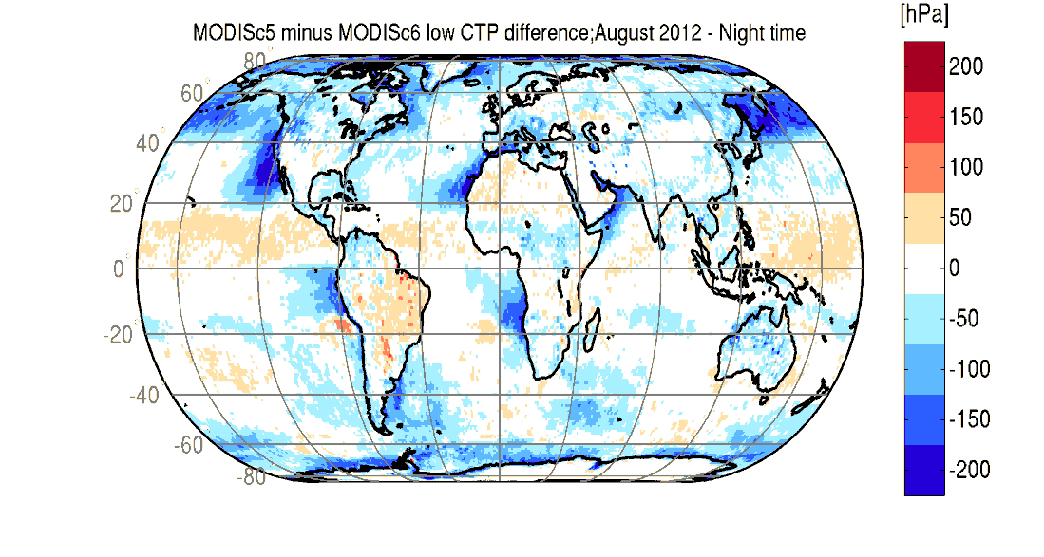
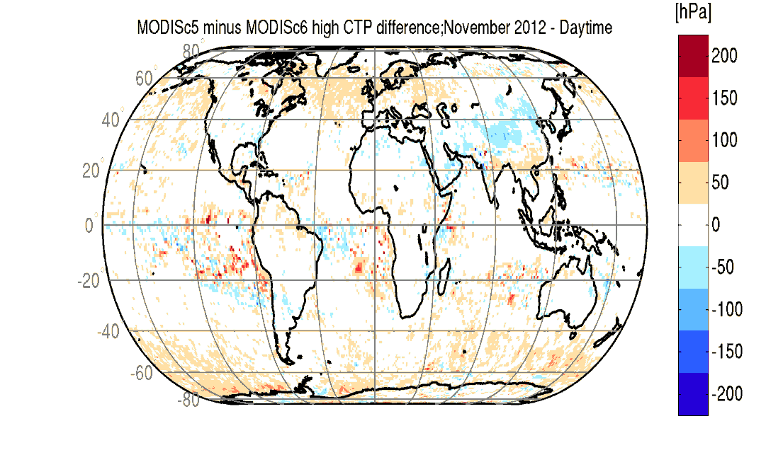
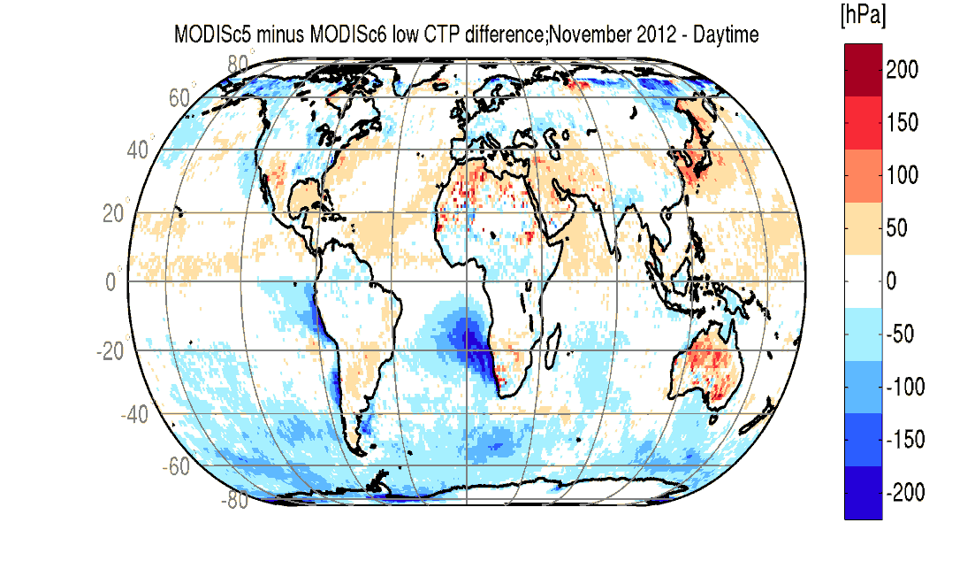
Global Distribution of C5 minus C6 CTP Differences CTPs from Aqua C5 and C6 for August and November 2012 have been compared using the Space-Time-Grid software (Smith et al. JAMC 2013). More transmissive cirrus are being reported as high cloud both day and night. C6 high cloud CTPs in mid-latitude oceans have decreased by ~50 hPa. C6 low marine stratus CTPs have increased by ~150 hPa. C5 to C6 adjustments vary seasonally.

Slide 49
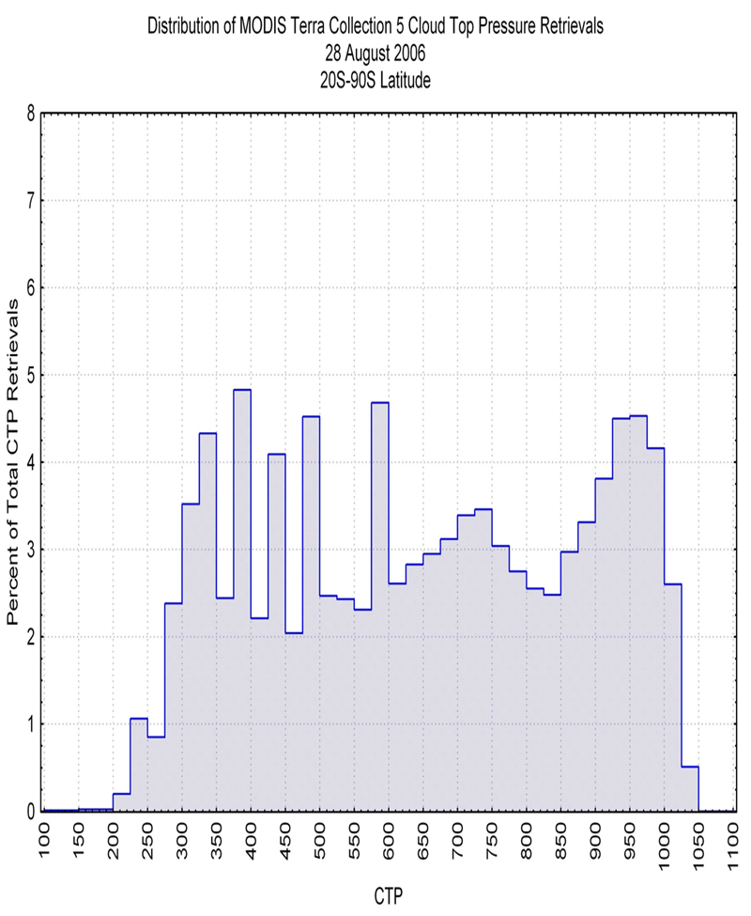
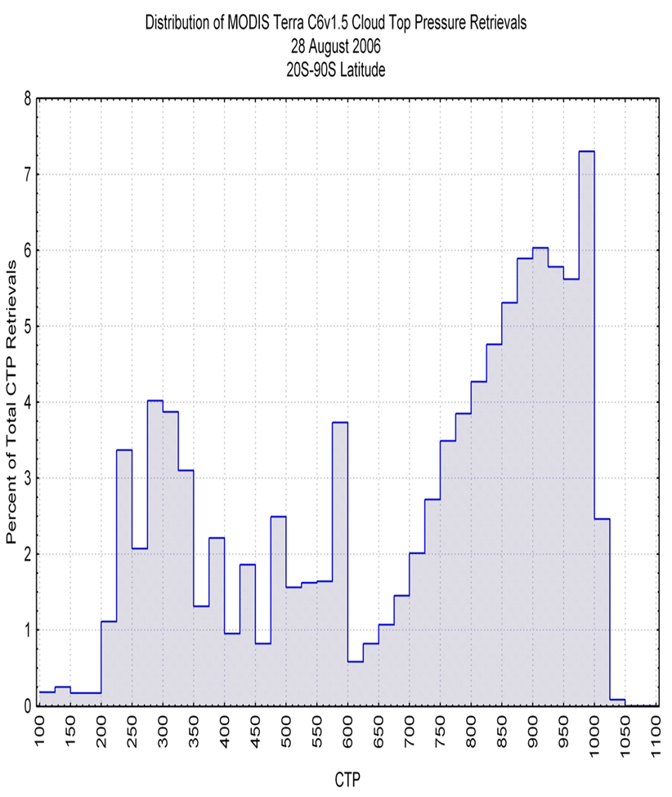
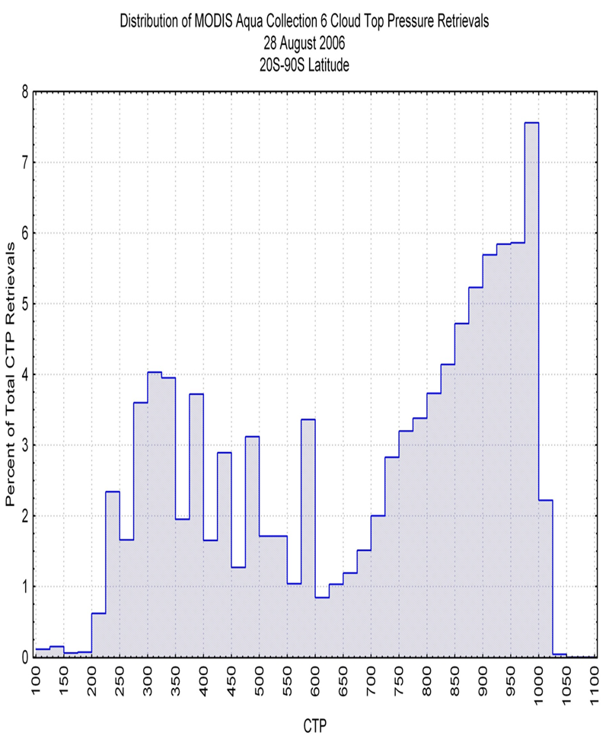
With C6, Vertical Distribution of Terra and Aqua Clouds Comes Into Agreement Vertical distribution of clouds in latitude bands (90S-20S, 20˚S-20˚N, and 20˚N–90˚N) for 28 August 2006 show closer agreement for Terra and Aqua with C6 algorithm changes.
Terra C5 (left) & C6 (middle) along with Aqua C6 (right) results for 90˚S-20˚S

Slide 50
Summary of Changes for Collect 6 (MOD06CT & MYD06CT)
Lower "noise" thresholds (clear minus cloudy radiances required to indicate cloud presence in CO₂ bands) enabling more CO₂ slicing solutions for high thin clouds.
Implement CO₂ spectral band shifts suggested by Tobin et al. (JGR 2006) for Terra and Aqua MODIS.
Adjust ozone profile between 10 and 100 hPa to GDAS values instead of using climatology (so that CO₂ radiances influenced by O₃ profiles are calculated correctly).
Incorporate sinusoidal CO2 increase.
Prohibit CO₂ slicing solutions for water clouds; use only IRW solution. Avoid IRW solutions for ice clouds; use CO₂ slicing whenever possible.
Restrict CO₂ solution to the appropriate part of troposphere (determined by CO₂ band weighting functions so 36/35 < 450 hPa, 35/34 < 550 hPa, and 34/33 < 650 hPa).
Implement marine stratus improvement where a constant lapse rate is assumed in low level inversions according to latitude region.
Add Upper Troposphere / Lower Stratosphere Flag.
Use Beta-ratios to determine cloud phase.

Slide 51
P
UT/LS Cloud Flag
indicated when BT13.9>BT13.3
x x x x x x
x x x x x
CO₂
above cloud
Cloud
BT13.9
BT13.3
Can also use
WV above cloud when
BTWV>BTIRW
T

Slide 52
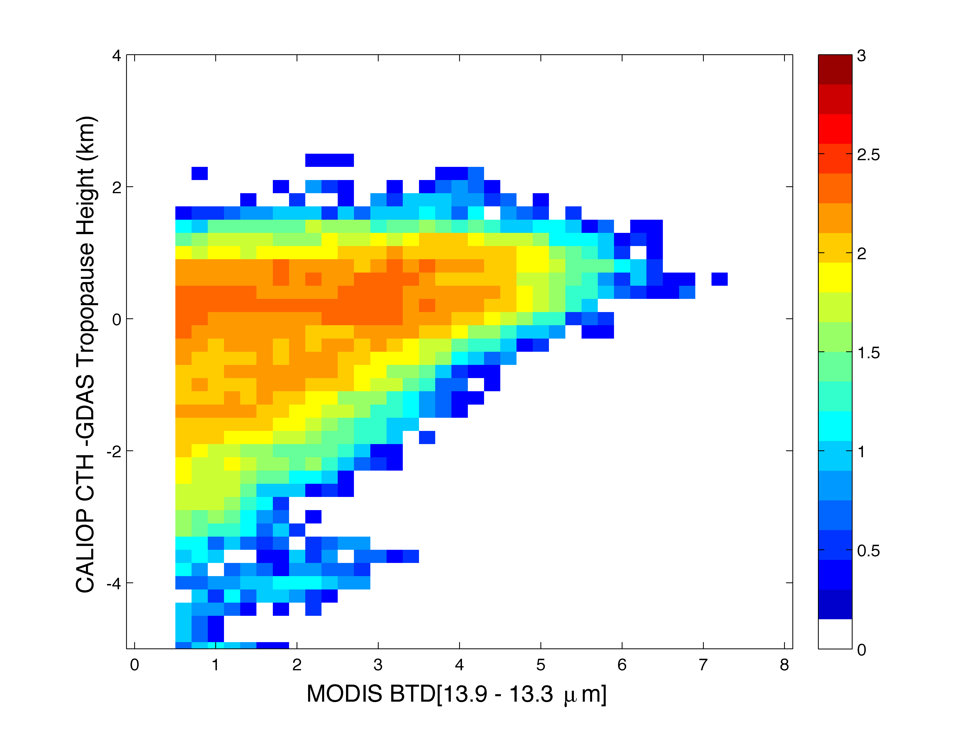
If BT13.9-13.3) > 0.5 C
then
87% of obs
within 2 km
of tropopause
Notes:
Histogram of collocations between CALIOP Version 3 5-km and MODIS Collection 6 1-km products for August, 2006. MODIS brightness temperature differences BTD[13.9-13.3 µm] are shown as a function of the difference between the CALIOP cloud-top height (CTH) and the tropopause height. The tropopause height is determined from the temperature profiles in the GDAS model at the closest time and location to the MODIS data. The collocated data are from 60˚S-60˚N for both daytime/nighttime conditions over all surfaces, but are filtered for single-layered, overcast clouds (CALIOP QC flag ≥ 18). The colors are in log10 scale.
95.9% of the collocated CALIOP cloud heights (and 88.6% of the MODIS cloud heights) were within 2 km of the tropopause

Slide 53
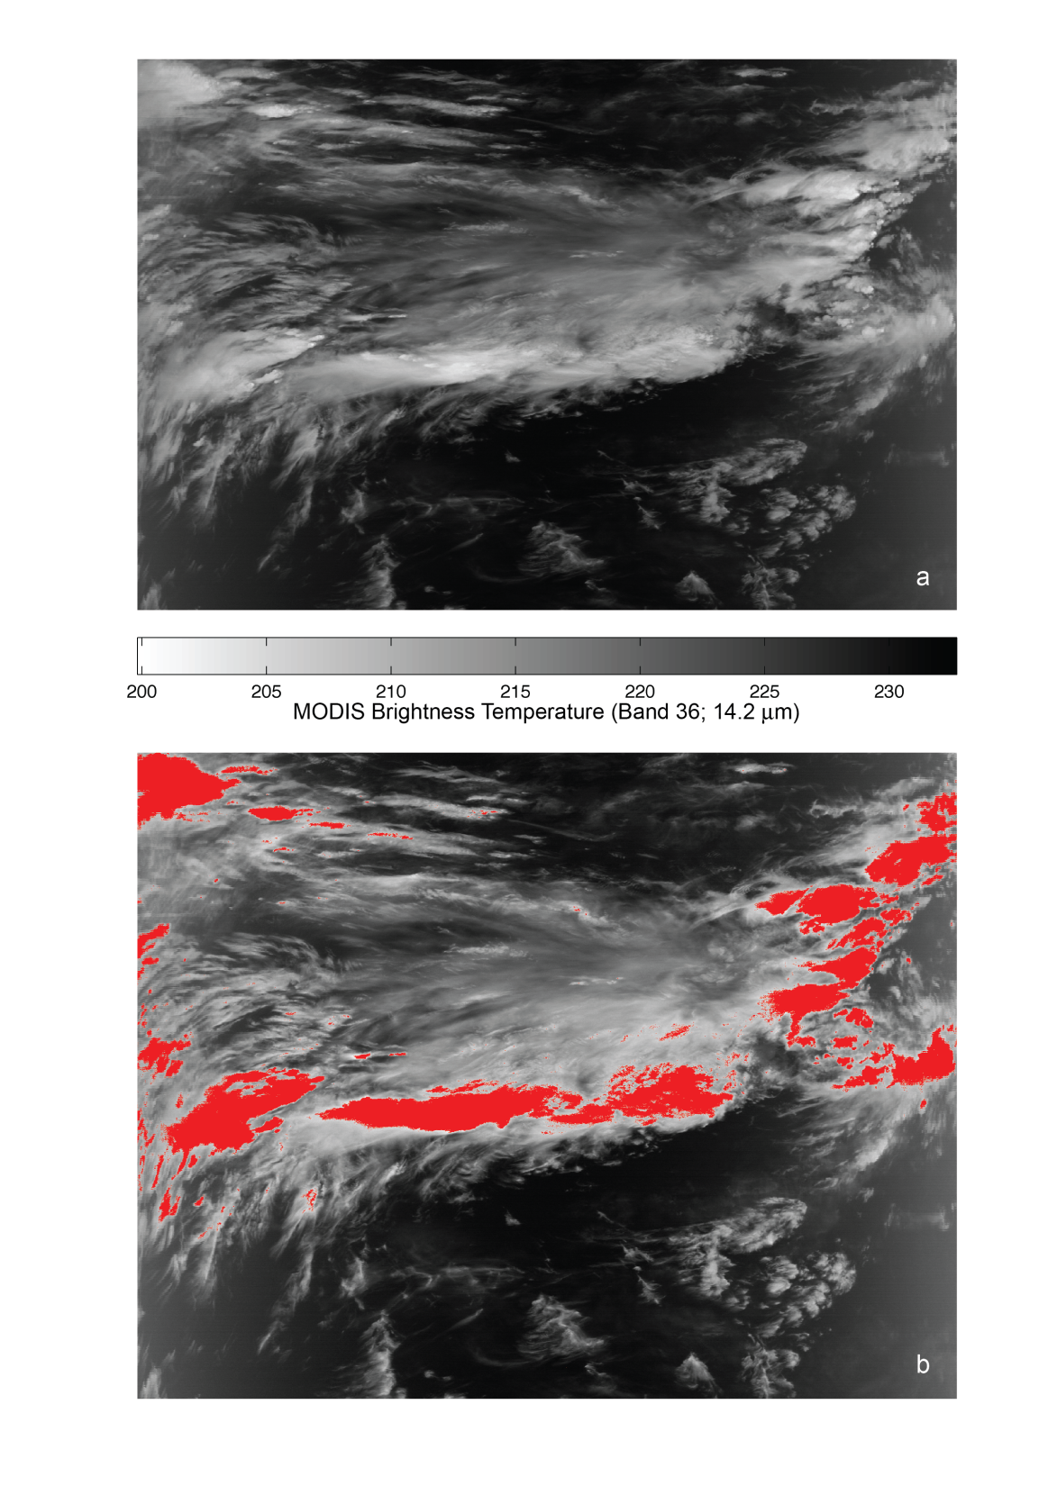
UTLS Clouds (flagged in red)
Notes:
Detection of clouds in the upper troposphere/lower stratosphere (UT/LS) for a MODIS granule at 0800UTC on 28 August, 2006, over the Indian Ocean. (a) Brightness temperatures (K) for MODIS band 36 (14.2 m), (b) 1-km pixels identified with the UT/LS cloud test are painted in red.

Slide 54
IR Phase Modifications
Bryan A. Baum, Richard Frey, and Andrew Heidinger
Collection 5:
- Based on 8.5/11-µm BTs and their differences
- Provided at 5-km resolution
Collection 6:
Supplement BT/BTD tests with emissivity ratios (b ratio)
b ratios are based on 7.3, 8.5, 11, 12-µm bands
Use of b ratio mitigates influence of the surface
Approach imposes new requirements:
- clear-sky radiances, which implies knowledge of…
- atmospheric profiles, surface emissivity, and a fast RT model
This approach can be implemented for only the 1-km products

Slide 55
The Beta ratio is based on cloud emissivity profiles
A cloud emissivity profile for a single band:
e(p) = (I-I_{clr})
–––––––––––––––––––––––––––
[I_{ac}(p) + T_{ac}(p)I_{bb}(p) – I_{clr})]
where
I_{clr} = clear-sky radiance
I_{ac}(p) = above cloud emission at pressure p
I_{bb}(p) = TOA radiance for opaque cloud at pressure p
T_{ac}(p)= above cloud transmission
b_{x,y}(p) = ln[1-e_{c,y}(p)]
––––––––––––––
ln[1-e_{c,x}(p)]
where x and y are two channels used to compute the ratio

Slide 56
Beta ratios used for C6 IR phase tests
8.5/11: has the most sensitivity to cloud phase
11/12: sensitive to cloud opacity; implementation of this pair helps with optically thin clouds (improves phase discrimination for thin cirrus)
7.3/11: sensitive to high versus low clouds; helps with low clouds (one of the issues was a tendency for low-level water clouds to be ringed with ice clouds as the cloud thinned out near the edges)

Slide 57
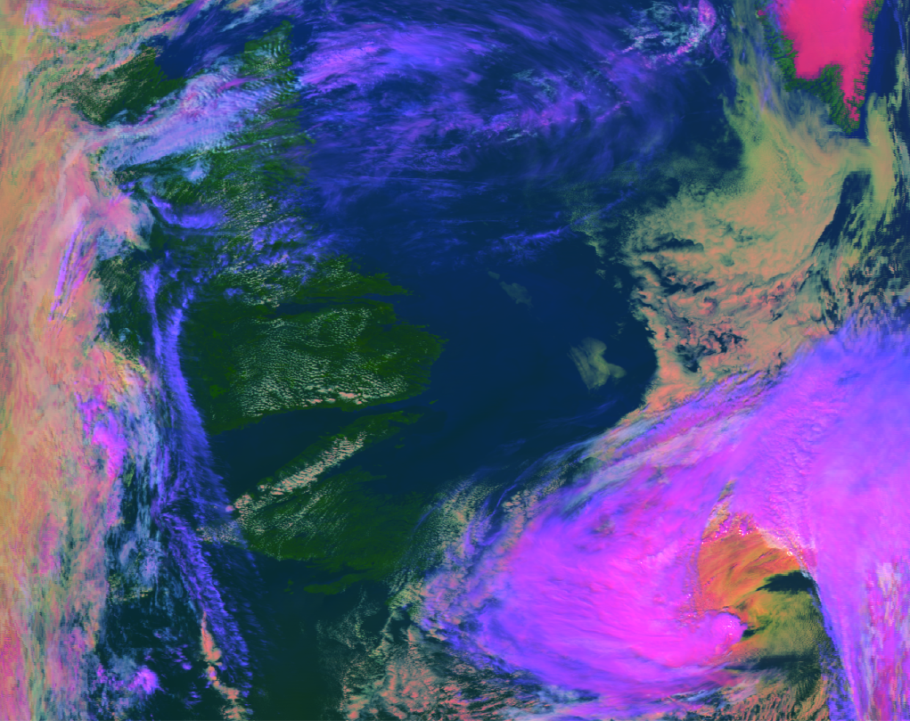
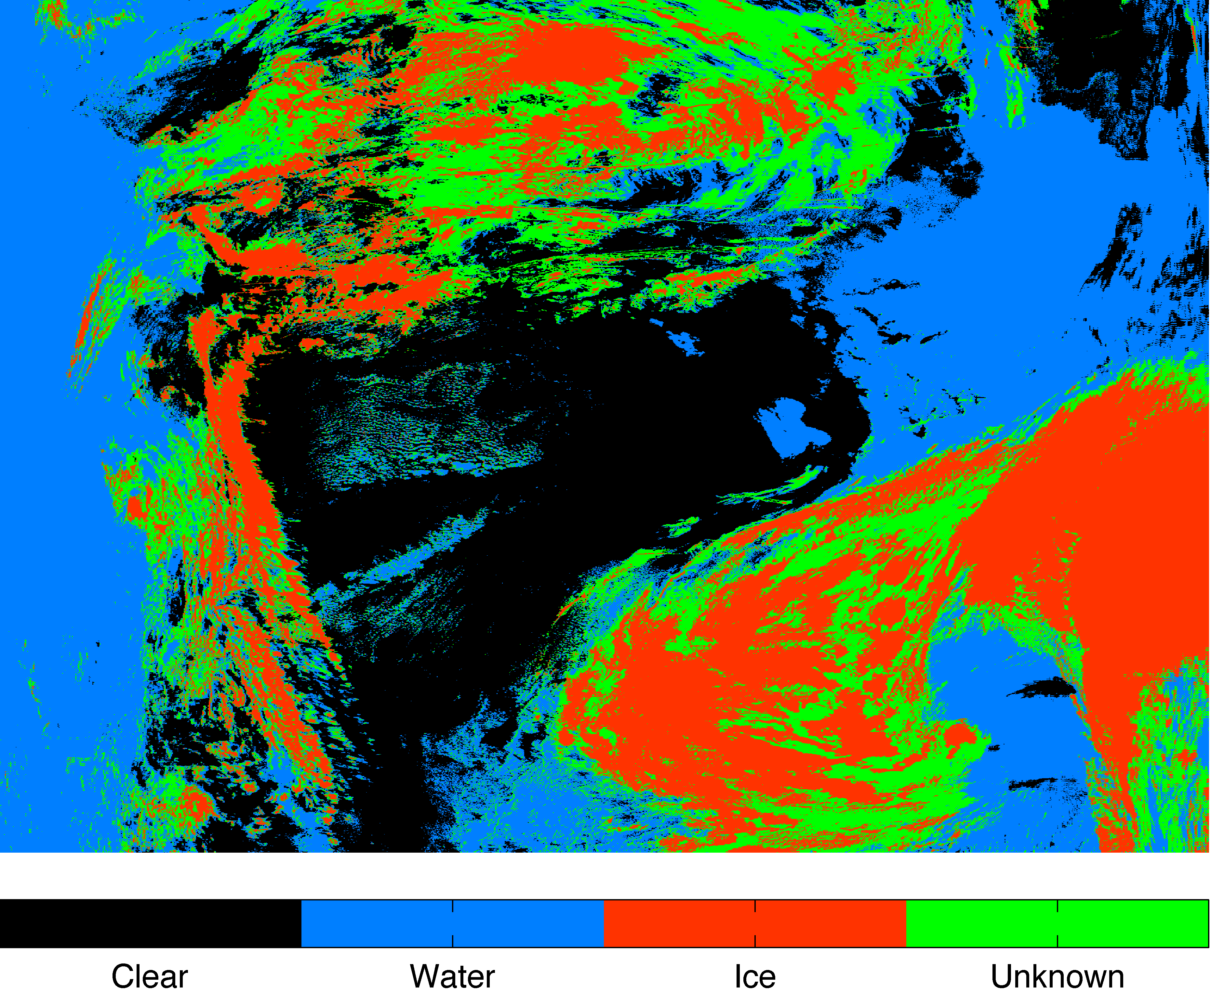
MODIS IR Phase for a granule on 28 August, 2006 at 1630 UTC
Over N. Atlantic Ocean between Newfoundland and Greenland
False color image
Red: 0.65 mm; Green: 2.1 mm; Blue: 11 mm
Thin cirrus: blue
Opaque ice clouds: pink
Water clouds: white/yellow
Snow/ice: magenta (Southern tip of Greenland)
Ocean: dark blue
Land: green
Collection 5 algorithm but with uncertain and mixed phase pixels combined into “uncertain” category

Slide 58
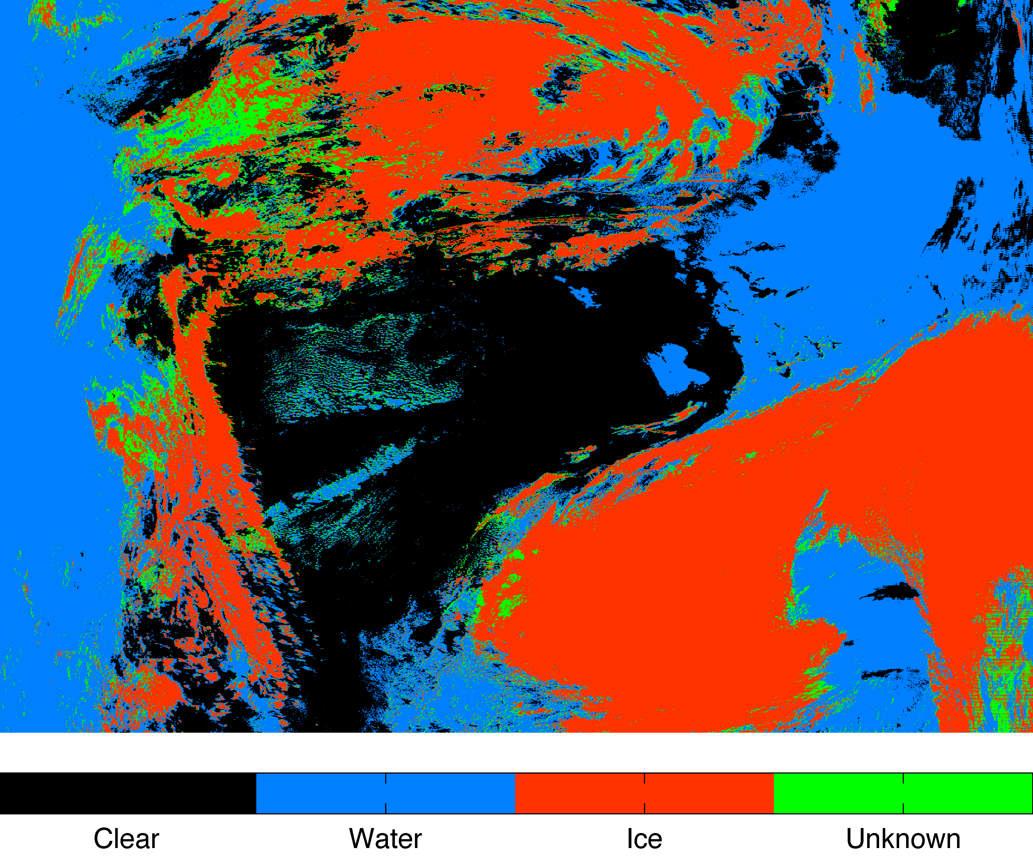
MODIS IR Phase for a granule on 28 August, 2006 at 1630 UTC
Over N. Atlantic Ocean between Newfoundland and Greenland
False color image
Red: 0.65 mm; Green: 2.1 mm; Blue: 11 mm
Collection 6 algorithm:
Propose 3 categories, deleting mixed phase since there is no justification for this category

Slide 59
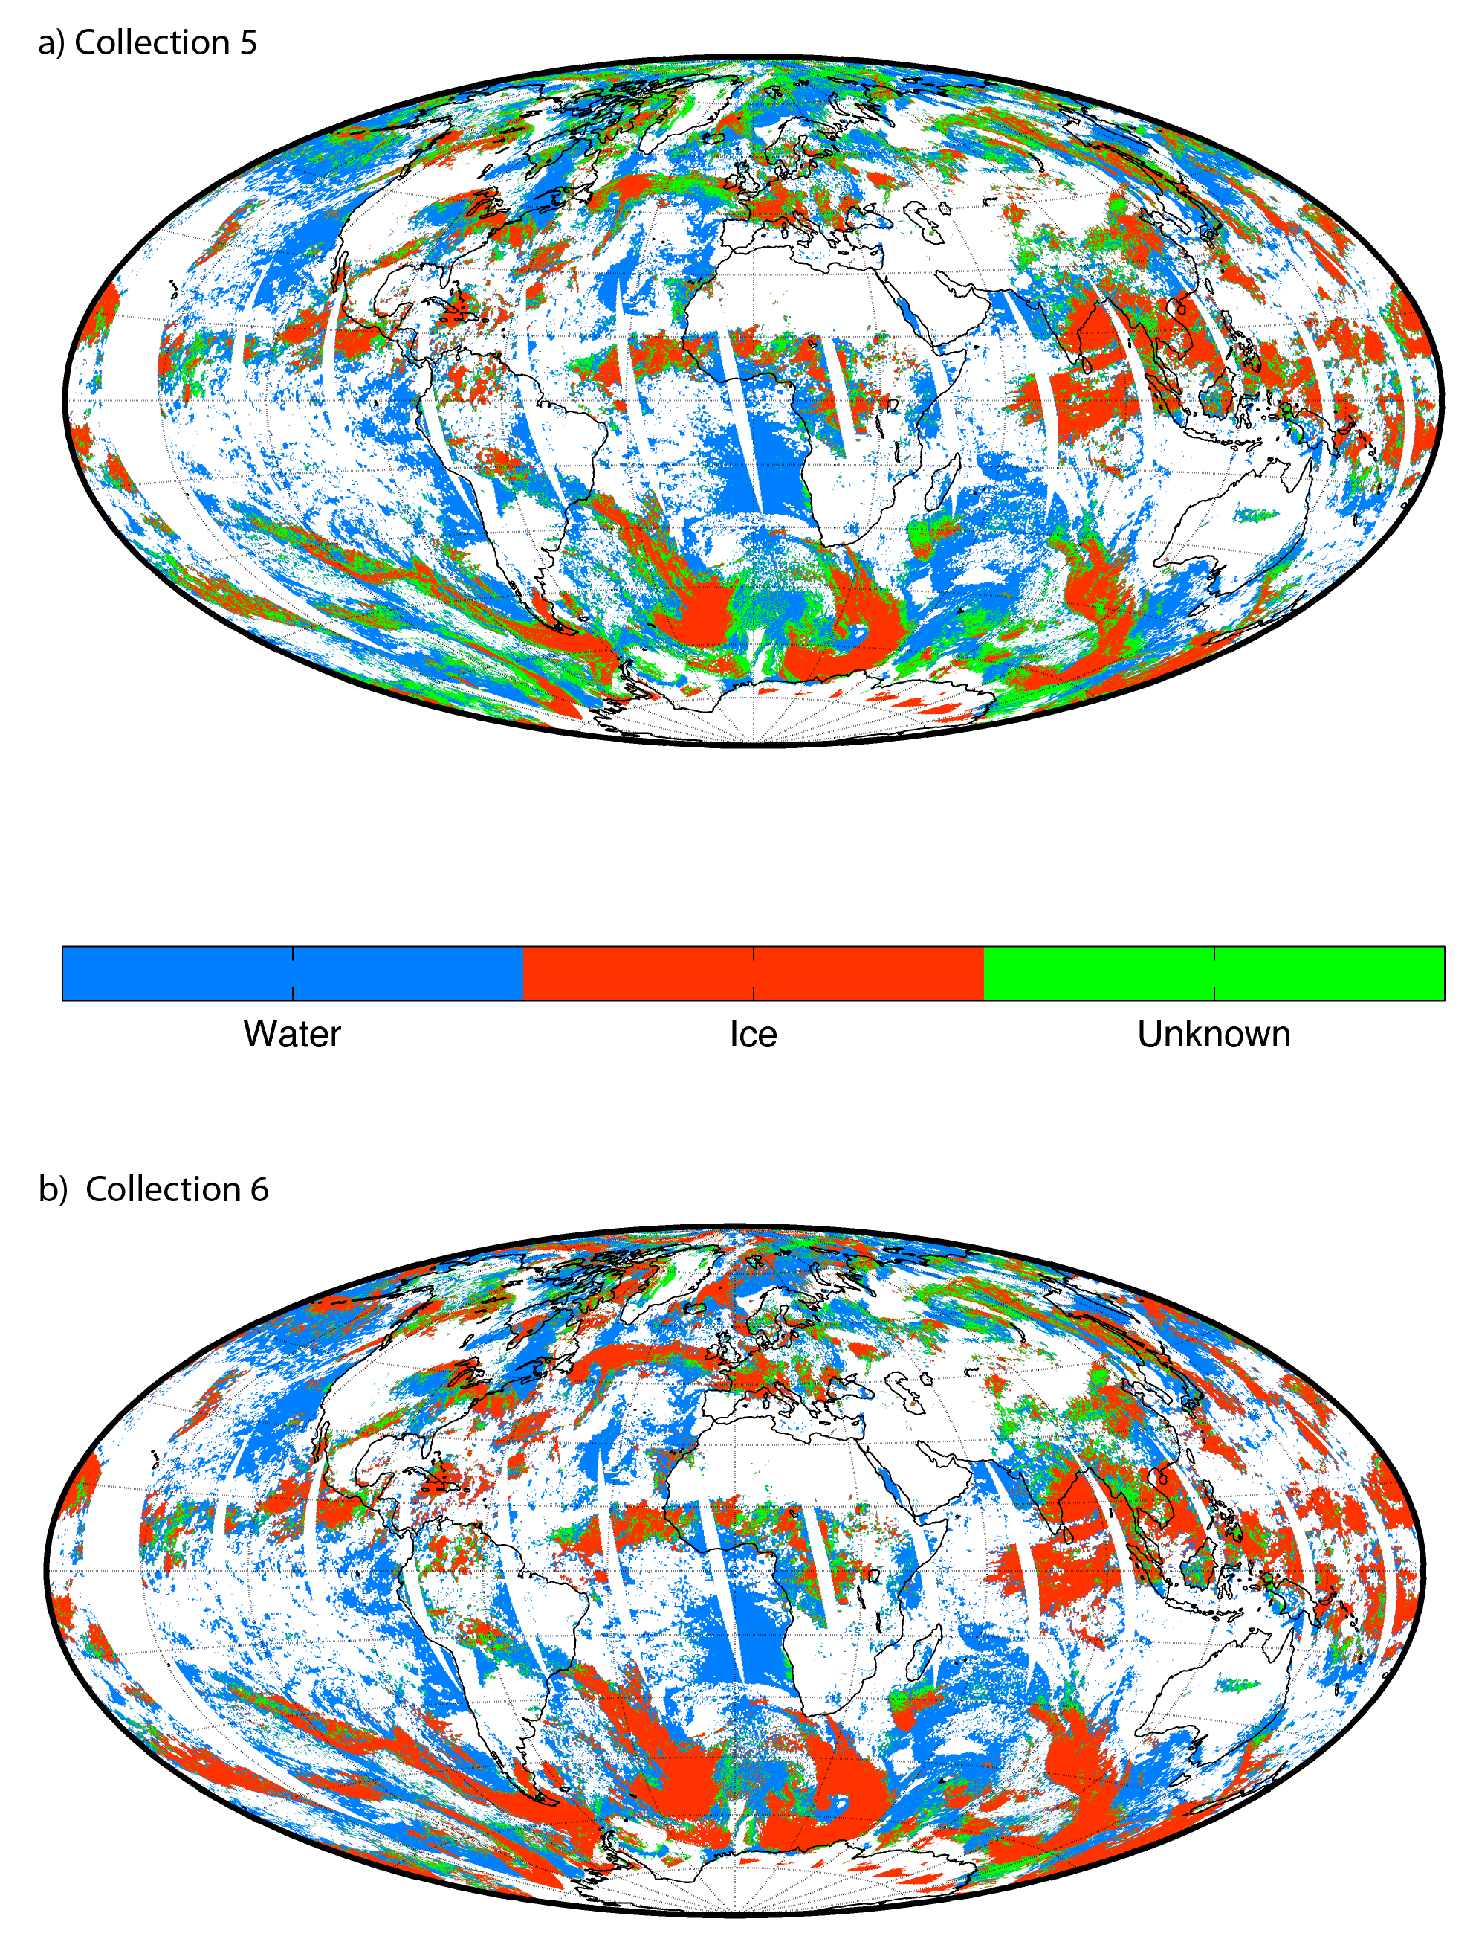
For C5, most of the uncertain phase pixels occurred in the storm tracks, i.e., at high latitudes
For C6, there are many less uncertain phase retrievals now that cirrus is more likely to be identified as ice phase clouds

Slide 60
Conclusions on CO2 Slicing CTH Algorithm Adjustments
The largest cloud height errors (>15 km) result from not using CO2 slicing
Spectral shifts reduce the bias in observed minus calculated radiances
Reducing the cloud detection threshold increases thin cloud sensitivity and produces more CO2 slicing solutions so that CTPs are decreased for high clouds
A high bias in marine stratus CTHs is mitigated by assuming a latitudinally dependent wet lapse rate
Using β-ratio cloud phase algorithm produces fewer uncertain retrievals and cirrus is more likely to be identified as ice
Vertical distributions of Terra and Aqua CTPs show better agreement
Making multiple passes through large data sets was necessary
Using CALIOP as a reference was invaluable
Notes:
60

Slide 61
Example MODIS Collection 6 Results monthly statistics of cloud top pressure March 2012 to February 2013
High vs. Low
Day vs. Night
Filtering and aggregation based on STG method described in Smith et al. (2013) JAMC
Richard Frey, Bryan Baum, Nadia Smith,
Nick Bearson, and Paul Menzel

Slide 62
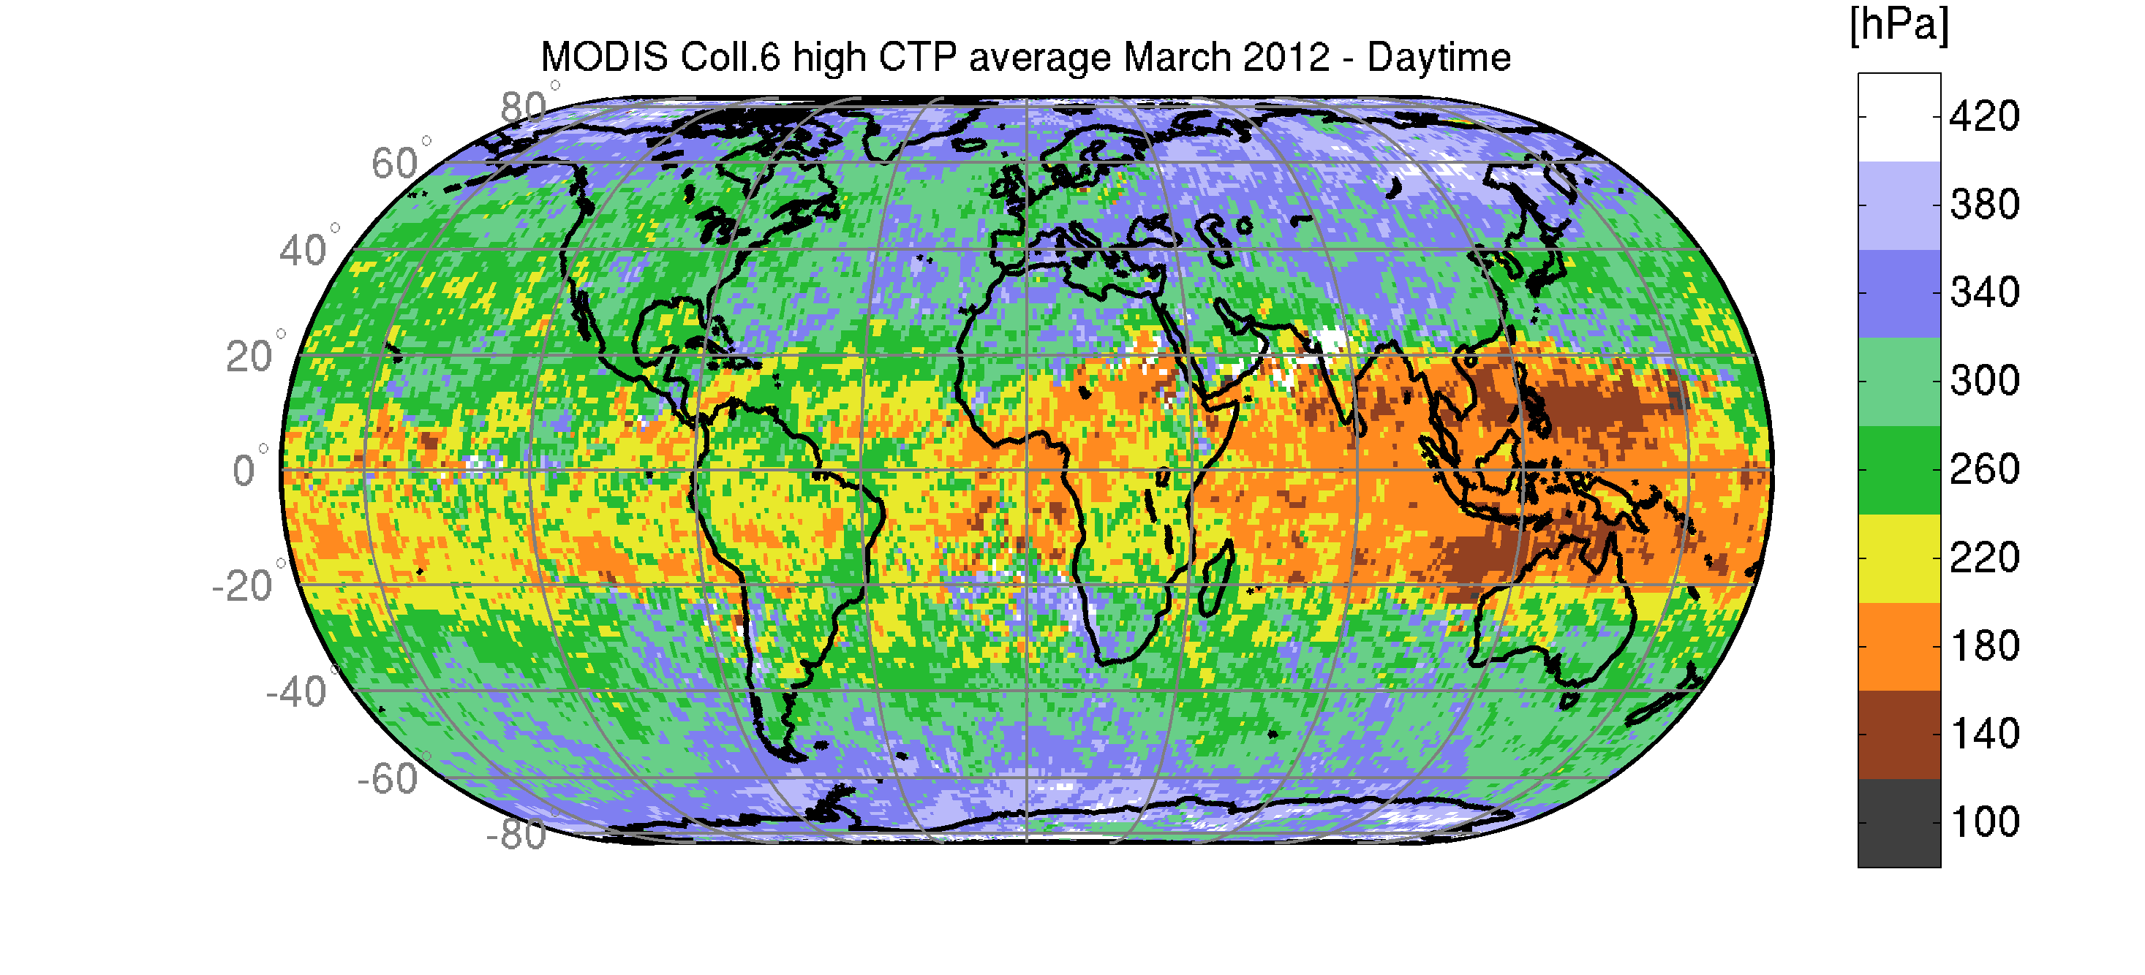
CTP average [hPa]
CTP frequency [%]
Day
March 2012 – HIGH
Night

Slide 63
CTP average [hPa]
CTP frequency [%]
Day
April 2012 – HIGH
Night

Slide 64
CTP average [hPa]
CTP frequency [%]
Day
May 2012 – HIGH
Night

Slide 65
CTP average [hPa]
CTP frequency [%]
Day
June 2012 – HIGH
Night

Slide 66
CTP average [hPa]
CTP frequency [%]
Day
July 2012 – HIGH
Night

Slide 67
CTP average [hPa]
CTP frequency [%]
Day
August 2012 – HIGH
Night

Slide 68
CTP average [hPa]
CTP frequency [%]
Day
September 2012 – HIGH
Night

Slide 69
CTP average [hPa]
CTP frequency [%]
Day
October 2012 – HIGH
Night

Slide 70
CTP average [hPa]
CTP frequency [%]
Day
November 2012 – HIGH
Night

Slide 71
CTP average [hPa]
CTP frequency [%]
Day
December 2012 – HIGH
Night

Slide 72
CTP average [hPa]
CTP frequency [%]
Day
January 2013 – HIGH
Night

Slide 73
CTP average [hPa]
CTP frequency [%]
Day
February 2013 – HIGH
Night

Slide 74
Low Clouds Study

Slide 75
CTP average [hPa]
CTP frequency [%]
Day
March 2012 – LOW
Night

Slide 76
CTP average [hPa]
CTP frequency [%]
Day
April 2012 – LOW
Night

Slide 77
CTP average [hPa]
CTP frequency [%]
Day
May 2012 – LOW
Night

Slide 78
CTP average [hPa]
CTP frequency [%]
Day
June 2012 – LOW
Night

Slide 79
CTP average [hPa]
CTP frequency [%]
Day
July 2012 – LOW
Night

Slide 80
CTP average [hPa]
CTP frequency [%]
Day
August 2012 – LOW
Night

Slide 81
CTP average [hPa]
CTP frequency [%]
Day
September 2012 – LOW
Night

Slide 82
CTP average [hPa]
CTP frequency [%]
Day
October 2012 – LOW
Night

Slide 83
CTP average [hPa]
CTP frequency [%]
Day
November 2012 – LOW
Night

Slide 84
CTP average [hPa]
CTP frequency [%]
Day
December 2012 – LOW
Night

Slide 85
CTP average [hPa]
CTP frequency [%]
Day
January 2013 - LOW
Night

Slide 86
CTP average [hPa]
CTP frequency [%]
Day
February 2013 – LOW
Night

Slide 87
Ten Year Trends

Slide 89
Contents of Output File

Slide 90
The Output File Contains
Time, Lat, Lon, SZA
BTs of bands 29, 31-36
Cloud height method (CO₂ slicing or IR window)
CTP, CTT, N, CEE (solutions selected by algorithm)
CTP (using IRW)
CTPs (from ratios 33/31, 34/33, 35/33, 35/34, 36/35)
Sfc Type
Cloud phase infrared
UTLS Flag

