Slide 1
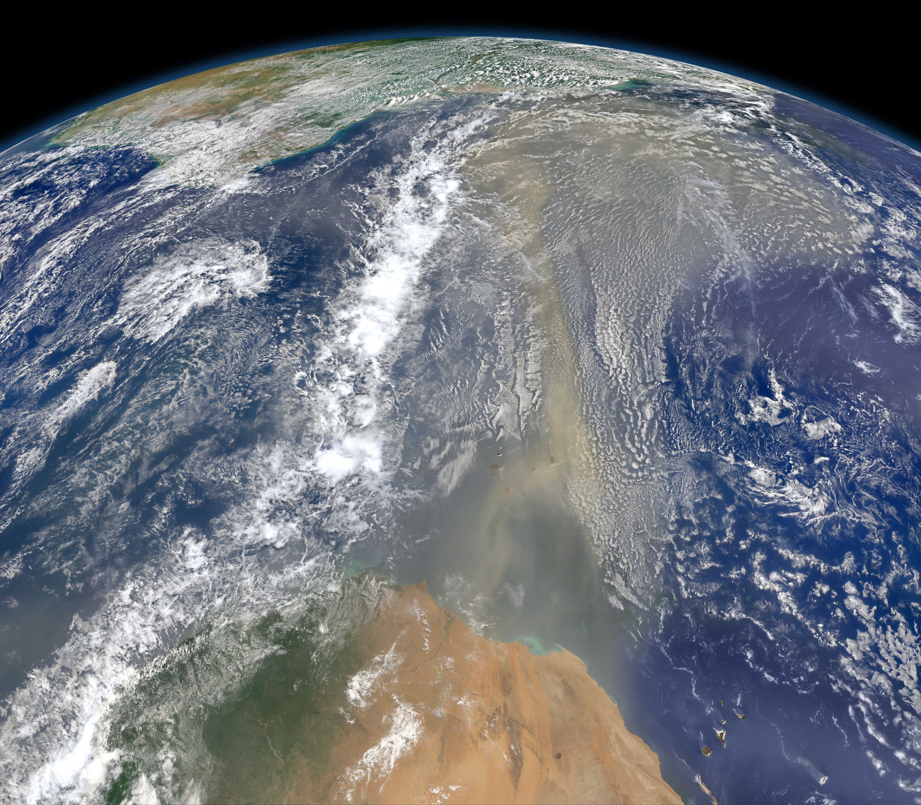
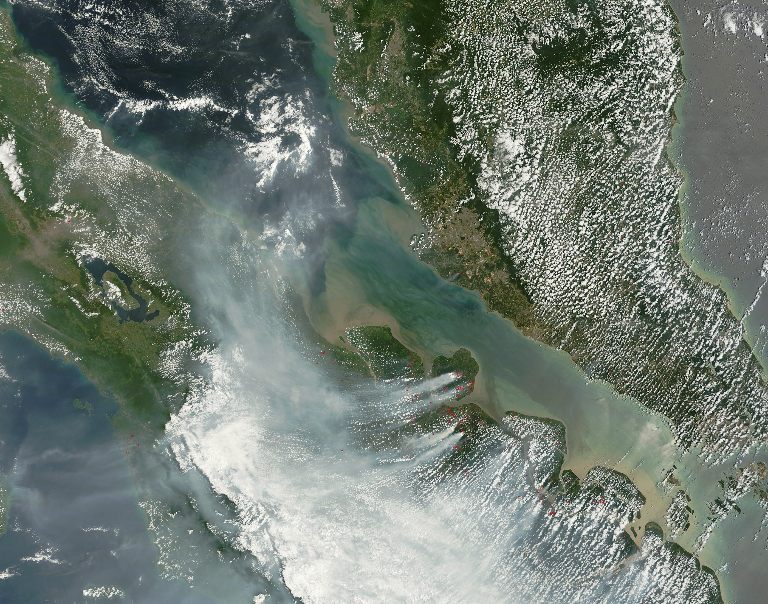
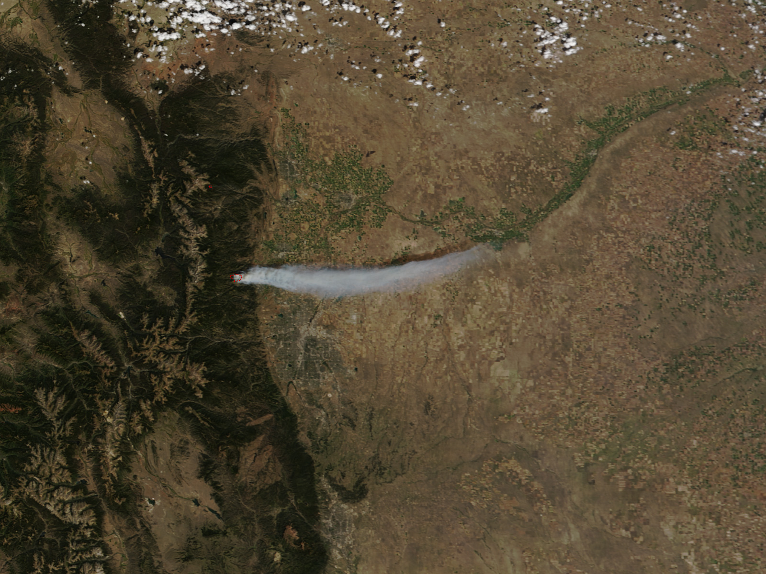
MODIS Atmosphere Team Webinar Series #5:
Overview of the 3 km aerosol product in Collection 6
Leigh Munchak (SSAI/613)
Robert Levy (613, PI), Shana Mattoo (SSAI/613), Lorraine Remer (UMBC)
21 July 2014
Images from NASA Earth Observatory, http://earthobservatory.nasa.gov/

Slide 2
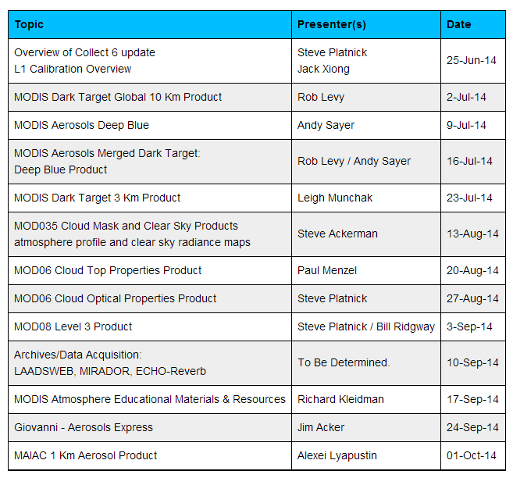
Atmosphere Team Webinar Schedule
http://aerocenter.gsfc.nasa.gov/ext/registration/

Slide 3
Outline
Motivation
Overview (where this new 3 km products fits in the MODIS structure)
Aerosol retrieval strategy and modifications for 3 km
Initial results and validation

Slide 4
Motivation

Slide 5
Aerosols vary on global, regional, and local scales
South America
Malaysia
Sumatra
Boulder
Denver
~ 1000 km
Africa
~ 100 km
~ 20 km
It is difficult to pick one appropriate spatial scale for the variety of aerosol phenomena on Earth

Slide 6
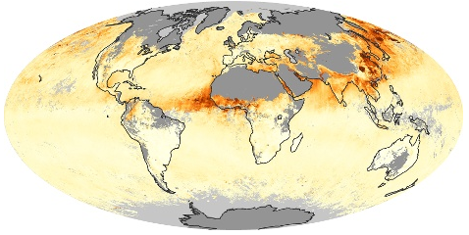
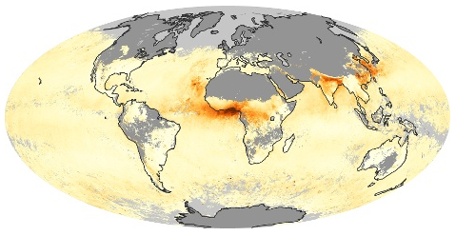
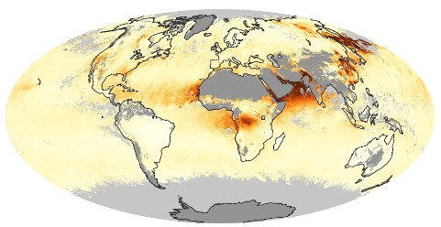
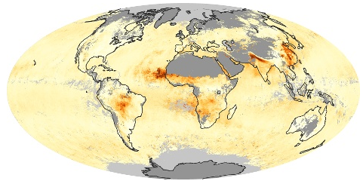

The MODIS aerosol products were originally designed for climate applications. The 10 km spatial scale of the aerosol product reflected that application.
January 2008
April 2008
July 2008
October 2008
AOD at 550 nm

Slide 7
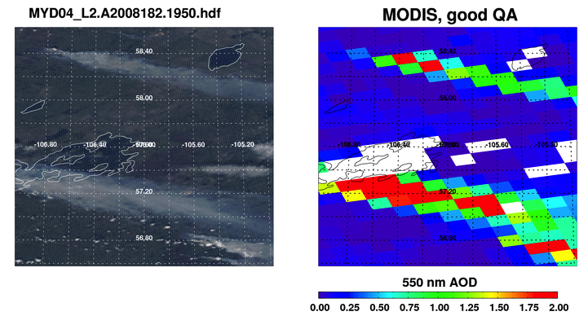
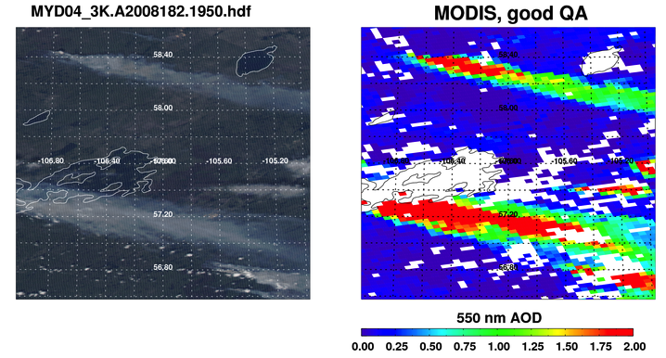
  The problem : Fine scale features are not always adequately resolved by the 10 km spatial scale.
  But, 10 km scale sometimes required to ‘beat down noise’
  Solution? Introduce a new product at 3 km, while maintaining the original 10 km product as well.
MODIS RGB
MODIS 10 km AOD
MODIS 3 km AOD
Notes:
Designed for climate
10 km stable, but doesn’t resolve features
Team will produce 3 km globally

Slide 8
3 km product in the MODIS Architecture

Slide 9
MODIS Atmosphere Team Product Organization and People
L1B MOD/MYD02,03
04 Aerosol
(“Dark Target”)
ATML2
(joint sampled product)
Ancillary Data
R. Levy (GSFC)
S. Platnick
04 Aerosol
(“Deep Blue”)
C. Hsu (GSFC)
08
Daily, 8-day, & monthly aggregations
MOD35/MYD35
Cloud Mask
06 Cloud-Top Properties
06 Cloud Optical Properties
S. Ackerman
S. Platnick
S. Platnick
S. Ackerman
(U. Wisconsin)
06 Cirrus Reflectance
05 Near-IR PW
Level-3
B.-C. Gao (no longer supported)
07 Clear-Sky Profiles
05 IR PW
S.Ackerman, P. Menzel
Level-2
Notes:
PIs or other principal only. Omits a lot of key people but later presentations will get into that.
Not shown: MOD35 and MOD07 both feed into land discipline team processing

Slide 10
MODIS Atmosphere Team Product Organization and People
L1B MOD/MYD02,03
3 km aerosol product comes from “dark target” only
04 Aerosol
(“Dark Target”)
ATML2
(joint sampled product)
Ancillary Data
R. Levy (GSFC)
S. Platnick
04 Aerosol
(“Deep Blue”)
C. Hsu (GSFC)
08
Daily, 8-day, & monthly aggregations
MOD35/MYD35
Cloud Mask
06 Cloud-Top Properties
06 Cloud Optical Properties
S. Ackerman
S. Platnick
S. Platnick
S. Ackerman
(U. Wisconsin)
06 Cirrus Reflectance
05 Near-IR PW
Level-3
B.-C. Gao (no longer supported)
07 Clear-Sky Profiles
05 IR PW
S.Ackerman, P. Menzel
Level-2
Notes:
PIs or other principal only. Omits a lot of key people but later presentations will get into that.
Not shown: MOD35 and MOD07 both feed into land discipline team processing

Slide 11
MODIS Atmosphere Team Product Organization and People
L1B MOD/MYD02,03
04 Aerosol
(“Dark Target”)
ATML2
(joint sampled product)
Ancillary Data
R. Levy (GSFC)
S. Platnick
04 Aerosol
(“Deep Blue”)
C. Hsu (GSFC)
08
Daily, 8-day, & monthly aggregations
MOD35/MYD35
Cloud Mask
06 Cloud-Top Properties
06 Cloud Optical Properties
S. Ackerman
S. Platnick
S. Platnick
S. Ackerman
(U. Wisconsin)
06 Cirrus Reflectance
05 Near-IR PW
Level-3
B.-C. Gao (no longer supported)
3 km does not go into L2 atmosphere product, or Level 3 daily gridded product
07 Clear-Sky Profiles
05 IR PW
S.Ackerman, P. Menzel
Level-2
Notes:
PIs or other principal only. Omits a lot of key people but later presentations will get into that.
Not shown: MOD35 and MOD07 both feed into land discipline team processing

Slide 12
MODIS Standardized Filenaming Convention
NASA Earth Science Data filenames for MODIS
10 km aerosol product: MxD04_L2.AYYYYDDD.HHMM.CCC.YYYYDDDHHMMSS.hdf
3 km aerosol product:
MxD04_3K.AYYYYDDD.HHMM.CCC.YYYYDDDHHMMSS.hdf
Definition of highlighted text:
MxD04 = Earth Science Data Type name (this is code for the “aerosol” product)
x = “O” for Terra or “Y” for Aqua
L2 = Denotes a Level-2 product (or L3 for Level-3, etc.). Changed to 3K for 3 km product.
A = indicates following date/time information is for the acquisition (observation)
YYYYDDD = acquisition year and day-of-year
HHMM = acquisition hour and minute start time
CCC = collection (e.g., ‘006’ for Collection 6)
YYYYDDDHHMMSS = production data and time
hdf = denotes HDF file format

Slide 13
Status of MODIS C6 Production
L1B exists for both Terra and Aqua (MxD02 and MxD03)
Cloud Mask (MxD35) and Atmospheric Profile (MxD07) exist for both Terra and Aqua
Processing of MYD04_3K products from Aqua MODIS started on 12-06-2013 and has completed.
  Aqua L3 expected to begin soon
  Terra reprocessing to start after completion of Aqua L3
Both C6 and C5 processing streams will continue in parallel for about a year before being exclusively C6.
Aerosol algorithm has been ported to work on Near Real Time (NRT from LANCE). 3 km product will be produced in NRT. I don’t know the schedule for production

Slide 14
Aerosol algorithm and modifications for 3 km

Slide 15
Aerosol Algorithm Overview
Our aerosol remote sensing retrieval algorithm has multiple phases:
Organizing Level 1B radiance data into 10 km boxes for each 5 minute granule.
Removing distortion (gas absorption, angular effects) from the satellite signal
Deciding whether over “land” or “ocean”
Separating signal (aerosol) from noise (clouds, surface inhomogeneities, instrument issues, etc), includes “cloud masking”
Correctly interpreting the signal to AOD and aerosol size. “the retrieval”
Assigning quality assurance, reporting retrieved, derived, and diagnostic products. “the post-process”

Slide 16
Aerosol Algorithm Overview
Our aerosol remote sensing retrieval algorithm has multiple phases:
Organizing Level 1B radiance data into 10 km boxes for each 5 minute granule.
Removing distortion (gas absorption, angular effects) from the satellite signal
Deciding whether over “land” or “ocean”
Separating signal (aerosol) from noise (clouds, surface inhomogeneities, instrument issues, etc), includes “cloud masking”
Correctly interpreting the signal to AOD and aerosol size. “the retrieval”
Assigning quality assurance, reporting retrieved, derived, and diagnostic products. “the post-process”
Only changes in the 3 km algorithm

Slide 17
Organize into 20x20
Retrieval boxes of
400 pixels at 0.5 km
resolution
Require minimum 10 pixels over ocean or 12 pixels over land for retrieval (more for high quality)
10 km path
Input MODIS geolocated
spectral reflectance and
ancilliary data
Discard darkest and brightest 25% over ocean and darkest 20% and brightest 50% over land
Mask clouds and inappropriate surfaces
Average remaining pixels and retrieve
This is a simplification. See Robert Levy’s dark target aerosol product webinar for the nitty gritty details (http://modis-atmos.gsfc.nasa.gov/Webinar2014/MODISAtmWebinar2LevyDT.pdf)

Slide 18
Organize into 20x20
Retrieval boxes of
400 pixels at 0.5 km
resolution
Require minimum 10 pixels over ocean or 12 pixels over land for retrieval (more for high quality)
10 km path
Input MODIS geolocated
spectral reflectance and
ancilliary data
Discard darkest and brightest 25% over ocean and darkest 20% and brightest 50% over land
Mask clouds and inappropriate surfaces
Average remaining pixels and retrieve
3 km path
Organize into 6x6
Retrieval boxes of
36 pixels at 0.5 km
resolution
Require minimum 5 pixels over ocean and 6 pixels over land

Slide 19
Pixel selection strategy
Notes:
In the 3 km retrieval the 0.5 km pixels are arranged in retrieval boxes of 6x6 arrays of 36 pixels. Note that in the 3 km retrieval box, the exact same pixels identified as cloudy in the 10 km retrieval box (denoted by the white rectangles) are identified as cloudy in the 3 km box. This is because both algorithms apply identical criteria to masking undesirable pixels. The 3 km retrieval applies a similar deselection of pixels at the darkest and brightest ends of the distribution: 25% and 25% over ocean, and 20% and 50% over land. Once these darkest and brightest pixels are discarded, the algorithm averages the remaining pixels to represent conditions in the 3 km retrieval box.

Slide 20
The only differences between the two algorithms are:
The size of the pixel-arrays defining each retrieval box
The minimum percentage of “good” pixels required for a retrieval.
10 km algorithm will attempt a “poor quality” retrieval, 3 km algorithm will not
Everything else is the same!

Slide 21
Initial results and validation

Slide 22
Example granules
3 km product better resolves smoke plume through broken clouds

Slide 23
Example granules
3 km product retrieves closer to islands and coastlines

Slide 24
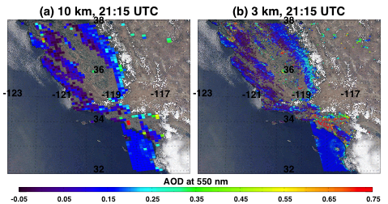
Example granules
3 km product tends to be noisier than 10 km

Slide 25
Comparison of global mean AOD from 10 and 3 km
Globally, 3 km AOD is 0.01 to 0.02 higher than 10 km AOD over land.
Proportionally greater number of very low AOD retrievals in 3 km product over ocean

Slide 26
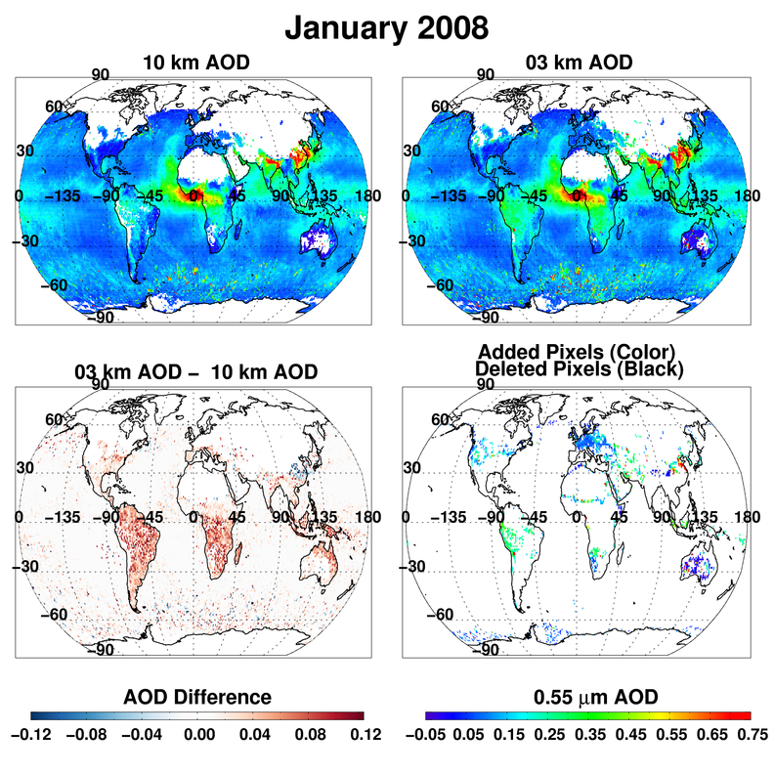

Slide 27
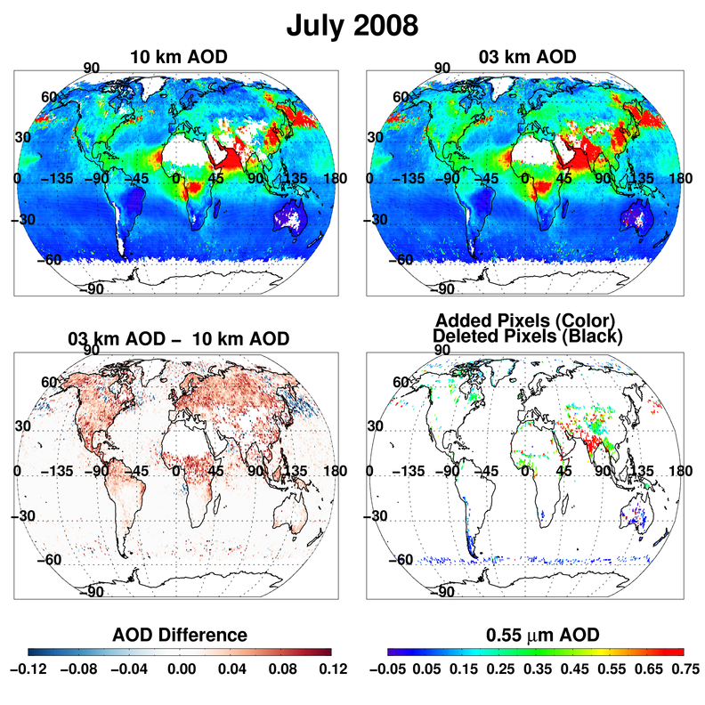

Slide 28
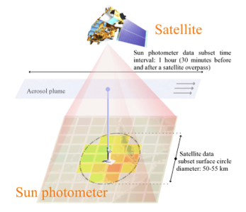
Validation strategy
Satellite measures AOD in an area around the sun photometer, while the sun photometer measures AOD at a point throughout time. Spatio-temporal averaging is employed to compare the two measurements.
Circle radius is 25 km for 10 km product and 7.5 km for 3 km product. Each circle will
enclose 25 pixels of each
product.
Petrenko et al., 2012

Slide 29
Validation with AERONET - land
Both 10 km and 3 km products are well correlated with AERONET
3 km shows slight high bias and a bit more uncertainty
Revised expected error for 3 km land product: ±0.05 + 0.2*AOD

Slide 30
Validation with AERONET - ocean
Revised expected error for 3 km ocean product: ±0.04 + 0.05*AOD

Slide 31
Impact of averaging circle size on 3 km validation
Land or Ocean | Averaging Circle | AERONET Mean | MODIS Mean | Bias | R | Slope | Intercept | N | % within EE
Land | 7.5 | 0.152 | 0.201 | 0.049 | 0.84 | 1.046 | 0.04 | 3280 | 62
Land | 25 | 0.149 | 0.175 | 0.026 | 0.86 | 0.96 | 0.03 | 4513 | 70
Ocean | 7.5 | 0.136 | 0.149 | 0.013 | 0.93 | 0.959 | 0.02 | 626 | 70
Ocean | 25 | 0.152 | 0.179 | 0.027 | 0.93 | 1.086 | 0 | 1915 | 67
All MODIS data is from the 3 km product
Different spatial averaging circle sizes affects the ability to directly compare 10 and 3 km validation.

Slide 32
Summary and Recommendations

Slide 33
Summary
3 km aerosol product is NOT a new algorithm, it is an existing algorithm applied at a new resolution.
3 km aerosol product will not aggregate up to Level 3, or be included in the joint atmosphere Level 2 product
3 km retrieves slightly different global AOD than the 10 km product
3 km validates with AERONET slightly less well than the 10 km product, accordingly, new expected error bounds are defined.

Slide 34
Recommendations
Global studies should continue to make use of the more robust and well-studied 10 km product. The 3 km product’s use should be restricted to obvious situations that require finer resolution.
Only the AOD at 550 nm has been studied in depth at this point. Difference in AOD at
wavelengths, and differences in the size parameters over ocean are possible. More validation will be forthcoming.
Aerosol-cloud studies with the 3 km product should proceed cautiously. At this time,
we do not specifically know how the 3 km product is affected in the proximity of clouds.
While the air quality community will be eager to apply the 3 km product across an
urban landscape, this must proceed cautiously because of known artifacts in the product over urban surfaces.
The power of the 3 km product is on local, not global, scales.

Slide 35
Relevant Literature
MODIS Collection 6 algorithm and update:
Levy, R. C., Mattoo, S., Munchak, L. A., Remer, L. A., Sayer, A. M., Patadia, F., & Hsu, N. C. (2013). The Collection 6 MODIS aerosol products over land and ocean. Atmospheric Measurement Techniques, 6, 2989–3034. doi:10.5194/amt-6-2989-2013
MODIS 3 km algorithm and global validation:
Remer, L. A., Mattoo, S., Levy, R. C., & Munchak, L. A.. (2013). MODIS 3 km aerosol product: algorithm and global perspective. Atmospheric Measurement Techniques, 6, 1829–1844. doi:10.5194/amt-6-1829-2013
Application of 3 km product during a DISCOVER-AQ in Washington/Baltimore:
Munchak, L. A., Levy, R. C., Mattoo, S., Remer, L. A., Holben, B. N., Schafer, J. S., et al.. (2013). MODIS 3 km aerosol product: applications over land in an urban/suburban region. Atmospheric Measurement Techniques, 6, 1747–1759. doi:10.5194/amt-6-1747-2013
Application of 3 km product during ARCTAS :
Livingston, J. M., et al. (2014), Comparison of MODIS 3 km and 10 km resolution aerosol optical depth retrievals over land with airborne sunphotometer measurements during ARCTAS summer 2008, Atmos. Chem. Phys., 14, 2015-2038, doi:10.5194/acp-14-2015-2014.

