Slide 1
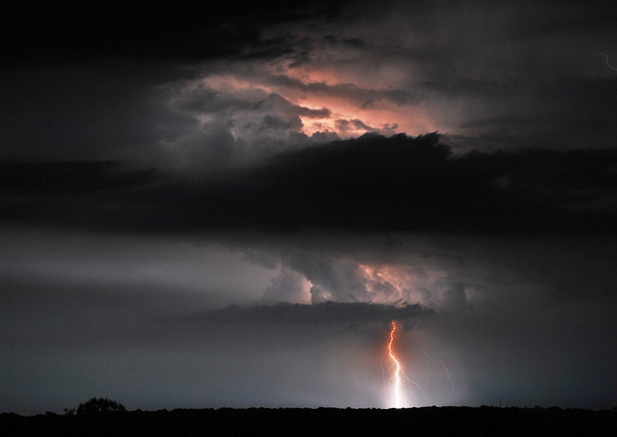
MODIS Atmosphere Web & L3 Algorithm / Product Detail
MOD08 Level-3 (L3) Products
(& MODIS-Atmos website review)
Paul A. Hubanks (NASA GSFC / Adnet Systems)
24 September 2014

Slide 2
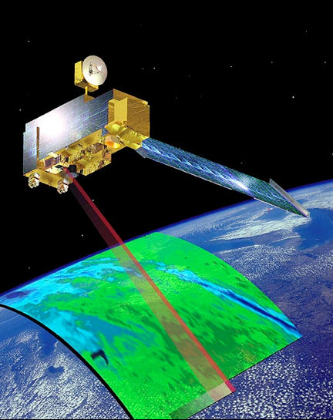
Outline of Today’s Talk
Part 1: MODIS Atmosphere L3 Product Review (Paul Hubanks)
Part 2: MODIS Atmosphere Website Review (Paul Hubanks)
Part 3: Definition of “Day” change in Collection 6 (Bill Ridgway)
Part 4: Q & A (Paul Hubanks, Bill Ridgway, & Steve Platnick)
Will try to answer everything today,
but you can always email me with questions at
Paul.A.Hubanks@nasa.gov

Slide 3
Thank You’s and Acknowledgments
It’s a TEAM effort!
L3 Team: Steve Platnick, Michael King, Paul Hubanks, Bill Ridgway,
Gala Wind, Vani Starry Manoharan, (CRG Team), (L2 Teams)
Webinar Organization & Support: Rich Kleidman
L2 Atmosphere Teams: (without the L2 input, L3 would be nowhere)
Operational/Production Support: Gang Ye, Kurt Hoffman, T.K.Lim, others
Original Authors of L3 Production Software: Robert Pincus & Xu Liang

Slide 4
Part 1:
MODIS-Atmosphere Level-3 Product Review
(MOD08)

Slide 5
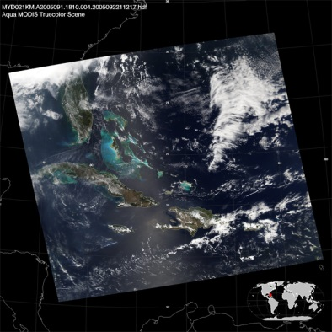
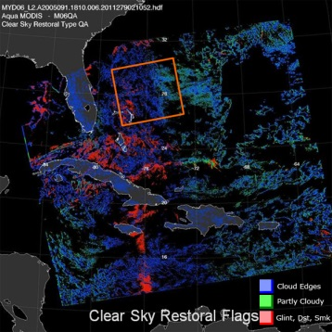
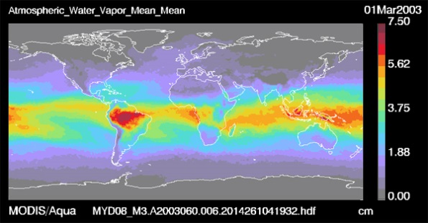
What is Level-3 (L3)?
First, let’s review Level-1B and Level-2.
Level-1B (L1B) denotes calibrated, geolocated instrument data processed to sensor units stored at a granule-level scale. Each L1B granule (36 spectral bands) is stored in a separate HDF file each covering a 5 minute time interval.
Level-2 (L2) denotes “science products” that are derived from the L1B data and other ancillary data on a granule-level scale. Each L2 granule (with multiple science parameters) is stored in a separate HDF file each covering a 5 minute time interval.
Level-3 (L3) denotes “science products” that are derived from L2 granule-level science products and then mapped to uniform space/time grid scales. (For MODIS Atmosphere, that’s global maps at daily or multiday time scales).
Notes:
Mod to the D3 “defn of day” will be discussed by Bill Ridgway after my presentation.
The E3 time period is always reset to 01 January at the start of a new year. M3 time period is always a calendar month.

Slide 6
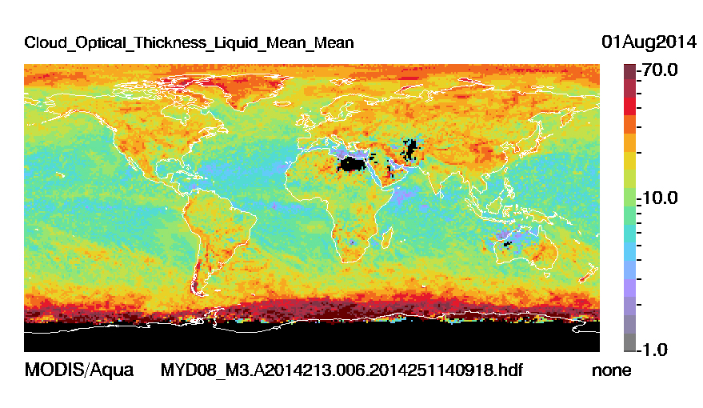
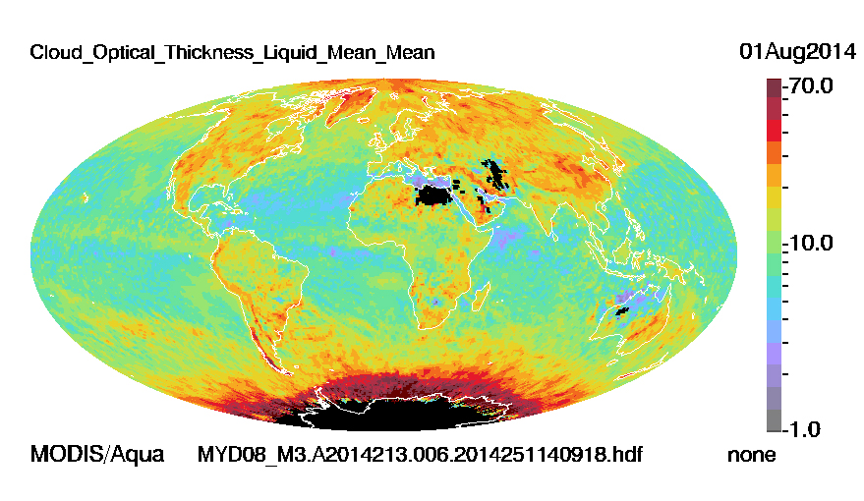
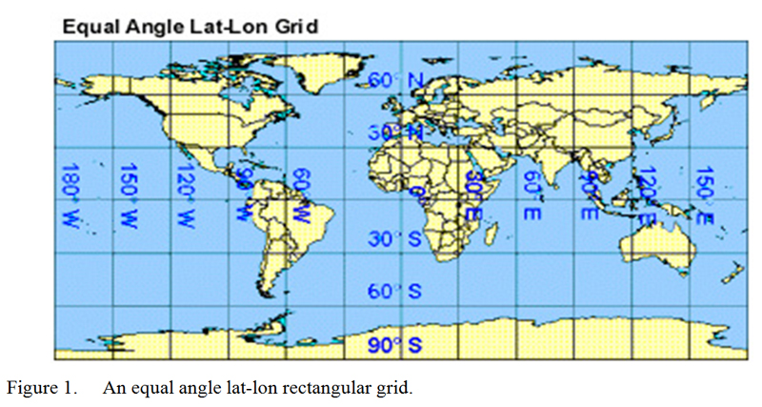
What are M-A Level-3 (L3) Characteristics?
Global Gridded Products at daily or multiday temporal scales
For MODIS-Atmosphere L3:
Q1: What grid projection is used? L3 data uses “Equal Angle” projection (Poles are distorted) *
Q2: How big are the L3 grid cells? Each L3 grid cell is 1x1° ( ~ 12,000 km² at Equator < 100 km² at Poles )
Q3: How big are the L3 data maps? Each L3 map is 360x180 pixels (360 pixel width & 180 pixel height)
Q4: What temporal scales are offered? Daily (D3), 8-Day (E3), & Monthly (M3)
* Note that Hammer-Aitoff elliptical projection images are available on the website for Monthly (M3)
Notes:
Bill Ridgway will talk a bit about how the “Definition of a Data Day” changed between C5/51 and C6 after my introductory talk
The E3 time period is always reset to 01 January at the start of a new year. M3 time period is always a calendar month.

Slide 7
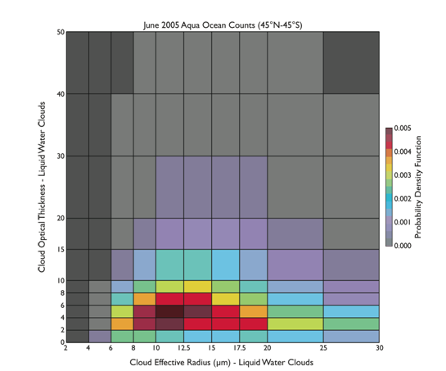
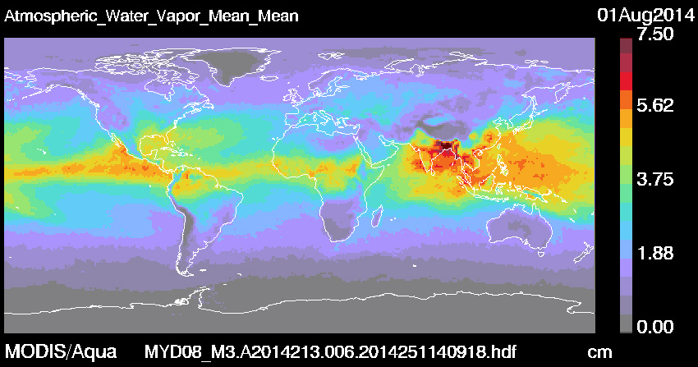
Some Strengths of Standard Level-3:
- Fairly large number of science parameters offered (approximately 180)
- Many different statistics offered (approximately 20 to 30)(over 20)
- Multiday files fill orbital gaps (nearly complete global coverage)
- Efficient study of global statistics & longer term trends
- Joint histograms show cross-parameter relationships *
- Useful in quality checking and debugging efforts of L2 inputs **
*
**
Notes:
Broad and Vast Spectrum of Information allowed by the relatively coarse grid resolution … On the fly images available on the web site … faster detection of problems

Slide 8
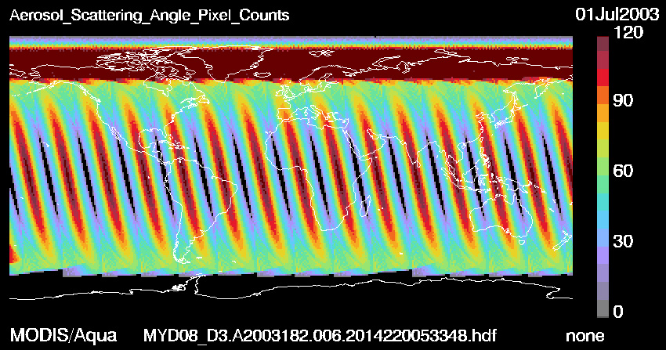
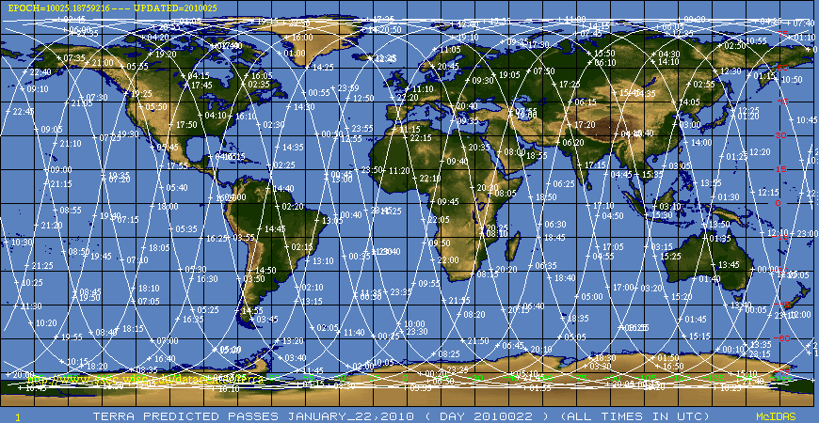
Some Limitations of Standard Level-3:
- Fixed map projection with a relatively coarse resolution (1x1°) (1˚)
- Fixed parameter set (file size issues in L3, esp. multiday)
- Fixed statistical set (not amenable to complex computations)
- L2 data is sampled at the resolution of the L2 geolocation (1km to 5km )(1
- Limited set of histograms with preset bin boundaries
- Input to the 08_E3 and 08_M3 … is 08_D3 (not L2)- - (per Collection)
- Overlapping orbits are averaged * (D3 polar data tends to be “smeared” with overlapping orbital overpasses over many hours, while D3 equatorial data tends to be a snapshot with a single overpass)
*
Notes:
Unprojected lat-lon

Slide 9
L3 Sub-sampling Impact
Product Family | Data Resolution | Geolocation Resolution | L2 Input Pixels (Max) per 1° Grid (Equator) | Impact
Aerosol 04 | 10km | 10 km | 121 out of 121 | No
Water Vapor 05 | 1 km | 5 km | 484 out of 12,231 | Yes
Cirrus Detection 06_CD | 1 km | 5 km | 484 out of 12,231 | Yes
Cloud Top Properties * 06_CT | 5 km | 5 km | 484 out of 484 | No
Cloud Optical Properties 06_OD | 1 km | 5 km | 484 out of 12,321 | Yes
Atmosphere Profile 07 | 5 km | 5 km | 484 out of 484 | No
* Note there are both 5km and new 1km data sets for CTP in Collection 6

Slide 10
The MODIS-Atmosphere L3 Products
Nearly 200 science parameters and well over 1,000 statistical SDS’s
Derived from:
Aerosol Product (04_L2)
Water Vapor Product (05_L2)
Cloud Product (06_L2) *Note that 06_L2 includes some Cloud Mask Product (35_L2) parameters
Atmosphere Profile Product (07_L2)
Statistics can include:
1. Simple Statistics (Mean, Minimum, Maximum, Standard Deviation)
2. QA-weighted Mean and QA-weighted Standard Deviation (using L2 QA Confidence Flags)
3. Log Mean and Log Standard Deviation (used for Cloud Optical Thickness)
4. Mean Uncertainty and Log Mean Uncertainty (if uncertainty is computed at L2)
5. Fraction of pixels that satisfy some condition (e.g., cloudy vs. clear)
6. Pixel Counts that satisfy some condition (e.g. liquid water vs. ice clouds)
7. Histograms of the categorical quantity within each grid box (1D Histograms)
8. Histograms of the confidence placed in each measurement (Confidence Histograms)
9. Joint Histograms and/or Regressions derived from comparing one science parameter to another, statistics may be computed for a subset that satisfies some condition. (Joint Histograms and/or Regression Statistics)

Slide 11
A brief note about
Aerosol Parameter/SDS Name Changes
in the C6 Level-3 Products

Slide 12
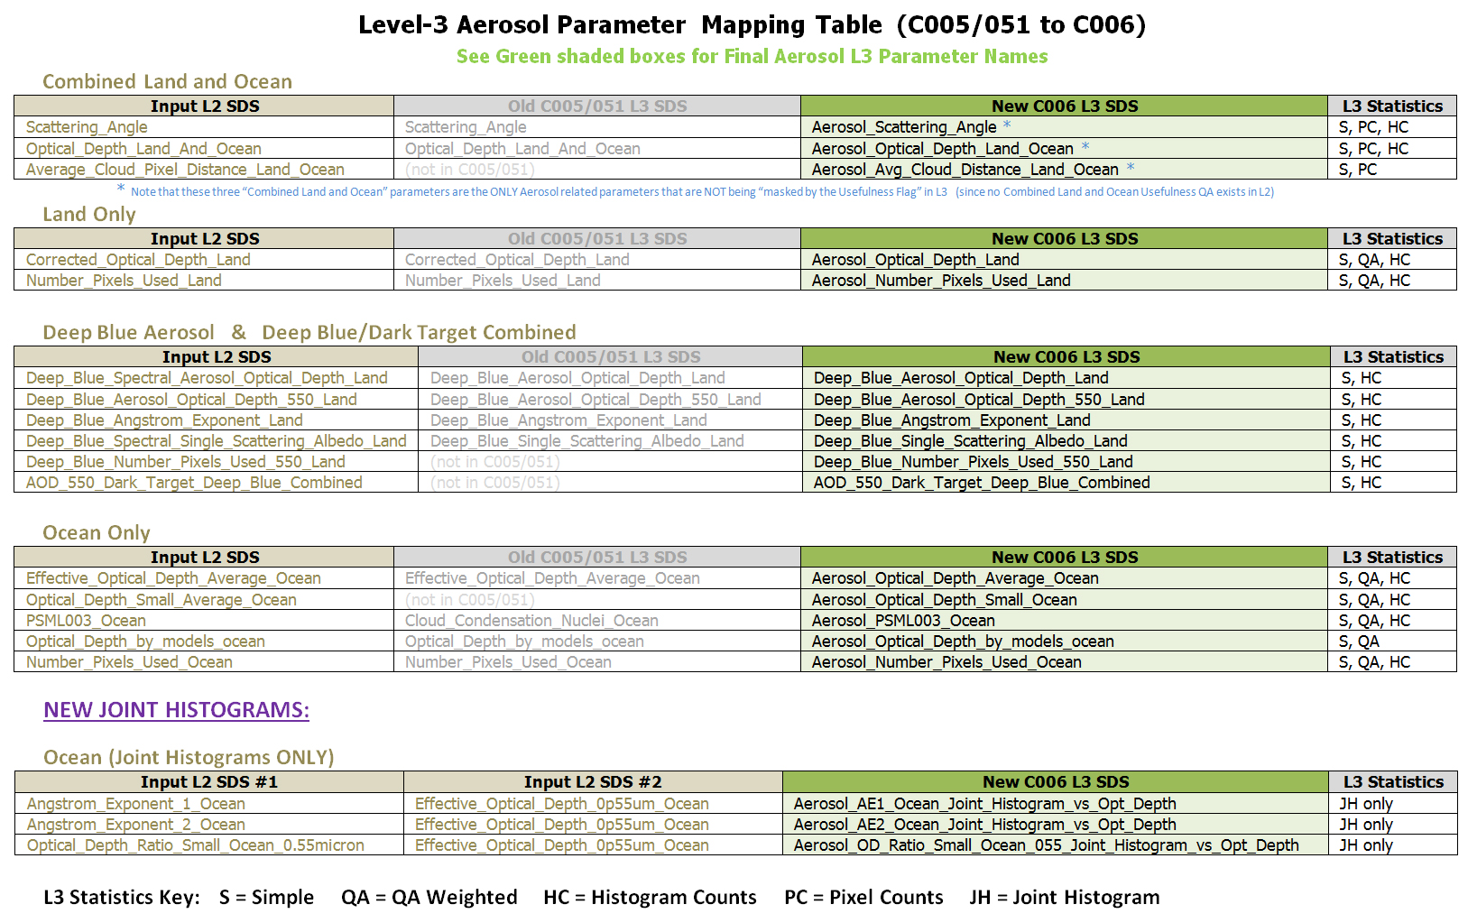
Aerosol SDS Name Changes in the C6 Level-3 Products
http://modis-atmos.gsfc.nasa.gov/products_C006update.html

Slide 13
An Inventory of the SDS’s
in the C6 Level-3 Products
Documentation that follows is for Daily (D3) only
(E3 and M3 are very similar)

Slide 14
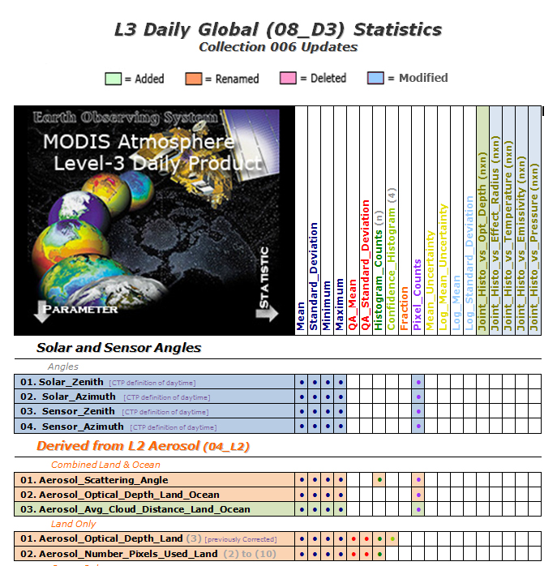
Summary of Statistical SDS’s in the L3 Daily Product (08_D3)
http://modis-atmos.gsfc.nasa.gov/products_C006update.html
http://modis-atmos.gsfc.nasa.gov/MOD08_D3/format.html

Slide 16
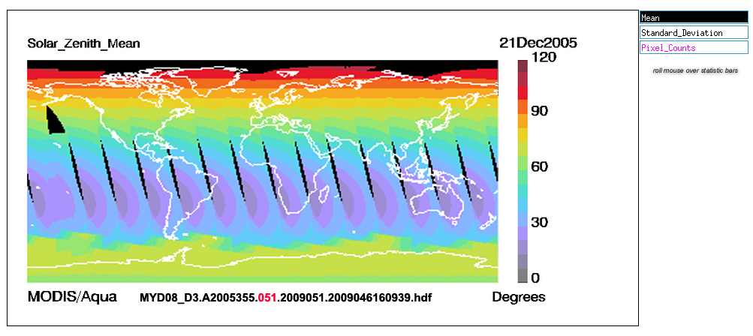
Old C5 Solar Zenith Angle
using Day Flags in the L2 Granules with “Any Sunlit View”

Slide 17
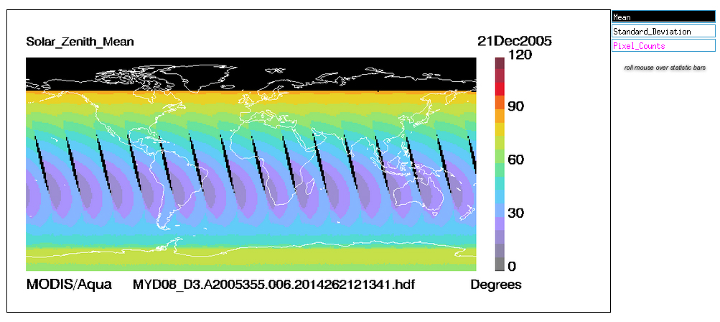
New C6 Solar Zenith Angle
using CTP definition of “Daytime” (Solar Zenith Angle ≤ 85°)

Slide 18
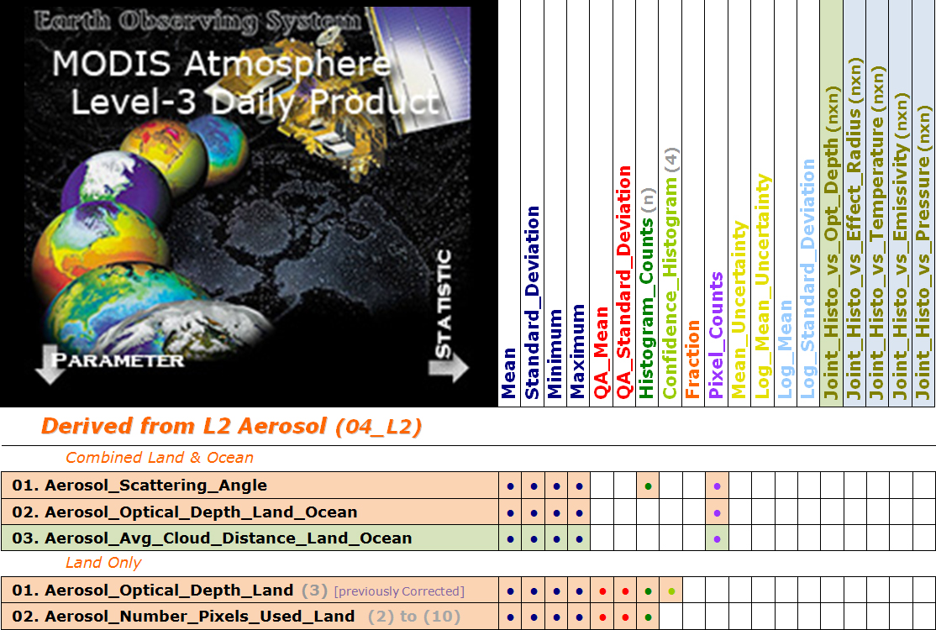

Slide 19
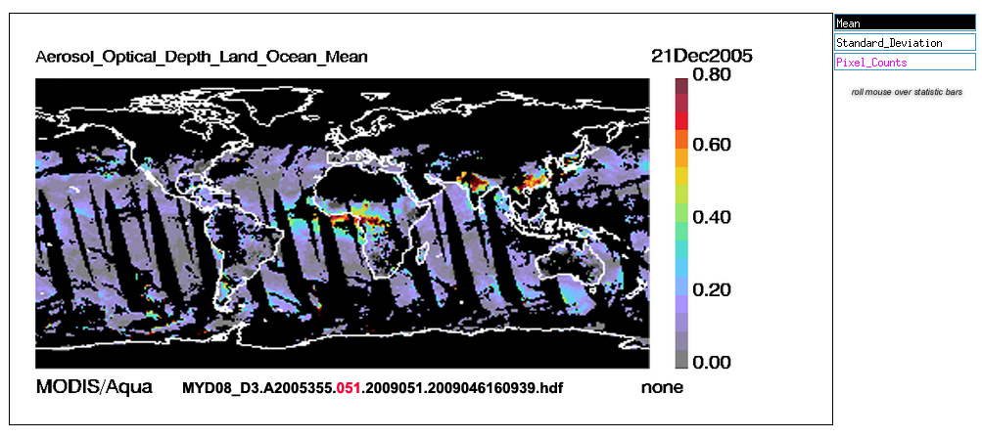
Old C5 Aerosol Optical Depth Land and Ocean

Slide 20
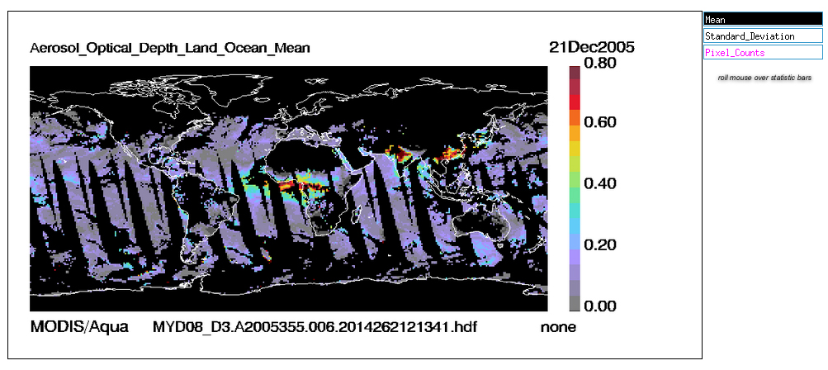
New C6 Aerosol Optical Depth Land and Ocean

Slide 21
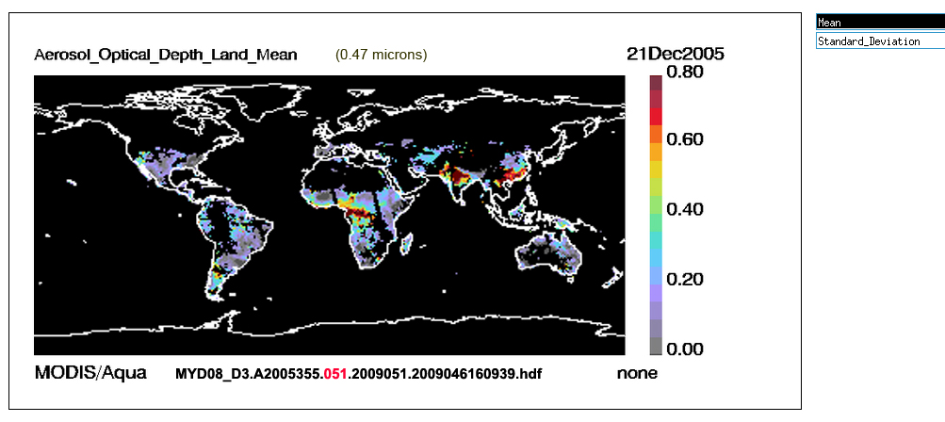
Old C5 Aerosol Optical Depth Land

Slide 22
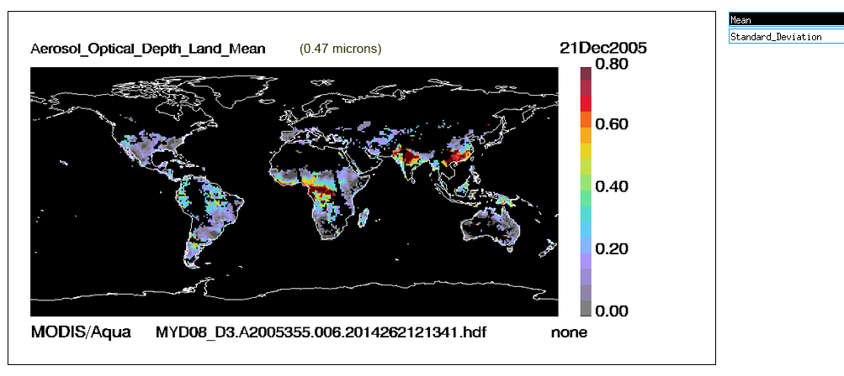
New C6 Aerosol Optical Depth Land

Slide 23
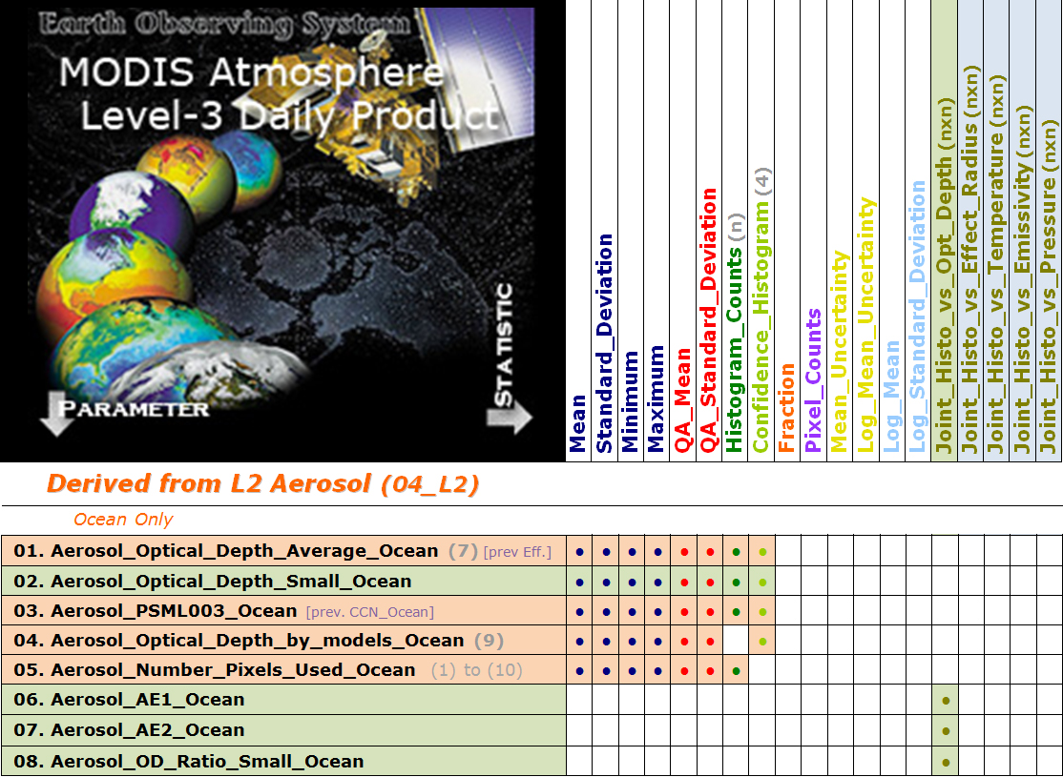
Summary of Statistical SDS’s in the L3 Daily Product (08_D3)

Slide 24
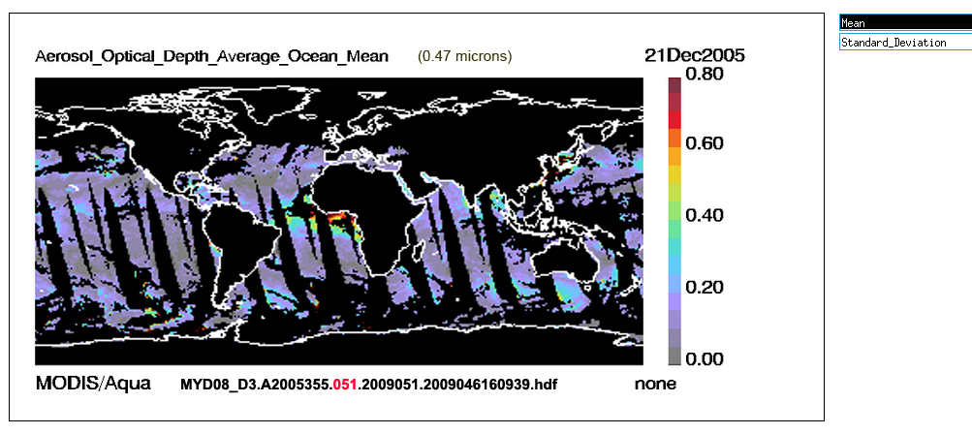
Old C5 Aerosol Optical Depth Average Ocean

Slide 25
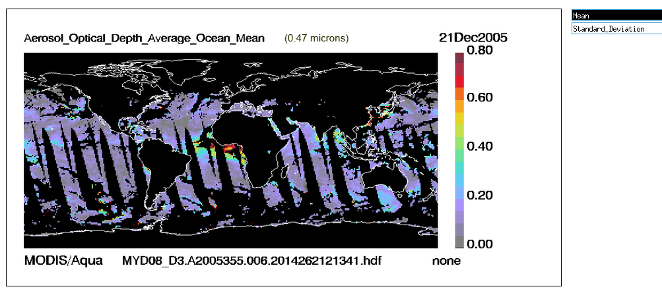
New C6 Aerosol Optical Depth Average Ocean

Slide 27
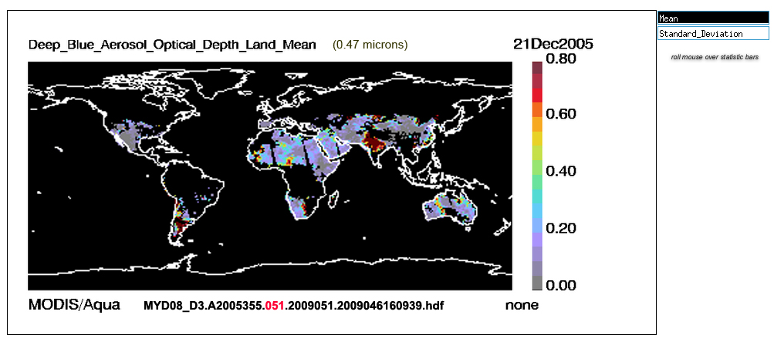
Old C5 Deep Blue Aerosol Optical Depth Land

Slide 28
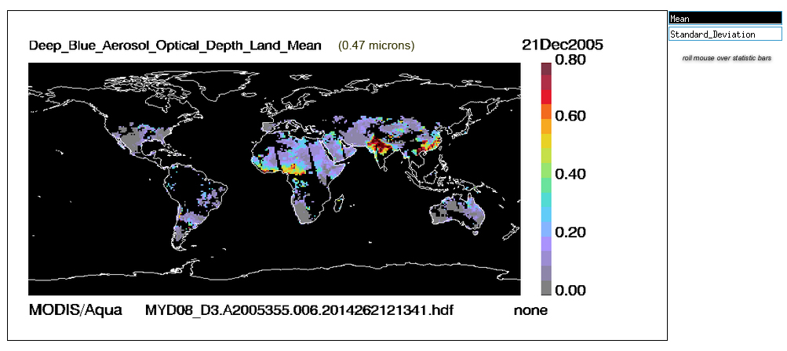
New C6 Deep Blue Aerosol Optical Depth Land

Slide 29
Now let’s take a look at the
New C6 “Combined” Deep Blue + Dark Target
Aerosol Optical Depth (AOD)
at 0.550 microns

Slide 30
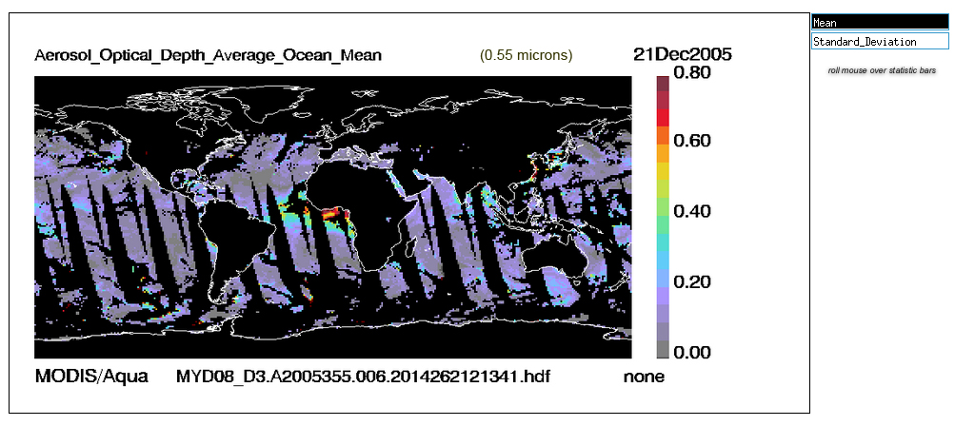
New C6 Aerosol Optical Depth (AOD) Average Ocean (0.550 microns)

Slide 31
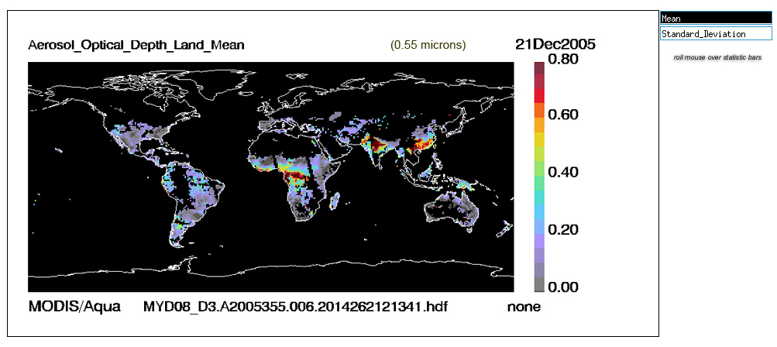
New C6 Aerosol Optical Depth (AOD) Land (0.550 microns)

Slide 32
New C6 Deep Blue Aerosol Optical Depth (AOD) Land (0.550 microns)

Slide 33
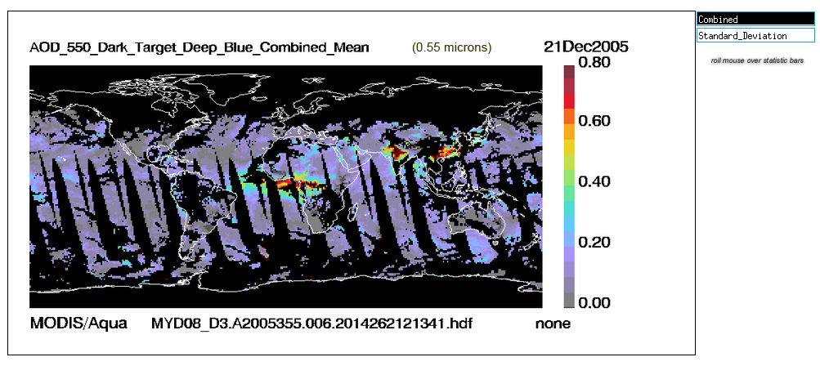
New C6 “Combined” Deep Blue + Dark Target AOD

Slide 34
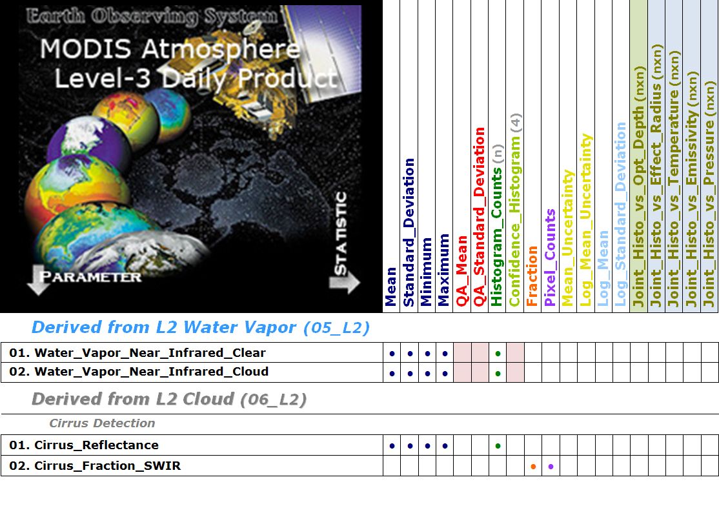

Slide 35
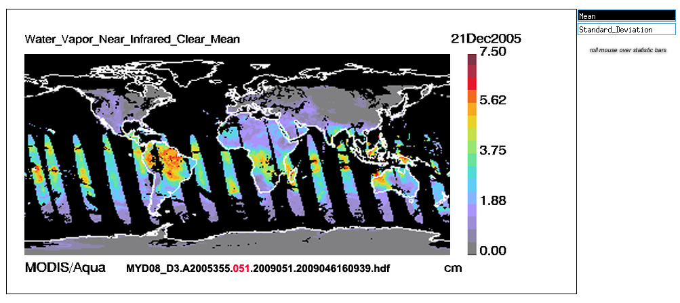
Old C5 Water Vapor (NIR) Clear (& Sunglint)

Slide 36
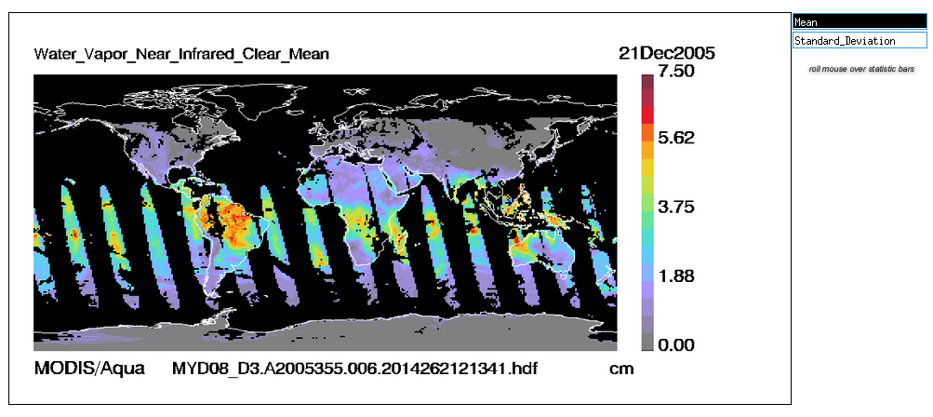
New C6 Water Vapor (NIR) Clear (& Sunglint)

Slide 37
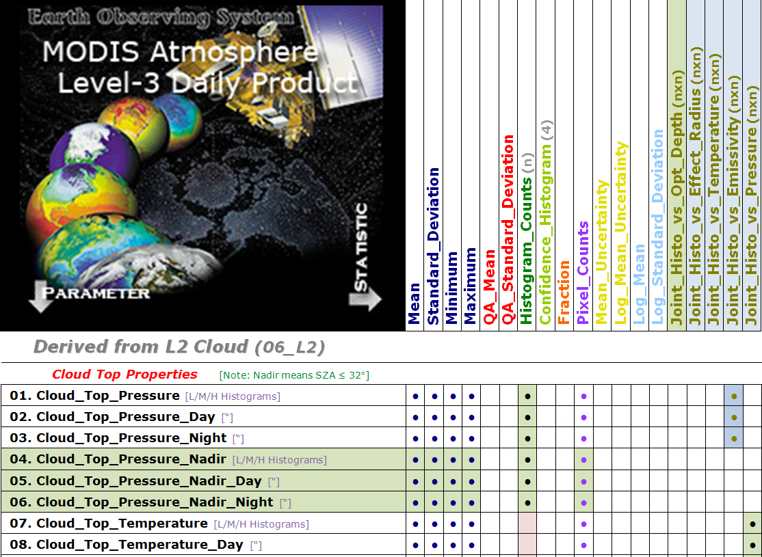

Slide 38
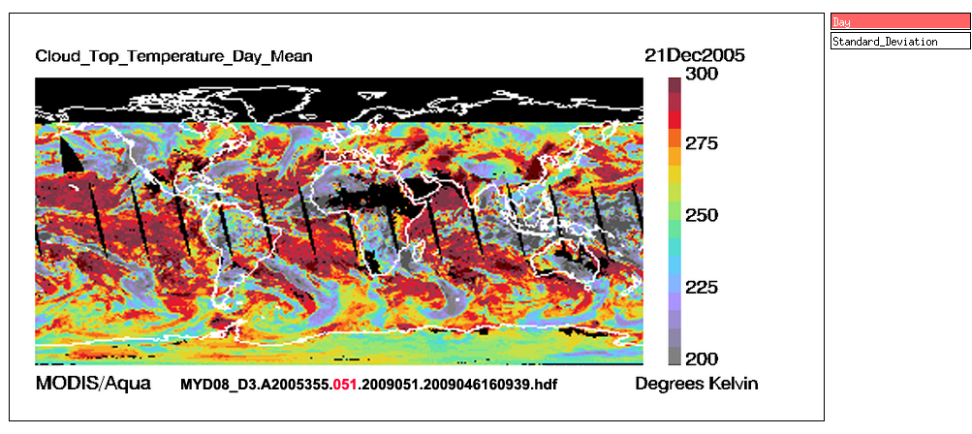
Old C5 Cloud Top Temperature (Daytime)

Slide 39
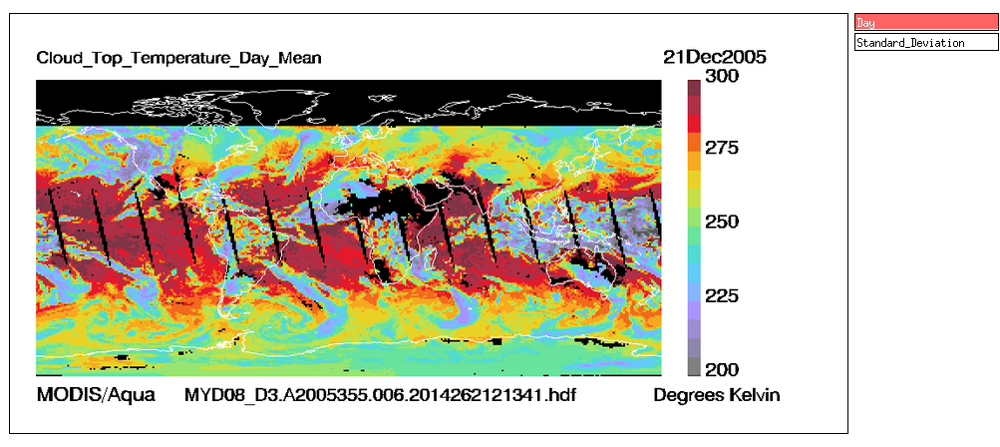
New C6 Cloud Top Temperature (Daytime)

Slide 40
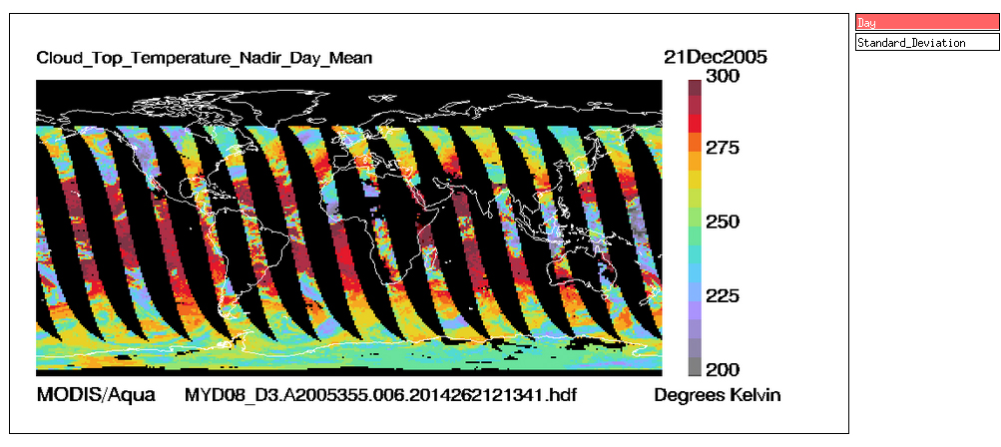
New C6 Cloud Top Temperature Nadir (Daytime)
using “Nearer-Nadir” (Sensor Zenith Angle ≤ 32°) Pixels Only

Slide 41
Question:
DID THE “NADIR VIEW” DAILY (D3)
MAKE A DIFFERENCE IN THE MONTHLY (M3) MEAN?

Slide 42
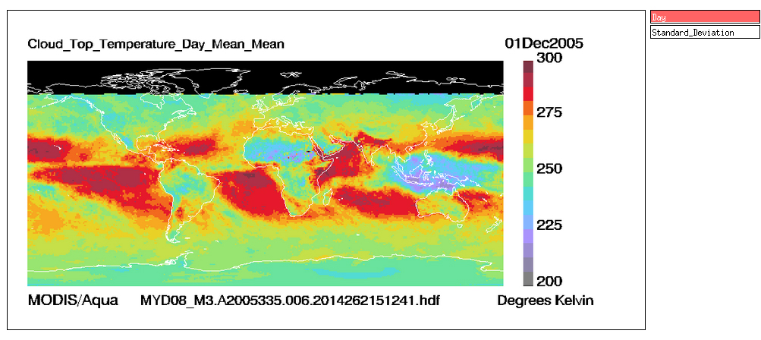
Q: DID THE “NADIR VIEW” MAKE A DIFFERENCE IN THE MONTHLY MEAN?
New C6 Cloud Top Temperature (Daytime) -- Monthly Mean

Slide 43
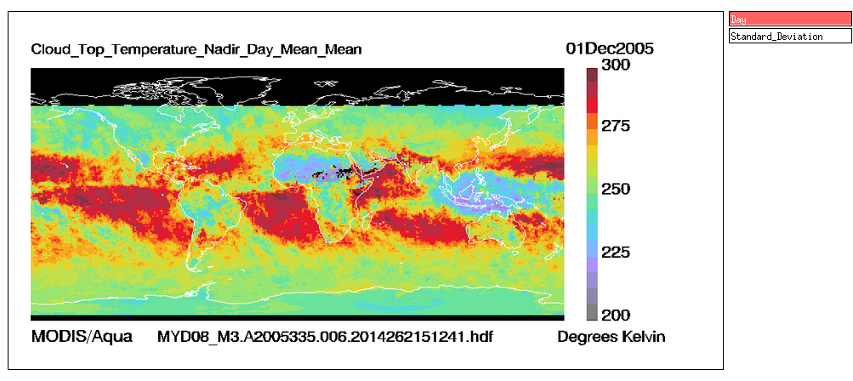
A: YES, MORE VARIATION IN CTT’s AT NEARER NADIR VIEWS
New C6 Cloud Top Temperature Nadir (Daytime) -- Monthly Mean

Slide 44
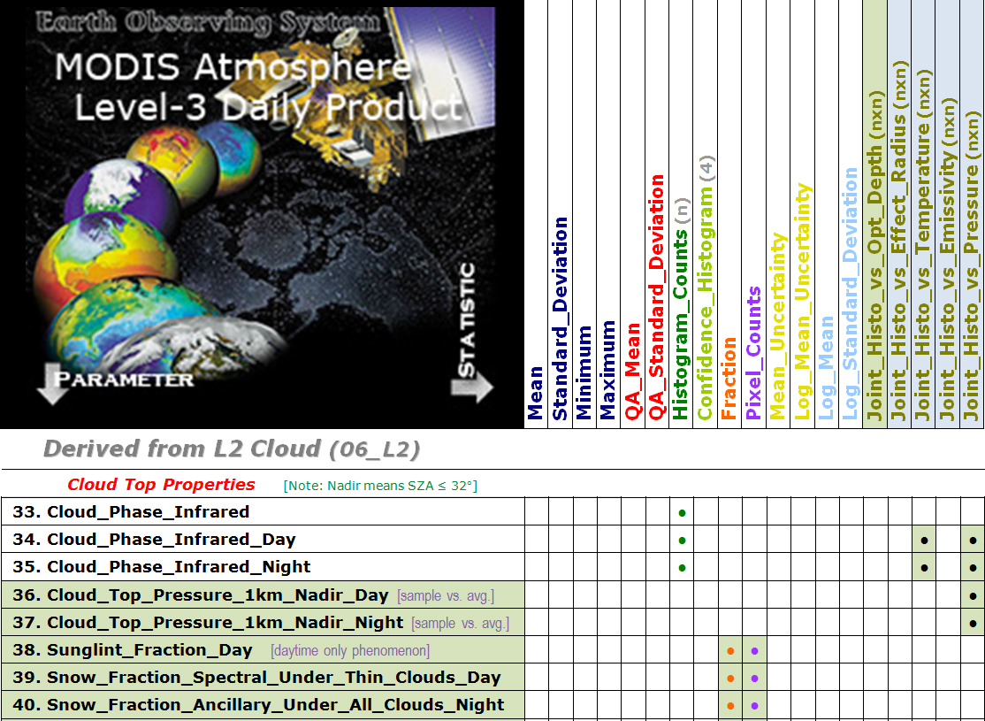

Slide 45
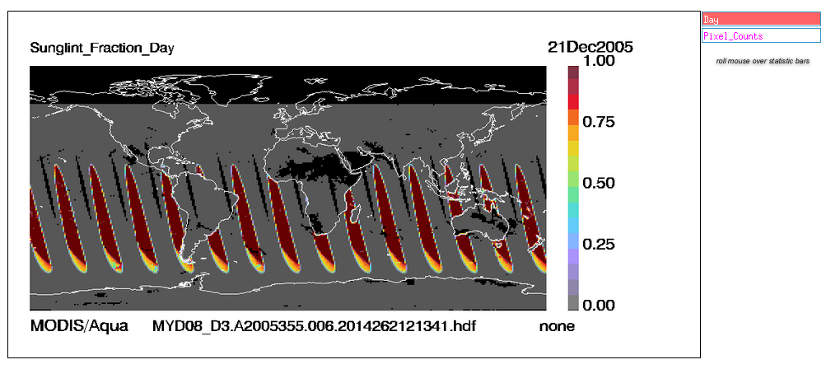
New C6 Sunglint Fraction (Daytime)

Slide 46
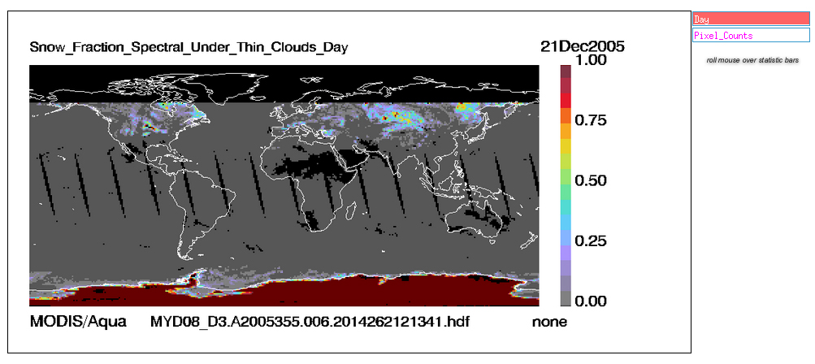
New C6 Snow Fraction (Daytime)
Using Spectral Tests under (CTP Retrieved) Thin Clouds only (Antarctica hardwired to 100%)

Slide 47
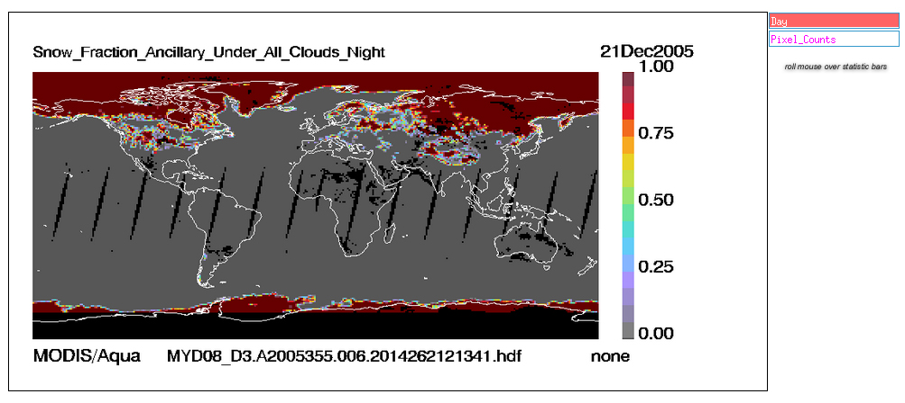
New C6 Snow Fraction (Nighttime)
Using Ancillary Snow Mask Data under (CTP Retrieved) Clouds Only (All Clouds)

Slide 48
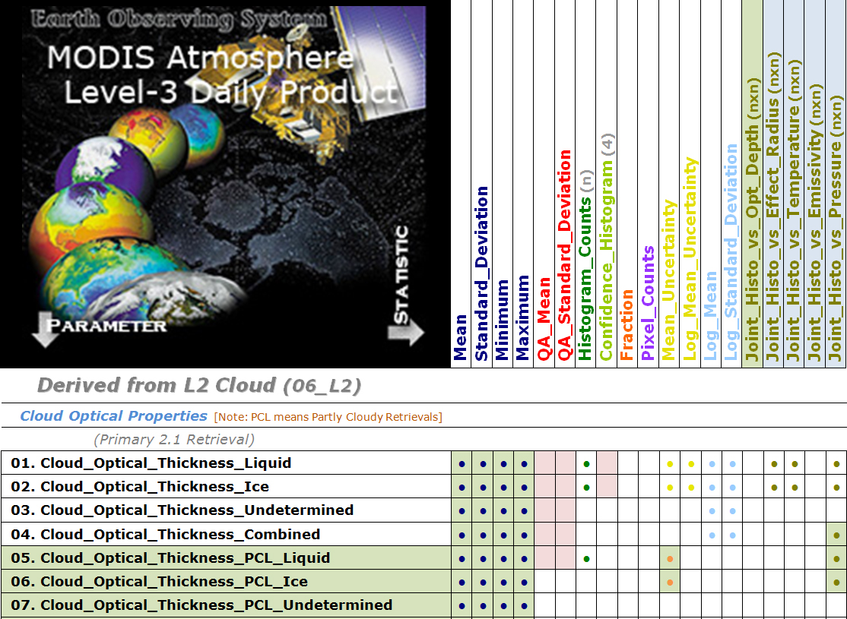

Slide 49
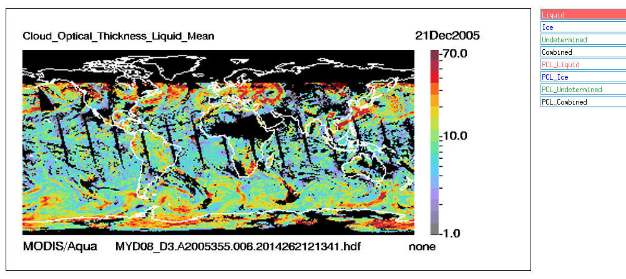
Old C5 Cloud Optical Thickness (Liquid Water Clouds)

Slide 50
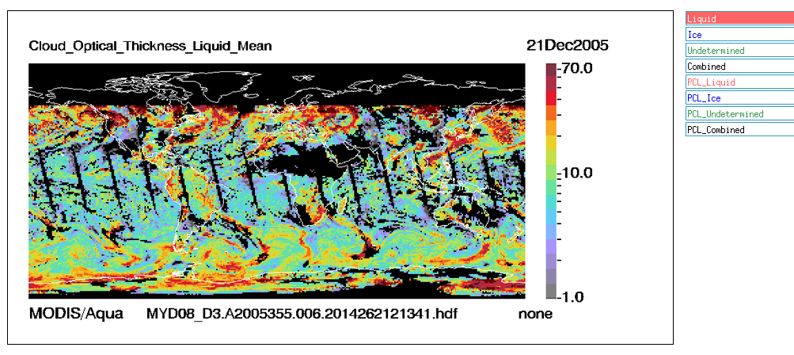
New C6 Cloud Optical Thickness (Liquid Water Clouds)

Slide 51
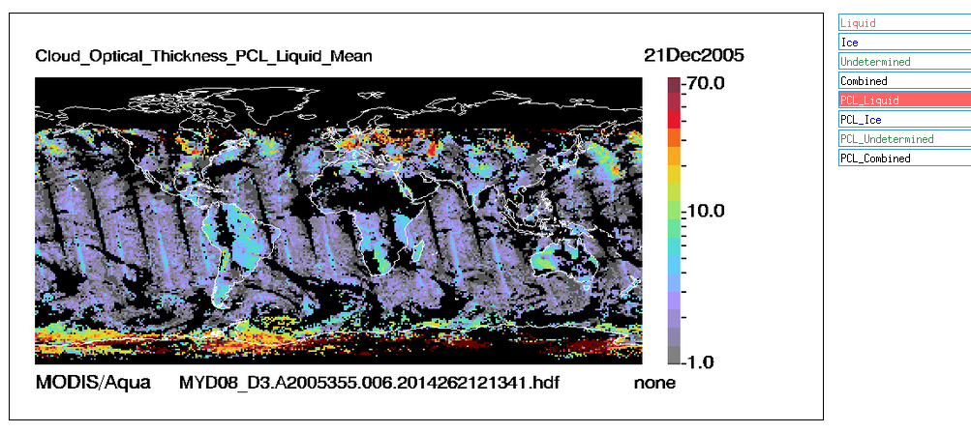
New C6 Cloud Optical Thickness PCL (Liquid Water Clouds)
PCL = Partly Cloudy Retrievals Only

Slide 52
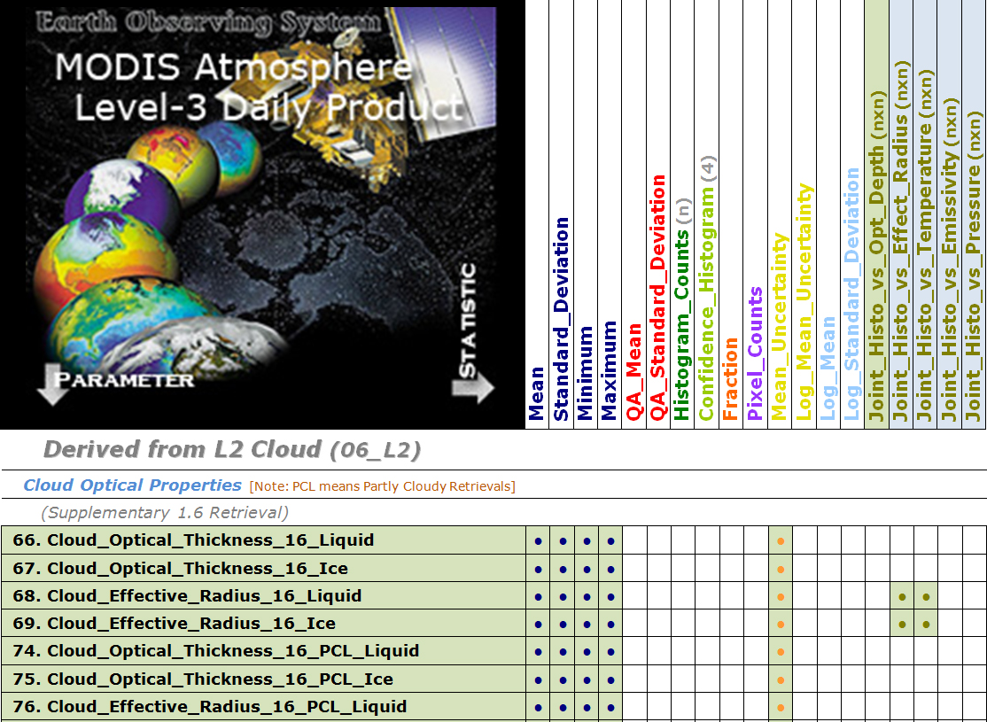

Slide 53
New C6 Cloud Optical Thickness (Liquid Water Clouds)
Primary 2.1 micron Retrieval

Slide 54
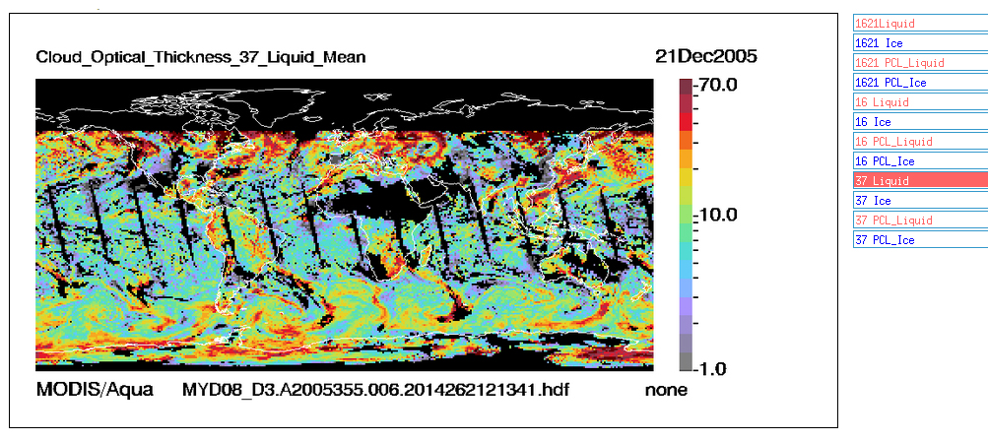
New C6 Cloud Optical Thickness (Liquid Water Clouds)
3.7 micron Retrieval

Slide 55
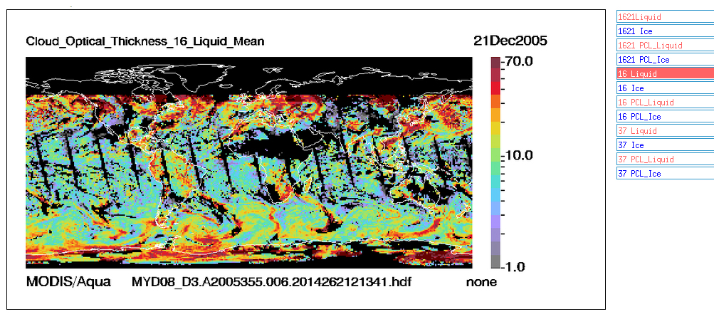
New C6 Cloud Optical Thickness (Liquid Water Clouds)
1.6 micron Retrieval

Slide 56
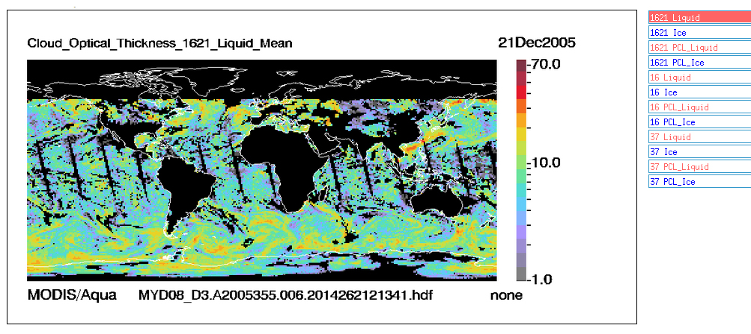
New C6 Cloud Optical Thickness (Liquid Water Clouds)
1.6 / 2.1 micron Retrieval

Slide 58
Old C5 Atmospheric Water Vapor “Low”
(In C5 ”Low” was Surface to 920 mb)

Slide 59
New C6 Atmospheric Water Vapor “Low”
(In C6 ”Low” is Surface to 680 mb)

Slide 60
More about Level-3
Want to emphasize the
Importance of the local attributes attached to each SDS
which can be found in the CDL File Spec and/or the HDF File itself
(HDF Files are self describing!)

Slide 61
The “Inner Workings” of Level-3
Four L3 PGE’s are required: Tile (interim 5° latitude strips), Daily, Eight Day, Monthly
MODIS Atmosphere L3 software was designed using “generalized logic”
- No special cases. KIS “Keep it Simple” to reduce software maintenance and “spaghetti logic”
- Statistics are computed the same way each time (a few “fixed case” choices sometimes offered)
3. Logical Branching in L3 software is determined through “local attribute” settings
- local attributes can be seen/read in the Common Data Language (CDL) File Spec (see M-A website)
- local attributes are also attached to each Scientific Data Set (SDS) in the HDF File itself (self described)
Pros:
Upside is the L3 SDS’s never get “out of sync” with the File Spec. Which can happen in L2.
File Specs (including Local attributes attached to each SDS) will tell 90% of the story on processing.
(The other 10% can be gleaned from the L3 Algorithm Theoretical Basis Document (ATBD).)
The operational software, in this case, is easier to maintain, with fewer changes needed.
Cons:
- Downside is huge File Specs (and sometimes time consuming effort needed for changes)
- File Specs for each L3 PGE are around 25,000 lines in length (close to 100,000 lines total)
- Have to be meticulous when editing. 90% of the maintenance and updates are done in the File Specs.
Upshot: Local attributes attached to each SDS gives info on “how “ (& “what”)
*

Slide 62
Some Key Local Attributes of Level-3
Most common question from new users: “How do I unpack L3 data from HDF Files?”
“_FillValue” is the value of the Fill or Missing data that should be thrown out before descaling.
The local attributes "scale_factor" and "add_offset" are used for the conversion of stored integer data to geophysical floating point numbers. The implementation follows conventional HDF usage (See HDF Users Guide)
float value = scale_factor * ( stored integer - add_offset )
float value = 0.01 * ( 10000 - (-15000) )
float value = 250.0 Degrees Kelvin
The units of the derived floating point value is indicated by the "units“ local attribute also provided.
Note the "valid_range" values apply to the packed data (before descaling). It is obtained from the L2 input file specification.
However it should be remembered that no "valid_range" screening on the input L2 data is performed in L3.

Slide 63
Some Key Local Attributes of Level-3
If you are confused by the SDS Name, try reading the “long_name” local attribute!
Note there is a character length limit on SDS names. So sometimes SDS names do not provide enough detail.
Always look at the “long_name” local attribute for added information.
Also with the “Derived_From_Level_2_Data_Set” given for each SDS, you can always refer back to the Level 2 input file
For added information

Slide 64
Level-3 SDS Statistic Suffix’s
Scientific Data Set (SDS) Statistical “Suffix’s” occasionally “tell a story”.
In D3, the mean statistic has an SDS suffix of “_Mean”, which defined as the
subsampled mean of the L2 input pixels (which meet the specified criteria).
In E3 and M3, the mean statistic has an SDS suffix of “_Mean_Mean”, which was initially implemented with the thought that it might help data users remember that it’s the “mean of a mean” or “Mean of the Daily Mean”.
There are 3 options on how the E3/M3 “Mean of the Daily Mean” is computed:
Unweighted Mean (each D3 mean has the same weight)
Pixel-Weighted Mean (each D3 mean is weighted by the pixel counts for that day)
Pixel-Weighted Mean with Pixel Count Screen (same as 2, except a min number of counts is req’d)
Weighting Options are set in the “local attributes” (can be viewed in the CDL File Spec, or can be read from the HDF file itself)
An Obvious FYI: Note that Histograms and Joint Histograms are never weighted (makes no sense) they are simple counts.

Slide 65
Mean Statistic Weighting Options in E3 and M3
Unweighted Mean (each D3 Mean has the same weight)
Pixel-Weighted Mean (each D3 Mean is weighted by the number of L2 input Pixel Counts for that day)
Pixel-Weighted Mean with Pixel Count Screen (same as 2, except a min number of counts is req’d)
Case 1 Example:

Slide 66
Mean Statistic Weighting Options in E3 and M3
Unweighted Mean (each D3 Mean has the same weight)
Pixel-Weighted Mean (each D3 Mean is weighted by the number of L2 input Pixel Counts for that day)
Pixel-Weighted Mean with Pixel Count Screen (same as 2, except a min number of counts is req’d)
Case 2 Example:

Slide 67
Multiday (E3 and M3) Statistics
One final note about Standard Deviations in the Multiday.
We have 2 Standard Deviation statistics stored in the E3 and M3,
with these SDS suffix’s:
_Mean_Std (Standard Deviation of the Daily Mean)
_Std_Deviation_Mean (Mean of the Daily Standard Deviation)
But there is no Standard Deviation of the input L2 Pixels in the Multiday (E3 or M3) files. (However, we do have this statistic in the Daily (D3) file.) This is something we would like to look into for Collection 7 in the E3 and M3 files. It would require calculating and keeping some additional intermediate statistics (Sum of Squares, etc.) in the D3. TBD

Slide 68
How do you order L3 Data?

Slide 69
Acquire MODIS Atmosphere Level 3 Data
For downloading few files
or monitoring processing progress,
FTP is useful:
ftp://ladsweb.nascom.nasa.gov/allData/6/
For larger orders, or sub-setting data,
use the LAADS website:
http://ladsweb.nascom.nasa.gov/data/search.html

Slide 70
What do the HDF filenames mean?

Slide 71
HDF filename “field” structure
The HDF File “Production Date“ is a good way to track the data generation (problems),
but reading the “PGE Version Number” in the HDF file metadata is more rigorous.
Note that for E3 and M3 HDF Files, the “Data Date” YYYYDDD, denotes the start day for the multiday period. For E3, the beginning of the 8-day period is always reset to 001 for a new year; and the previous 8-day period runs for the full 8 days (overlap is possible).

Slide 72
Where can I find more detailed information
on MODIS-Atmosphere Level-3?

Slide 73
Users should review the MODIS-Atmosphere
L3 Algorithm Theoretical Basis Document
http://modis-atmos.gsfc.nasa.gov/MOD08_D3/atbd.html

Slide 74
End of Part 1 !

Slide 75
Part 2:
MODIS-Atmosphere Website Overview

Slide 76
MODIS-Atmosphere Web Site
http://modis-atmos.gsfc.nasa.gov
Highlights
Images:
L1 & L2 high-res global mosaics [Subset of L1 & L2 SDS’s -- Mapped Globally w. Zoom Capability]
L1 high-res Granules [3 channel RGB, daytime only, mapped]
L3 standard: D3 & E3 (native LL) ; M3 on two projections (LL & HA) [Subset of Stats Only]
Documentation:
Processing and Data Availability Calendar
Known Problems of C6
New Collection Documentation (C6 is most recent)
Other Resources: File Specs, QA Plan, ATBDs, Users Guides, Science Papers

Slide 77
Home Page
(navigation primer)
http://modis-atmos.gsfc.nasa.gov

Slide 78
Notes:
Top Links appear on all pages on the website
So it’s easy to see where you are and can easily move to other sections of the site

Slide 79
Products Section:
Calendar Page
(Data Processing and Availability Calendar)
http://modis-atmos.gsfc.nasa.gov/products_calendar.html

Slide 81
Products Section:
Collection 006 Update Page
(Summary Changes)
http://modis-atmos.gsfc.nasa.gov/products_C006update.html

Slide 83
Images Section
(L1, L2, L3 Images)
http://modis-atmos.gsfc.nasa.gov/IMAGES

Slide 85
L1B Composite Image: R:G:B = 1:4:3 produces near “True Earth Color”

Slide 86
Cloud Optical Thickness: ”warm” (ROY) color bar for liquid ”cool” (GBIV) color bar for ice

Slide 87
Clickable Zoom of L1B Composite

Slide 88
Clickable Zoom of Cloud Optical Thickness
Notes:
Two color bars … cool colors for ice clouds … warm colors for water clouds

Slide 91
Taiwan
Cat 1 Hurricane Fung-Wong
China
Notes:
Hurricane Fung-Wong just to the S of Taiwan Saturday afternoon Sept 20th Ragged eyewall and picture perfect anticyclonic outflow (or blowoff) cirrus in the upper atmosphere

Slide 95
Notes:
Rollover buttons for Mean and Standard Deviation statistic

Slide 96
Notes:
Some L3 Parameters … have more website browse images available … and more “rollover buttons”

Slide 100
Data Issues Section
Known Problem Pages
of all Collection 6 L2 and L3 Products
http://modis-atmos.gsfc.nasa.gov/validation.html

Slide 103
A Closer Look at the “Latest PGE Version Available” Graphic
Sample for PGE06 (Aqua) that creates 06_L2 (Cloud Product) HDF Files:

Slide 104
Now for L3 Processing Status!
“Latest PGE Version Available” Graphics
PGE56 creates 08_D3 (Daily) PGE70 creates 08_E3 (Eight Day) PGE57 creates 08_M3 (Monthly)
*Upshot: C6 L3 Data (for Aqua) is now available from July 2002 – Dec 2012

Slide 106
News Section
What’s New Page
http://modis-atmos.gsfc.nasa.gov/news.html

Slide 108
Reference Section
(Publications, Presentation, ATBD’s and Plans)
http://modis-atmos.gsfc.nasa.gov/reference

Slide 112
Tools Section
(Reading, Manipulating, and Visualizing HDF Files)
http://modis-atmos.gsfc.nasa.gov/tools.html

Slide 113
New GUI viz tool!
Panoply \PAN-uh-plee\
noun: 1. "A splendid or impressive array".

Slide 114
Specific Product Sections
Each MODIS Atmosphere Data Product
has it’s own “Section” for added detail
Example Links:
http://modis-atmos.gsfc.nasa.gov/MOD04_L2
http://modis-atmos.gsfc.nasa.gov/MOD06_L2
http://modis-atmos.gsfc.nasa.gov/MOD08_D3
http://modis-atmos.gsfc.nasa.gov/MOD08_M3

Slide 117
End of Part 2 !

Slide 118
Just for “fun” …
Image Animation
One year time-series of L3 Monthly images
for Atmospheric Water Vapor

Slide 120
Thank you
Now hand off to Bill Ridgway for Part 3 on the new Definition of “Day” in Collection 6

Slide 121
Part 3:
Definition of “Day” Change
in C6 MOD08

Slide 122
Definition of “Day” Change in C6
Bill Ridgway (NASA GSFC / SSAI)

Slide 123
Definition of “Day” Problem in C5/C51
In Collection 5 / 51 (and earlier) a “Day” was defined as 0000-2400 UTC.
This caused an orbital gapping and orbital overlapping problem
most visible (noticeable) near the International Date Line
This problem is clearly visible in L3 browse images for C51.
These D3 browse images loop for 4 consecutive days.
Notes:
Unprojected lat-lon Item 3 expanded with images bottom 3 are fixed per collection

Slide 124
Definition of “Day” Problem in C5/C51
“Overlap” on 2 May 2011
Notes:
Unprojected lat-lon Item 3 expanded with images bottom 3 are fixed per collection

Slide 125
Definition of “Day” Problem in C5/C51
“Gap” on 3 May 2011
Notes:
Unprojected lat-lon Item 3 expanded with images bottom 3 are fixed per collection

Slide 126
Definition of “Day” Problem in C5/C51
“Overlap” on 4 May 2011
Notes:
Unprojected lat-lon Item 3 expanded with images bottom 3 are fixed per collection

Slide 127
The Collection 6 Fix
Starting in Collection 6 (C6)
we use fixed “longitudinal spatial boundaries”
to separate “data days”
(instead of UTC (temporal) boundaries)
International Dateline for daytime
Greenwich Meridian for nighttime
This fix allows L3 to sample at similar local times for all longitudes
(instead of mixing data taken nearly 24 hours apart in some regions)
and eliminates the orbital gapping / overlapping problem
we were seeing in C5 / C51.
Notes:
Unprojected lat-lon Item 3 expanded with images bottom 3 are fixed per collection

Slide 128
This change in definition of a “data day” in C6 MODIS Atmosphere L3:
1. eliminates the orbital gapping and overlapping issue
2. allows for clean data day boundaries that run along a particular longitude
3. prevents MODIS L2 observations that are roughly 24 hours apart from being mixed
The following 3 slides provides a visual of that correction.
Note that interested MODIS Data Users
may directly compare C5 and C6 daily aggregations
for Aqua (or Terra) and Day (or Night) orbits
by visiting this web link:
http://modis-atmos.gsfc.nasa.gov/Definition_of_Day_Four_Panel/

Slide 129
Using the old C5 / C51 definition of “Day”
shows the problem of “orbital gapping” near the International Date Line

Slide 130
Step 1: To implement the C6 “Definition of Day: Fix, (Aqua Daytime example),
we first remove the first 3 hours (0000-0300) of data for the UTC day being processed
east of the International Dateline

Slide 131
Step 2: Finally we add in the early granules from (0000 to 0300)
for the following UTC day
east of the International Dateline

Slide 132
Implementation
Daytime

Slide 133
Problematic Collection 5 Data
Collection 5 Cloud Top Temperature Daytime
This slide shows the orbital gapping prevalent in C5.
For daytime, in C5, the “seam” in the data was ragged/choppy and extended from 90° to 180° W longitude.

Slide 134
Fixed Collection 6 Data
Collection 6 Cloud Top Temperature Daytime
This slide shows the fix with no orbital gapping and smooth data transitions.
For daytime, in C6, the “seam” in the data is (technically) at 180° W longitude, along the left edge of the image.
Orbital gapping and doubling is removed.
(Note that the data discontinuity seam is formed by data taken 24 hours apart.)

Slide 135
Implementation
Nighttime

Slide 136
Problematic Collection 5 Data
Collection 5 Cloud Top Temperature Nighttime
This slide shows the orbital gapping prevalent in C5.
For nighttime, in C5, the “seam” in the data was ragged/choppy and extended from 0 ° to 90° E longitude.

Slide 137
Fixed Collection 6 Data
Collection 6 Cloud Top Temperature Nighttime
This slide shows the fix with no orbital gapping & a single data discontinuity at 0°.
For nighttime, in C6, the “seam” in the data is at 0° longitude (Greenwich Meridian) along the center line of the image.
Orbital gapping and doubling is removed.
(Note that the data discontinuity seam is formed by data taken 24 hours apart on either side of the Greenwich Meridian)

Slide 138
End

