Slide 1
MODIS AP (MOD07) Webinar #7
Clear Sky Atmospheric Profiles
The Retrieval Problem and Profile Solution
Algorithm Adjustments - Resolving Some Early Issues
C6 TPW and TOZ Validation
Moisture Trends
Contents of MOD07 Output File
29 October 2014
Eva Borbas, Suzanne Seemann, Paul Menzel

Slide 2
RTE and Profile Retrieval

Slide 3
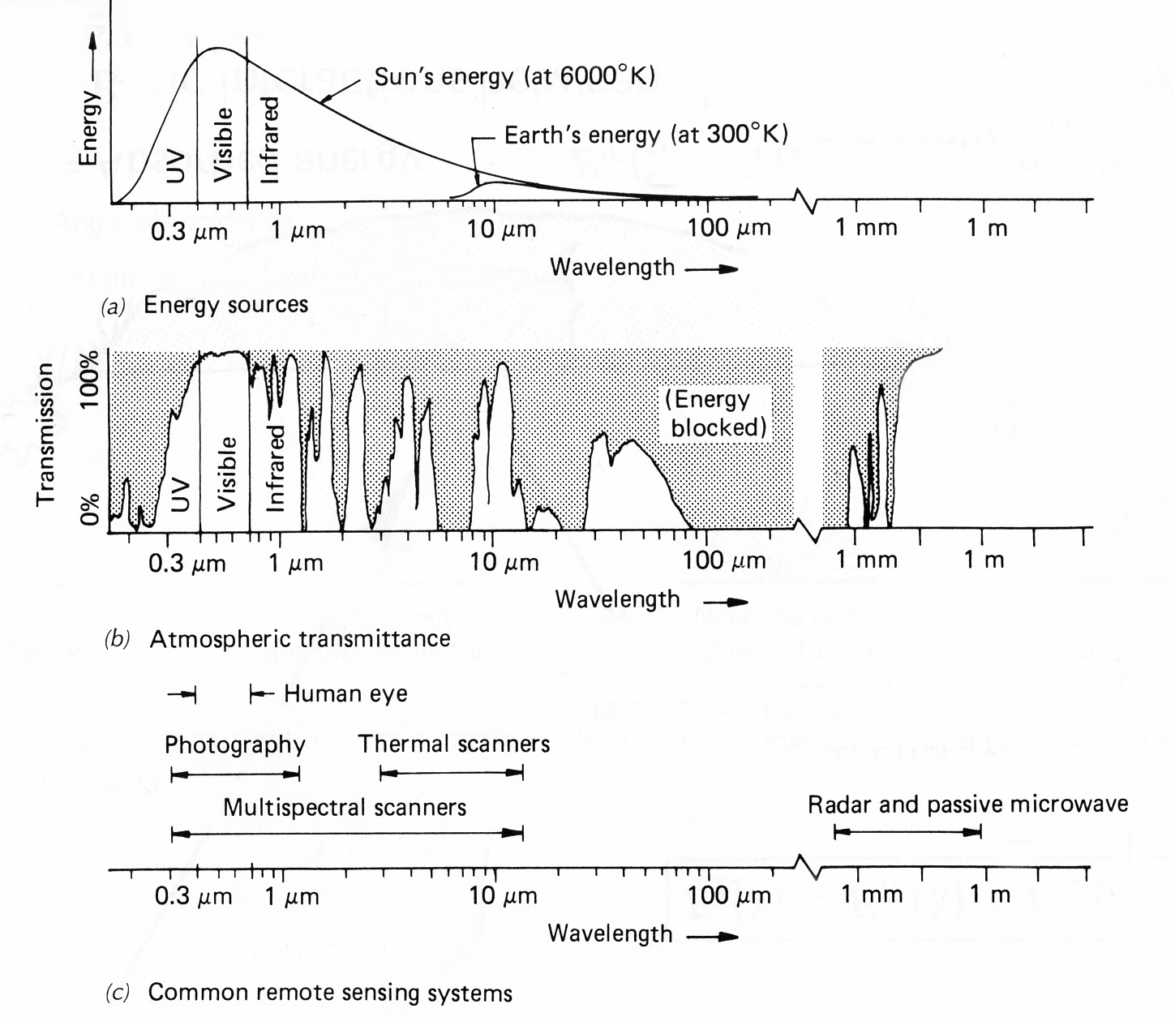
Spectral Characteristics of
Atmospheric Transmission and Sensing Systems

Slide 4
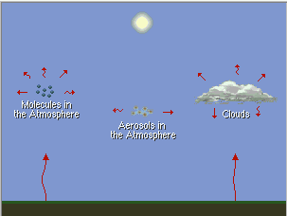
Re-emission of Infrared Radiation

Slide 5
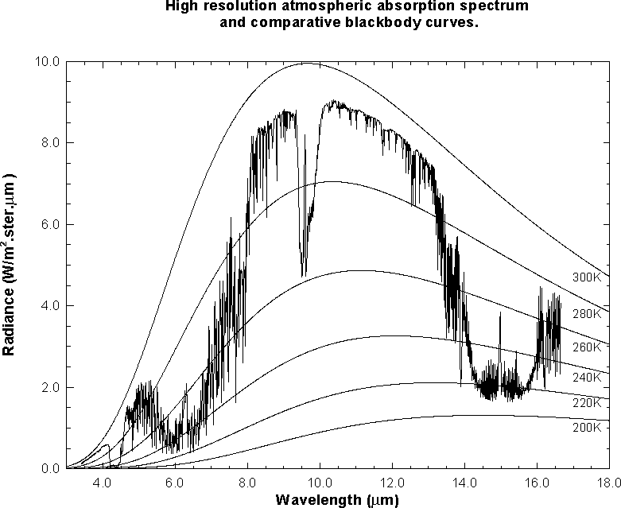
Earth emitted spectra overlaid on Planck function envelopes
O3
H2O
CO2
H2O
CO2
CO2

Slide 6
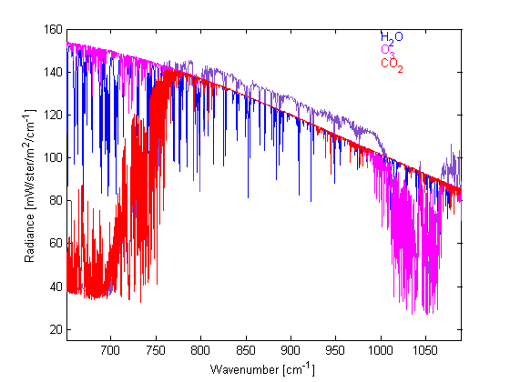
IR absorption Spectra due to CO2, H2O, O3 vibrations and rotations

Slide 7
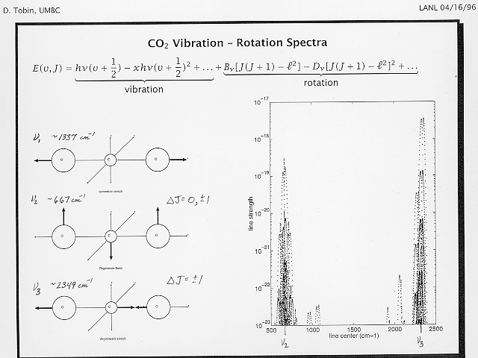
CO₂ Lines

Slide 8
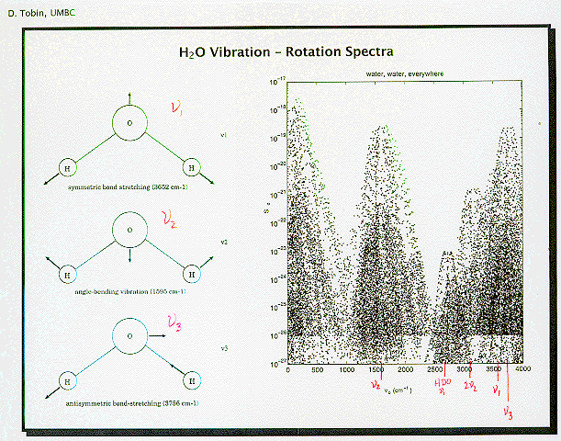
H₂O Lines

Slide 9
I_{λ} = ε_{λ}^{sfc} B_{λ}(T_{sfc}) τ_{λ}(sfc - top) + Σ ε_{λ}^{layer} B_{λ}(T_{layer}) τ_{λ}(layer - top)
layers
The emission of an infinitesimal layer of the atmosphere at pressure p is equal to the absorption (1 - transmission). So,
ε_{λ}(layer) τ_{λ}(layer to top) = [1 - τ_{λ}(layer)] τ_{λ}(layer to top)
Since transmission is multiplicative
τ_{λ}(layer to top) - τ_{λ}(layer) τ_{λ}(layer to top) = -Δτ_{λ}(layer to top)
So we can write
I_{λ} = ε_{λ}^{sfc} B_{λ}(T(p_{s})) τ_{λ}(p_{s}) - Σ B_{λ}(T(p)) Δτ_{λ}(p) .
p
which when written in integral form reads
p_{s}
I_{λ} = ε_{λ}^{sfc} B_{λ}(T(p_{s})) τ_{λ}(p_{s}) - ∫ B_{λ}(T(p)) [ dτ_{λ}(p) / dp ] dp .
o

Slide 10
Weighting Functions
z_{N}
z_{N}
z₂
z₂
z₁
z₁
1
τ
dτ/dz

Slide 11
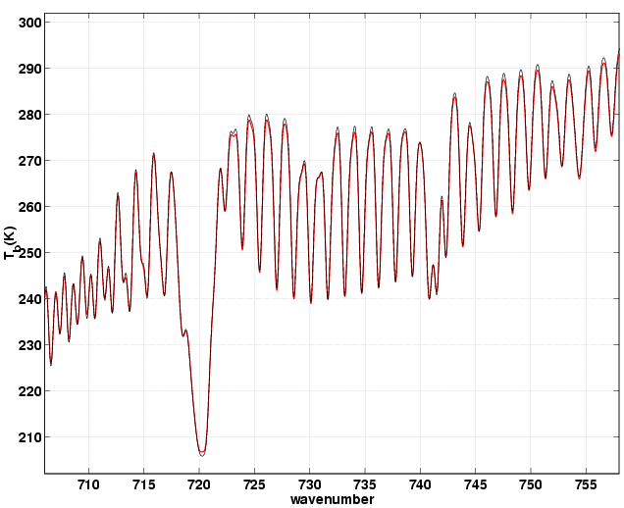
line broadening with pressure explains weighting function locations
- k_{λ} u
dτ_{λ} /dp where τ_{λ} = e
ABC
↓↓↓
k_{λ}
high z
(low p)
k_{λ}
mid z
k_{λ}
low z
A
B
C
↑↑↑ ABC
λ→

Slide 12
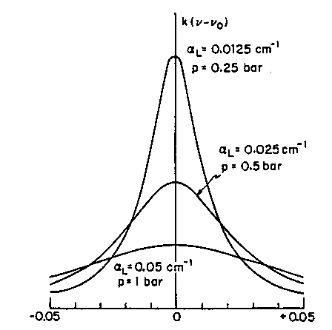
line broadening with pressure helps to explain weighting functions
- k_{ν} u (z)
τ_{ν} (z → ∞ ) = e
A
b
s
o
r
p
t
i
o
n
H
e
i
g
h
t
Wavenumber
Energy Contribution

Slide 13
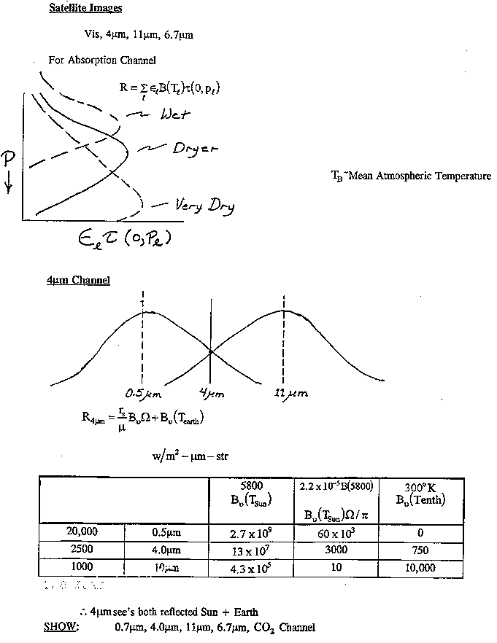
For a given water vapor spectral channel the weighting function location depends on the amount of water vapor in the atmospheric column
H
e
i
g
h
t
Wet Atm.
Wet
Moderate
Moderate
Dry Atm.
Dry
0
Tau
100%
=dTau/dHt
CO2 is about the same everywhere, the weighting function for a given CO2 spectral channel is the same everywhere

Slide 14
When reflection from the earth surface is also considered, the Radiative Transfer Equation for infrared radiation can be written
o
I_{λ} = ε_{λ}^{sfc} B_{λ}(T_{s}) τ_{λ}(p_{s}) + ∫ B_{λ}(T(p)) F_{λ}(p) [dτ_{λ}(p)/ dp] dp
p_{s}
where
F_{λ}(p) = { 1 + (1 - ε_{λ} ^{sfc} ) [τ_{λ}(p_{s}) / τ_{λ}(p)]² }
since τ↓(a,b) = τ↑(a,b) commutative
and τ(a,b) * τ(b,c) = τ(a,c) associative
The first term is the spectral radiance emitted by the surface and attenuated by the atmosphere, often called the boundary term and the second term is the spectral radiance emitted to space by the atmosphere directly or by reflection from the earth surface.
The atmospheric contribution is the weighted sum of the Planck radiance contribution from each layer, where the weighting function is [ dτ_{λ}(p) / dp ]. This weighting function is an indication of where in the atmosphere the majority of the radiation for a given spectral band comes from.

Slide 16
MODIS IR Spectral Bands
Notes:
Figure 1 shows the spectral responses of the MODIS infrared bands in relation to an atmospheric emission spectrum computed by a line-by-line radiative transfer model (LBL-RTM) for the US standard atmosphere.

Slide 17
Primary Atmospheric Application | Band | Bandwidth¹ | T_{typical} (K) | Radiance² at T_{typical} | NEΔT (K) Required
Temperature profile | 25 | 4.482-4.549 | 275 | 0.59 | 0.25
Moisture profile | 27 | 6.535-6.895 | 240 | 1.16 | 0.25
 | 28 | 7.175-7.475 | 250 | 2.18 | 0.25
 | 29 | 8.400-8.700 | 300 | 9.58 | 0.05
Ozone | 30 | 9.580-9.880 | 250 | 3.69 | 0.25
Surface Temperature | 31 | 10.780-11.280 | 300 | 9.55 | 0.05
 | 32 | 11.770-12.270 | 300 | 8.94 | 0.05
Temperature profile | 33 | 13.185-13.485 | 260 | 4.52 | 0.25
 | 34 | 13.485-13.785 | 250 | 3.76 | 0.25
 | 35 | 13.785-14.085 | 240 | 3.11 | 0.25
 | 36 | 14.085-14.385 | 220 | 2.08 | 0.35

Slide 18
MODIS TPW, UTH, & TOZ
  MODIS TPW, UTH, and TOZ retrievals are based on a statistical regression developed from the SeeBor data base (Borbas et al. 2005) that consists of geographically and seasonally distributed radiosonde, ozonesonde, and ECMWF ReAnalysis data.
  Retrievals are determined for clear sky radiances measured by MODIS over land and ocean both day and night (Seemann et al. 2003, Seemann et al. 2008).
  * MOD35 cloud mask algorithm (Ackerman et al. 1998) is used to identify pixels that are cloud free. The operational retrieval algorithm averages the clear pixels in a 5x5 field-of-view (at least 5 of the 25 pixels must be clear).

Slide 19
Algorithm Adjustments

Slide 20


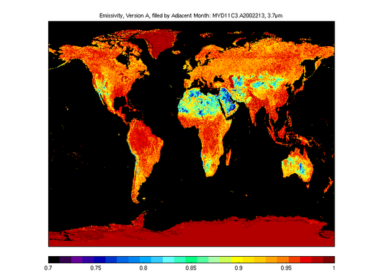
Current status of the UW Global Infrared Land
Surface Emissivity Database
Time coverage: Monthly: Oct 2002 - Dec 2006 - 4.2 years (based on MYD11 V4.0)
Jan 2007–Dec 2013 – 7.0 years (based on MYD11 V4.1)
Spatial Resolution: 0.05 degree ~ 5 km;
Spectral Resolution: 10 hinge points (3.7 and 14.3 μm)
Available: http:/cimss.ssec.wisc.edu/iremis
Applications/Users:
MODIS Atmospheric Retrievals (UW,NASA)
IMAPP/AIRS retrievals (UW)
GEOCAT (NOAA/CIMSS)
Climate Monitoring SAF (EUMETSAT)
AIRS Retrieval of Dust Optical Depths
(UMBC/ASL)
IASI-Metop Cal/Val (CNES, France)
IASI retrieval (EUMETSAT, UW, Neteo-France))
Retrieval of hot spot data from AATSR (ESA)
Energy balance from ASTER over glacier
(Univ of Milan)
AIRS trace gas retrieval (Stellenbosch University,
South-Africa, JCET-UMBC)
Education (Seoul National Univ.; NTA, Konstantin)
SEVIRI water vapor retrievals (UW, EOS)
SEVIRI aerosol retrieval (Univ Oxford)
SEVIRI cloud and ozone retrieval (EUMETSAT)
SEVIRI cloud phase, cloud top parameter retrievals (KNMI)
LST retrievals from GOES-R (NOAA NESDIS)
OSS calculations (AER)
AIRS NWP model assimilation (UKMO)
Uwiremis BF emissivity at 3.7μm
Sept 2002-Dec 2006

Slide 21
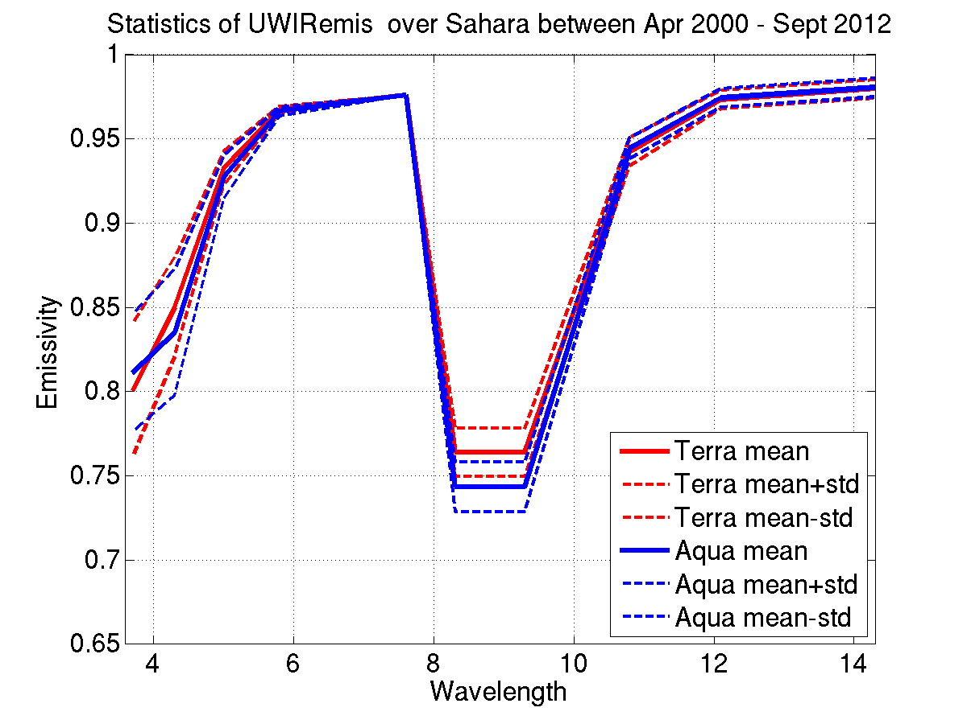
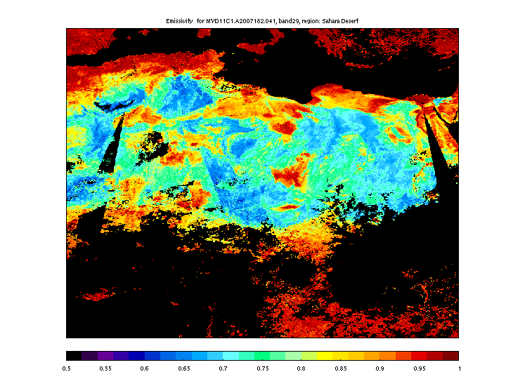

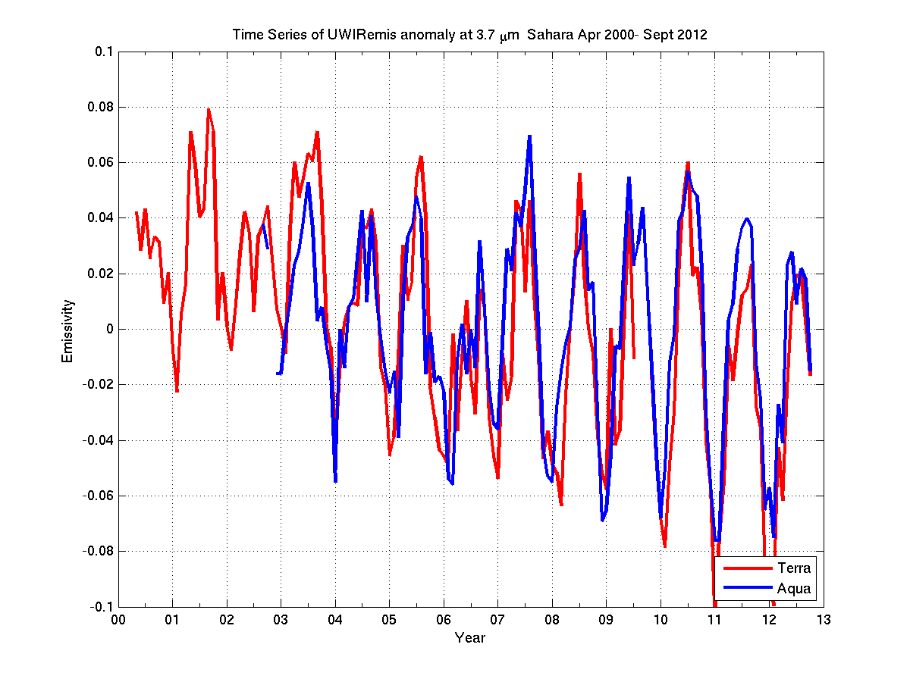
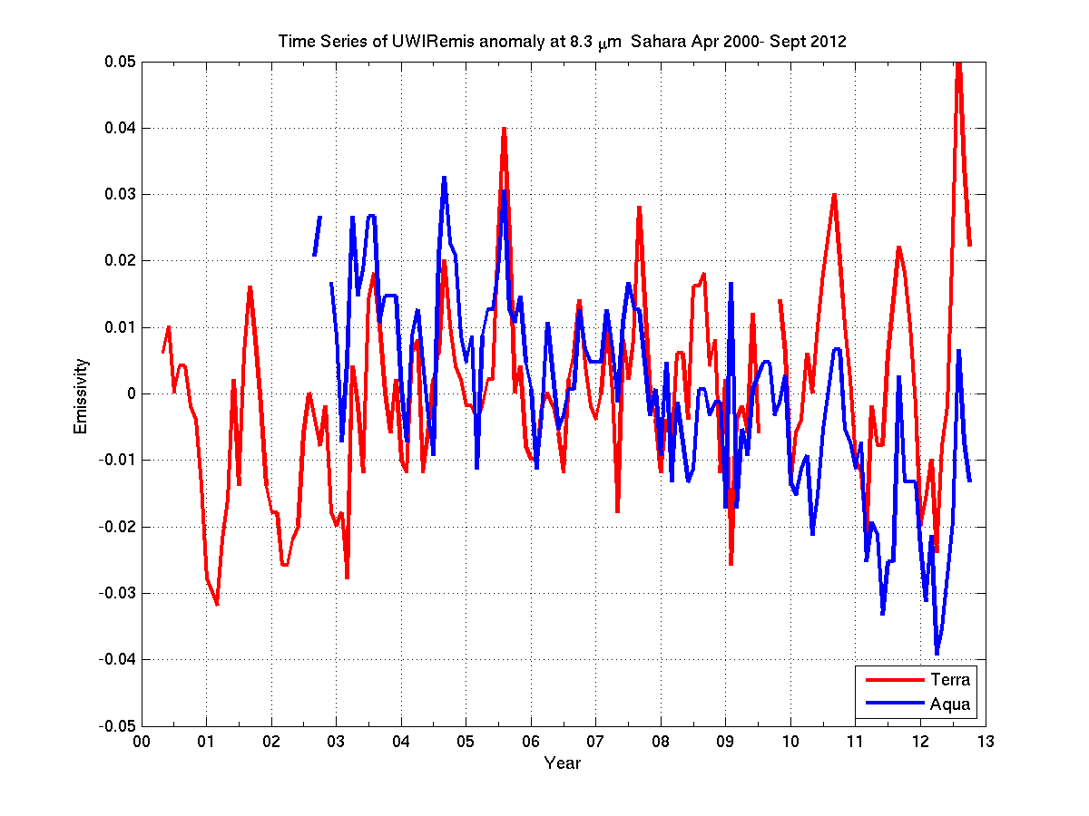
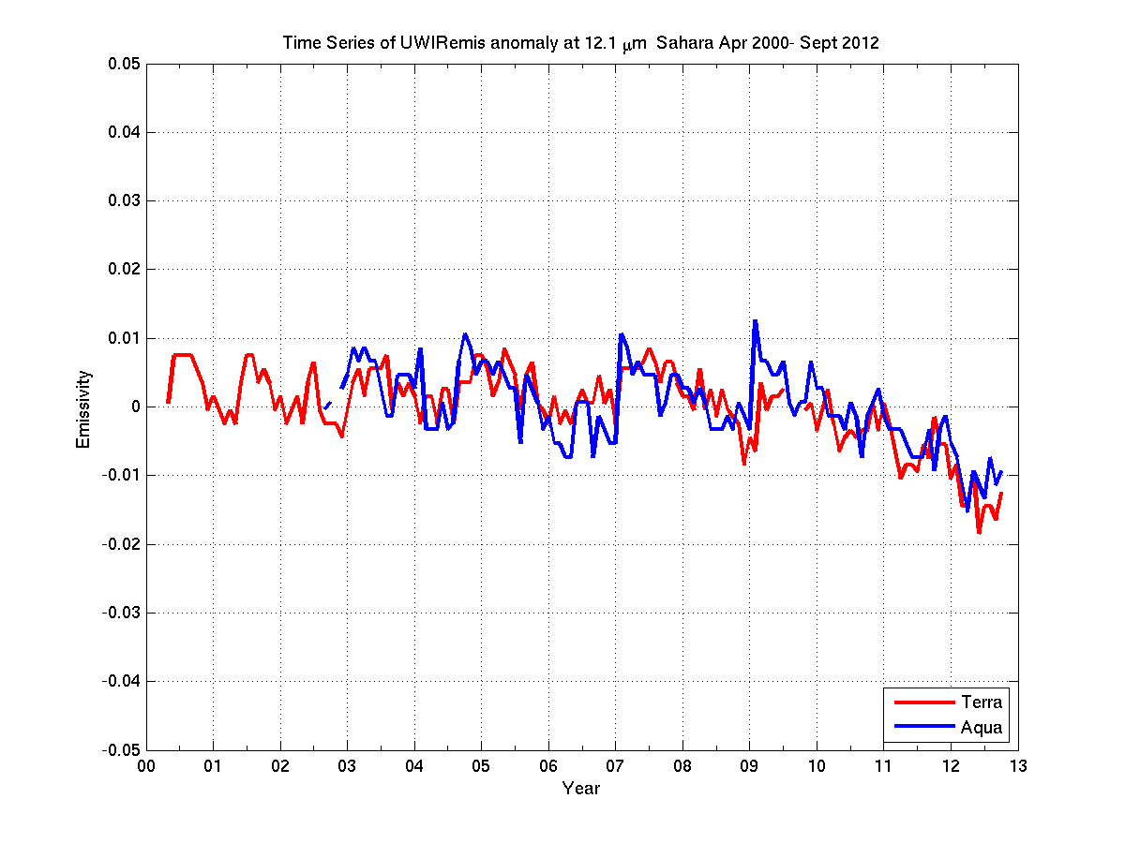
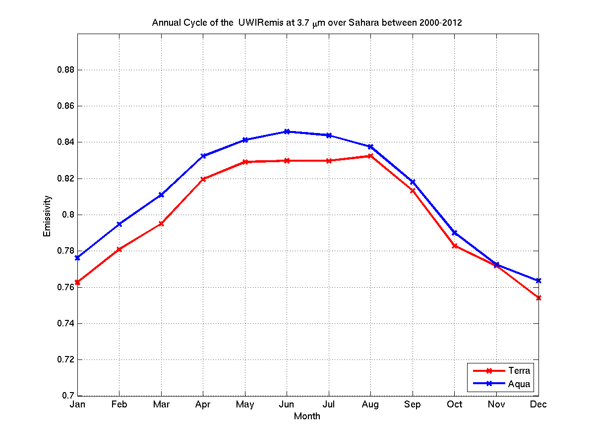
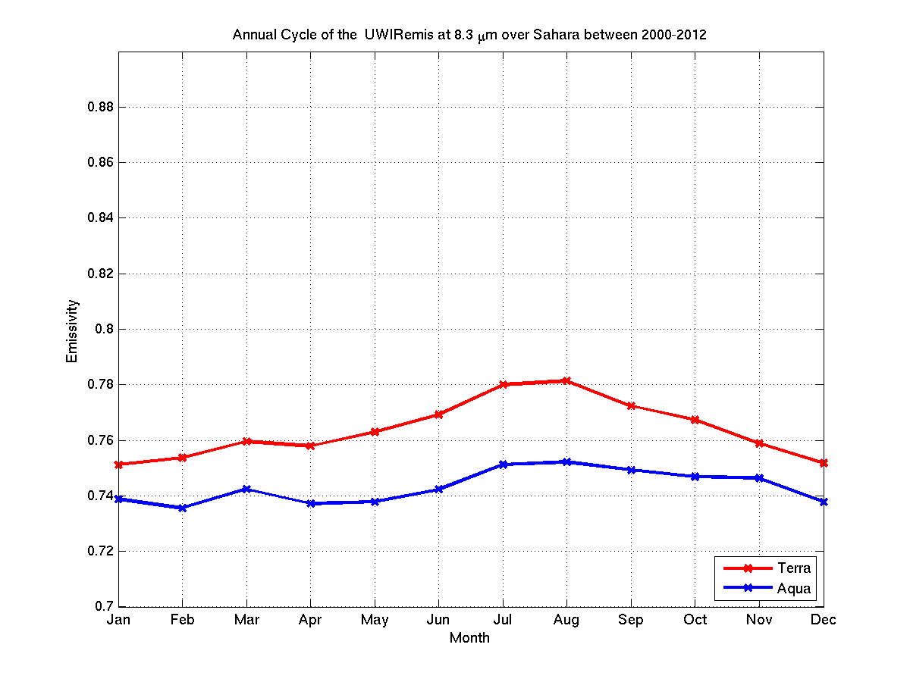
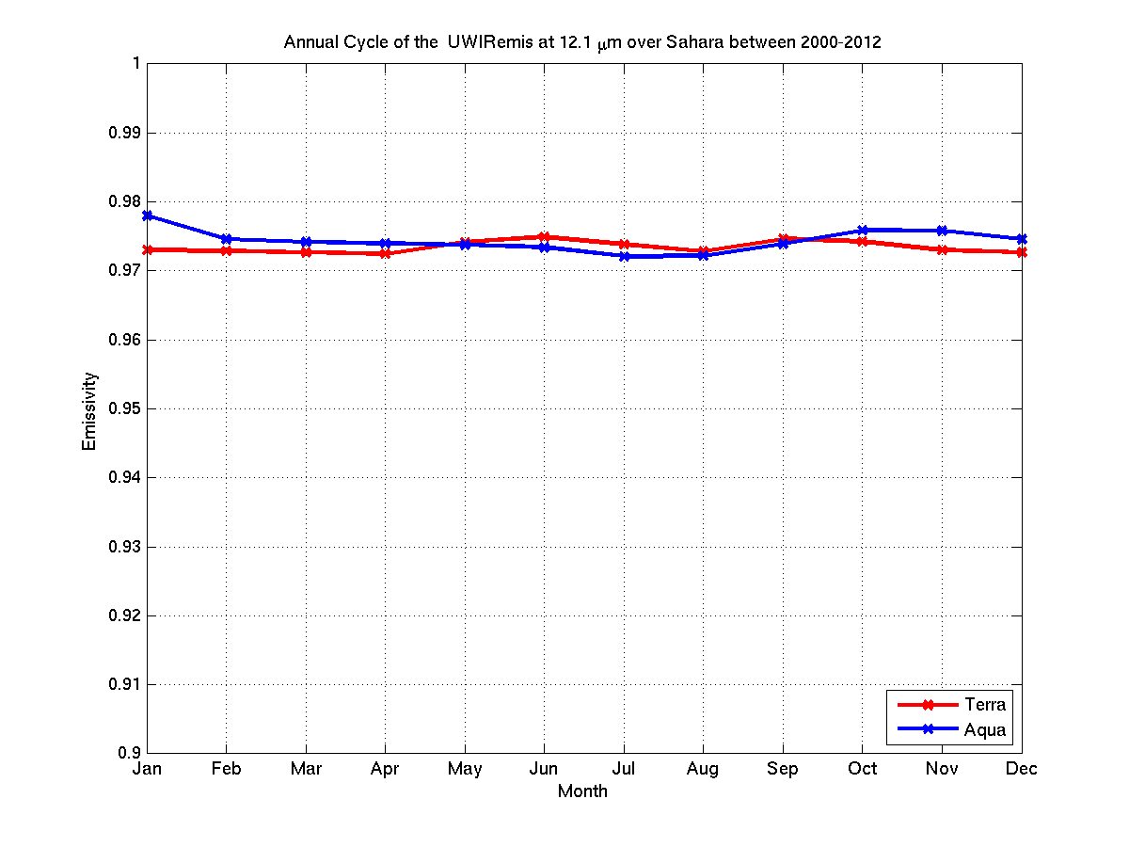
Ten years of the UW high spectral resolution global IR land
surface emissivity (UWIREMIS) database
The UW BF emissivity database is available at:
http://cimss.ssec.wisc.edu/iremis/
It covers the time from early postlaunch onwards
Terra: Apr 2000 – Sept 2012 / Aqua: Sept 2002– Sept 2012
Collection 6 updated in 2013.
Over 160 users are internationally distributed
The UWIREMIS module was implemented into RTTOV10 and
has been available since Jan 2012.
Timeseries of anomalies
Timeseries of anomalies
Timeseries of anomalies
3.7 μm
8.3 μm
12.1 μm
00 01 02 03 04 05 06 07 08 09 10 11 12 13
00 01 02 03 04 05 06 07 08 09 10 11 12 13
00 01 02 03 04 05 06 07 08 09 10 11 12 13
Annual cycle
Annual cycle
Annual cycle
3.7 μm
8.3 μm
12.1 μm
J F M A M J J A S O N D
J F M A M J J A S O N D
J F M A M J J A S O N D
Notes:
Figures show statistics over a selected sandy location in Sahara Desert. Similar figs but for latitude zones are presented at the AGU 2012.
Monthly mean Terra and Aqua MODIS emissivities show differences: Generally, Terra gives lower value over the SW range and higher value in the rest of the IR spectra.
Anomaly definition here: value – mean_value
There was a cloud mask update at 2007 January. It is very visible at higher latitude locations over all wavelength.
Decreasing emissivity can be seen for all three selected wavelengths from 2007.

Slide 22
Predictor | Noise used in MOD07 algorithm (Terra) | Noise used in MOD07 algorithm (Aqua)
Band 25 BT(4.52mm) | 0.063 ºK | 0.055 ºK
Band 27 BT (6.7mm) | 0.411ºK | 0.145 ºK
Band 28 BT (7.3mm) | 0.184ºK | 0.129 ºK
Band 29 BT (8.55mm) | 0.035ºK | 0.043 ºK
Band 30 BT (9.73mm) | 0.139ºK | 0.110 ºK
Band 31 BT (11mm) | 0.041ºK | 0.026 ºK
Band 32 BT (12mm) | 0.047ºK | 0.039 ºK
Band 33 BT (13.3mm) | 0.151 ºK | 0.082 ºK
Band 34 BT (13.6mm) | 0.234 ºK | 0.115 ºK
Band 35 BT (13.9mm) | 0.266 ºK | 0.146 ºK
Band 36 BT (14.2mm) | 0.428ºK | 0.209 ºK
Surface Pressure | 5 hPa | 5 hPa
Latitude | 0.0 | 0.0
Month | 0.0 | 0.0
Percent Land | 0.0 | 0.0

Slide 23
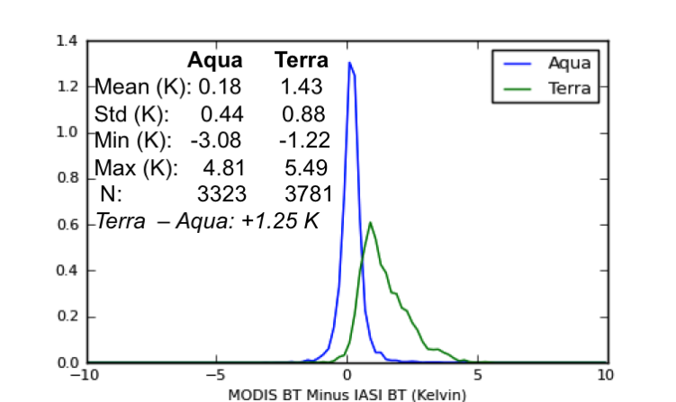
Band | Terra Shift (cm-1) | Aqua Shift (cm-1)
27 | 4 | 5
28 | 2 | 2
30 | 1 | 0
34 | 0.8 | 0.8
35 | 0.8 | 0.8
36 | 1 | 1
SRF shifts
suggested by
IASI intercomparisons
Band 30
MODIS minus IASI BT
Intercomparisons
before shift

Slide 24
Product Validation
Total Precipitable Water (TPW)
Total Ozone (TOZ)

Slide 25
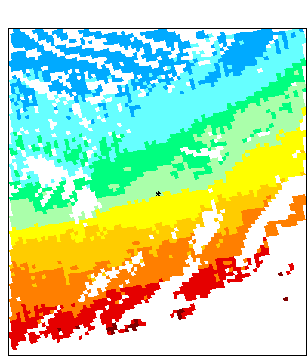
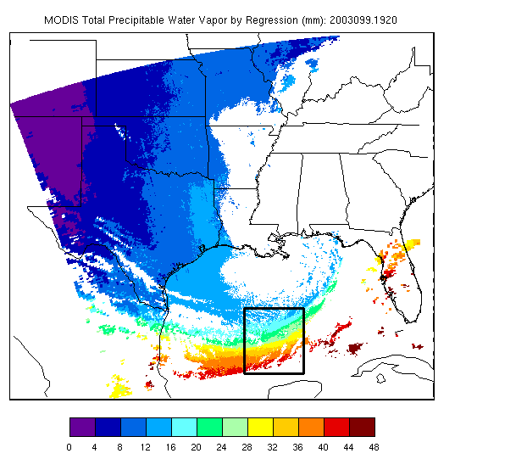
Aqua AIRS / MODIS MOD07 Comparison
MOD07 Collection 5 TPW
Only AIRS pixels with retrieval_type = 0 are displayed

Slide 26
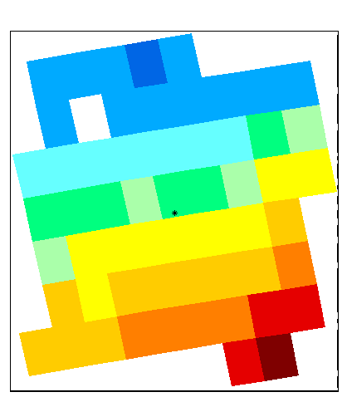
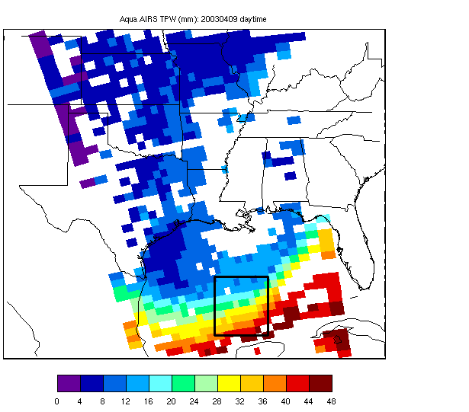
AIRS TPW (Granule #s 193 & 194)
airs_file193 = 'AIRS.2003.04.09.193.L2.RetStd.v3.0.8.0.G04114142705.hdf';
airs_file194 = 'AIRS.2003.04.09.194.L2.RetStd.v3.0.8.0.G04114143117.hdf';

Slide 27
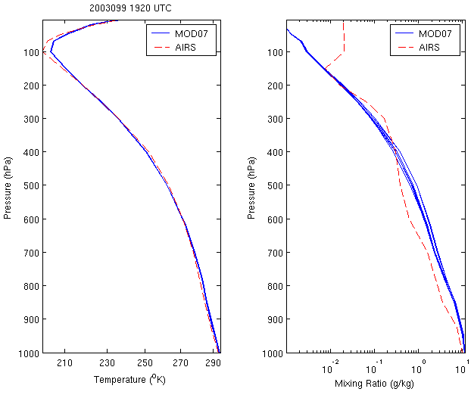
AIRS and collocated MOD07 profiles

Slide 28

Aqua/MYD07 TPW comparison with ground-based observations at the SGP CART site
Comparison of total precipitable water (mm) at the ARM SGP site from MODIS, with the ground-based ARM SGP microwave radiometer for 317 clear sky Aqua cases from 4/2001 to 8/2005.
Col6

Slide 29
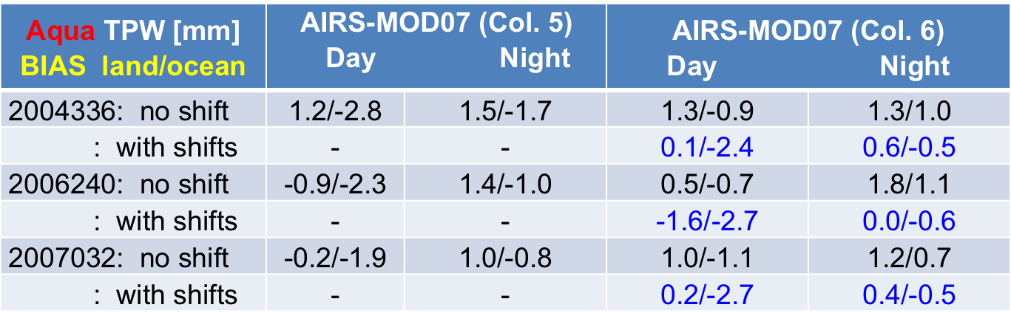
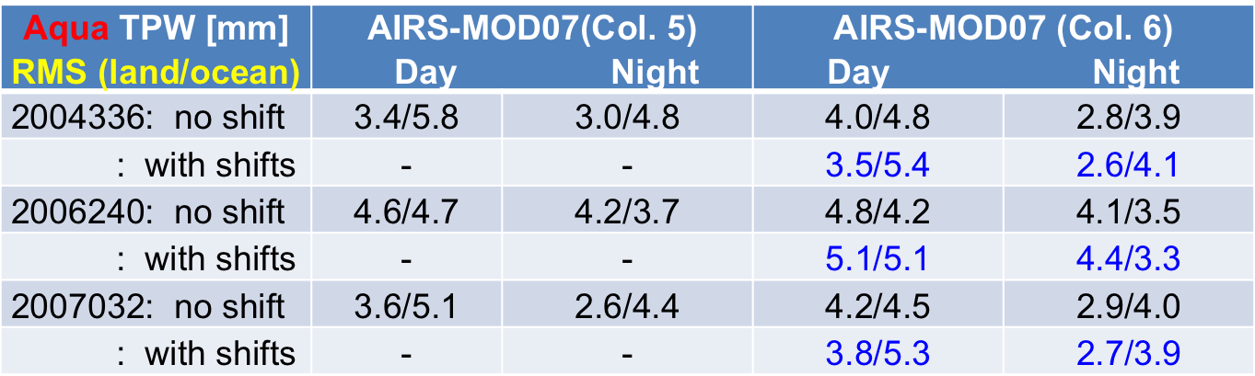
Global Aqua MYD07 TPW and AIRS L2 operational TPW products
separated by scene (sea/land and day/night)
Notes:
Table 11: Bias and rms differences between Aqua MODIS MOD07 TPW and AIRS L2 operational TPW products separated by scene (sea/land) and day – night for: Aug 28 2006 (2006240) , Aug 14 2001 (2001226), and March 11 2007 (2006070).

Slide 30
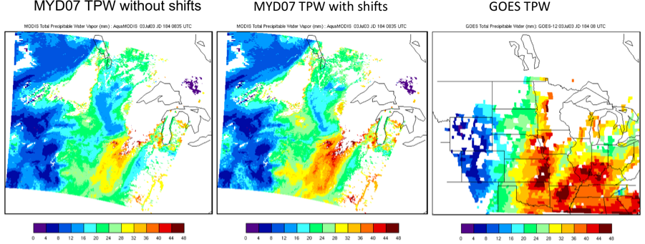
Total Precipitable Water from 3 July 2003 at 08:00 UTC
Notes:
Figure 10: Total Precipitable Water field from July 3, 2003, at 08:00 UTC.

Slide 31
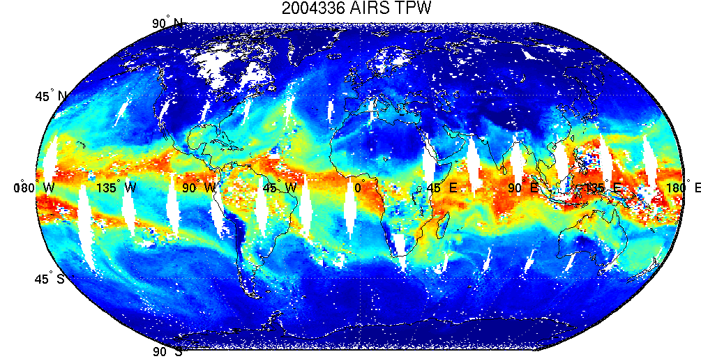
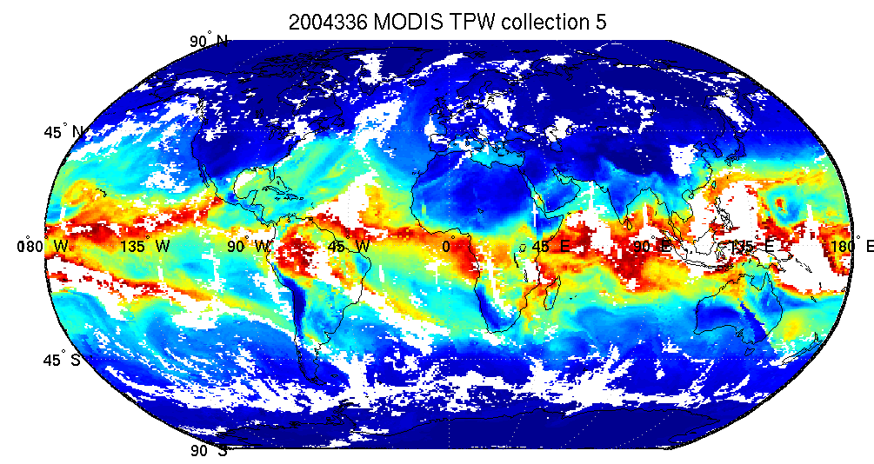
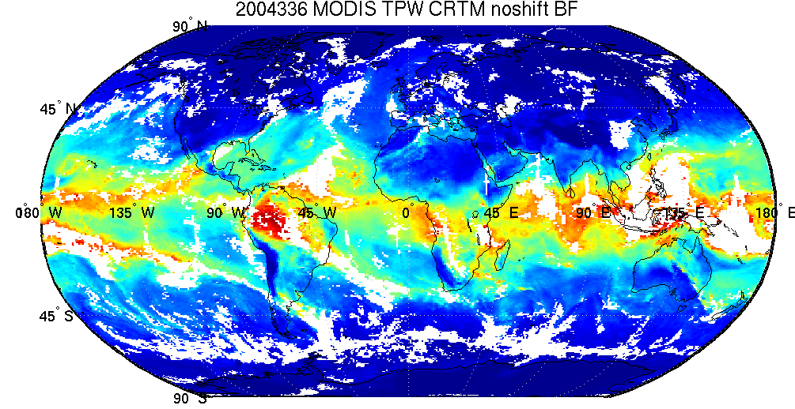

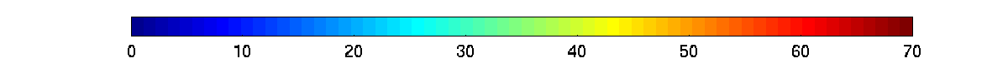
AIRS versus MODIS TPW
Notes:
Figure 15: Comparison of the official AIRS L2 (top left) standard TPW products and MODIS Collection 5 (top right) and Collection 6 TPW products with spectral shifts applied (top right) and without for December 1, 2004.

Slide 32
Total Ozone

Slide 33
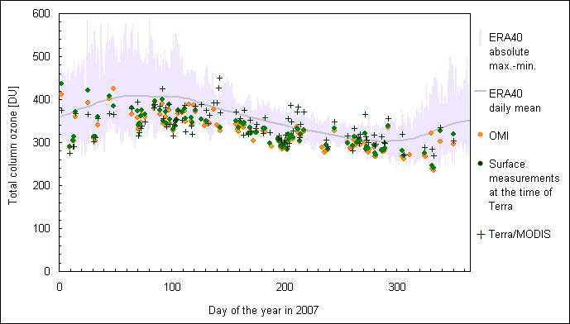
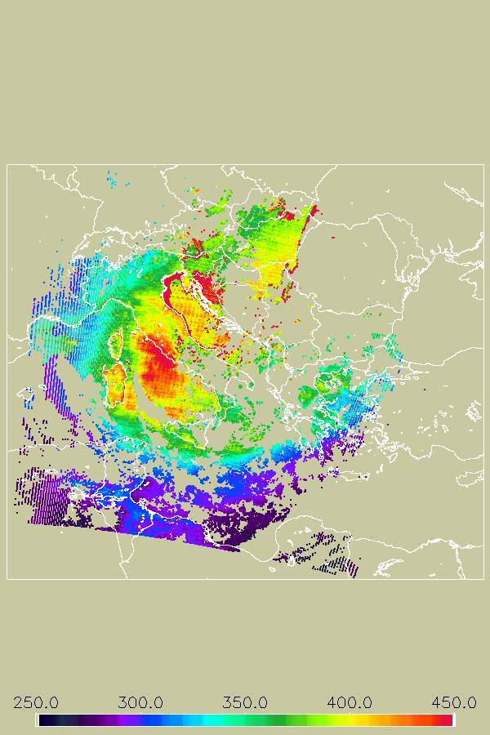
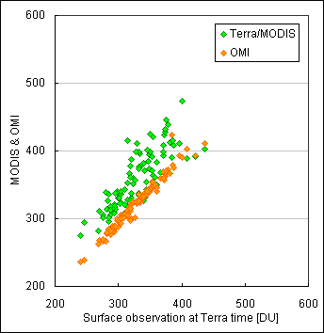
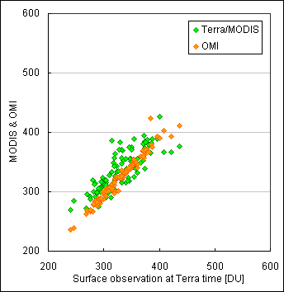
The impact of the Terra H2O/CO2/O3 channel spectral shifts on MOD07 TOZ over Budapest, HU over 2007: Comparison with ground-based Brewer Spectrophotometer measurements
Col6
April 14 2007 at 09:50 UTC
Terra/MODIS with shift
The impact of the Terra H2O/CO2/O3 band spectral shifts on MOD07 TOZ over Budapest, HU
for 2007: Comparison with ground-based Brewer Spectrophotometer measurements
Budapest, HU
No shift
With shift
Notes:
IASI (earlier AIRS) vs MODIS BT differences show that MODIS H2O and (Terra only) O3 channels are more opaque while the CO2 channels are less opaque.
TOZ: Overall, application of Terra spectral shifts shows significant improvement (reduced bias and rms) for MOD07 TOZ products in both the local (Budapest, Hungary)
and global validation studies. The Aqua TOZ is also positively effected on the global scale by the H20/CO2 spectral shifts.
TPW: Application of spectral shifts improved MOD07 TPW products (reduced bias) for the dry cases at the SGP cart and also over the global scale.

Slide 34
MODIS and OMI vs. ground-based Brewer TOZ for 2007
at Budapest, Hungary
with SRF shift wo SRF shift
Notes:
Figure 11: Scatter plot of satellite-based (MODIS and OMI) Total Ozone vs. ground-based Brewer measurements for the year 2007 at Budapest, Hungary with (left) and without (right) the MODIS H2O/CO2/O3 channel SRF shifts applied.

Slide 35
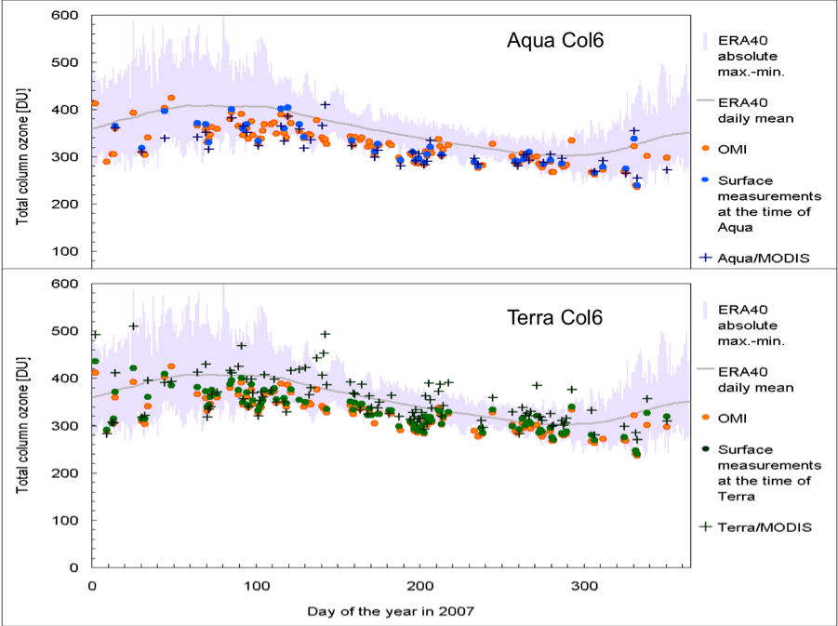
Total Ozone observations for the year 2007 over Budapest, Hungary separated by Aqua (Top) and Terra (bottom) overpass times.
Terra Col6
2007 ECMWF ERA40 daily mean and absolute maximum and minimum TPW shown in grey.
Notes:
Figure 12: Time series of Total Ozone observations for the year 2007 over Budapest, Hungary separated by Aqua (Top) and Terra (bottom) overpass times. The ECMWF ERA40 daily mean and absolute maximum and minimum TPW for the year 2007 are also plotted in grey.

Slide 36
Comparison of TOZ measured by OMI and MODIS (Terra and Aqua) vs surface Brewer measurements for year 2007 over Budapest, Hungary.
Satellite-based TOZ vs. Surface Brewer Measurements | Bias [DU] | Stdev [DU] | RMSE [DU]
OMI at Terra overpass times | 6.8 | 6.9 | 9.7
MOD07/Terra Col 5 | -16.8 | 20.0 | 26.1
MOD07/Terra Col 6 without spectral shifts | -35.5 | 26.7 | 44/4
MOD07/Terra Col 6 with spectral shifts | -9.6 | 21.6 | 23.6
OMI at Aqua overpass times | 0.6 | 7.5 | 7.6
MYD07/Aqua Col 5 | 6.0 | 20.8 | 21.6
MYD07/Aqua Col 6 without spectral shifts | -1.2 | 17.6 | 17.7
MYD07/Aqua Col 6 with spectral shifts | 4.0 | 16.0 | 16.5
Notes:
Comparison of TOZ measured by OMI and MODIS (Terra and Aqua) vs the surface Brewer measurements for year 2007 over Budapest, Hungary. Bias, standard deviation, root mean square error and correlation are included.

Slide 37
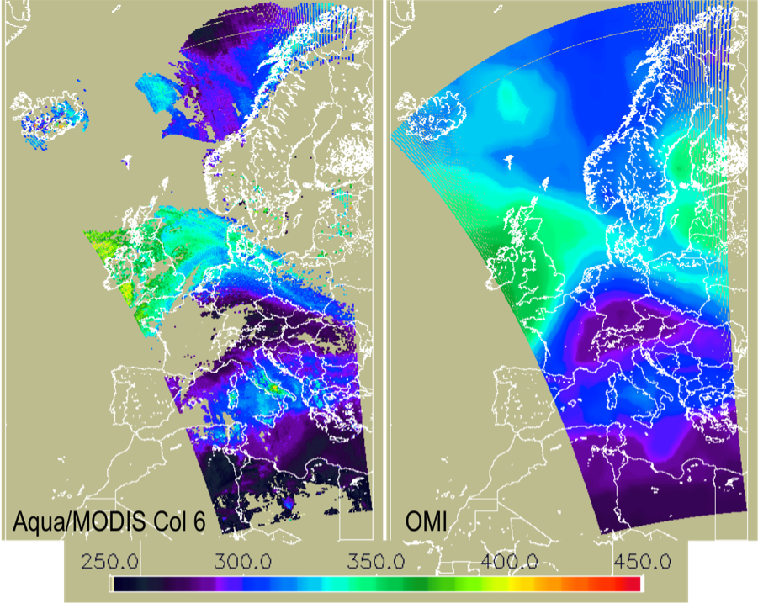
Total Ozone by Aqua/MODIS (left) and OMI (right) on July 8, 2007 at 12:18:55 UTC.
Notes:
Figure 13: Total Ozone by Aqua/MODIS (left) and OMI (right) on July 8, 2007 at 12:18:55 UTC.

Slide 38
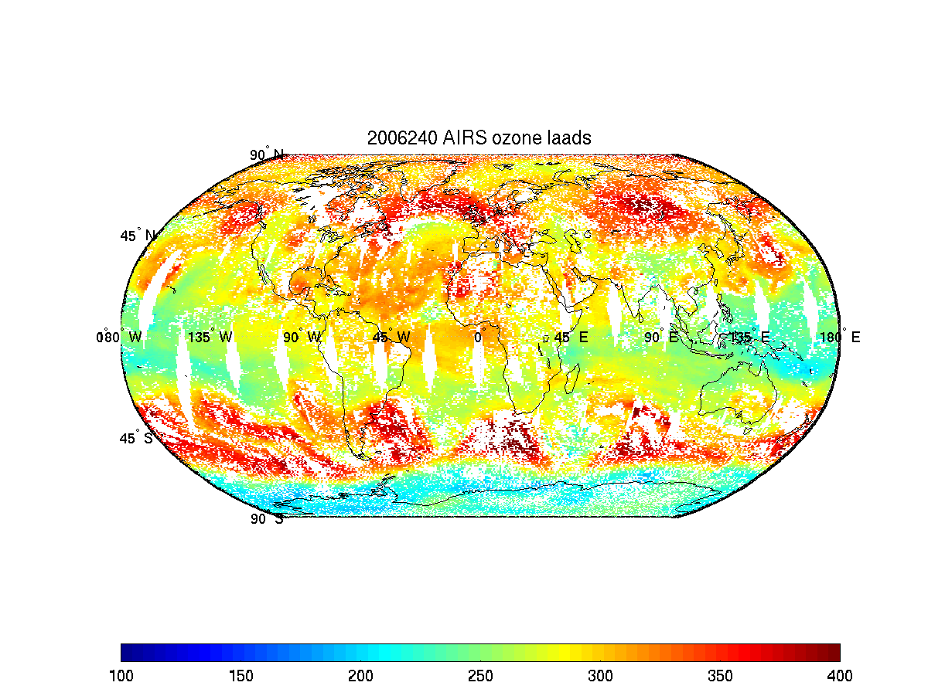
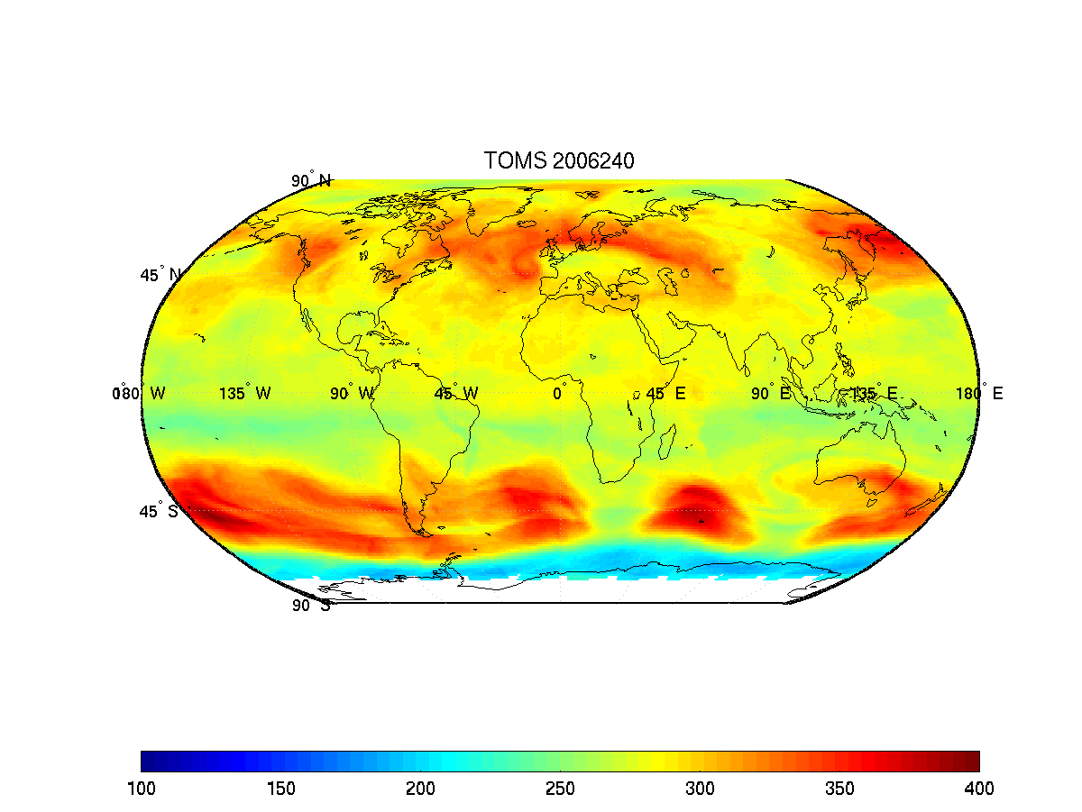
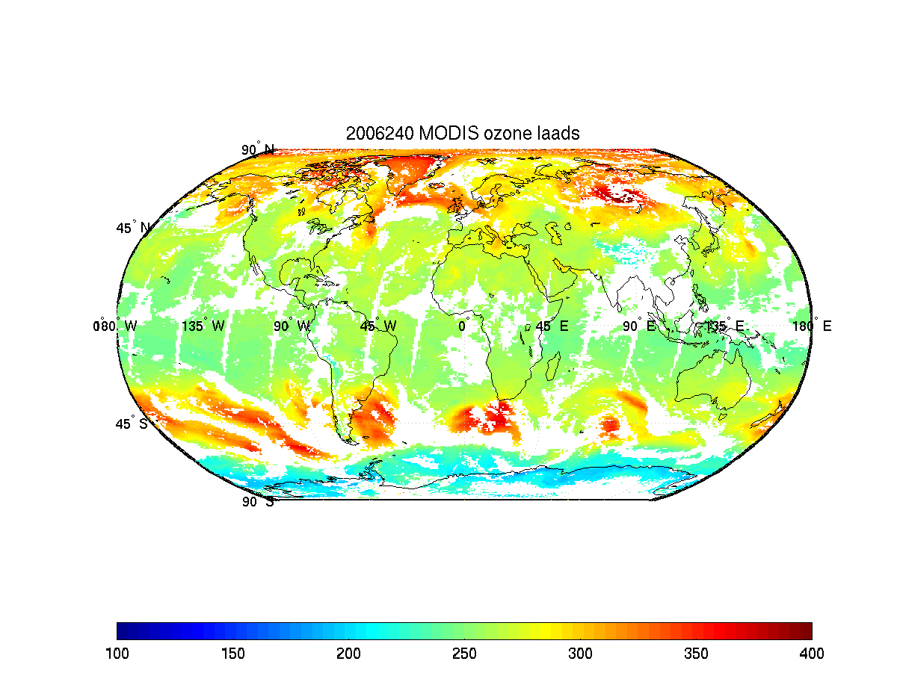
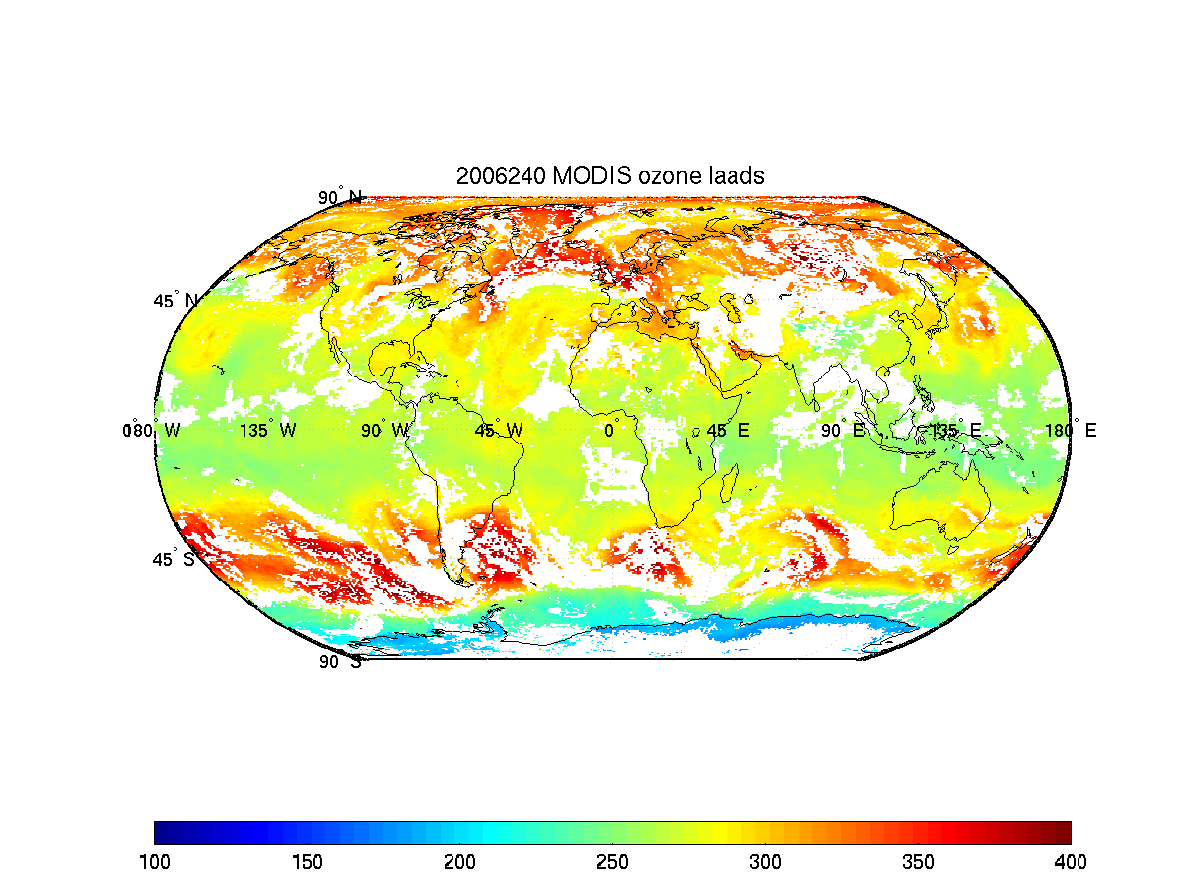
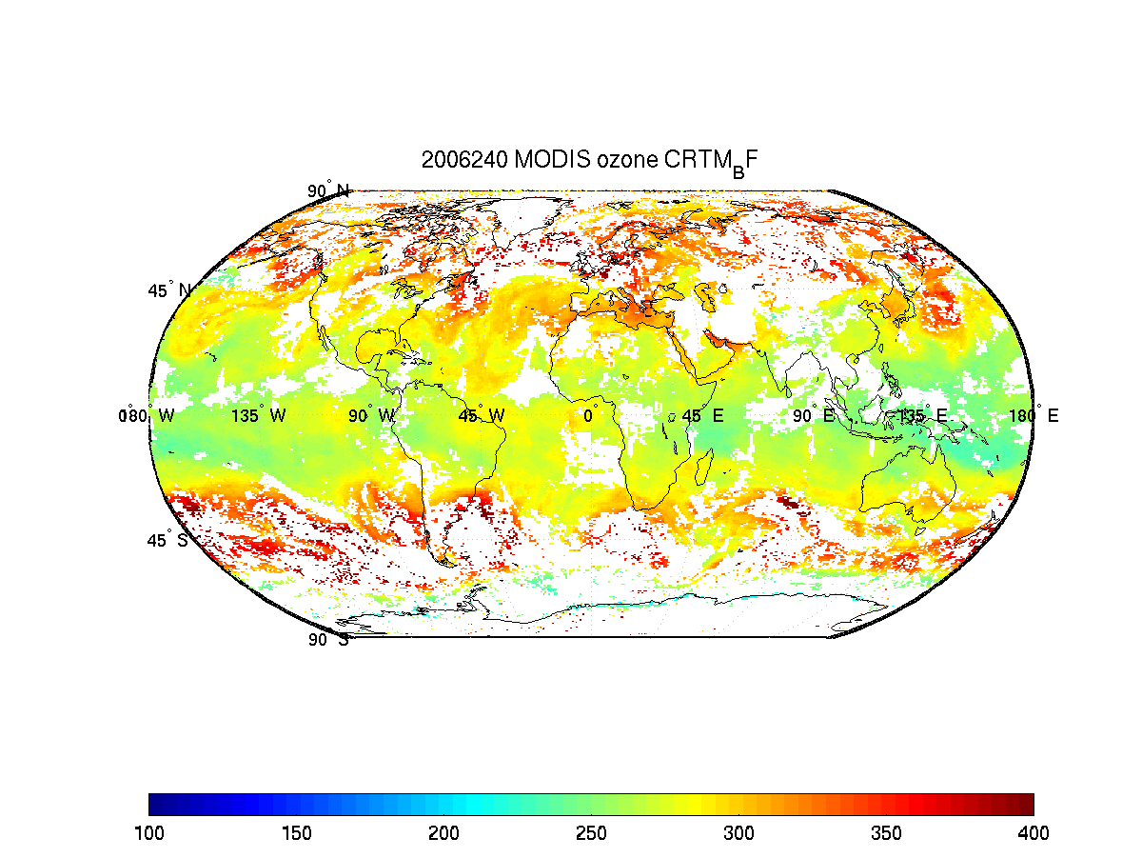
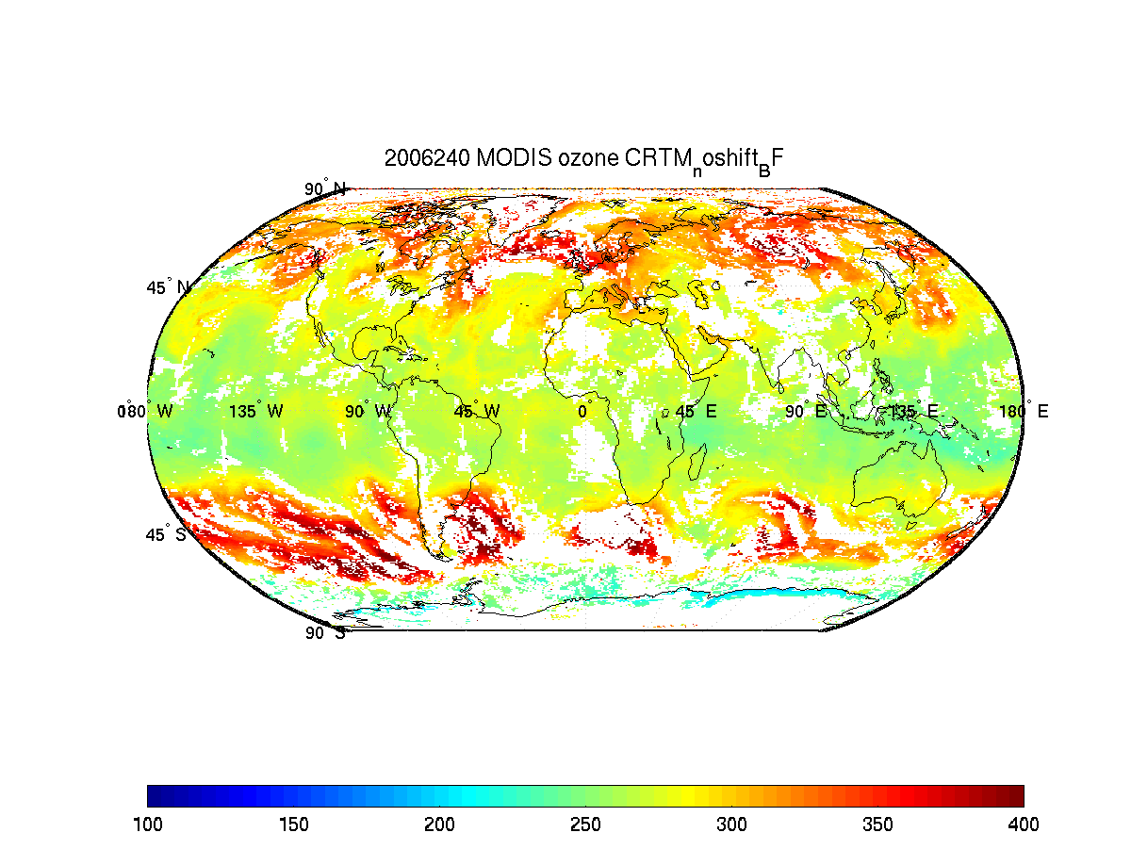
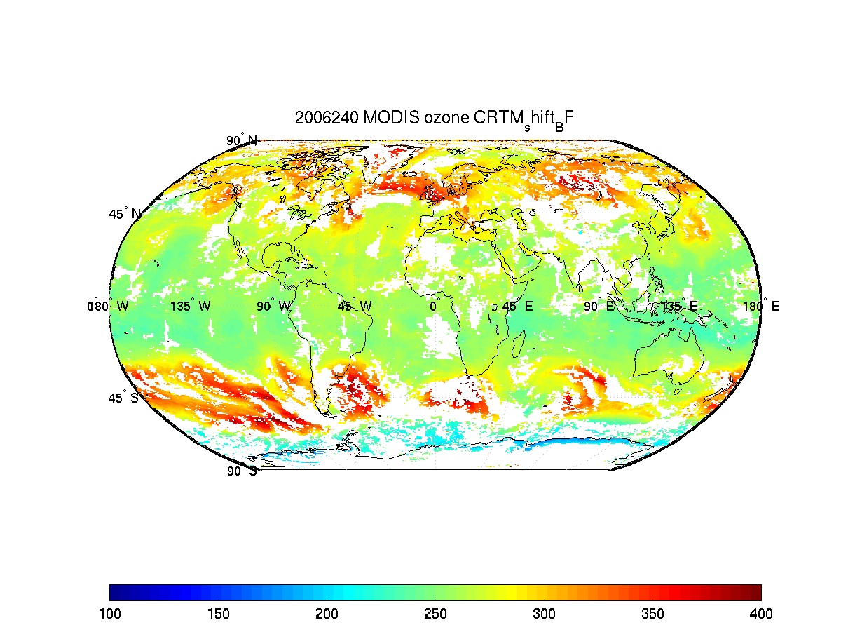
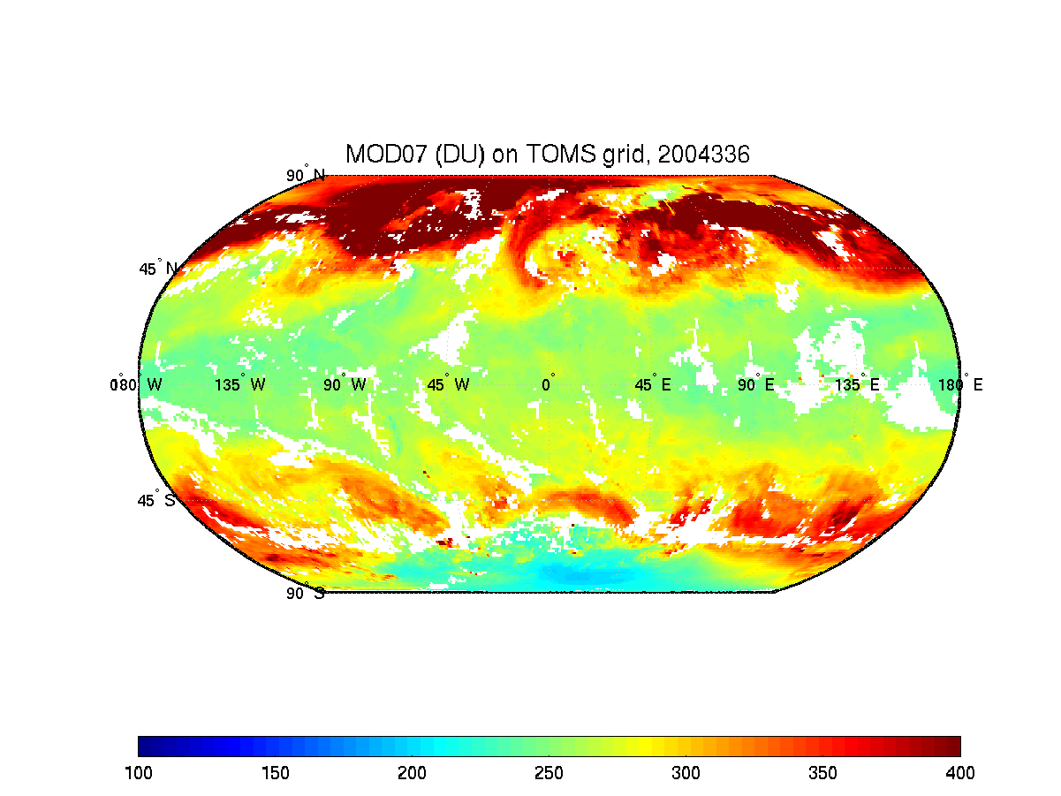
AIRS
Terra
MODIS
Col5
Aqua
MODIS
Col5
Aqua
MODIS
Col6
shifted
TOMS
OMI
Terra
MODIS
Col6
Aqua
MODIS
Col6
Total Ozone
Notes:
Figure 14: Total Ozone for August 28, 2006. Data sources from AIRS (top left), TOMS/OMI (top right), Terra/MODIS Col5 (2nd row left), Terra/MODIS Col6 (2nd row right), Aqua/MODIS Col5 (3rd row left), Aqua/MODIS Col6 without (3rd row right) and with (4th row) applying the H2O/CO2 channel spectral shifts.

Slide 39
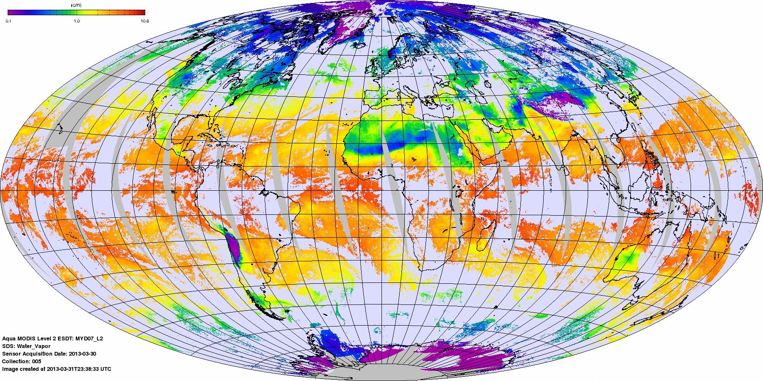
Conclusions
TOZ: Overall, application of Terra spectral shifts shows significant improvement (reduced bias and rms) for MOD07 TOZ products in both the local (Budapest, Hungary) and global validation studies. The Aqua TOZ is also positively effected on the global scale by the H20/CO2 spectral shifts.
TPW: Application of Aqua spectral shifts (using CRTM V1.2/ODAS) a significant positive improvement was realized for the Aqua/MODIS TPW over the SGP Cart site by applying the Band 27 & 28 spectral shifts. Comparing to the Col5 product, the dry bias for the wet cases has been reduced by 1.1mm!
For application of Terra spectral shifts show a positive effect for the dry cases (the wet bias is reduced by 0.5
mm), but have a negative effect for the
wet and overall cases (0.7 mm bias
increase). The overall rms differences
are not changed significantly.
MYD07 TPW

Slide 40
Recent Trends

Slide 41
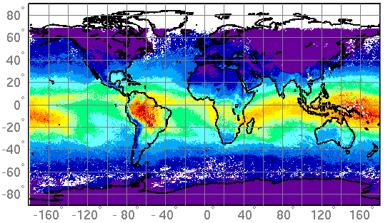
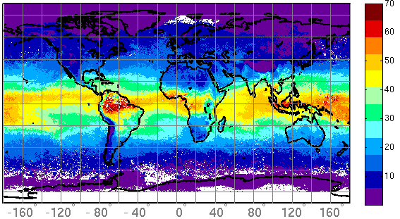
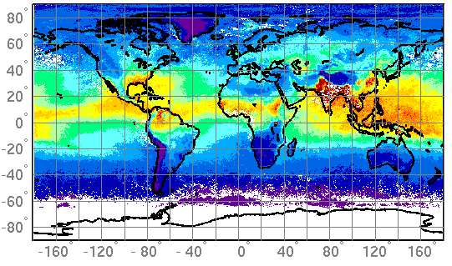
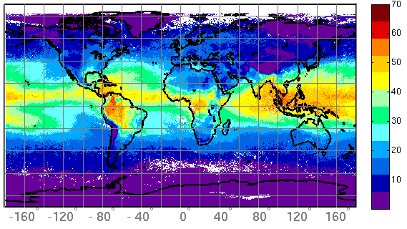
MOD07 monthly mean TPW (mm) (day)
Mm
M
M
M
M
M
M
M
M
M
M
M
M
M
M
M
M
M
m
January 2005
April 2005
July 2005
October 2005
(Borbas and Menzel)

Slide 42



MODIS 30-60 S Latitude
MODIS 30-60 N Latitude
MODIS -30 - +30 Latitude

Slide 43


MODIS 30-60 S Latitude
MODIS 30-60 N Latitude
MODIS -30 - +30 Latitude

Slide 44

Timeseries of MOD07 IWV high, middle and low over Daytime
MODIS 30-60 S Latitude
MODIS 30-60 N Latitude
MODIS -30 - +30 Latitude

Slide 45

Timeseries of MYD07 IWV high, middle and low over Daytime
MODIS 30-60 S Latitude
MODIS 30-60 N Latitude
MODIS -30 - +30 Latitude

Slide 46

Timeseries of MOD07 IWV high, middle, and low anomaly over Daytime
MODIS 30-60 S Latitude
MODIS 30-60 N Latitude
MODIS -30 - +30 Latitude

Slide 47

Timeseries of MYD07 IWV high, middle and low anomaly over Daytime
MODIS 30-60 S Latitude
MODIS 30-60 N Latitude
MODIS -30 - +30 Latitude

Slide 48






C
H
2
7
T
E
R
R
A
M
O
D
I
S
2008
2011
2009
2012
2010
2013

Slide 49






C
H
2
7
A
Q
U
A
M
O
D
I
S
2008
2011
2009
2012
2010
2013

Slide 50



Smoothed anomaly of SSMI
and Aqua MODIS TPW
La Ninas
Moderate 07-08
Strong 10-11
2008 La Nina Water Vapor 10 yr Anomaly
Notes:
Anomaly time series of TCWV both from SSM/I and from an average of GPS stations. The time series have been smoothed to remove variability on time scales shorter than 6 months. A linear fit to the SSM/I data is also shown, indicating an increasing trend in water vapor over the 1988–2008 period.
Peterson, T. C., and M. O. Baringer, Eds., 2009: State of the Climate in 2008. Bull. Amer. Meteor. Soc., 90, S1-S196.

Slide 51

Weak (<0.5C), moderate ,or strong (>1.5C) for at least 3 consecutive overlapping 3-month periods.
Notes:
The Oceanic Niño Index (ONI) has become the de-facto standard that NOAA uses for identifying El Niño (warm) and La Niña (cool) events in the tropical Pacific. It is the running 3-month mean SST anomaly for the Niño 3.4 region (i.e., 5oN-5oS, 120o-170oW). Events are defined as 5 consecutive overlapping 3-month periods at or above the +0.5o anomaly for warm (El Niño) events and at or below the -0.5 anomaly for cold (La Niña) events. The threshold is further broken down into Weak (with a 0.5 to 0.9 SST anomaly), Moderate (1.0 to 1.4) and Strong (≥ 1.5) events. For the purpose of this report for an event to be categorized as weak, moderate or strong it must have equaled or exceeded the threshold for at least 3 consecutive overlapping 3-month periods.

Slide 52
Conclusions
Regarding Atm Profiles
* Surface emissivity data base offers good retrievals over land and ocean
* TPW within 2 (4) mm rms for dry (wet) retrievals wrt ground microwave
* TOZ within 25 DU rms of OMI
Regarding Recalibration
* MODIS recalibration using IASI offers suggestions for SRF shifts
* Sensor calibration drift over time needs to be monitored and may need further correction to be useful for long term trend analyses
Regarding H2O Trends
* Terra and Aqua MODIS TPW trends are in good agreement; Terra MODIS UTH is out of family due to Ch 27 calibration drift
* Seasonal TPW cycle is strongest in northern mid-latitudes and weakest in tropics
* Seasonal TPW cycle is stronger in the afternoon than at night
* La Nina decrease in tropical TPW evident in all sensor trends
* Decrease in tropical TPW from 2002 to 2008 and increase after 2008 is evident Terra & Aqua MODIS

Slide 53
Contents of MOD07 Output File
Time, Lat, Lon, SZA, SatZA
BTs of IR bands
Cloud Mask
Sfc Skin T & p
Retrieved T(p), Q(p) at 20 levels
TOZ, TPW, TPW (440-10 hPa), TPW(sfc-680 hPa)
Stability Indices (LI, Total Totals, K-Index)

Slide 54
Extra Slides from the MOD07 ATBD and conference presentations

Slide 55

IRT Skin T – Sonde Surface Air T
Skin Temperature and Surface Air Temperature relationship for the SGP CART site based on clear sky observations between Apr2001 and Oct2003.
Solar Zenith Angle
Notes:
Figure 3: Skin Temperature and Surface Air Temperature relationship for the SGP CART site based on clear sky observations between April 2001 and October 2003. Points are colored according to solar azimuth category.

Slide 56


(left) 1 Aug 2005 TPW retrieved from MOD07 with two different surface emissivities used in the training data (0.95 left, BF center) for all Terra MODIS ascending (nighttime) passes over the Sahara Desert .
(right) 00 UTC NCEP-GDAS TPW analysis from 2 August 2005
Notes:
TPW retrieved from MOD07 with two different surface emissivities used in the training data (0.95 left, BF center) for all Terra MODIS ascending (nighttime) passes over the Sahara Desert region of Africa on 1 August 2005. MODIS overpass times range from 20:00 UTC (eastern Sahara) to 23:20UTC (western Sahara). For comparison, the 00 UTC NCEP-GDAS TPW analysis from 2 August 2005 is shown (right). The white areas in the MODIS image indicate no retrievals because of either cloudy skies or no MODIS data coverage.

Slide 57



MODIS MOD07 TPW for 21:40 UTC on August 1, 2005. Emissivities of 0.95 (left), 1.0 (center), and the baseline fit emissivity (right) were applied to the training data used in the regression retrieval algorithm.
Notes:
Figure 5: MODIS MOD07 TPW for the 5 minute Terra granule beginning at 21:40 UTC on August 1, 2005. This granule is in the north-central Sahara desert and is also shown in Figure 4, although the color scale range is different. Emissivities of 0.95 (left), 1.0 (center), and the baseline fit emissivity (right) were applied to the training data used in the regression retrieval algorithm.

Slide 58

TPW Bias (ARM SGP MWR minus MODIS MOD07) in mm for 18 different training data configurations. The statistics are shown for all cases (All), but also separated into “dry” (TPW < 15 mm) and “wet” (TPW >= 15mm) cases
Derived from integration of vertical layers regression or total column regression (dir)
Notes:
Figure 6: TPW Bias (ARM SGP MWR minus MODIS MOD07) in mm for 18 different training data configurations. The statistics are shown for all cases (All), but also separated into “dry” (TPW < 15 mm) and “wet” (TPW >= 15mm) cases,. The MOD07 TPW product is vertically integrated from the moisture retrievals (no indication in the legend) , but also can be derived directly during the synthetic regression using as a predictor. The statistics relate to the direct TPW is indicated by “dir” in the legend.

Slide 59

Notes:
Figure 7 As in Figure 6 except for TPW RMSE (ARM SGP MWR compared with MODIS MOD07) in mm for 18 different training data configurations.

Slide 60


Comparison of MODIS TPW (mm) and MWR at the ARM SGP site from MODIS (y-axis, red dots original, green dots “direct”): Aqua (left) and Terra (right)
Also shown are GOES-8 and -12 (blue diamonds) and radiosonde (black x’s) TPWs
Notes:
Figure 8: Comparison of total precipitable water (mm) at the ARM SGP site from MODIS (y-axis, red dots original, green dots “direct”): Aqua (left) and Terra (right) with the MWR. Also compared with the MWR are GOES-8 and -12 (blue diamonds) and radiosonde (black x’s). 317 Aqua and 345 Terra manually-selected clear sky cases from launch through 8/2005 are compared using the Collection 6 MODIS MOD07 algorithm.

Slide 61

Red wo SRF shift
Blue with SRF shift
Notes:
Figure 9: TPW differences between MWR and MOD07 data (y-axis) vs. the MWR TPW (X-axis) at the ARM SGP site for 317 clear sky cases from Sept 2002 to August 2005. Red stands for the Collection 6 algorithm run without the SRF shift applied and blue indicates the run with the spectral shift application.

Slide 62

Global Aqua (top) / Terra (bottom) MOD07 Total O3 (Dobson Unit) vs OMI TOMS and AIRS
Date (Terra) TOZ [DU] No shifts | OMI–MOD07 (Col5) bias ± Stdev | OMI –MOD07 (Col6) Bias ± Stdev | AIRS–MOD07 (Col5) Land Sea |  | AIRS–MOD07 (Col6) Land Sea
Aug 14 2001 | +2±17 | -9±26 | - | - | - | -
March 11 2006 | -1±29 | -14±49 | +7±38 | -1±19 | +27±52 | -5±34
Aug 28 2006 / | +1±25 | -8±41 | -+29±71 | +9±66 | -0.6±38 | -3±30
Notes:
Table 9: Global comparison of Aqua (top) and Terra (bottom) MOD07 Total Ozone (Dobson Unit) with OMI TOMS and AIRS retrievals for two selected days. Collection 6 MODIS TOZ without and with the spectral shifts are also calculated and shown.

Slide 63



MODIS WVNIR, MOD07 and RAOB TPW (mm)
ECMWF (12h forecast) TPW (mm)

Slide 64



