Slide 1
Using Aerosol Express (aka Giovanni-4)
with MODIS Aerosol Data
James G. Acker
NASA Goddard Earth Sciences Data and Information Services Center
(GES DISC)
October 1, 2014

Slide 2
Aerosol Express & Giovanni-4
The first public release of the next-generation Giovanni system, Giovanni-4, was named Aerosol Express because it operated exclusively atmospheric aerosol data.
This presentation will demonstrate the basic operations of Giovanni-4, and provide two basic case studies using the system.

Slide 3
The basic operations of Giovanni-4, like its predecessor system,
are:
Selecting the desired visualization type;
selecting the time period of interest;
selecting the spatial area of interest; and
selecting the data variables to be plotted.
The following slides will demonstrate each of these operations.

Slide 4
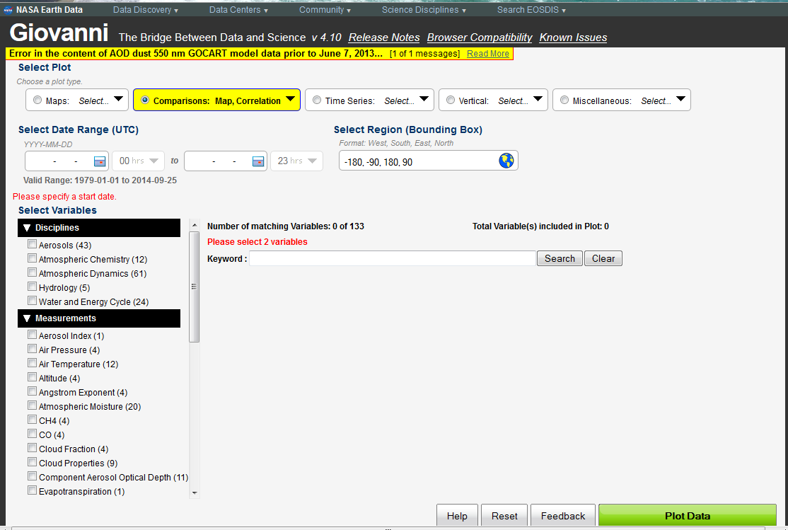
The Giovanni-4 Interface

Slide 5
Selecting a Visualization Type

Slide 6
Selecting a Data Product

Slide 7
Selecting a Time Period

Slide 8
Selecting a Spatial Region

Slide 9
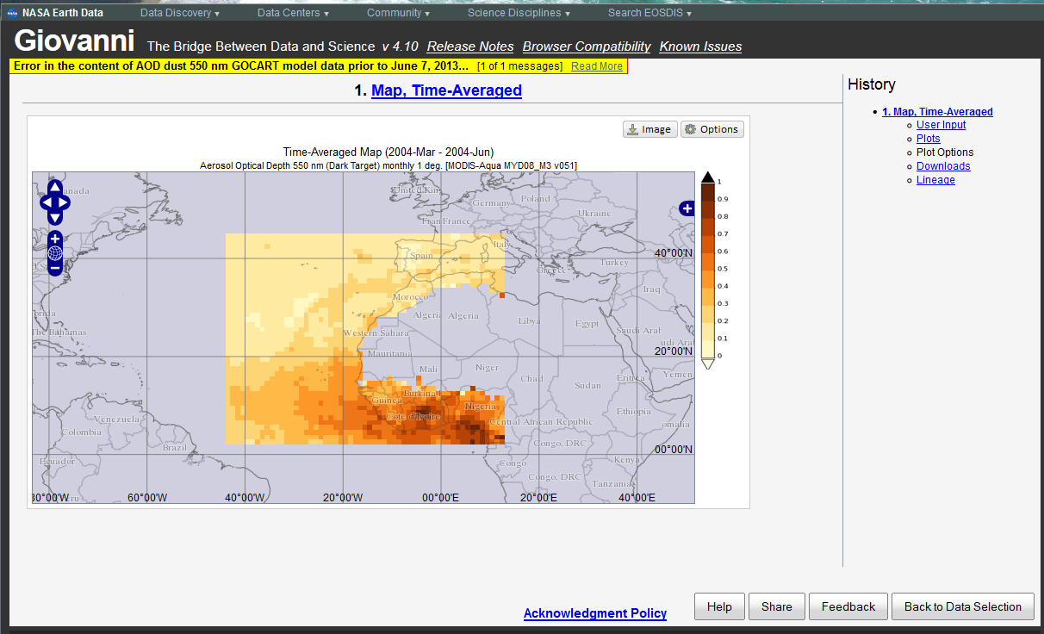
Result
Plot Options
(palette and range)
Image download
Report a problem or make a suggestion
Do it again

Slide 10
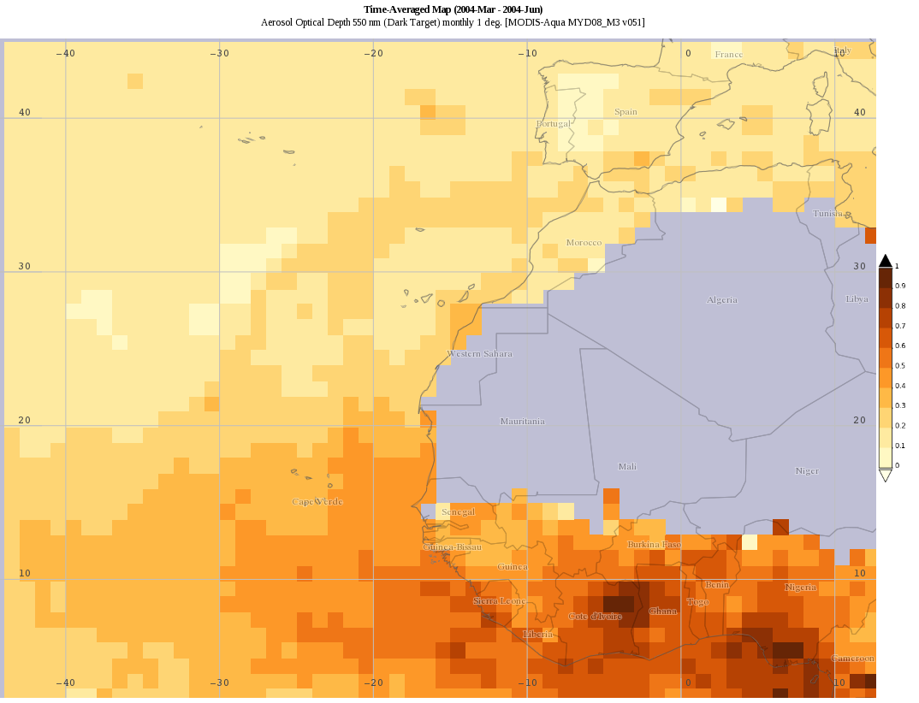
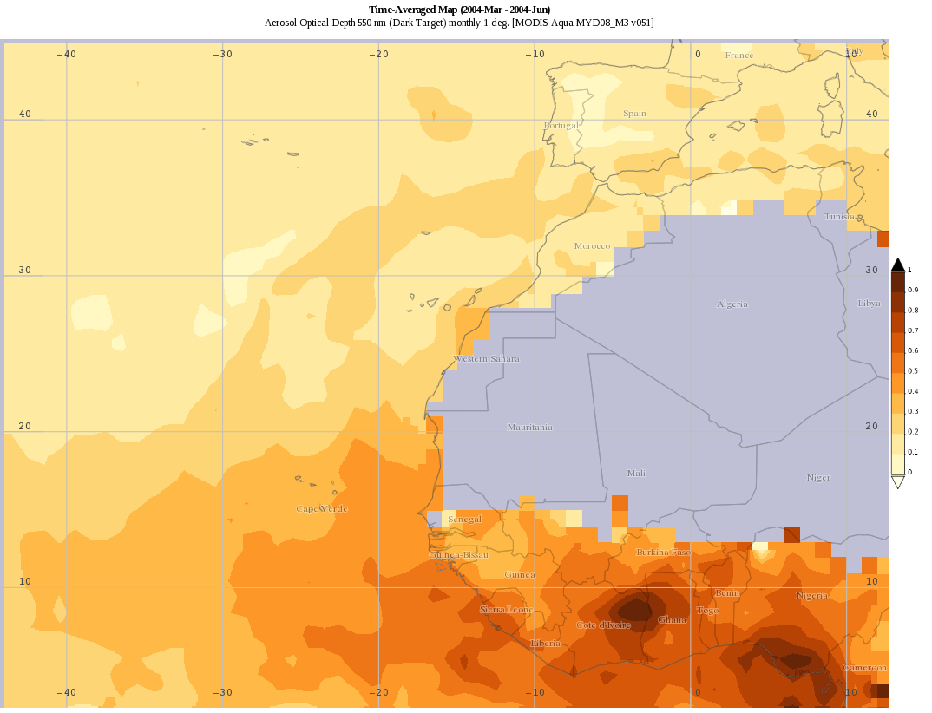
Image Download
(PNG; GeoTIFF also available)
Unsmoothed
(default)
Smoothed plotting option

Slide 11
Share-able URLs !
http://giovanni.gsfc.nasa.gov/giovanni/#service=INTERACTIVE_MAP&starttime=2004-03-01T00:00:00Z&endtime=2004-06-30T23:59:59Z&bbox=-44.2969,2.3203,12.6563,45.2109&data=MYD08_M3_051_Optical_Depth_Land_And_Ocean_Mean_Mean&variableFacets=dataFieldDiscipline%3AAerosols%3B
The URL for this session:

Slide 12
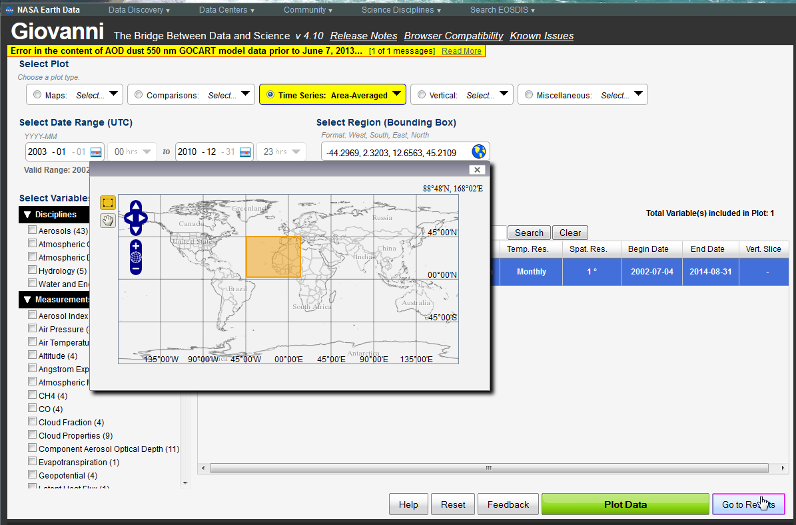
Time-Series Case Studies
I. A “Normal” Time – Series

Slide 13
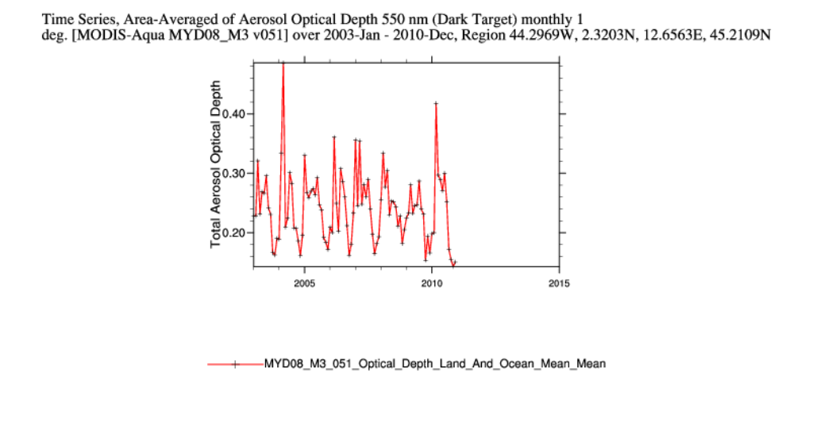
Result

Slide 14
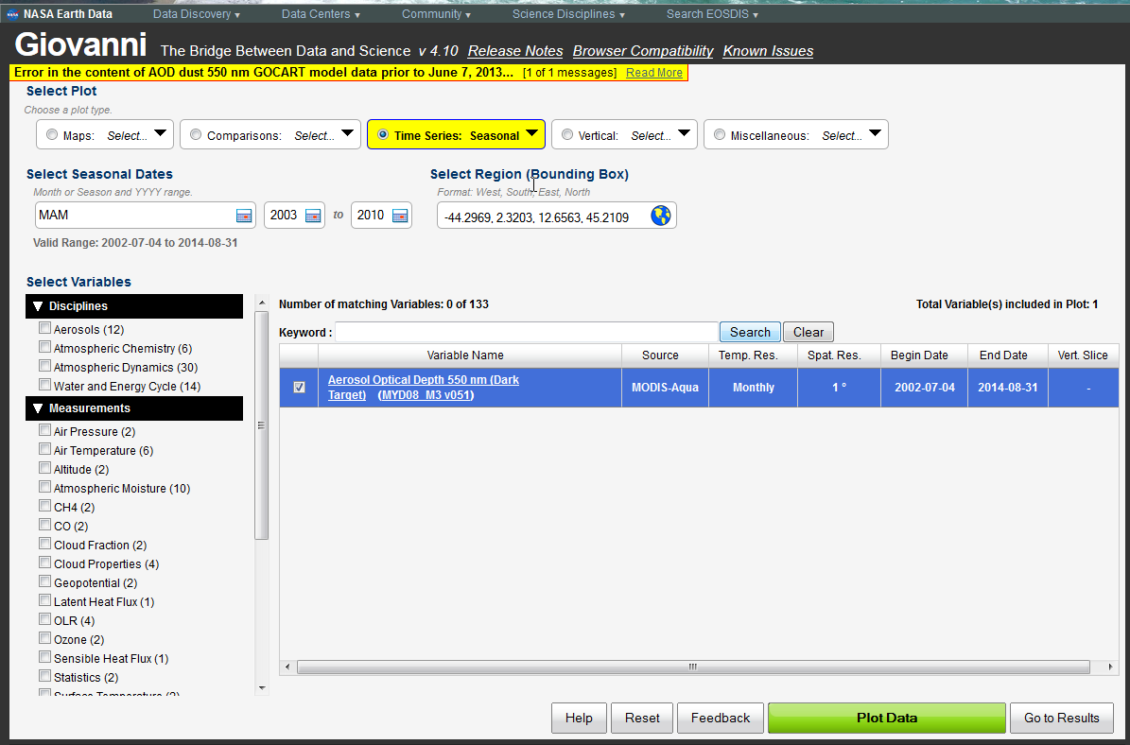
Time-Series Case Studies
II. A Seasonal Time – Series

Slide 15
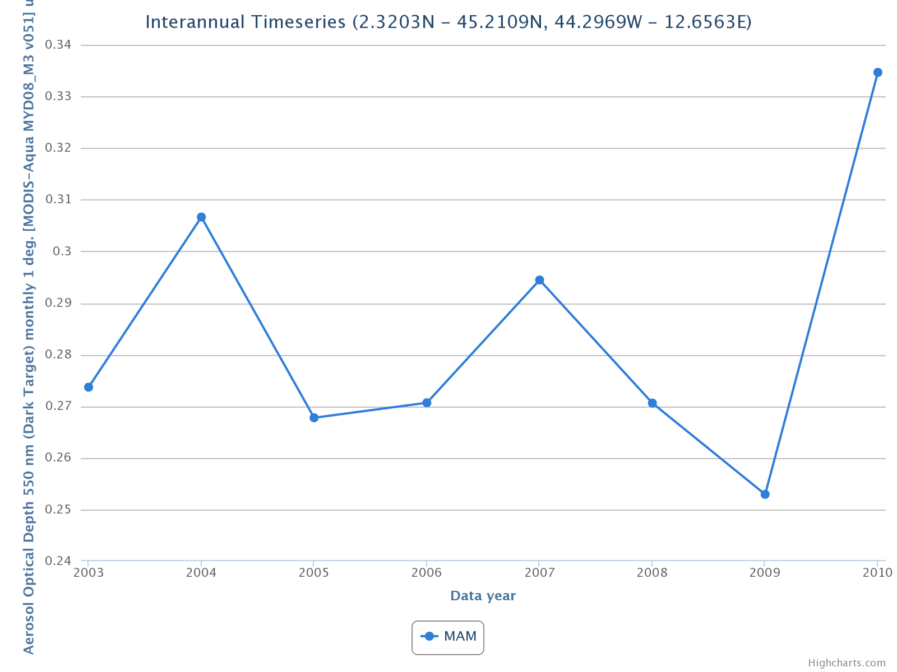
Result

Slide 16
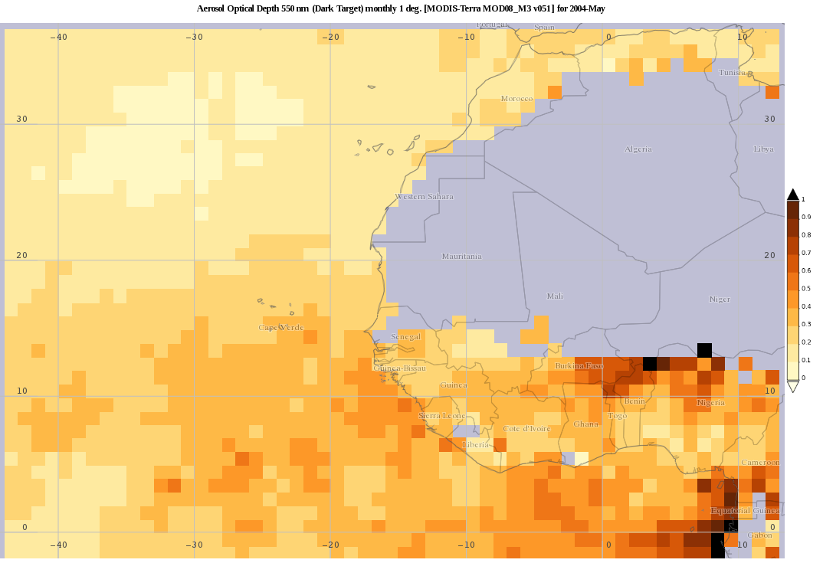
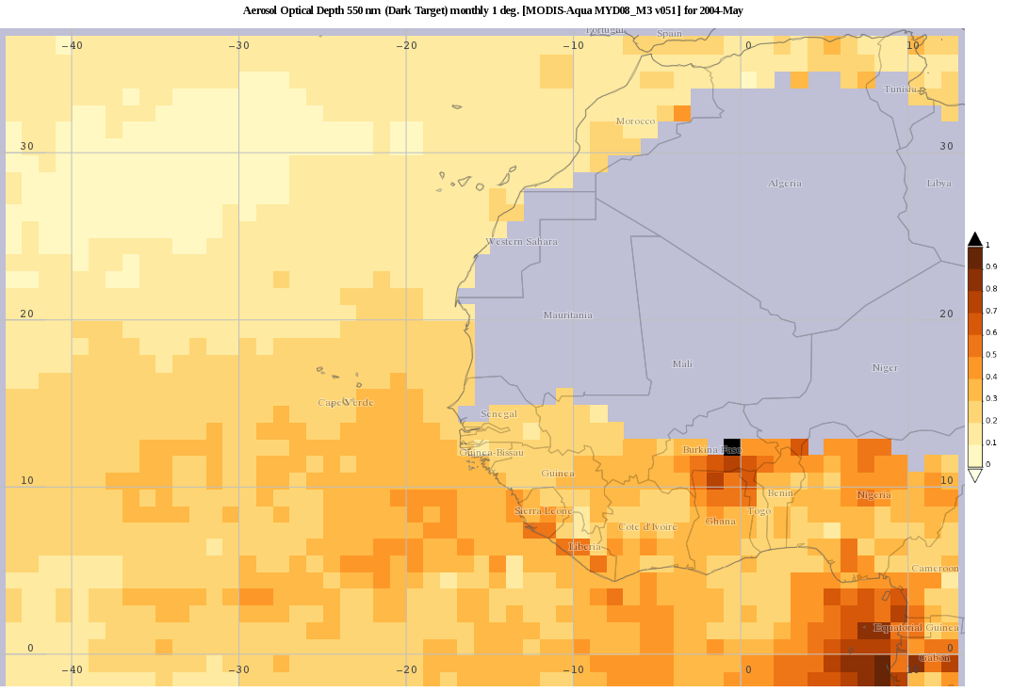
Interactive Scatter Plot :
Compare MODIS-Terra AOD
to MODIS-Aqua AOD
MODIS-Terra AOD
May 2004
MODIS-Aqua AOD
May 2004

Slide 17
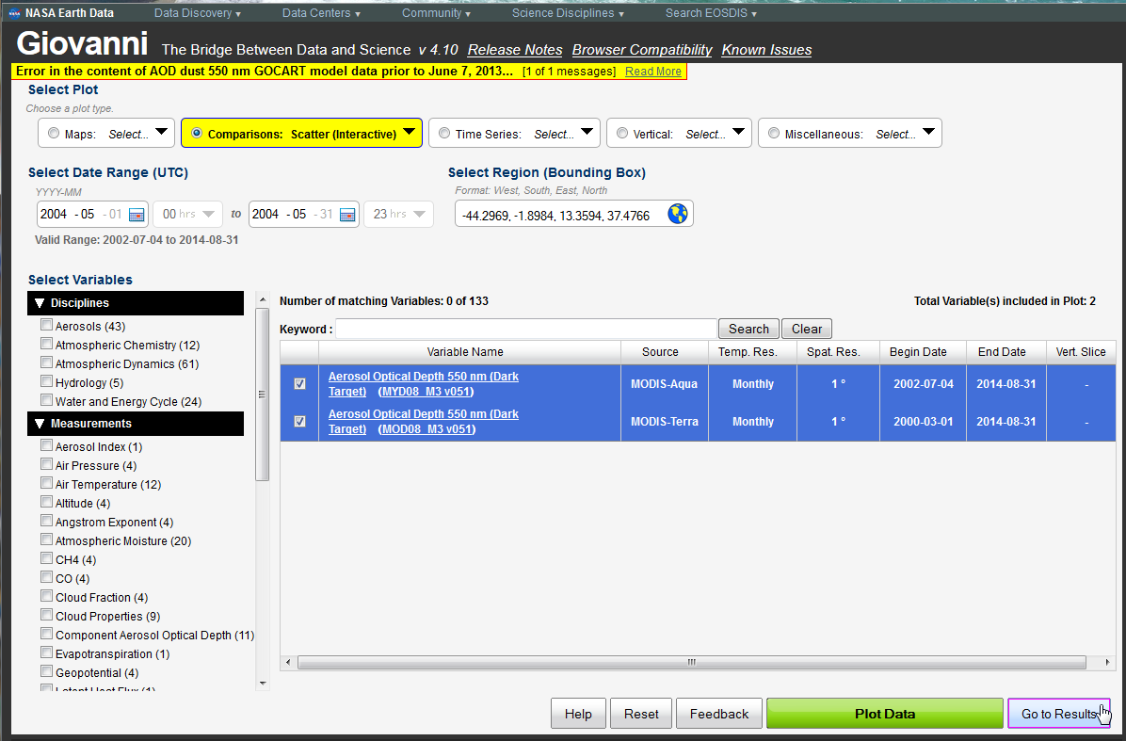
Interactive Scatter Plot :
Compare MODIS-Terra AOD
to MODIS-Aqua AOD
Choose 2 variables to compare

Slide 18
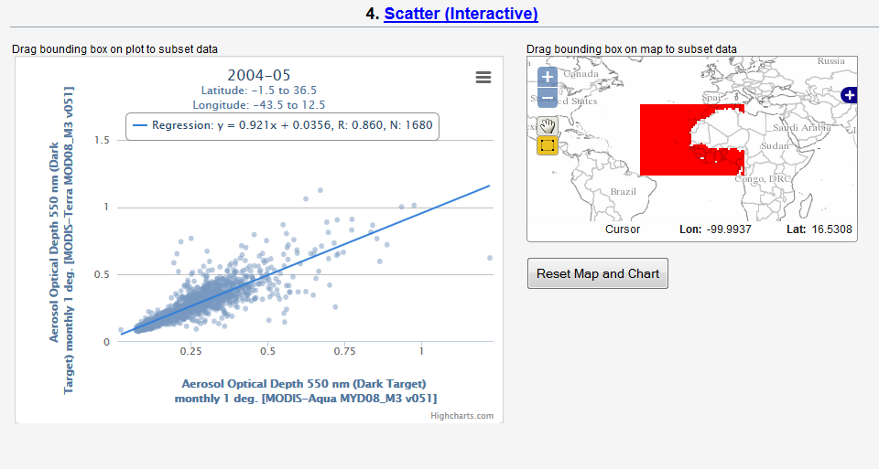
Interactive Scatter Plot :
Compare MODIS-Terra AOD
to MODIS-Aqua AOD

Slide 19
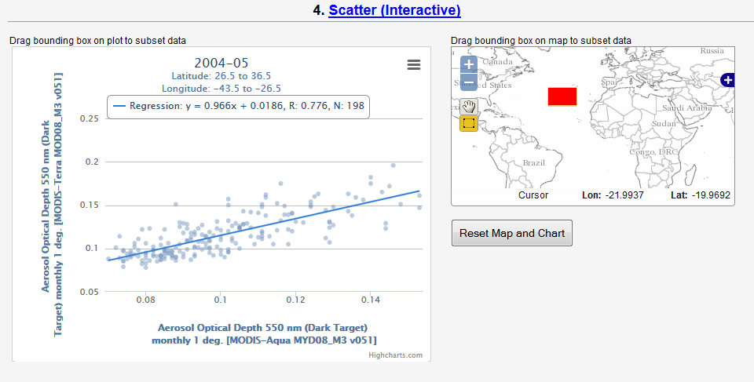
Interactive Scatter Plot :
Compare MODIS-Terra AOD
to MODIS-Aqua AOD

Slide 20
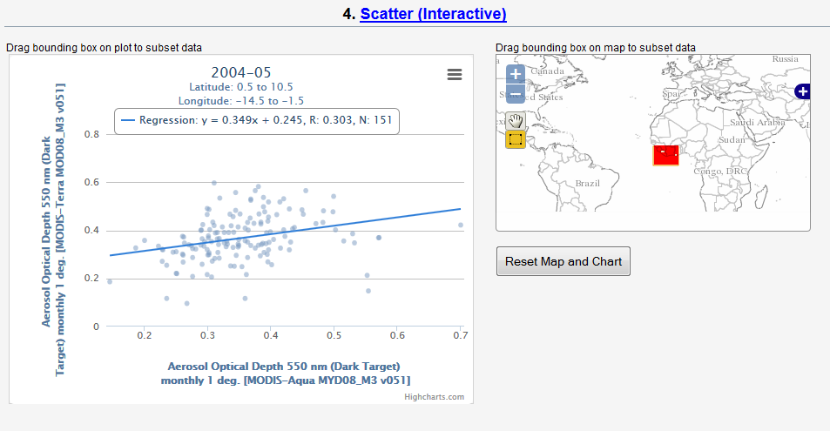
Interactive Scatter Plot :
Compare MODIS-Terra AOD
to MODIS-Aqua AOD

Slide 22
Thank you for attending this demonstration of Giovanni-4 today.
Any questions?

