Slide 1
Ordering MODIS products
Edward Masuoka
Edward.J.Masuoka@NASA.GOV
September 10, 2014

Slide 2
Overview
EarthData – EOSDIS portal for all EOS products (standard and near realtime)
LAADS
  LAADS Web
  OPenDAP
  Ftp
  Web Services
Mirador
EarthData
  Reverb | ECHO
  Worldview (GIBS)

Slide 3
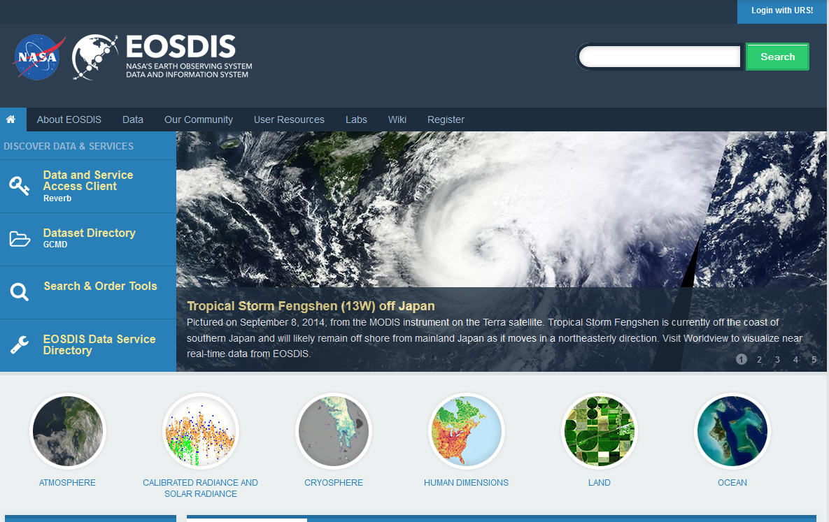
EOSDIS Earthdata
Portal for all EOSDIS satellite data holdings
https://earthdata.nasa.gov

Slide 4
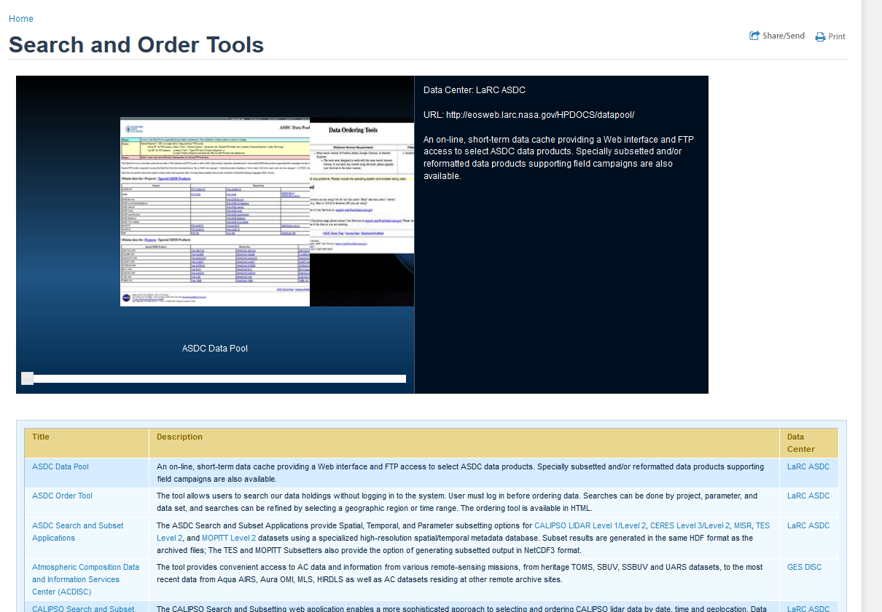
Earthdata – Search and Order
Tab on Earthdata with links to all Search and Order tools available at the DAACs

Slide 5
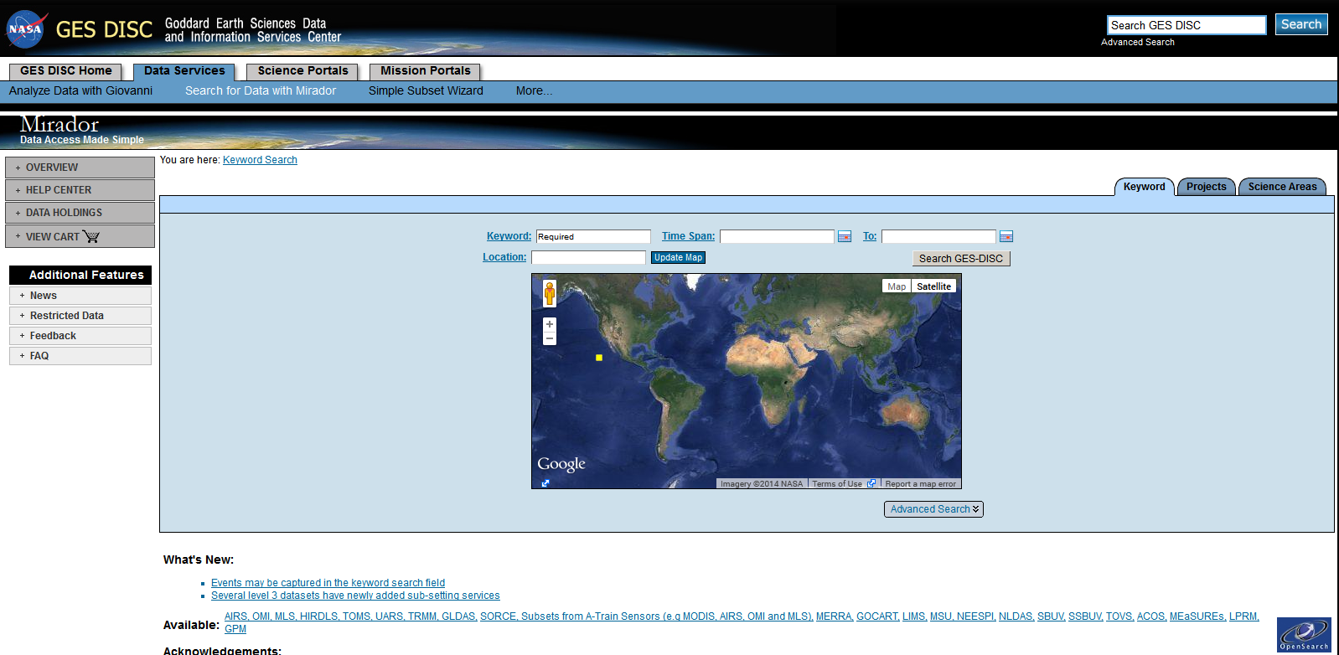
Mirador
http://mirador.gsfc.nasa.gov/
Mirador is an earth science data search tool developed at the GES DISC for our data users. It has a drastically simplified, clean interface and employs the Google mini appliance for metadata keyword searches. Other features include quick response, spatial and parameter subsetting, data file hit estimator, Gazetteer (geographic search by feature name capability), and an interactive shopping cart

Slide 6
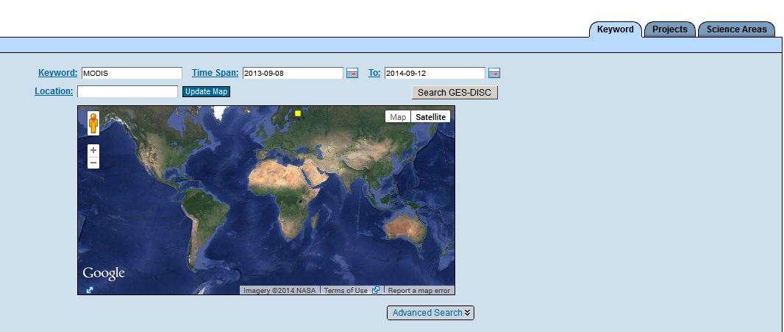
Mirador
Looking for MODIS products in the GES-DISC from 9/8/13 to 9/12/2014 using Keyword search

Slide 7
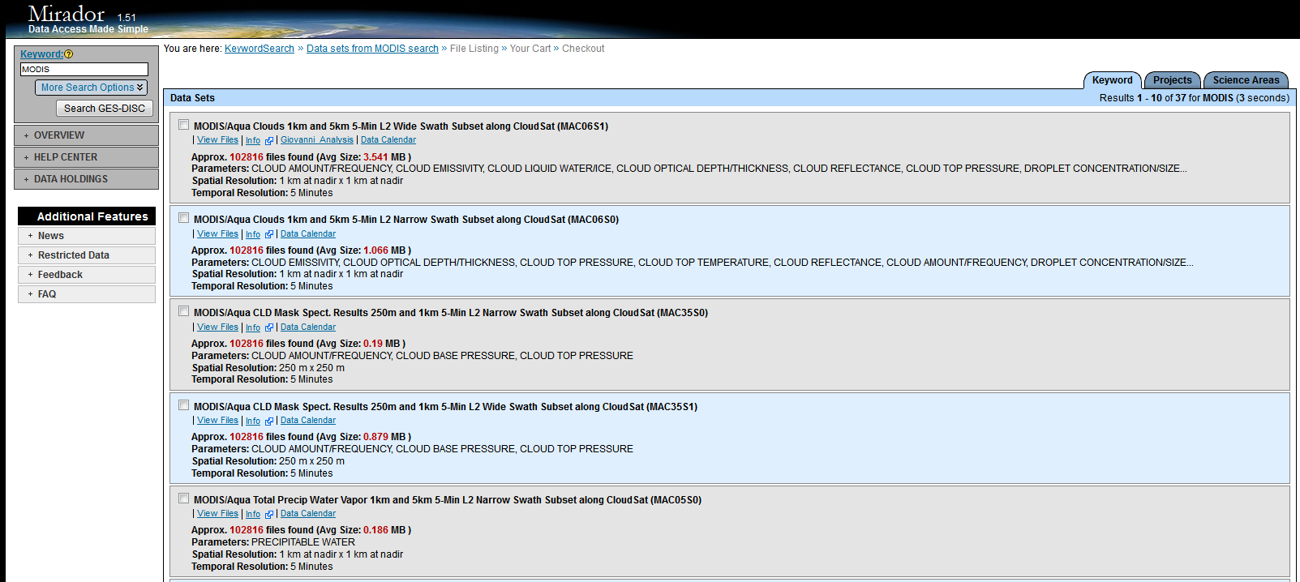
Mirador – Search results
Results for search summarized at the product level.
Links under each product get you to the individual files, Giovani tool or the Data Calendar which summarizes all the GES DISC holdings for that product by month/year

Slide 8
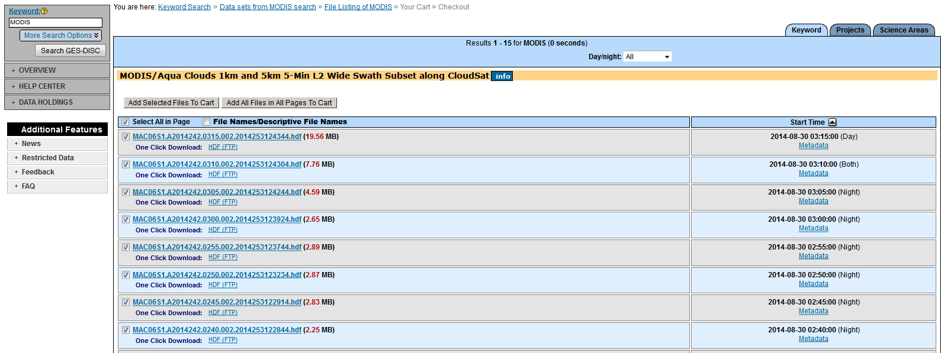
Mirador
You can add files to your shopping cart or click on HDF (FTP) to download a file

Slide 9
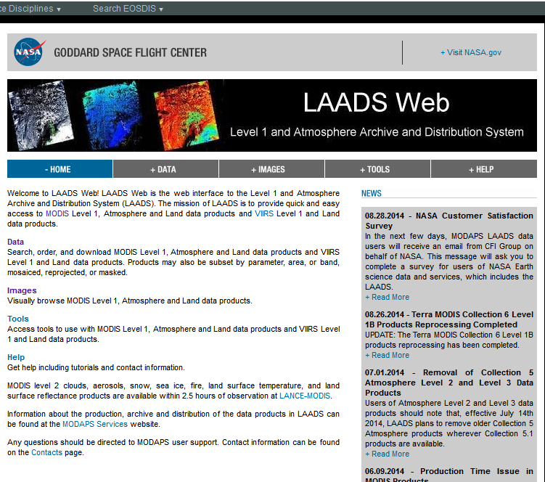
LAADS
http://ladsweb.nascom.nasa.gov/
LAADS is the DAAC that archives and distributes Atmosphere products from MODIS and VIIRS.

Slide 10
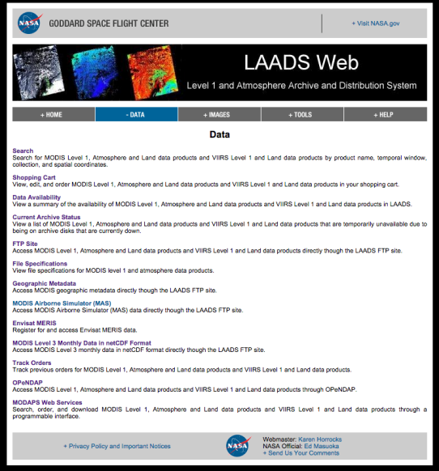
Access Methods Described Online
http://ladsweb.nascom.nasa.gov/data/

Slide 11
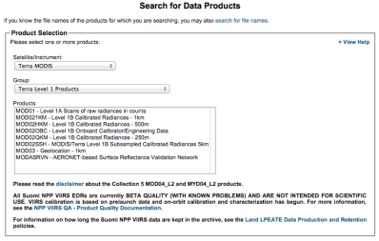
Interactive Options
Web Services (MWS)
  Subset, Mosaic, Reprojection, etc…
FTP
  Direct Downloads
OPeNDAP
  Format Conversions

Slide 12
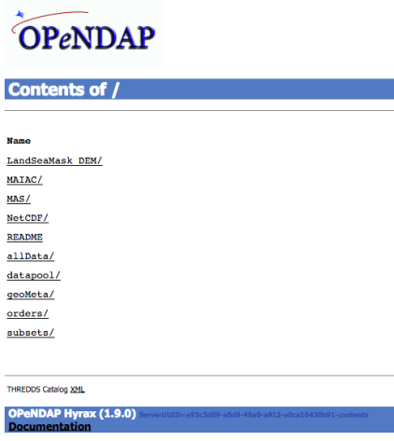
Scripted
FTP
  Curl, Wget, Perl scripts, etc.
OPeNDAP
  URL based subsetting, Format Conversion
Web Coverage Service
  OGC Compliant Protocol
  Reprojection, Search, Format Conversion
Web Services (MWS)
  REST or SOAP interface
  Search, Reprojection, Subsetting, Format Conversion, etc…

Slide 14
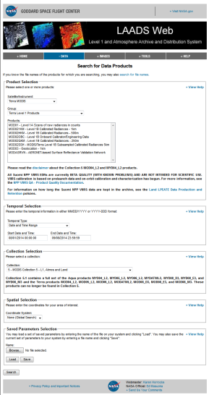
Search for Products
Product Selection (product)
Temporal Selection (time period)
Collection Selection (reprocessing)
Spatial Selection (geographic area)
Saved Parameters Selection (save or load search parameters)

Slide 15
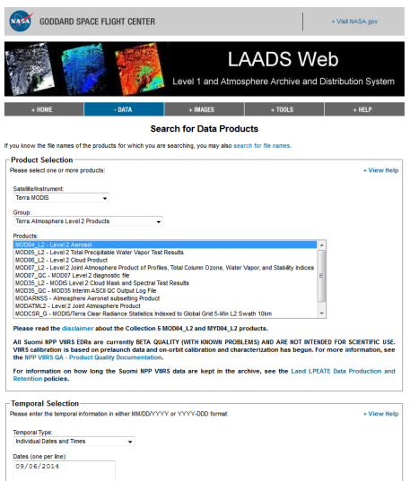
Searching LAADS for L2 Aerosol
Under Satelite/Instrument I selected Terra MODIS which set choices for Group. Under Group, I selected Terra Atmosphere Level 2 Products. Under Products, I selected Level 2 Aerosol by clicking on it. To keep things simple, I selected just the 5 minute granules from 9/6/2014.

Slide 16
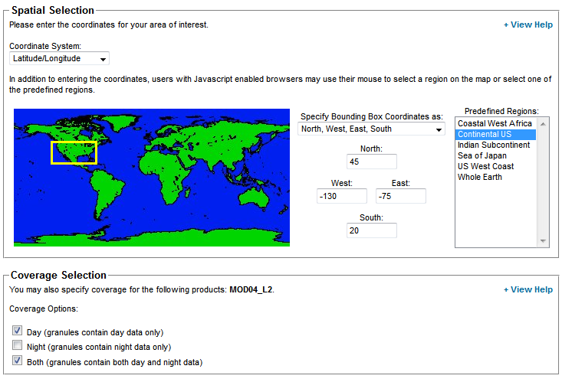
Searching LAADS for L2 Aerosol
Spatial Selection is Lat/Lon. It can be Tile ID if Level 3.
I chose a predefined region,
Continental US. Note only one bounding box can be defined per search.
I selected Day and Both (mixed day and night mode) granules.

Slide 17
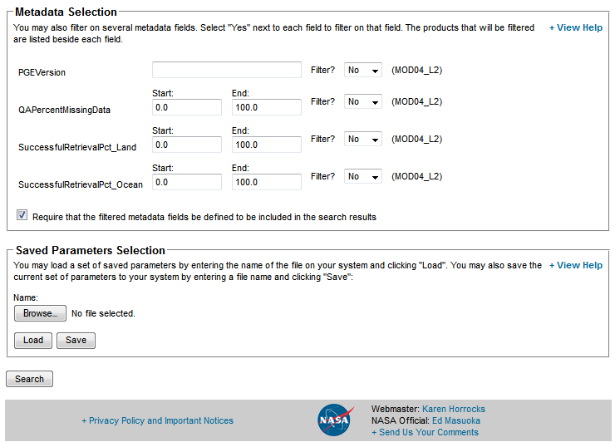
Searching LAADS for L2 Aerosol
I can filter on metadata fields including PGEVersion.
Before you Search you may wish to save the Search parameter selections in a file to use later.

Slide 18
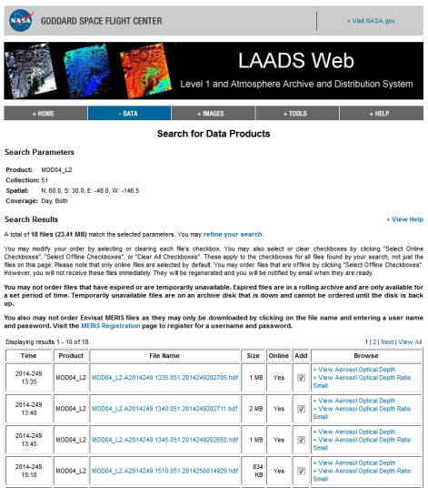
Search Results L2 Aerosol
Search results are displayed. You can open a product or a browse image by clicking the link under File Name or Browse.

Slide 19
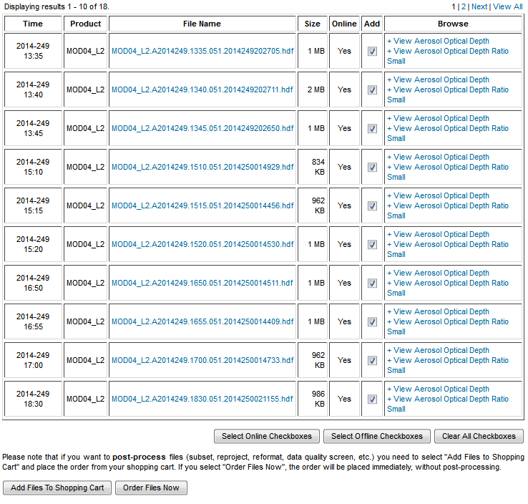
Ordering Aerosol Products
All checked files will be downloaded. Order Files Now places the order immediately. For post-processing select Add Files to Shopping Cart

Slide 20
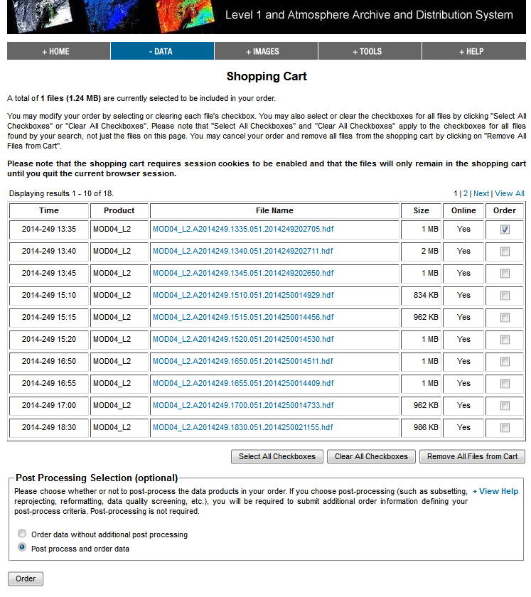
Post-processing
In the shopping cart: Select files to Post process; click on Post process and order data then click Order

Slide 21
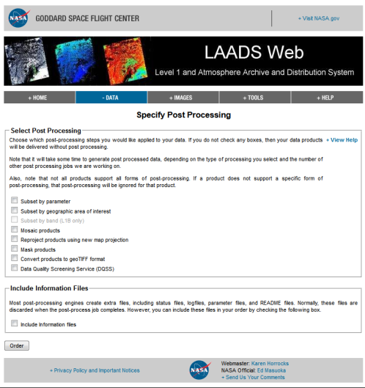
Post-processing
Select post-processing options then click Order

Slide 22
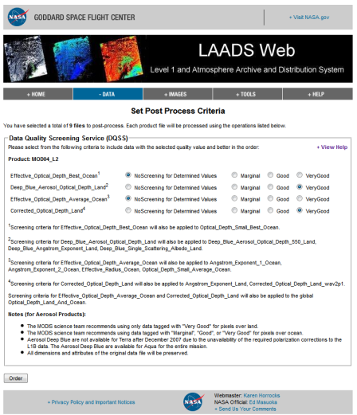
Data Quality Screening Service
Data Quality Screening Service uses Q/A metadata in the product to screen SDSes by replacing lower quality observations with fill values.

Slide 23
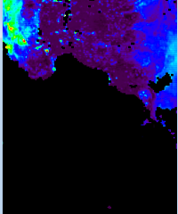
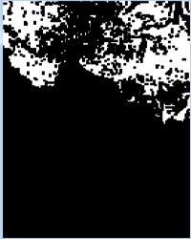
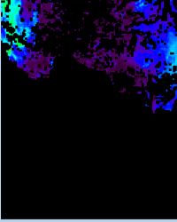
Data Quality Screening Service
Original Image
Mask
Screened Image
Mask is white (1) where data meet the quality threshold specified (in this example, Good or Very Good) and black (0) where data fall below threshold. Observations that correspond to black (0) elements in the mask are replaced with fill values in the screened product.

Slide 24
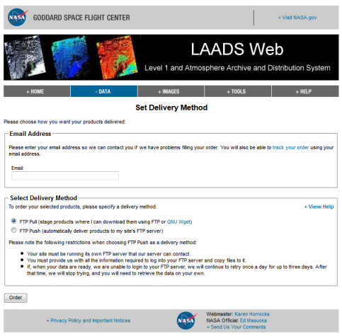
Final step in ordering
Provide the email address LAADS will use to contact you about your order and you can use to track status. FTP Pull is our preferred method of delivery and if chosen, when your order completes an email message will provide you with link to the directory containing your products.

Slide 25
Your order notification
Your Export ID is: 500862006
The data you ordered will be staged (in a few minutes), and you can retrieve the data through anonymous FTP using:
ftp ladsweb.nascom.nasa.gov
username: anonymous
password: edward.j.masuoka@nasa.gov
cd /orders/500862006
binary
prompt
mget *
The following is a list of the data files (CkSum, Size [Bytes]):
MOD04_L2.A2014249.1515.051.2014250014456.dqcs_000500862006.hdf (4268921639, 1140025)
MOD04_L2.A2014249.1520.051.2014250014530.dqcs_000500862006.hdf (13529451, 1684665)
MOD04_L2.A2014249.1525.051.2014250014526.dqcs_000500862006.hdf (4079920764, 967058)
MOD04_L2.A2014249.1655.051.2014250014409.dqcs_000500862006.hdf (1366509343, 1296342)
MOD04_L2.A2014249.1700.051.2014250014733.dqcs_000500862006.hdf (1434794372, 1055083)
MOD04_L2.A2014249.1705.051.2014250014453.dqcs_000500862006.hdf (3127496211, 700183)
MOD04_L2.A2014249.1835.051.2014250021359.dqcs_000500862006.hdf (4014910587, 2175732)
MOD04_L2.A2014249.1840.051.2014250021351.dqcs_000500862006.hdf (2795295329, 1041399)
MOD04_L2.A2014249.2015.051.2014250032754.dqcs_000500862006.hdf (453027313, 2091438)
README.1410212620_22665.5403.500862006.txt (3559821994, 1031)
checksums_500862006 (1994261109, 1286)
NOTE: The files will be deleted after 5 days, please download the files before they get deleted.
For help, please contact us at modapsuso@sigmaspace.com.

Slide 26
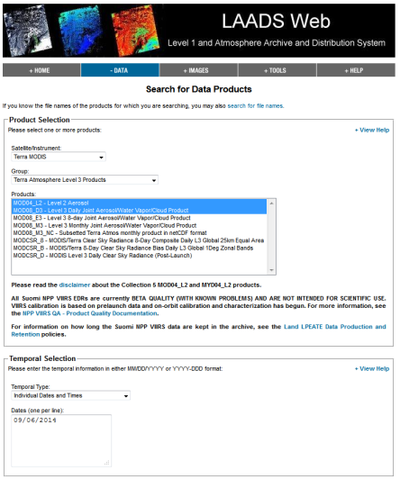
Adding L3 Aerosol to the search
If I want to include Level 3 Daily Joint Aerosol/Water product in the search, I can selected it under Group and it will be added to the search. Note, the previously selected Level 2 Aerosol appears under Products.

Slide 27
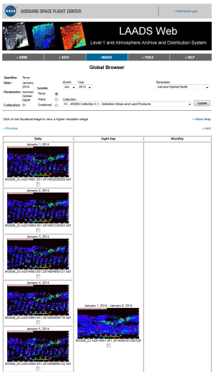
Viewing Global Browse
One can view global browse images of products under the IMAGES tab at LAADS Web

Slide 28
OPeNDAP
OPeNDAP directory structure same as FTP
URL based access to all features
  Variable Subsetting
  Format Conversion
Documentation and Examples at
  http://ladsweb.nascom.nasa.gov/data/opendap.html

Slide 29
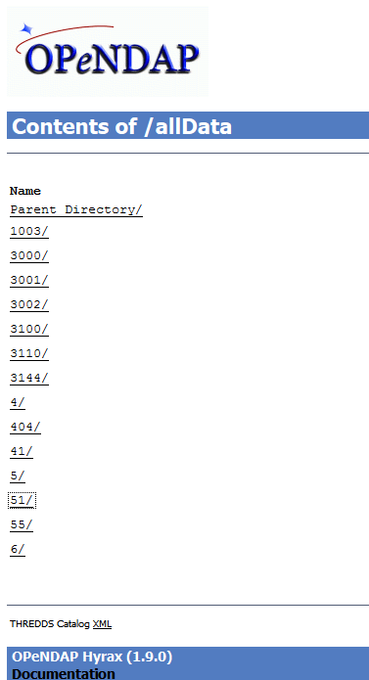
Transforming products with OPeNDAP
Contents of /allData tree shown, latest Collection 5 Aerosol products are in 51/. Clicking on 51/ will take you to a list of all products produced in the C5.1 reprocessing. Once there click on MYD04_L2/ then the year and day of interest.

Slide 30
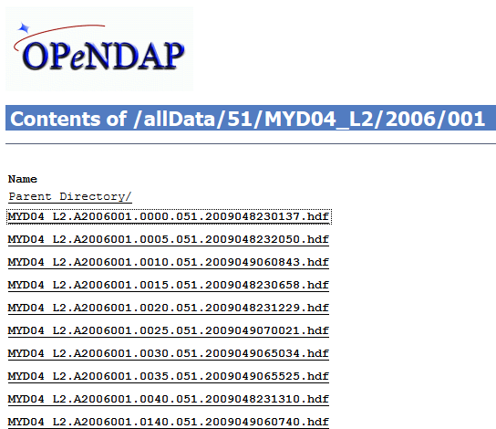
OPeNDAP
Level 2 Aqua Aerosol product s (MYD04_L2) from Collection 5.1 reprocessing, acquired on 1/1/2006,
Click on a file to convert and download

Slide 31
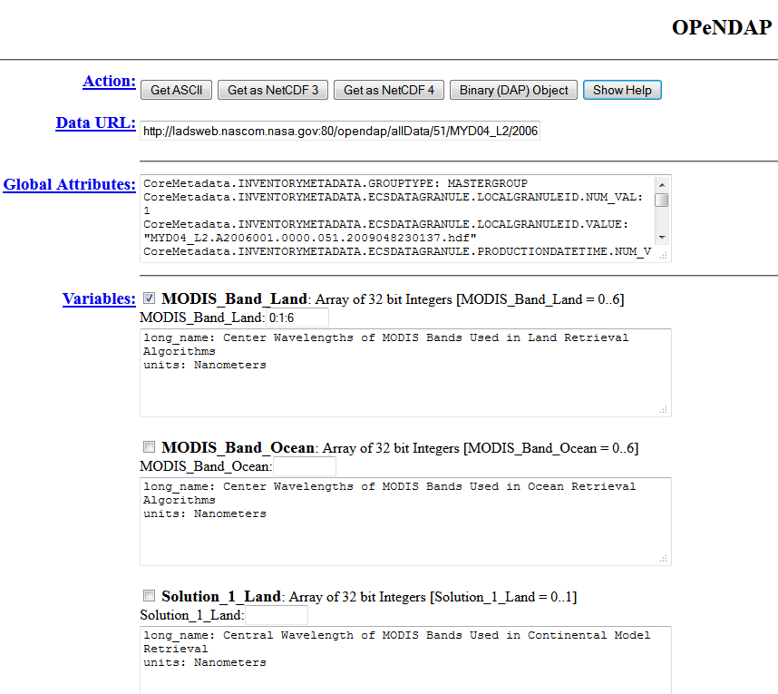
OPeNDAP: choosing format and parameters (SDSes)
Once you have selected file(s) you can choose the output format and a subset of the parameters

Slide 32
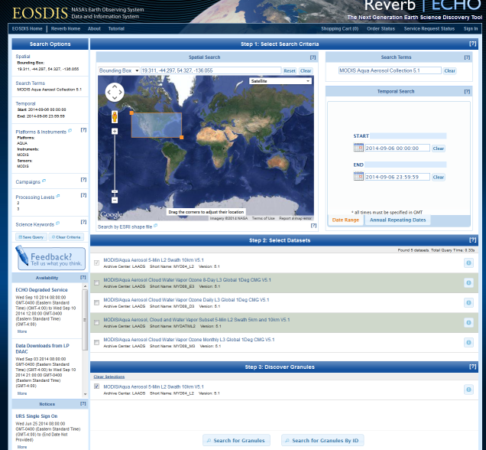
Reverb search
Searching for Aqua MODIS
Aerosol products from the
Collecton 5.1 reprocessing which fall over the United
States on 9/6/2014

Slide 33
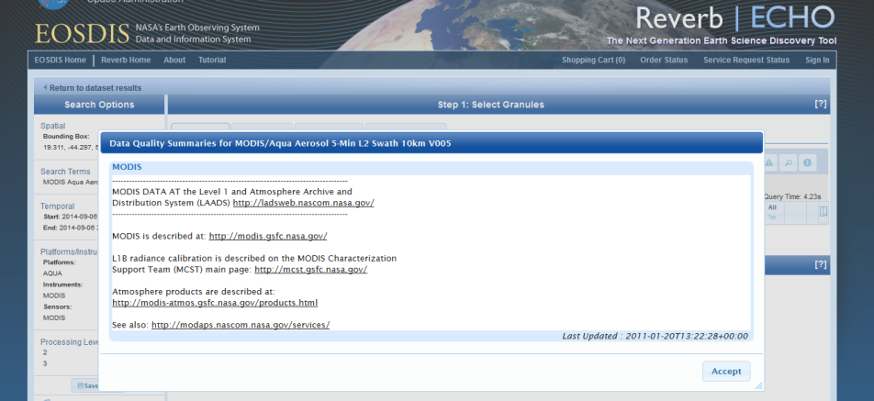
Q/A Notification
Before you get the search results you have to read the Q/A summary information and click accept

Slide 34
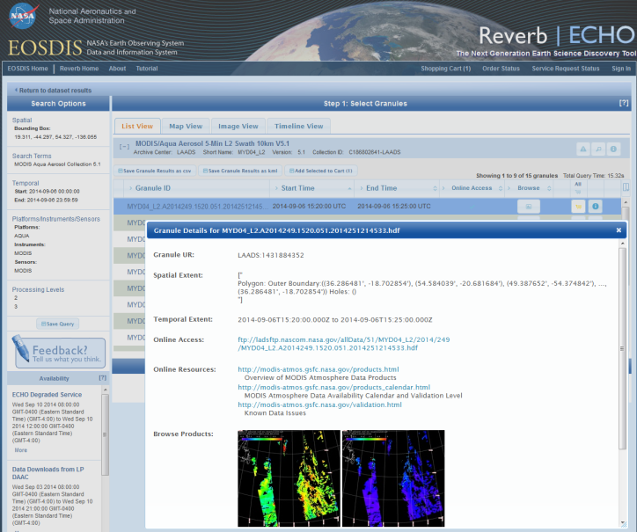
Reverb Search Results
Search results shown in List View for the aerosol product. Plus information about the first granule in the list.

Slide 35
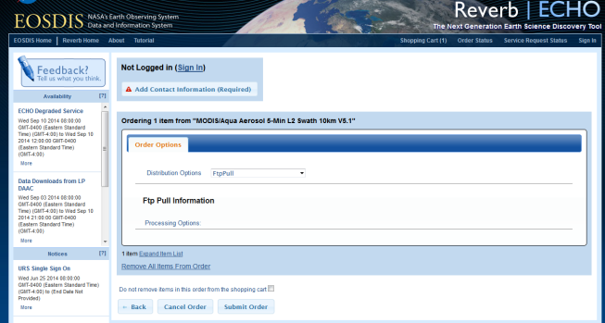
Reverb placing an order
If you submit an order then you will need to enter contact information or sign in. Since this product is available online for download, I canceled this order.

Slide 36
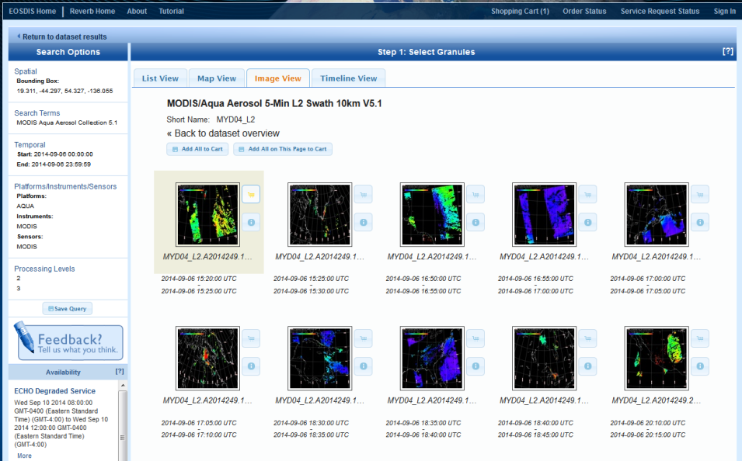
Reverb Search results in Image View

Slide 37
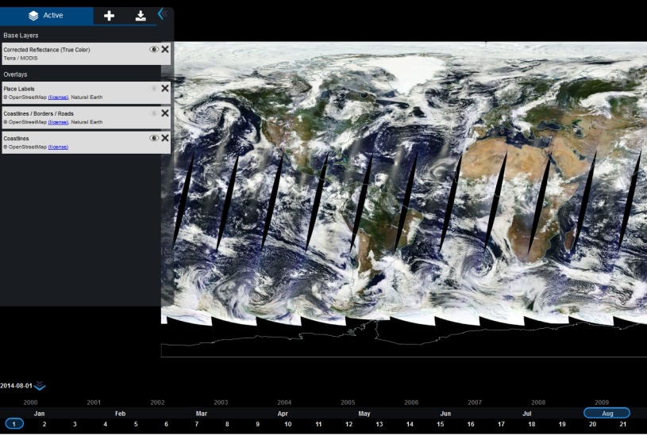
Earthdata - Worldview

Slide 38
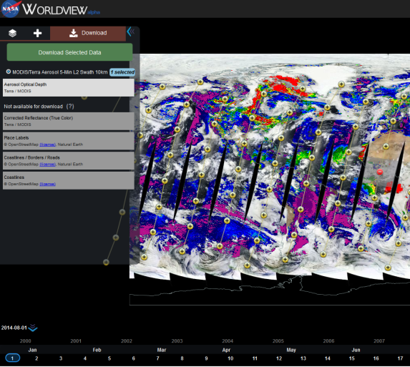
Worldview – download aerosol
Terra Aerosol overlay on Land Surface Reflectance 8/1/14. Yellow circles are granule centers. Click on a circle to download Aerosol product from LAADS ftp site

Slide 39
Backup Material on scripting

Slide 40
OPeNDAP Examples
Retrieve file in NetCDF format
  http://ladsweb.nascom.nasa.gov/opendap/allData/<AS>/<ESDT>/<YEAR>/<DOY>/<file>.hdf.nc

Slide 41
OPeNDAP Examples
Retrieve file in ASCII format
  http://ladsweb.nascom.nasa.gov/opendap/allData/<AS>/<ESDT>/<YEAR>/<DOY>/<file>.hdf.ascii

Slide 42
OPeNDAP Examples
Retrieve file in NetCDF format
  Only include Scan_Offset variable
    Range [0-4079][0-2707]
  http://ladsweb.nascom.nasa.gov/opendap/allData/<AS>/<ESDT>/<YEAR>/<DOY>/<file>.hdf.nc?Scan_Offset[0:1:4079][0:1:2707]

Slide 43
MODAPS Web Services
URL and SOAP based access to all features
  Variable Subsetting, Reprojection, Spatial, Temporal or Product searches, etc…
XML responses for easy parsing
Full Documentation at
  http://ladsweb.nascom.nasa.gov/data/web_services.html
Quick start documentation at
  http://ladsweb.nascom.nasa.gov/data/quickstart.html

Slide 44
MODAPS Web Services Example
Search for files and get file ID
  http://modwebsrv.modaps.eosdis.nasa.gov/axis2/services/MODAPSservices/searchForFiles?<parameters>
Get information for file given fileID(s)
  http://modwebsrv.modaps.eosdis.nasa.gov/axis2/services/MODAPSservices/getFileProperties?fileIds=<ID1>,<ID2>
Get URLs for given file ID(s)
  http://modwebsrv.modaps.eosdis.nasa.gov/axis2/services/MODAPSservices/getFileUrls?fileIds=<ID1>,<ID2>

Slide 45
WCS Example
Similar to MODAPS Web Services
  Format conversion, Reprojections, Spatial and Temporal searches
Utilizes OGC WCS protocol 1.0.0
Documentation at
  http://ladsweb.nascom.nasa.gov/data/web_services.html
Quick Start Guide at
  http://ladsweb.nascom.nasa.gov/data/wcs_quickstart.html

Slide 46
WCS Example
Get a list of Coverages for MOD21KM in Collection 5
  http://modwebsrv.modaps.eosdis.nasa.gov/wcs/5/MOD021KM/getCapabilities?service=WCS&version=1.0.0&request=GetCapabilities

